Slide 1
Computer Engineering Department
Islamic University of Gaza
ECOM 3421
Computer Architecture and Organization
Fall 2020-2021
Syllabus & Course Overview
Mohammad A. Mikki
Professor of Computer Engineering
College of Engineering
Islamic University of Gaza, Gaza, Palestine
Email: mmikki@iugaza.edu.ps
Homepage: http://site.iugaza.edu.ps/mmikki

Slide 2
Instructor’s Info.
Mohammad A. Mikki
Professor of Computer Engineering
College of Engineering
Islamic University of Gaza, Gaza, Palestine
Email: mmikki@iugaza.edu.ps
Homepage: http://site.iugaza.edu.ps/mmikki
Tel.: +970-08-2644400 Ext. 2833
Office: Admin. Building Room B3xx

Slide 3
Where to find me
Office: Admin. Building, Room B3XX
and
Online through Google Meet

Slide 4
Office Hours
This is an online course
The instructor will hold Weekly Google Meets to meet with students

Slide 5
Teaching Assistants
Section 101: Eng. Amjad Abu Abdo
Email: aaa@iugaza.edu.ps
Section 201: Eng. Rasha Sammour
Email: bbb@iugaza.edu.ps

Slide 6
Course Information
Course Code: ECOM 3421
Course Name: Computer Architecture
and Organization
Number of credits: 4
201 | 101 | Section
This is an online course |  | Days
 |  | Time
 |  | Location

Slide 7
Course Description
This course introduces details of computer architecture and organization. It introduces the internal structure of digital computers. The design of gates, flip-flops, registers, and memories to perform operations on numerical and other data represented in binary form. It studies the architecture of computer systems from four-bit machines to supercomputers.
It covers data representation, basic digital logic circuits, memory types and hierarchies, I/O and Storage devices, I/O processors, CPU architectures such as RISC, CISC, parallel, multi-core, multi-computer systems and GPGPU systems .
The course establishes the relationship of hardware and software. Includes hands-on projects.

Slide 8
Instructional Learning Objectives
This course, in particular, includes instruction in the following knowledge units identified in the ACM Computer Science CS2013 Knowledge Units:
Digital logic and digital systems, machine language representation, memory system organization, interfacing and communication, functional organization, performance enhancements, processing, concurrency, parallelism fundamentals, computational paradigms, state and state machines, and resource allocation.

Slide 9
Prerequisites
See “Computer Engineering” department curriculum

Slide 10
Course Internet Resources
The course material is posted on the course webpage at
http://moodle.iugaza.edu.ps
“Facebook” course page: The instructor will create this page for announcements and student cooperation/Collaboration/communication.
Please check the above sources once a week for updated:
Announcements
lecture notes
Assignments and solutions
Exams and solutions
Quizzes and solutions
The instructor will provide and/or post a revised version of the course syllabus with additional information stating his policies for the course, such as attendance policy, labs and assignments submission policy, quizzes policy, and others.

Slide 11

Required Textbook and Material
Computer Organization and Architecture, 10th Edition, William Stallings, 2016, Pearson

Slide 12
Class Schedule
Week | Topic | Textbook/Reading Material
1 | Syllabus, Course overview Organization and Architecture, Structure and Function | Chapter 1 Basic Concepts and Computer Evolution
2 | Organization and Architecture, Structure and Function | Chapter 1 (Cont.)
3 | Computer Components, Computer Function, Interconnection Structures, Bus Interconnection | Chapter 3: A Top-Level View of Computer Function and Interconnection
4 | Computer Components, Computer Function, Interconnection Structures, Bus Interconnection | Chapter 3 (Cont.)
5 | Machine Instruction Characteristics, Types of Operands, Types of Operations | Chapter 12: Instruction Sets: Characteristics and Functions
6 | Machine Instruction Characteristics, Types of Operands, Types of Operations | Chapter 12 (Cont.)

Slide 13
Class Schedule (Cont.)
Week | Topic | Textbook/Reading Material
7 | Addressing Modes, Instruction Formats, Assembly Language | Chapter 13: Instruction Sets: Addressing Modes and Formats
8 | Processor Organization, Register Organization, Instruction Cycle, Instruction Pipelining | Chapter 14: Processor Structure and Function
9 | Midterms exam
10 | Micro-Operations, Control of the Processor, Hardwired Implementation | Chapter 20: Control Unit Operation
11 |  | Chapter 20 (Cont.)
12 | Basic Concepts, Microinstruction Sequencing, Microinstruction Execution | Chapter 21: Microprogrammed Control

Slide 14
Class Schedule (Cont.)
Week | Topic | Textbook/Reading Material
13 | Computer Memory System Overview, Cache Memory Principles, Elements of Cache Design | Chapter 4: Cache Memory
14 |  | Chapter 4 (Cont.)
15 | Input/Output | Chapter 07 -I/O
15 | Semiconductor Main Memory, Error Correction, DDR DRAM, Flash Memory, Newer Nonvolatile Solid-State Memory Technologies | Chapter 5: Internal Memory
16 | Review
 | Last day of classes
 | First day of Final exams

Slide 15
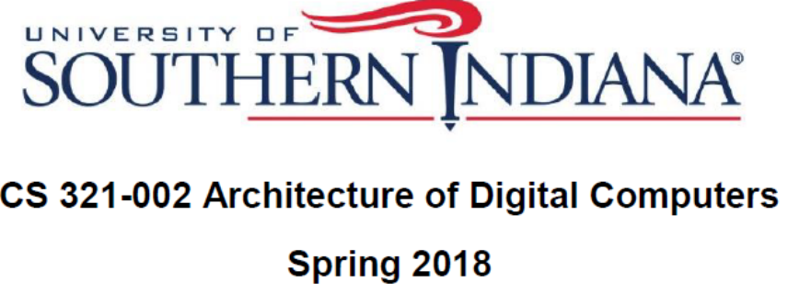
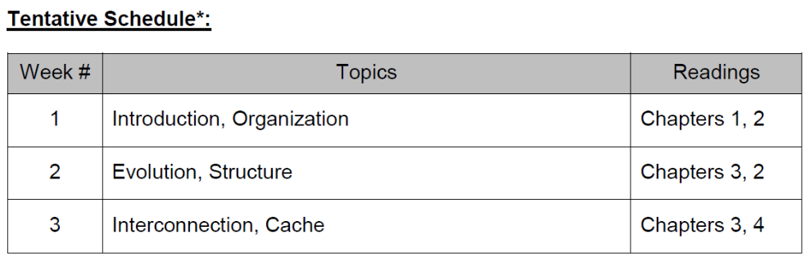
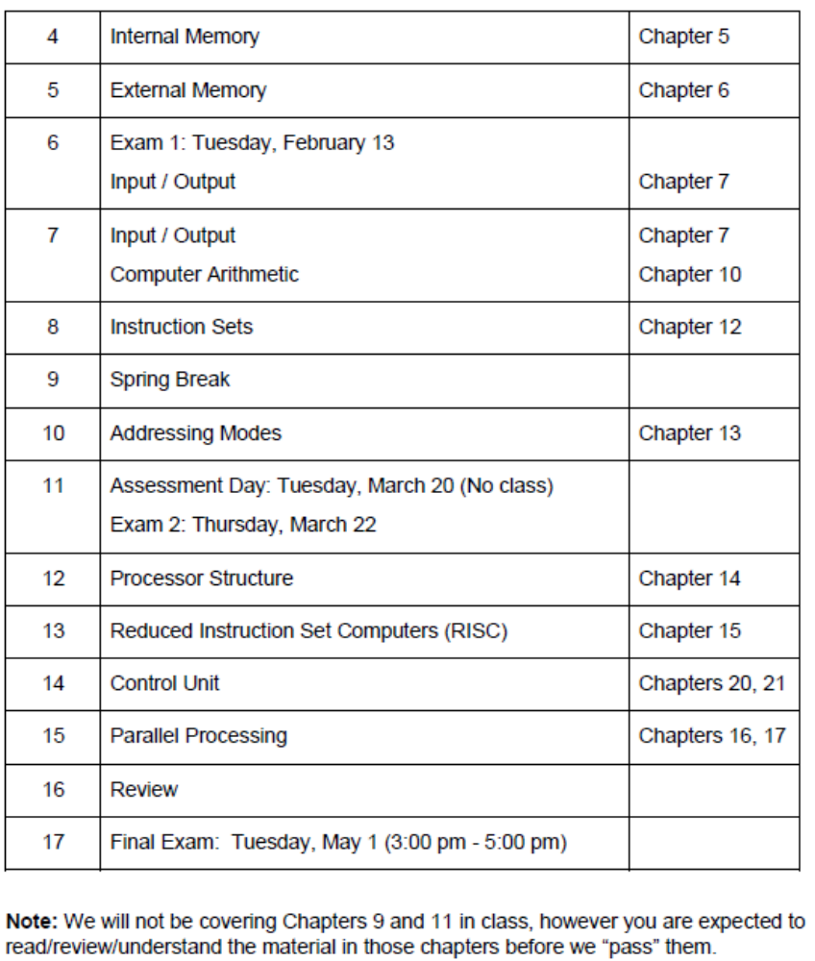

Slide 16

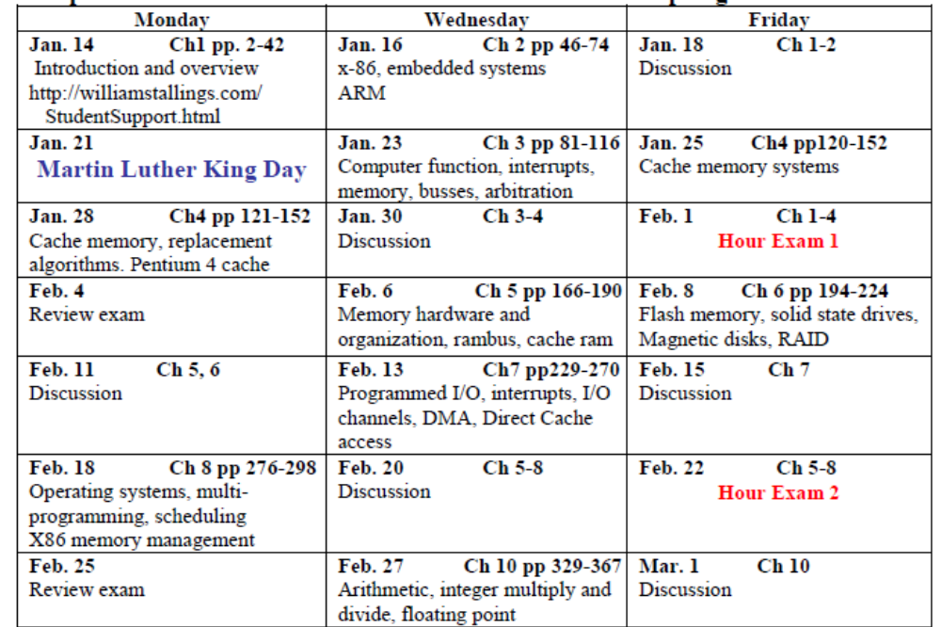

Slide 17
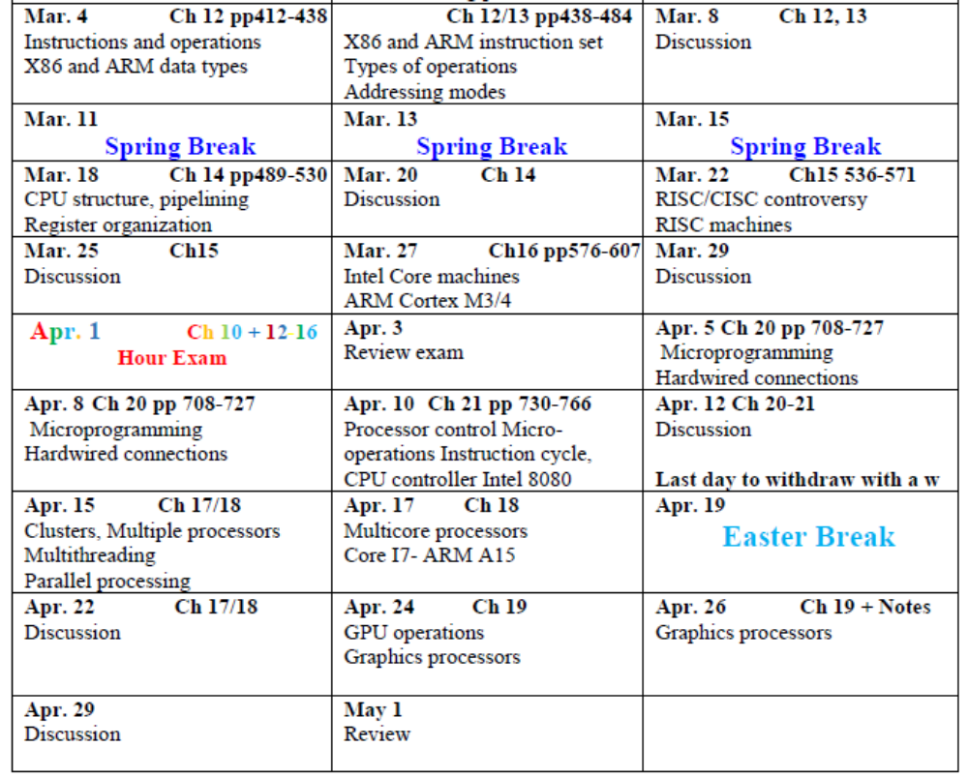

Slide 18


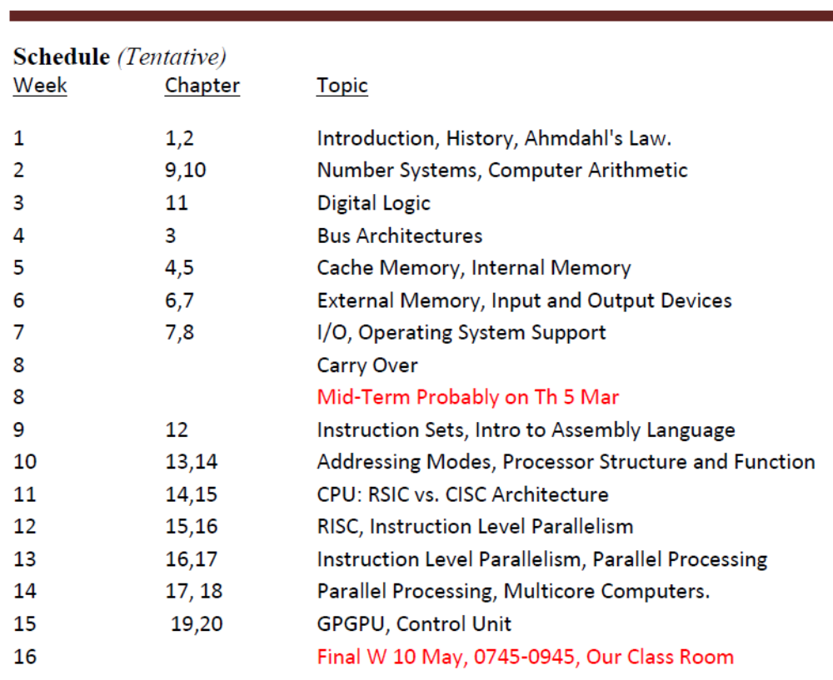

Slide 19
Assessment (Grading) Criteria
Quizzes | 15%
Midterm exam | 20%
Lab (TA) | 25%
Final exam | 40%
 | 100%

