Slide 1
Control Systems
Lect.8 Root Locus Techniques
Basil Hamed

Slide 2
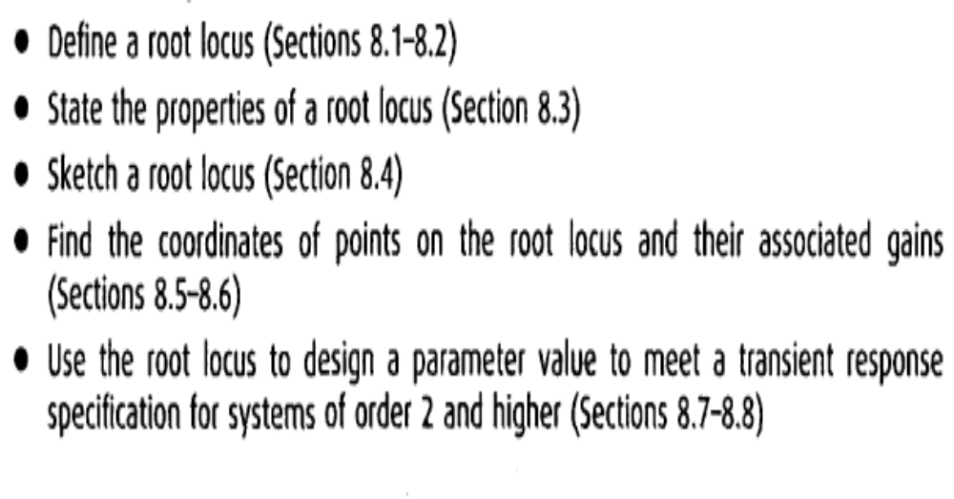
Chapter Learning Outcomes
After completing this chapter the student will be able to:

Slide 3
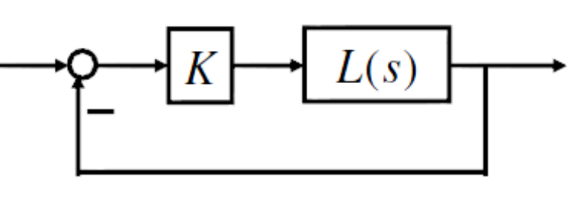
Root Locus – What is it?
W. R. Evans developed in 1948.
Pole location characterizes the feedback system stability and transient properties.
Consider a feedback system that has one parameter (gain) K > 0 to be designed.
Root locus graphically shows how poles of CL system varies as K varies from 0 to infinity.
L(s): open-loop TF

Slide 4
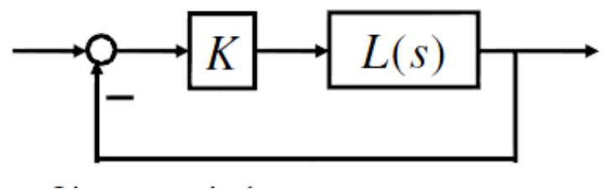
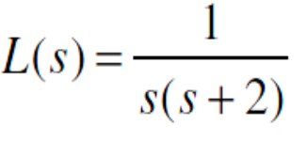
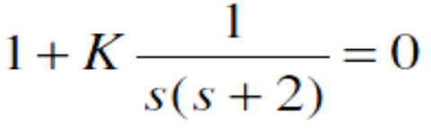
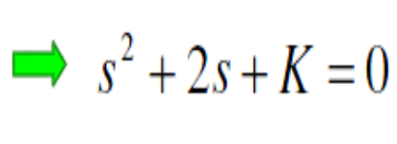
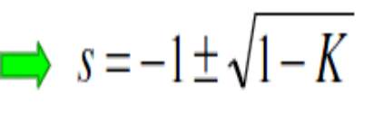
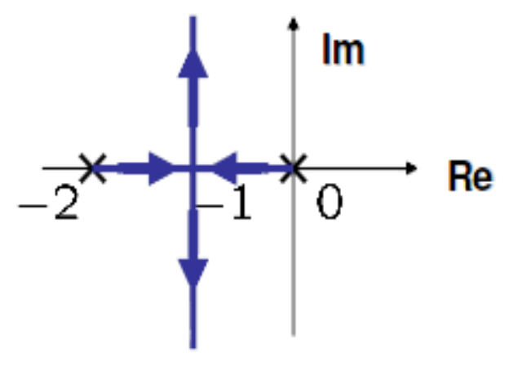
Root Locus – A Simple Example
Characteristic eq.
K = 0: s = 0,-2
K = 1: s = -1, -1
K > 1: complex numbers

Slide 5
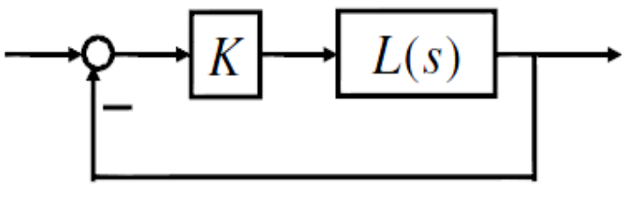
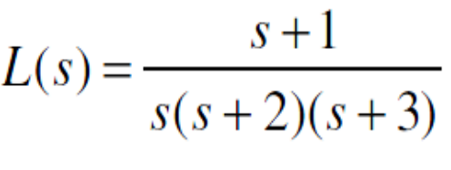
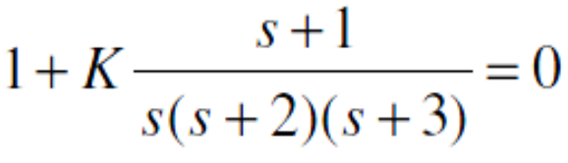
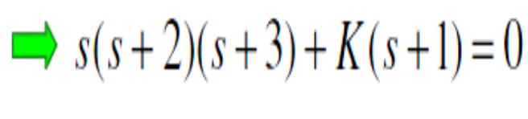
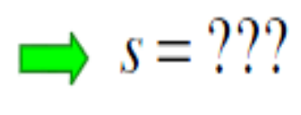
Root Locus – A Complicated Example
Characteristic eq.
It is hard to solve this analytically for each K.
Is there some way to sketch a rough root locus by hand?

Slide 6
8. 1 Introduction
Root locus, a graphical presentation of the closed-loop poles as a system parameter is varied, is a powerful method of analysis and design for stability and transient response(Evans, 1948; 1950).
Feedback control systems are difficult to comprehend from a qualitative point of view, and hence they rely heavily upon mathematics.
The root locus covered in this chapter is a graphical technique that gives us the qualitative description of a control system's performance that we are looking for and also serves as a powerful quantitative tool that yields more information than the methods already discussed.

Slide 7
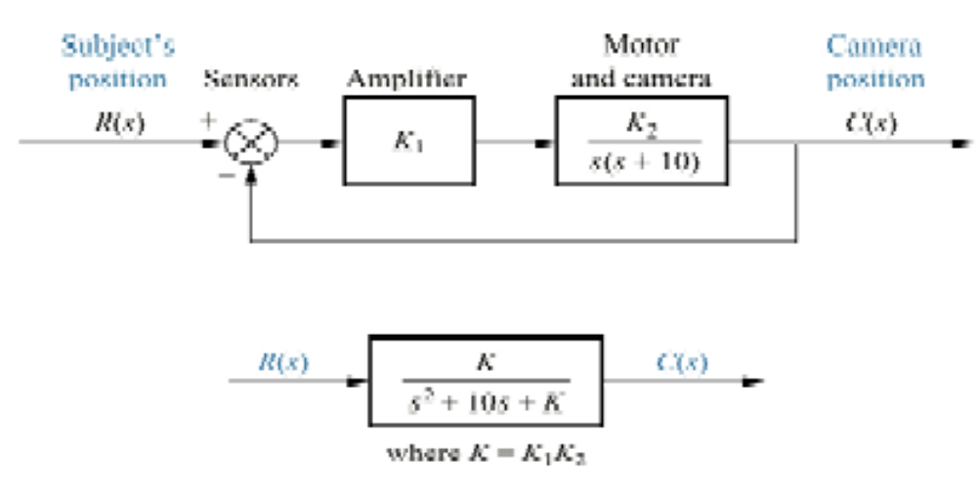
8.2 Defining the Root Locus
The root locus technique can be used to analyze and design the effect of loop gain upon the system's transient response and stability.
Assume the block diagram representation of a tracking system as shown, where the closed-loop poles of the system change location as the gain, K, is varied.

Slide 8
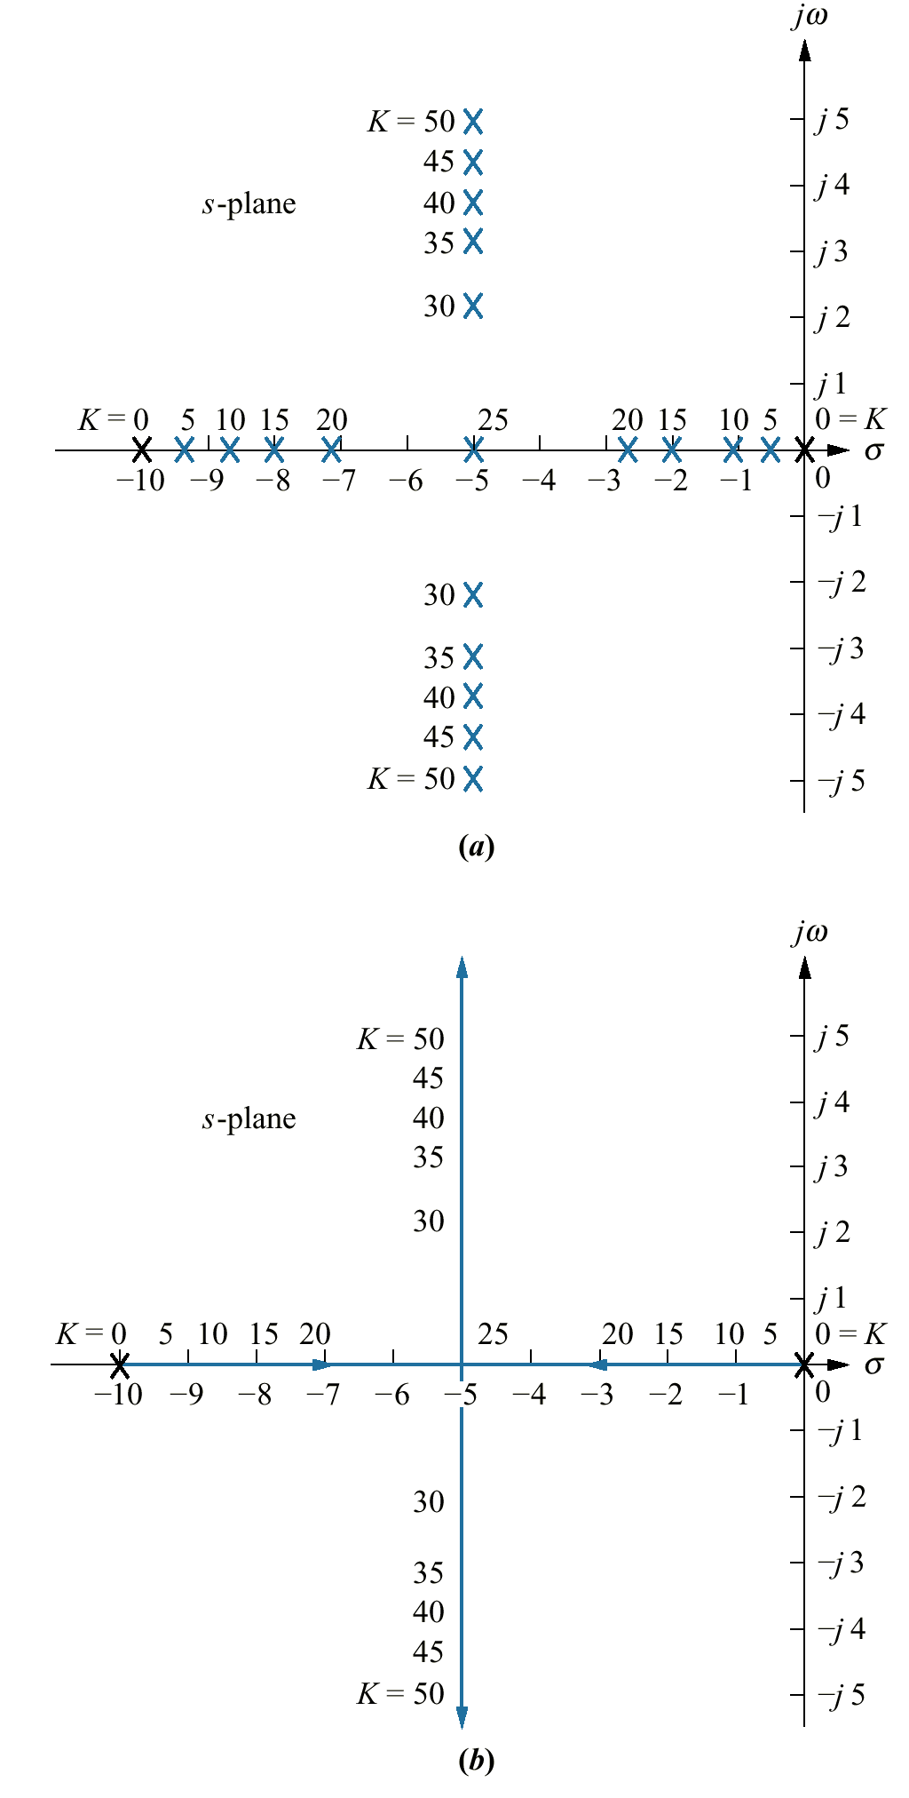
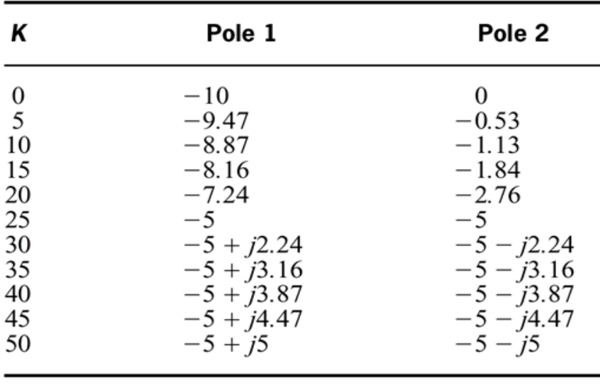
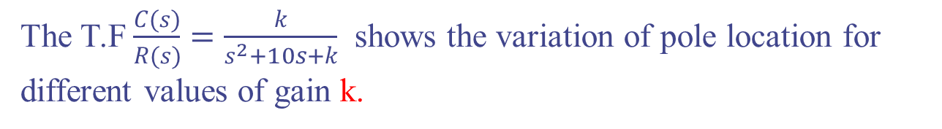
8.2 Defining the Root Locus
The T.F $\frac{C(s)}{R(s)}=\frac{k}{s^{2}+10s+k}$ shows the variation of pole location for different values of gain k.
Pole location as a function of gain for the system

Slide 9
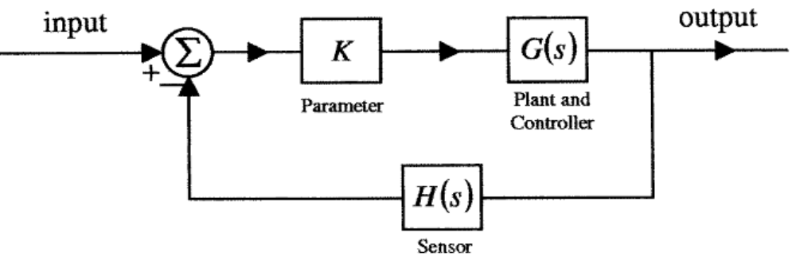
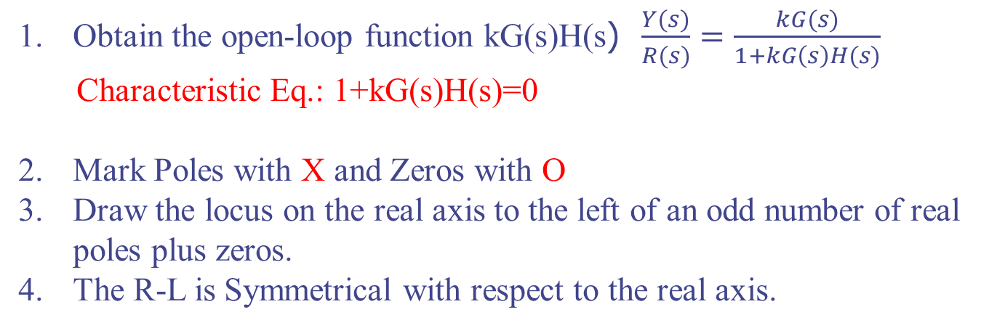
8.4 Sketching the Root Locus
Obtain the open-loop function kG(s)H(s) $\frac{Y(s)}{R(s)}=\frac{kG(s)}{1+kG\left(s\right)H(s)}$
Characteristic Eq.: 1+kG(s)H(s)=0
Mark Poles with X and Zeros with O
Draw the locus on the real axis to the left of an odd number of real poles plus zeros.
The R-L is Symmetrical with respect to the real axis.

Slide 10
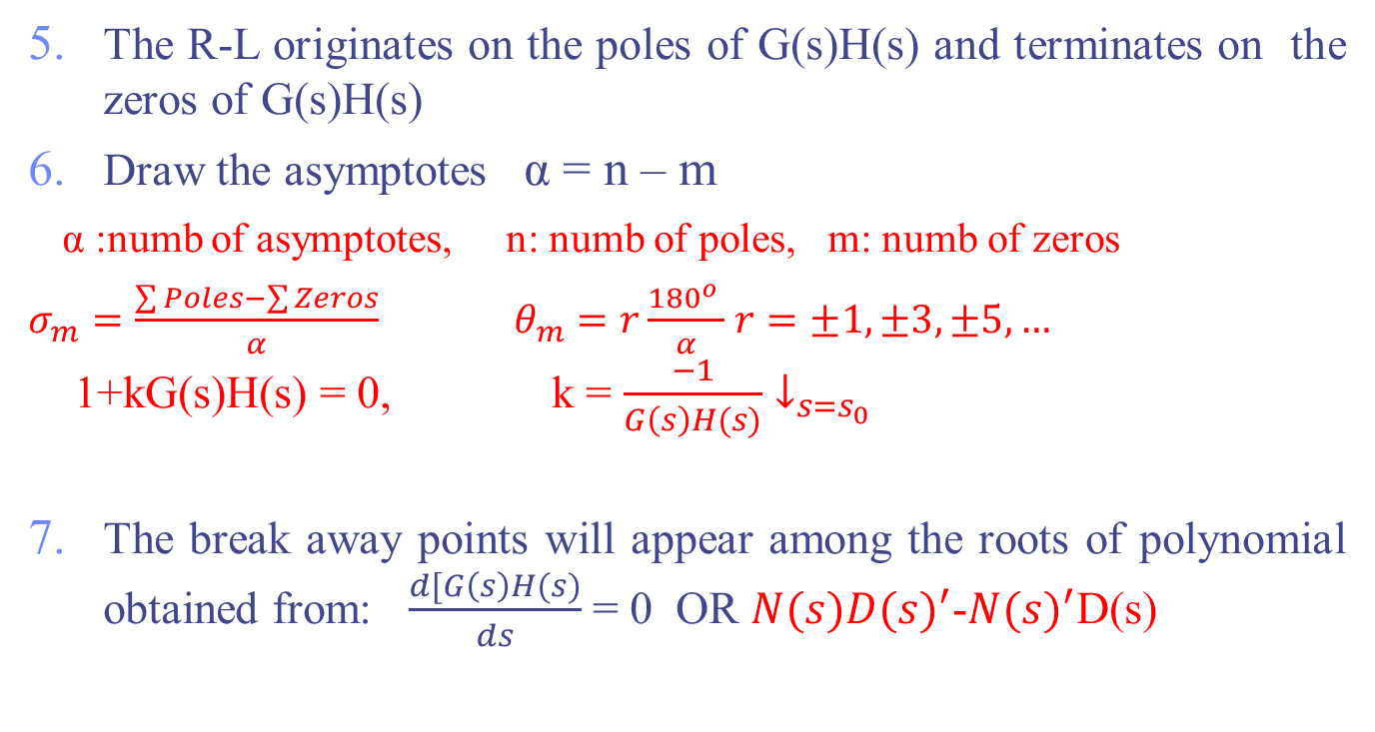
8.4 Sketching the Root Locus
The R-L originates on the poles of G(s)H(s) and terminates on the zeros of G(s)H(s)
Draw the asymptotes α = n – m
α :numb of asymptotes, n: numb of poles, m: numb of zeros
$σ_{m}=\frac{\sum{Poles}−\sum{Zeros}}{α}$ $θ_{m}=r\frac{{180}^{o} }{α}$ $r=±1,±3,±5,…$
1+kG(s)H(s) = 0, k = $\frac{−1}{G\left(s\right)H(s)}↓_{s=s_{0}}$
The break away points will appear among the roots of polynomial obtained from: $\frac{d[G\left(s\right)H(s)}{ds}$ = 0 OR $N(s){D(s)}^{′}$-${N(s)}^{′}$D(s)

Slide 11
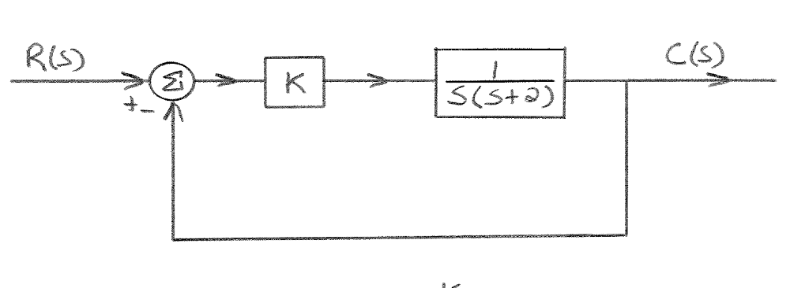
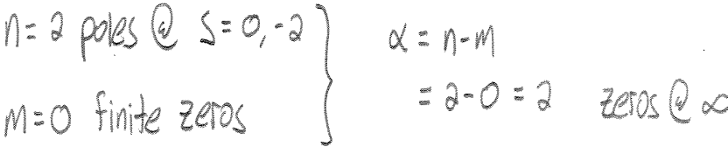
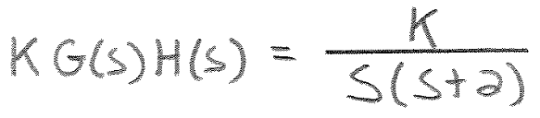
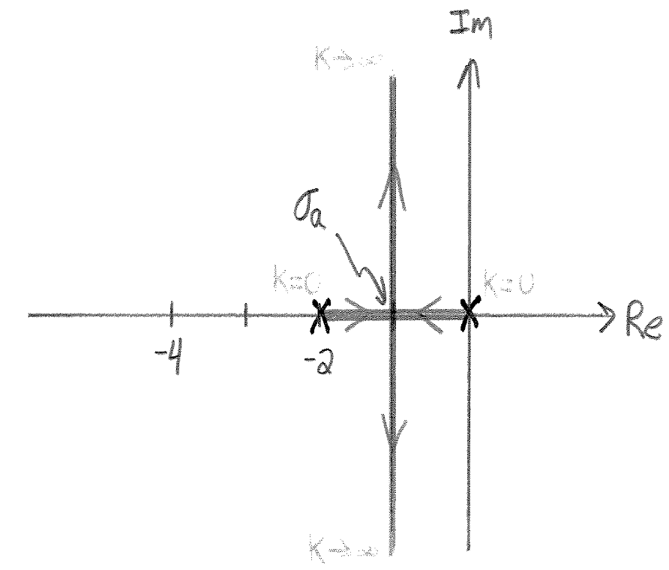
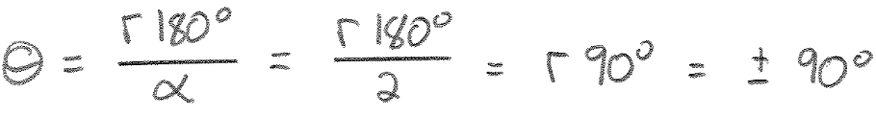
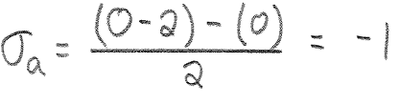
Example
Find R-L

Slide 12
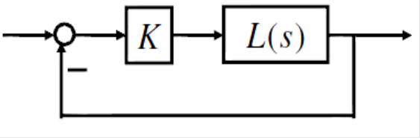
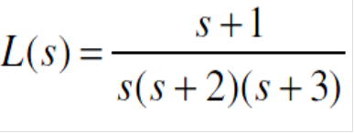
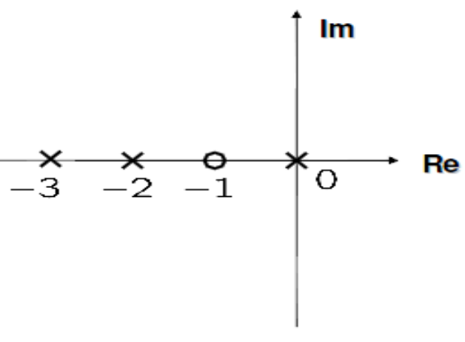
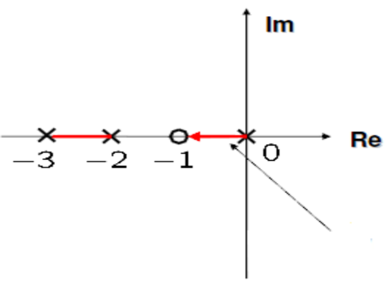
Example
Sketch R-L
Solution:
Indicate the direction
with an arrowhead

Slide 13
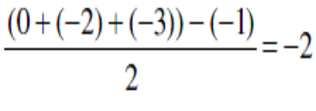
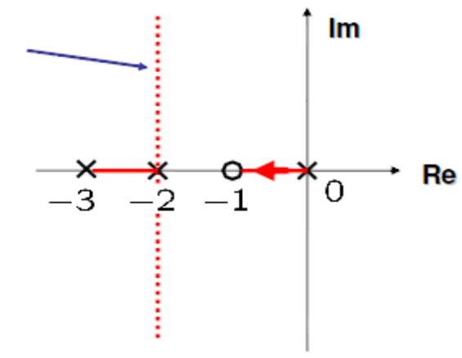
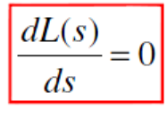
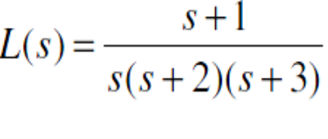
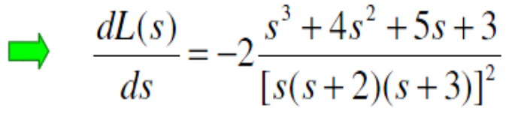
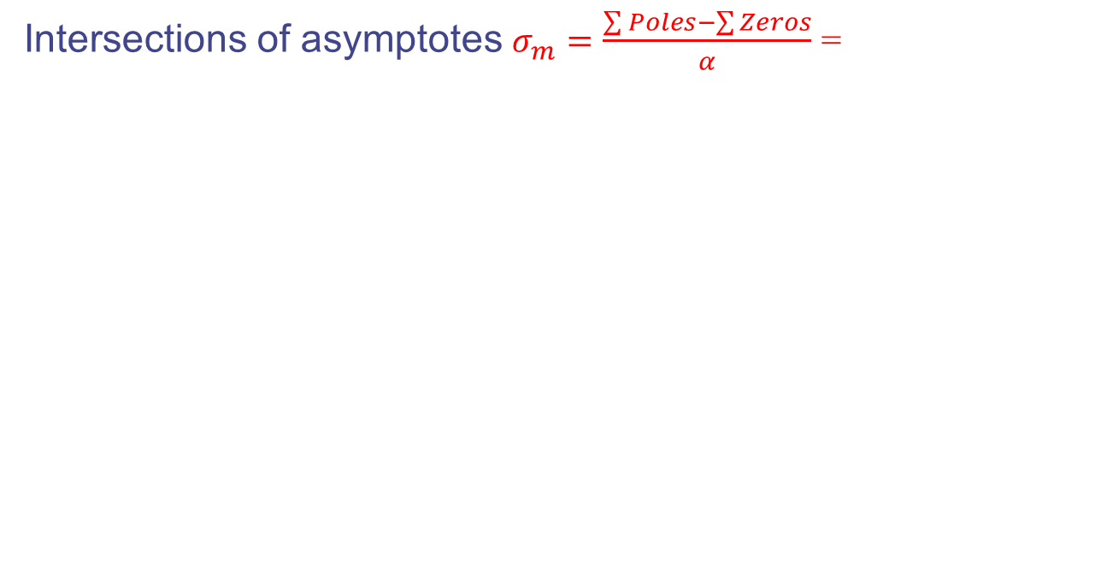
Example
Intersections of asymptotes $σ_{m}=\frac{\sum{Poles}−\sum{Zeros}}{α}$ =
Asymptotes
(Not root locus)
Breakaway points are among roots of
s = −2.4656, −0.7672 ± 0.7925 j

Slide 14
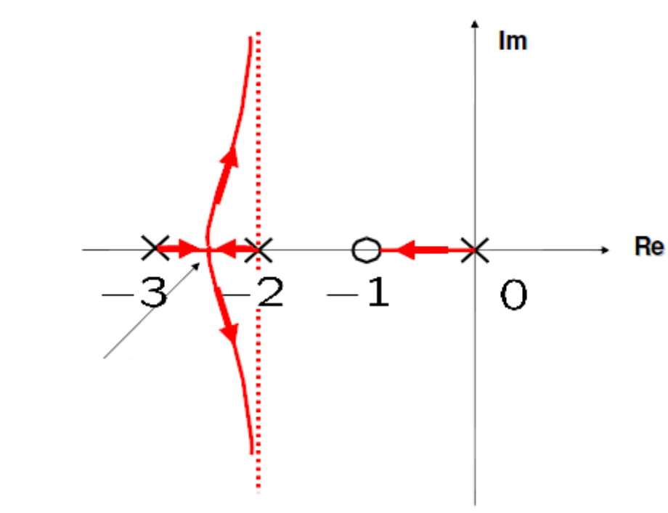
Example
Breakaway point
-2.46
K=.4816

Slide 15
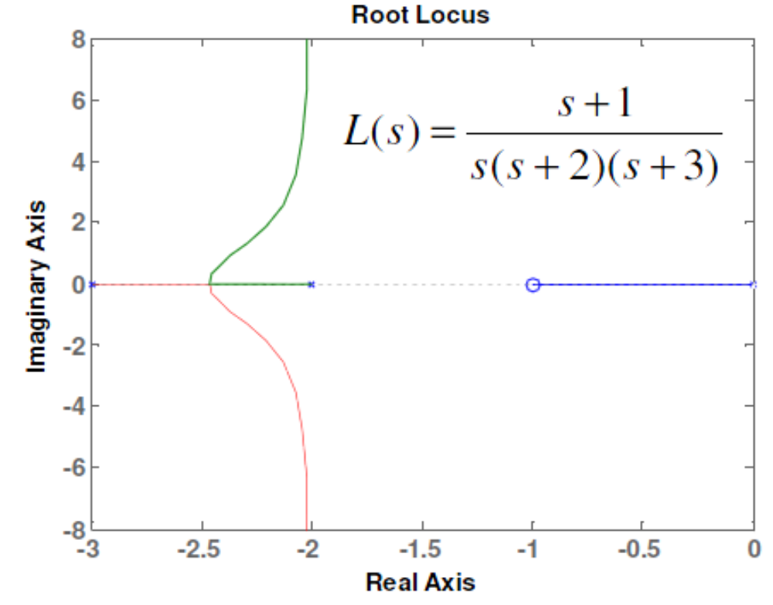
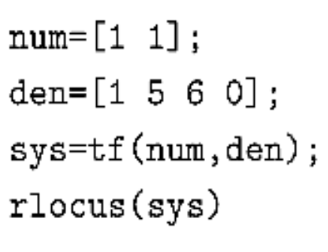
Root Locus – Matlab Command “rlocus.m”

Slide 16
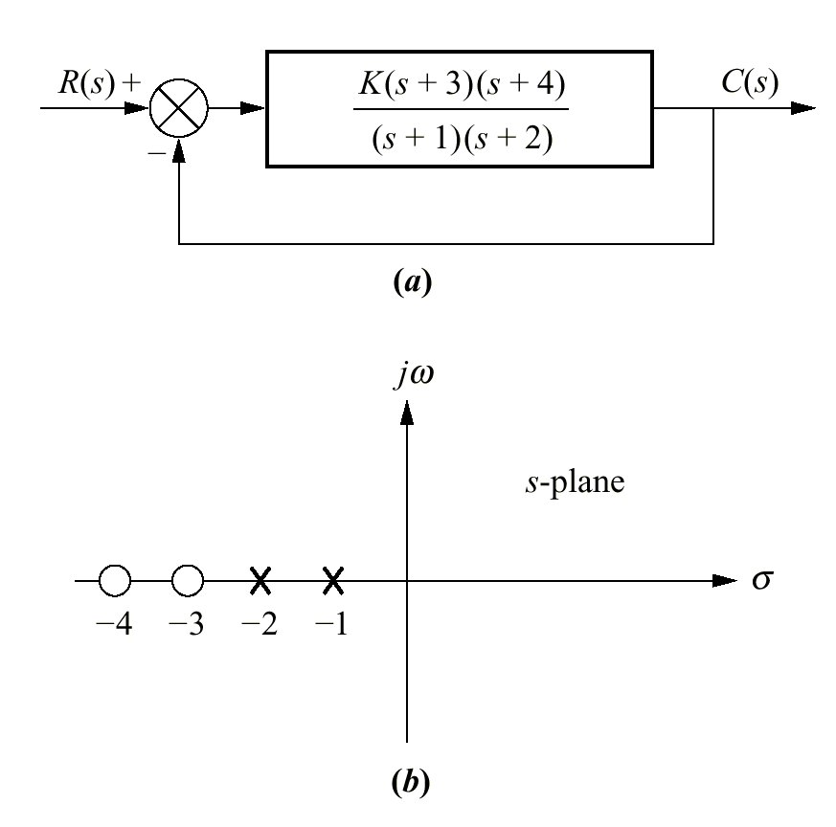
Example
There are two finite poles, at s = - 1, and - 2, and two zeros at s = -3, and -4

Slide 17
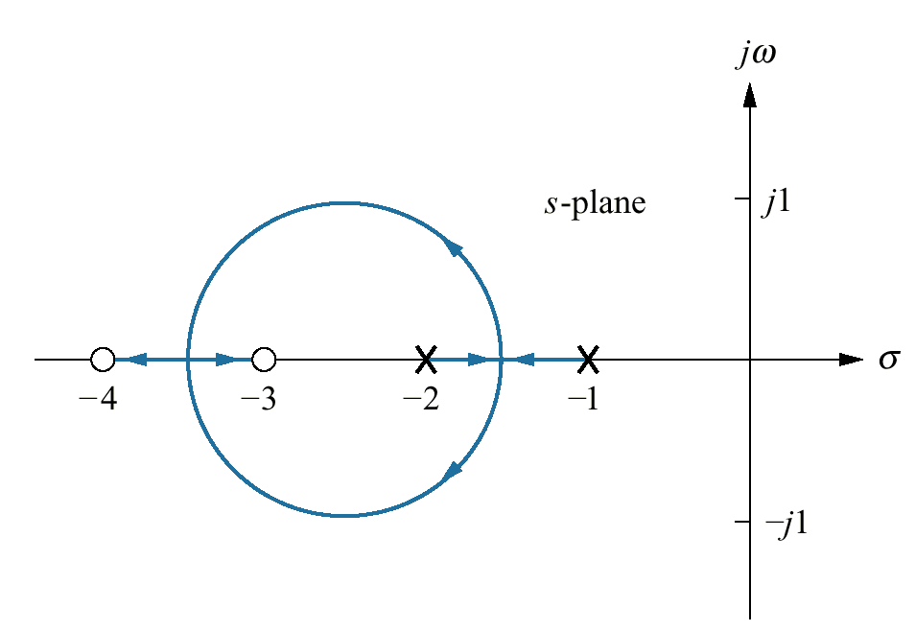
Example

Slide 18
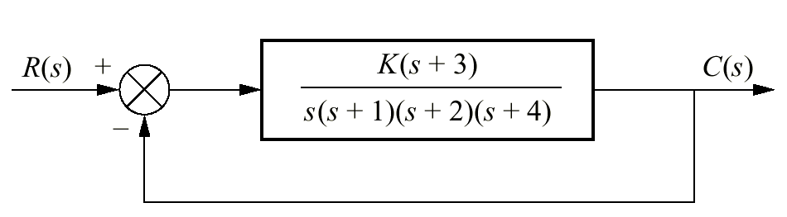
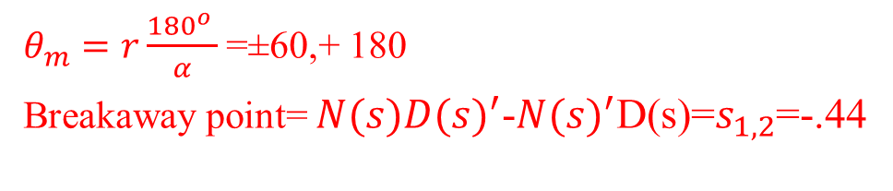
Example 8.2 P. 400
PROBLEM: Sketch the root locus for the system shown in Figure
SOLUTION: Let us begin by calculating the asymptotes α = n – m =4-1=3
$θ_{m}=r\frac{{180}^{o} }{α}$ =±60,+ 180
Breakaway point= $N(s){D(s)}^{′}$-${N(s)}^{′}$D(s)=$s_{1,2}$=-.44

Slide 19
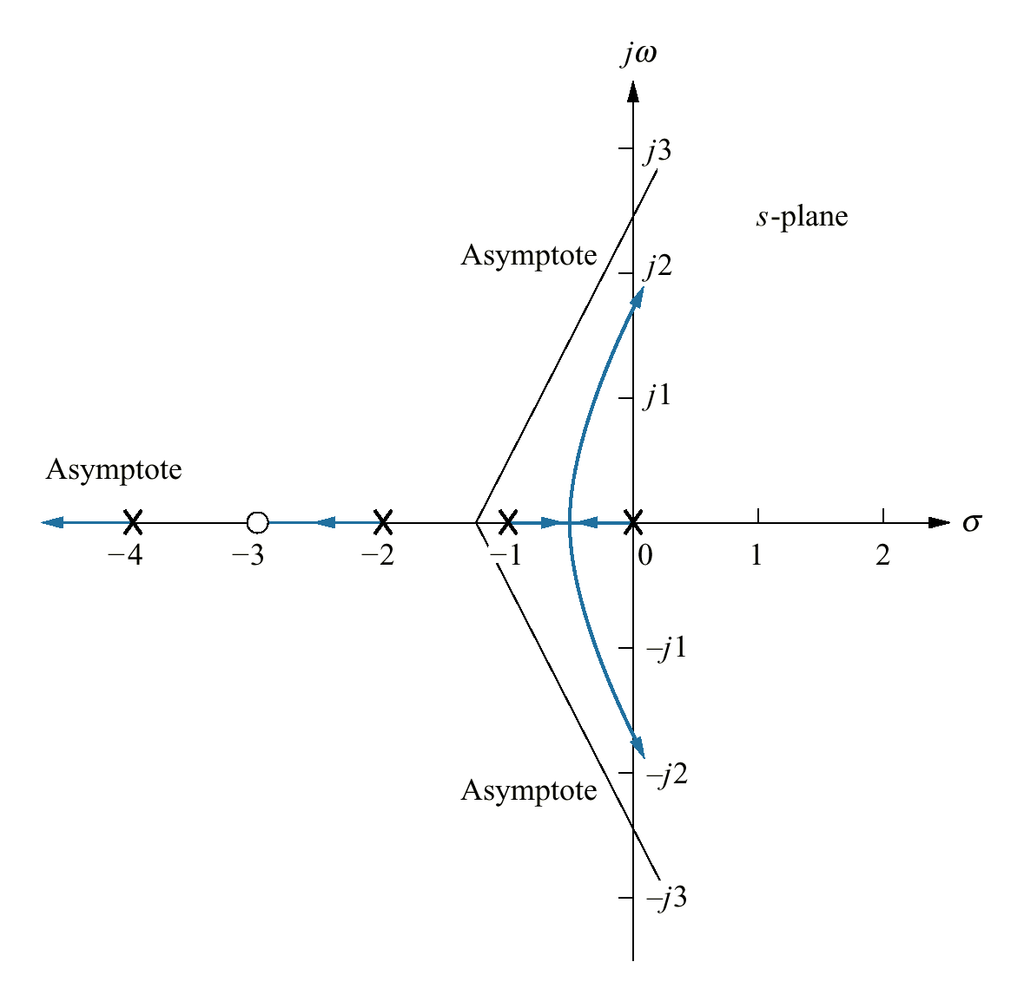
Example 8.2 P. 400

Slide 20
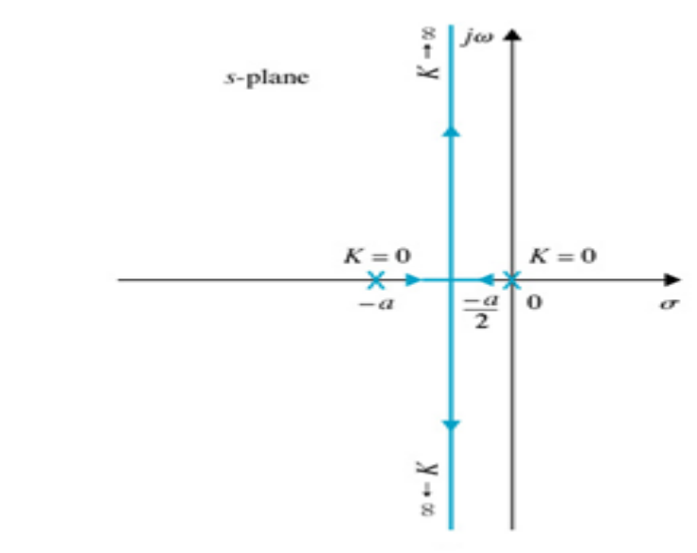
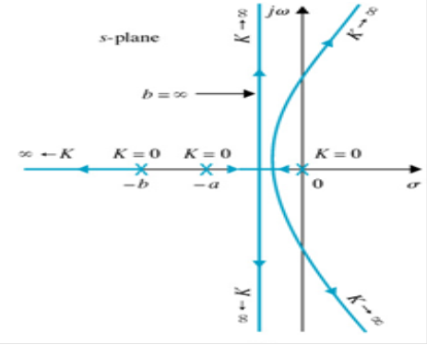
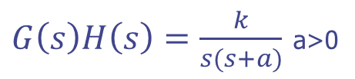
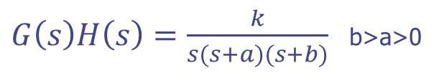
Root-locus diagrams that show the effects of adding poles to G(s) H(s)
$G\left(s\right)H\left(s\right)=\frac{k}{s(s+a)}$ a>0
$G\left(s\right)H\left(s\right)=\frac{k}{s(s+a)(s+b)}$ b>a>0

Slide 21
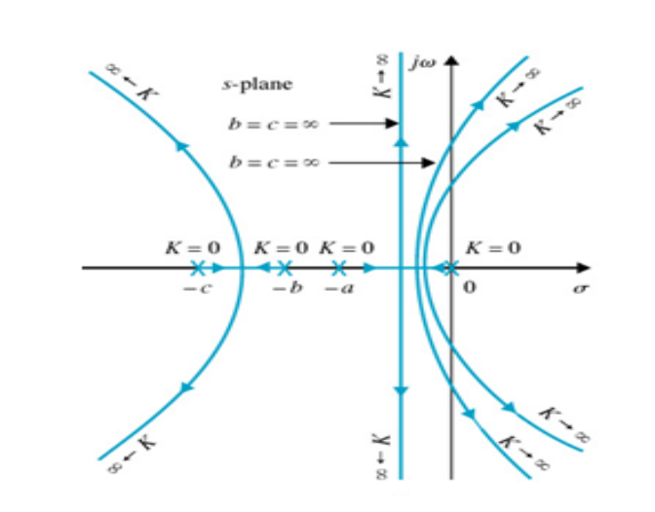
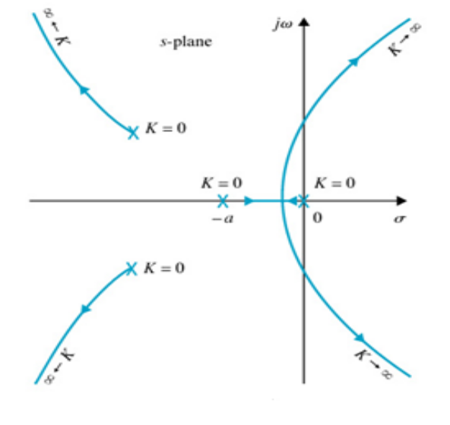


Root-locus diagrams that show the effects of adding poles to G(s) H(s)
another pole is added to G(s)H(s) at s = -c
$$G\left(s\right)H\left(s\right)=\frac{k}{s(s+a)(s+b)(s+c)}$$
addition of a pair of complex conjugate
poles to the transfer function
$$G\left(s\right)H\left(s\right)=\frac{k}{s(s+a)(s+∝±jω)}$$

Slide 22

Root-locus diagrams that show the effects of adding a zero to G(s)H(s)

Slide 23


Example
Given :$G\left(s\right)H\left(s\right)=\frac{k(s+b)}{s^{2}(s+a)}$ find R-L when b=1,i) a=10, ii)a=9, iii)a=8 , iv) a=3, v) a=1
Solution: i)a = 10. Breakaway points: s = -2.5 and -4.0.

Slide 24


Example
ii) a = 9. The breakaway point at s = -3.
iii) a = 8. No breakaway point on RL

Slide 25


Example
iv) a = 3.
v) a = b = 1. The pole at s = -a and the zero at -b cancel each other out, and the RL degenerate into a second-order case and lie entirely on the jw-axis.

Slide 26

2 Real Poles

Slide 27

2 Real Poles + 1 Real Zero

Slide 28

2 Complex Poles and 1 Real Zero

Slide 29


Example
Consider the closed loop system with open loop function
K $G\left(s\right)H\left(s\right)=\frac{k}{(s−1)(s+2)(s+3)}$ a) sketch R-L
b)What range of k that ensures stability?
Solution:

Slide 30




Example
Not valid

Slide 31


Example
Part b) Charct Eq, 1+kGH=0 1+$\frac{k}{(s−1)(s+2)(s+3)}$=0
$s^{3}+4s^{2}+s−6+k=0$ Using R-H array
For stability need
b= (-1/4)(k-10)>0 k<10
C= k-6 k> 6 6<k<10

Slide 32




Example
Find R-L and find k for critical stability
Solution
Breakaway points are among roots of

Slide 33

Example

Slide 34




Example
Characteristic equation
Routh array
When K = 30

Slide 35

Example

Slide 36



Example
Find R-L, check if the R-L cross the Imj. axes
$G\left(s\right)=\frac{s+1}{s^{2}(s+4)}$ , H(s)=1
Solution
>> n=[1 1];
>> d=[1 4 0 0];
>> rlocus(n,d)
There is no Imj axes crossing

Slide 37



Example
Find R-L, check if the R-L cross the Imj. axes
$G\left(s\right)=\frac{1}{s^{3}+4s^{2}+s−6}$ , H(s)=1
Solution
>> n=[1];
>> d=[1 4 1 -6];
>> rlocus(n,d)

Slide 38












Example
Given check if the following poles are on R-L, if so, find the value of k;
s=-1+j, ii) s=-2+j
Solution: R-L is
i) Select a point s=-1+j, we can see that s is on R-L , find value of k
ii) Select a point s=-2+j, we can see that s is not on R-L there is no k value.
s is NOT on root locus..

Slide 39



Example
Given:$G\left(s\right)=\frac{10}{s^{2}+3s+7}$, H(s)=1
Find R-L, and the value of k that satisfy the design criteria : % O.S $≤$ 20 %
$t_{s}≤2.7 sec$
Solution: α = n – m= 2 Asymptote
$θ_{m}=r\frac{{180}^{o} }{α}$ = $±$90, $σ_{m}=\frac{\sum{Poles}−\sum{Zeros}}{α}=−1.5$

Slide 40

Example
From % O.S we find ζ=0.45. We have $t_{s}≤2.7 sec$
$t_{s}=\frac{4}{ζω_{n}}$= 2.7 $ω_{n}$= 3.29, the pole location will be
$s_{1,2}=−ζω_{n}±ω_{n}\sqrt{ζ^{2}−1}$= -1.5 $±$ j 2.93. as we can see that the pole will be on the R-L.
The value of k will be $k=−\frac{1}{G(s)}↓_{s=s_{0}}=\frac{\frac{−1}{10}}{s^{2}+3s+7}↓_{s=−1.5±j2.93}$=0.382

Slide 41



Example

Slide 42



Root Locus – Control Example
a) Set Kt = 0. Draw R-L for K > 0.
b) Set K = 10. Draw R-L for Kt > 0.
c) Set K = 5. Draw R-L for Kt > 0.
Solution:Root Locus – (a) Kt = 0
There is no
stabilizing gain K!

Slide 43





Root Locus – Control Example
Root Locus – (b) K = 10
Characteristic eq.
By increasing Kt, we can stabilize the CL system..

Slide 44




Root Locus – Control Example
Characteristic equation
R-H array
When Kt = 2

Slide 45




Root Locus – Control Example
Root Locus – (c) K = 5
Characteristic eq.
>> n=[1 0];
>> d=[1 5 0 5];
>> rlocus(n,d)

Slide 46





Root Locus – Effect of Adding Poles
Pulling root locus to the RIGHT
– Less stable
– Slow down the settling

Slide 47







Root Locus – Effect of Adding Zeros
Pulling root locus to the LEFT
– More stable
– Speed up the settling
Add a zero

Slide 48



Example
The Plant
Feedback Control System

Slide 49


Example
P controller set Gc(s)=k, open loop TF is: $\frac{k}{ms^{2}}$
$α=n−m=2−0=2 asympt.$ $θ=±{90}^{0}$
Breakaway point=0
>> n=[1];
>> d=[1 0 0];
>> rlocus(n,d)
Marginal stable for all value of k
P control is unacceptable

