Slide 1
Control Systems
Lect.7 Steady State Error
Basil Hamed

Slide 2
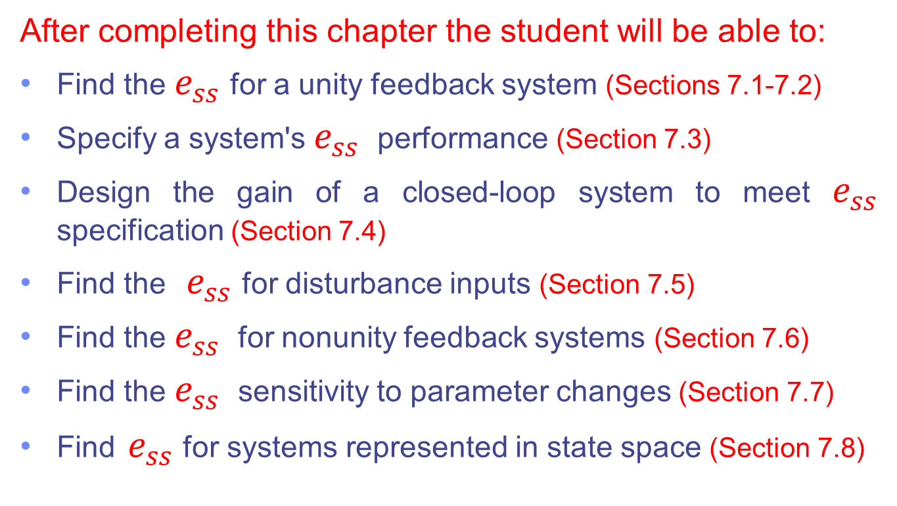
Chapter Learning Outcomes
After completing this chapter the student will be able to:
Find the $e_{ss}$ for a unity feedback system (Sections 7.1-7.2)
Specify a system's $e_{ss}$ performance (Section 7.3)
Design the gain of a closed-loop system to meet $e_{ss}$ specification (Section 7.4)
Find the $e_{ss}$ for disturbance inputs (Section 7.5)
Find the $e_{ss}$ for nonunity feedback systems (Section 7.6)
Find the $e_{ss}$ sensitivity to parameter changes (Section 7.7)
Find $e_{ss}$ for systems represented in state space (Section 7.8)

Slide 3
7.1 Introduction
In Chapter 1, we saw that control systems analysis and design focus on three specifications:
Transient Response (Chapter 4)
Stability (Chapter 6)
Steady-State Errors (Chapter 7)
Now we are ready to examine steady-state errors. We define the errors and derive methods of controlling them.

Slide 4
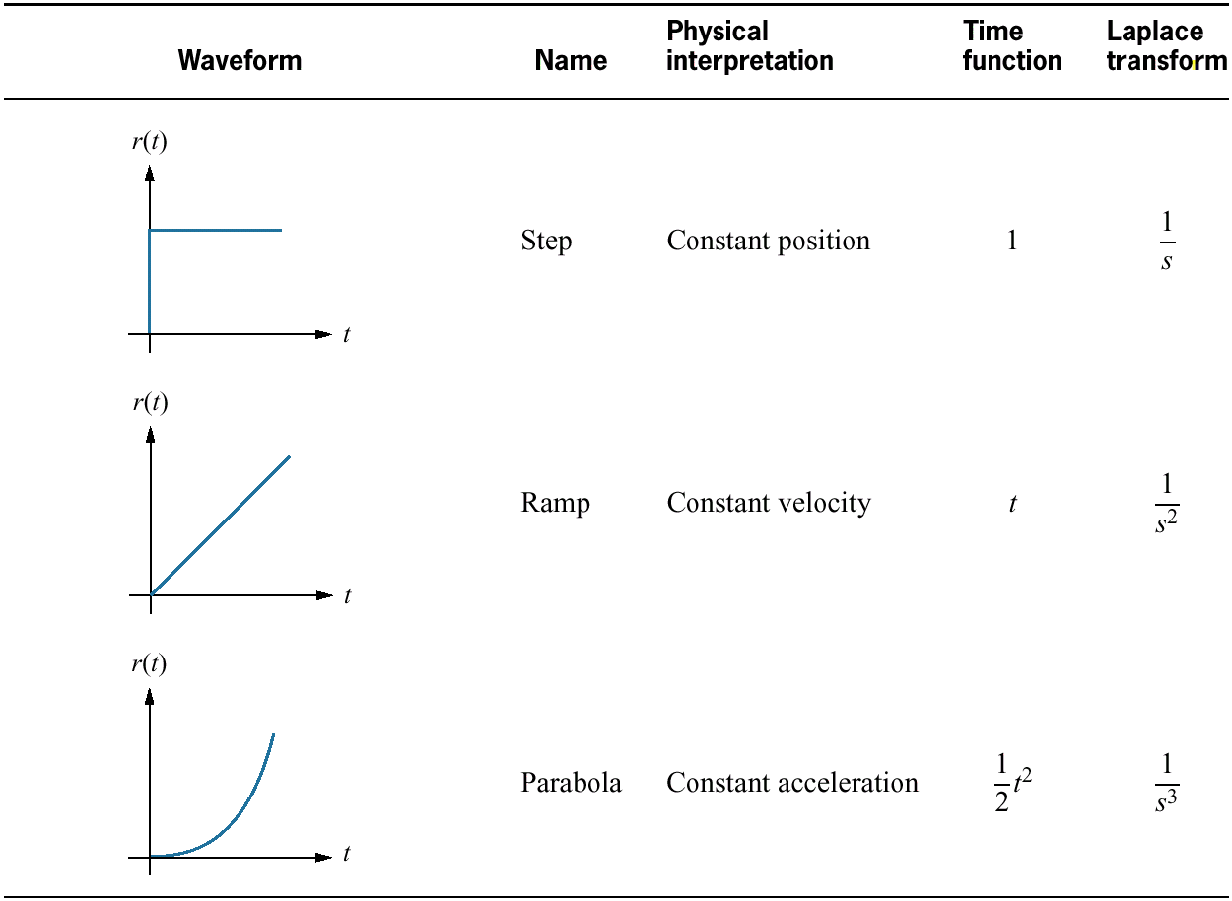
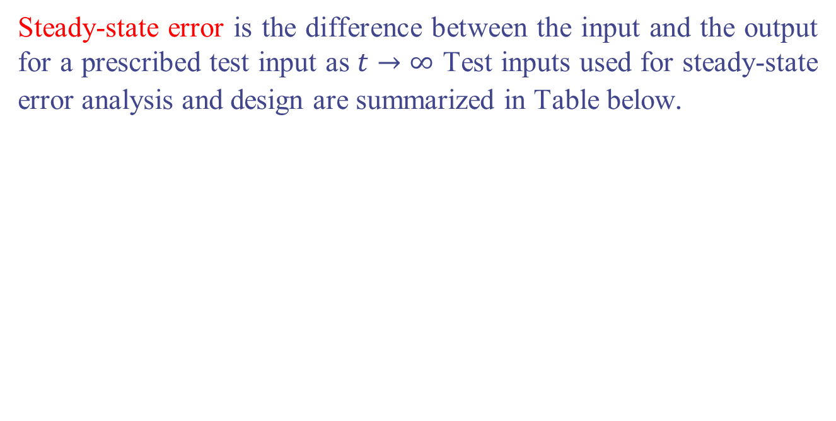
Definition and Test Inputs
Steady-state error is the difference between the input and the output for a prescribed test input as $t→∞$ Test inputs used for steady-state error analysis and design are summarized in Table below.

Slide 5
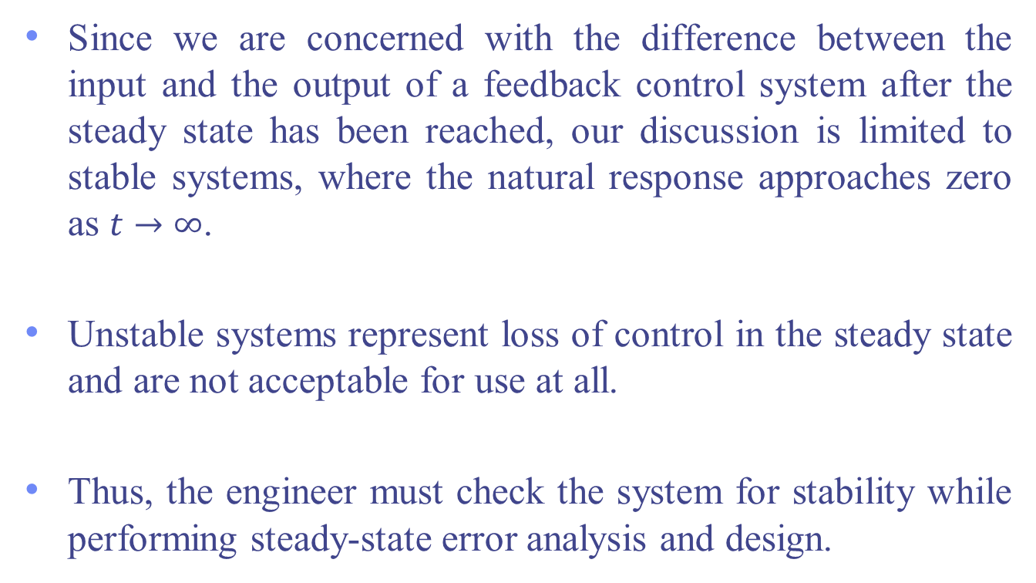
Application to Stable Systems
Since we are concerned with the difference between the input and the output of a feedback control system after the steady state has been reached, our discussion is limited to stable systems, where the natural response approaches zero as $t→∞$.
Unstable systems represent loss of control in the steady state and are not acceptable for use at all.
Thus, the engineer must check the system for stability while performing steady-state error analysis and design.

Slide 6
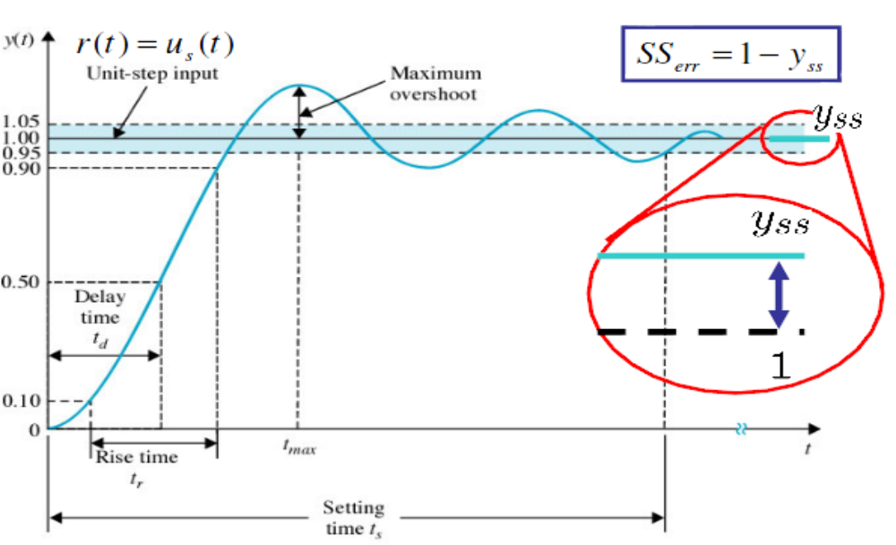
SS Error for Unit Step Input

Slide 7
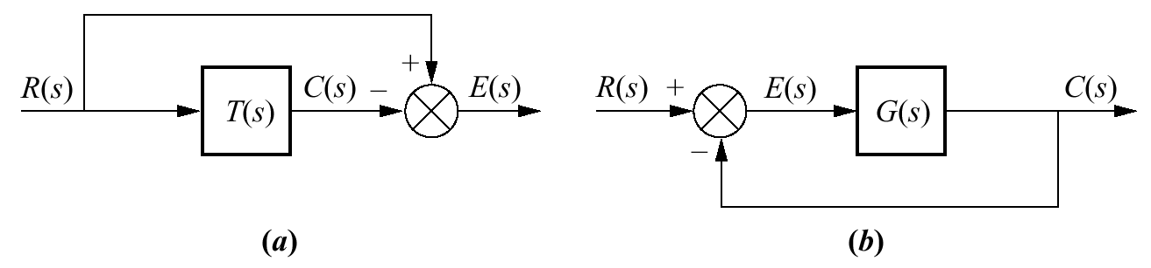
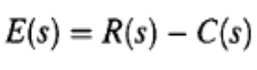
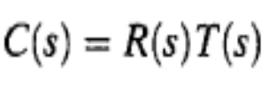
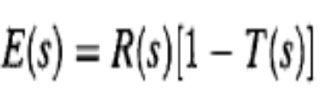
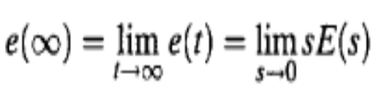
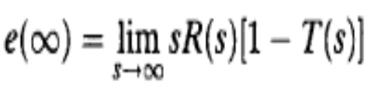
7.2 Steady-State Error for Unity
Feedback Systems
Steady-state error can be calculated from a system's closed-loop transfer function, T(s), or the open-loop transfer function, G(s), for unity feedback systems.
Steady-State Error in Terms of T(s)
To find $e_{ss}$ we need to Apply the final value theorem

Slide 8


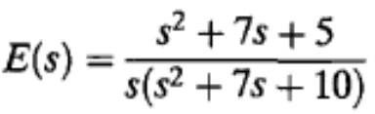
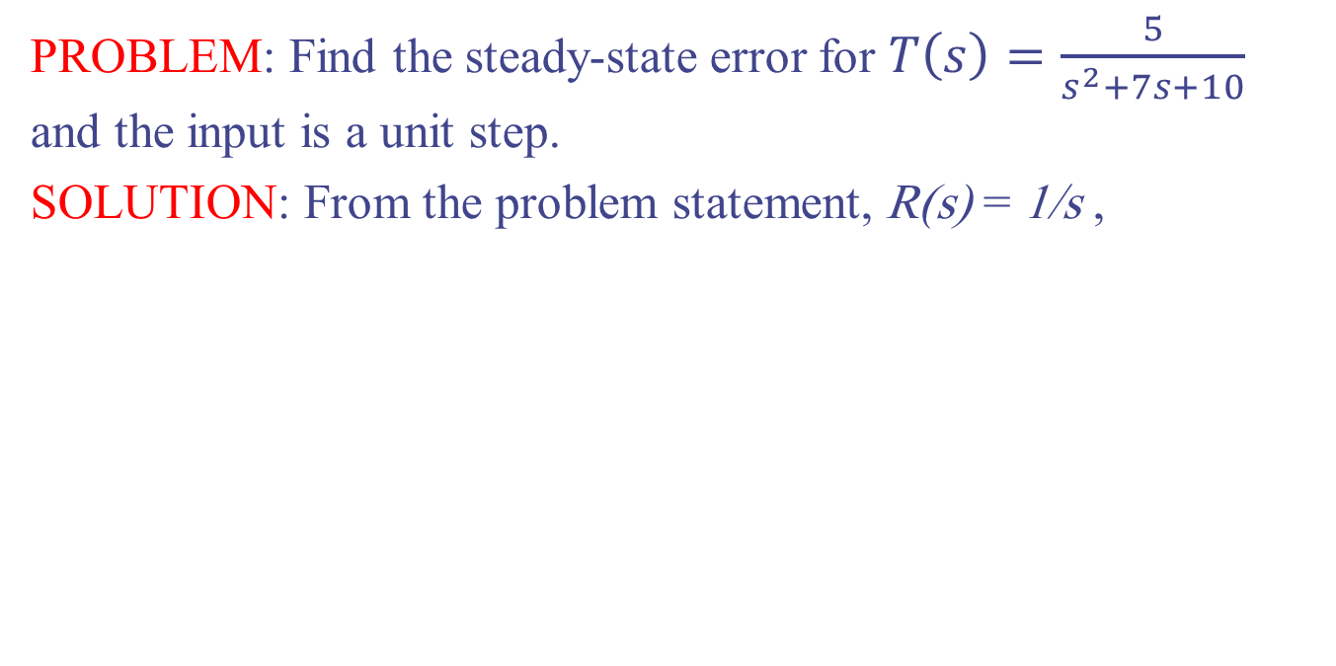
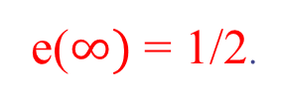
Example 7.1 P 345
PROBLEM: Find the steady-state error for $T\left(s\right)=\frac{5}{s^{2}+7s+10}$ and the input is a unit step.
SOLUTION: From the problem statement, R(s) = 1/s ,
Since T(s) is stable and, subsequently, E(s) does not have right-half-plane poles or jw poles other than at the origin, we can apply the final value theorem
e($∞)$ = 1/2.

Slide 9
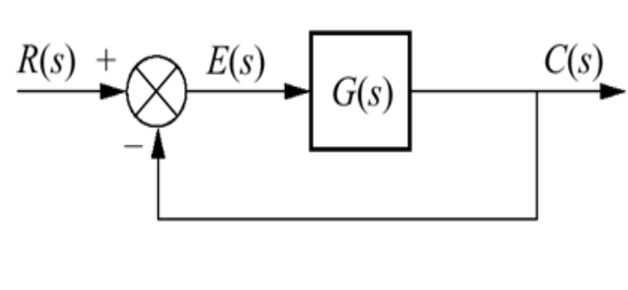
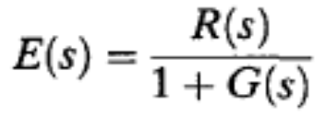
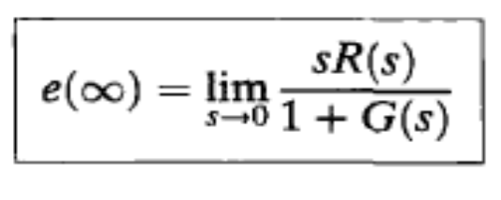
Steady-State Error in Terms of G(s)
E(s)= R(s)- C(s); C(s) =G(s) E(s)
We now apply the final value theorem

Slide 10
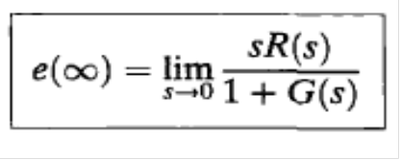
Test Signals
The three test signals we use to establish specifications for a control system's steady-state error characteristics are :
Step
Ramp
Parabola
Let us take each input and evaluate its effect on the steady-state error by using Eq.

Slide 11
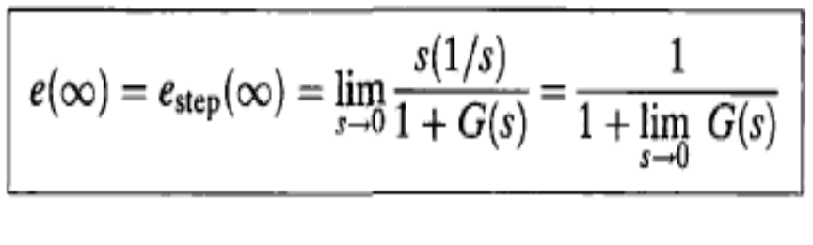
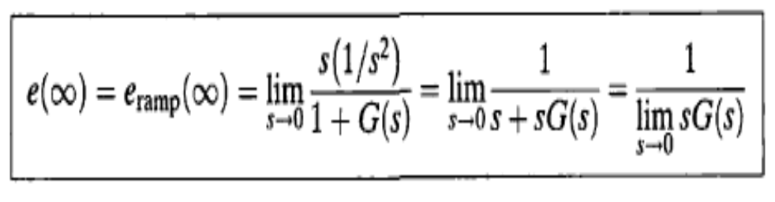
Test Signals
Step Input
Using Eq. With R(s) = 1/s, we find
Ramp Input Using above Eq. with, R(s) = $\frac{1}{s^{2}}$, we obtain

Slide 12
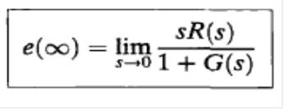
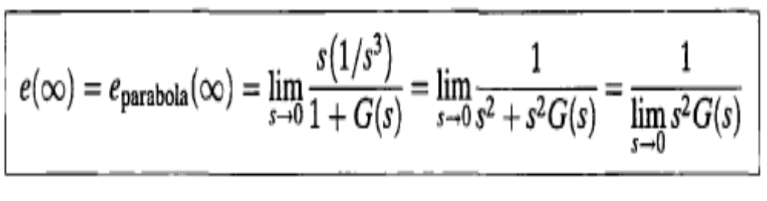
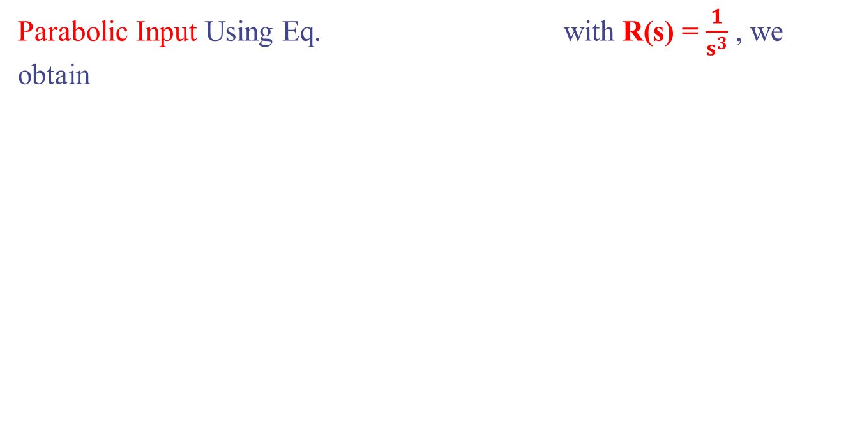
Test Signals
Parabolic Input Using Eq. with R(s) = $\frac{1}{s^{3}}$ , we obtain

Slide 13
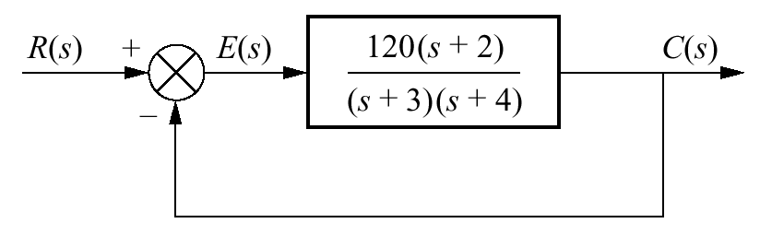
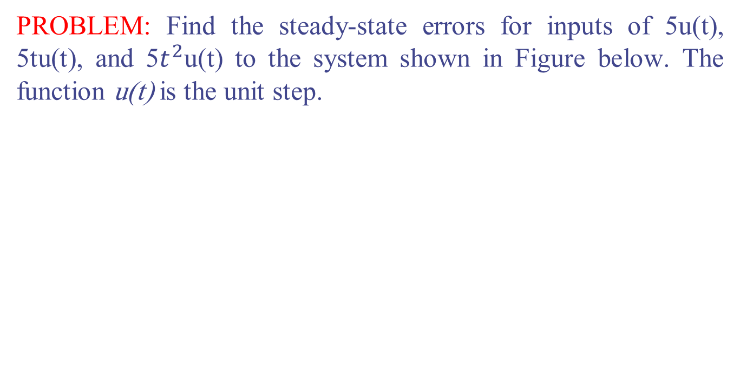
Example 7.2 P. 347
PROBLEM: Find the steady-state errors for inputs of 5u(t), 5tu(t), and 5$t^{2}$u(t) to the system shown in Figure below. The function u(t) is the unit step.

Slide 14
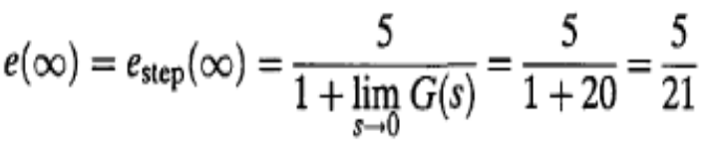
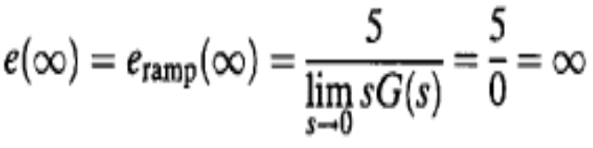
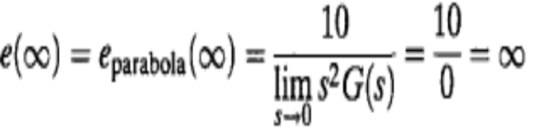
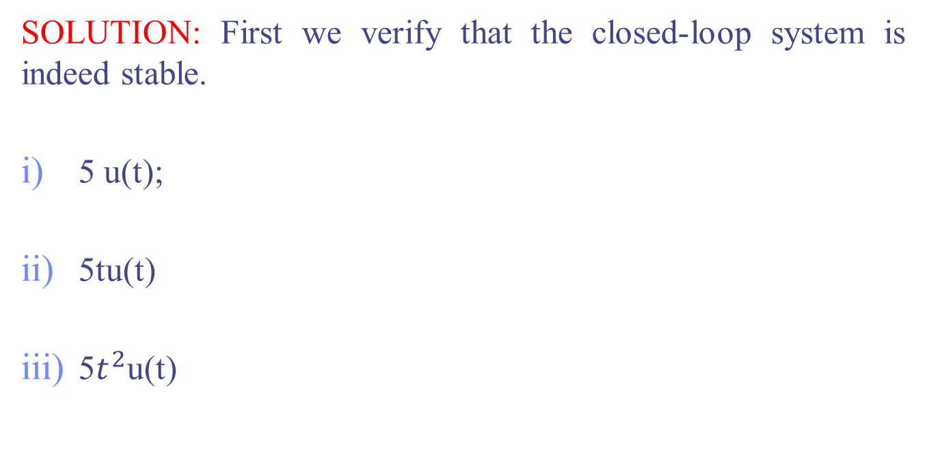
Example 7.2 P. 347
SOLUTION: First we verify that the closed-loop system is indeed stable.
5 u(t);
5tu(t)
5$t^{2}$u(t)

Slide 15
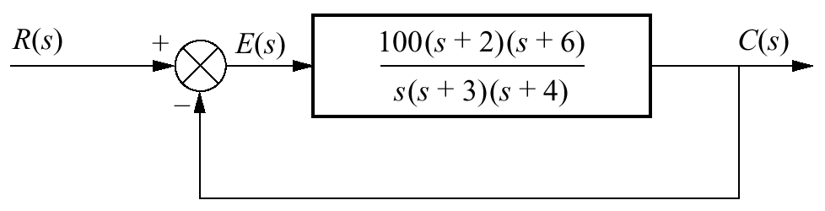
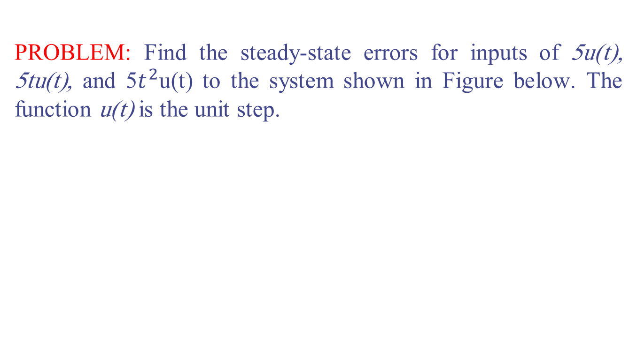
Example 7.3 P 348
PROBLEM: Find the steady-state errors for inputs of 5u(t), 5tu(t), and 5$t^{2}$u(t) to the system shown in Figure below. The function u(t) is the unit step.

Slide 16
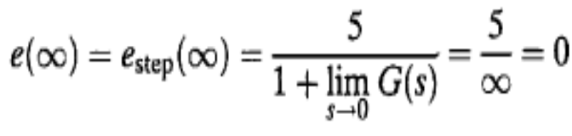
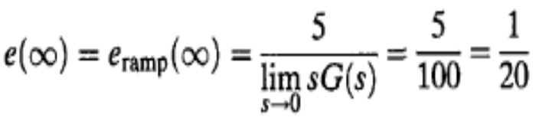
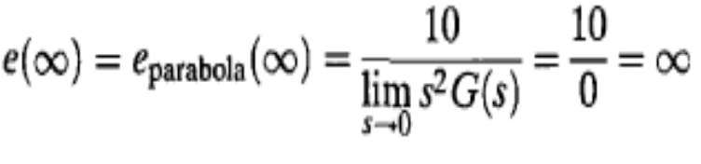
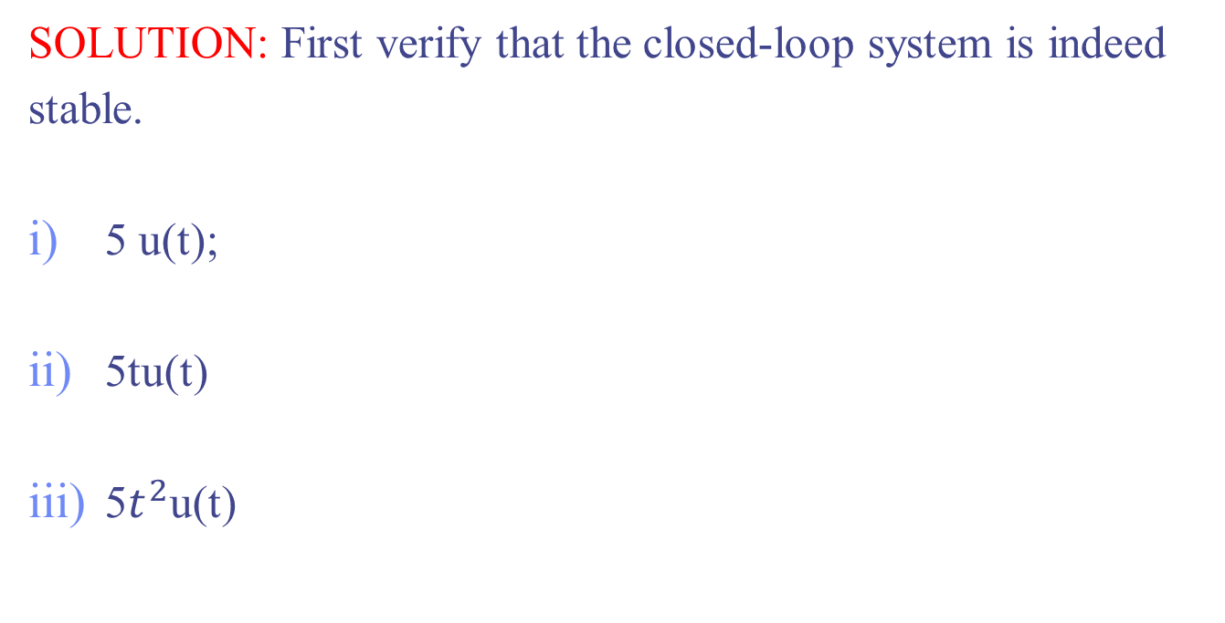
Example 7.3 P 348
SOLUTION: First verify that the closed-loop system is indeed
stable.
5 u(t);
5tu(t)
5$t^{2}$u(t)

Slide 17
7.3 Static Error Constants and
System Type
We continue our focus on unity negative feedback systems and define parameters that we can use as steady-state error performance specifications. These steady-state error performance specifications are called static error constants.

Slide 18
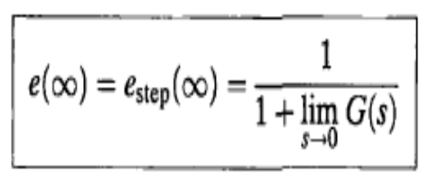
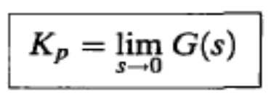
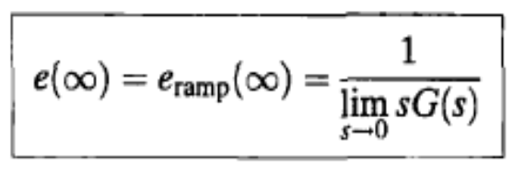
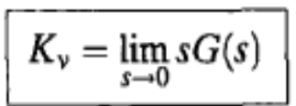

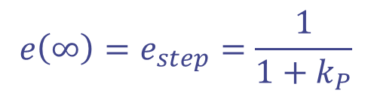

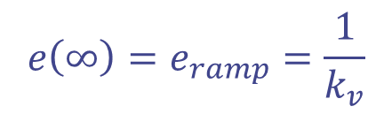
Static Error Constants
For a step input, u(t),
$k_{P}$:position constant
$$e\left(∞\right)=e_{step}=\frac{1}{1+k_{P}}$$
For Ramp input, tu(t),
$k_{v}$:velocity constant
$$e\left(∞\right)=e_{ramp}=\frac{1}{k_{v}}$$

Slide 19
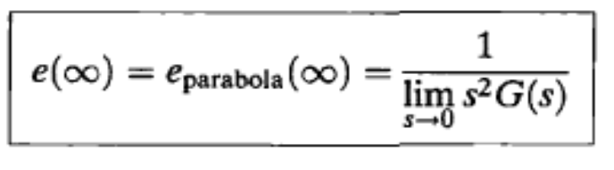
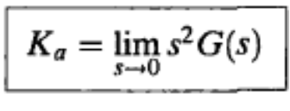
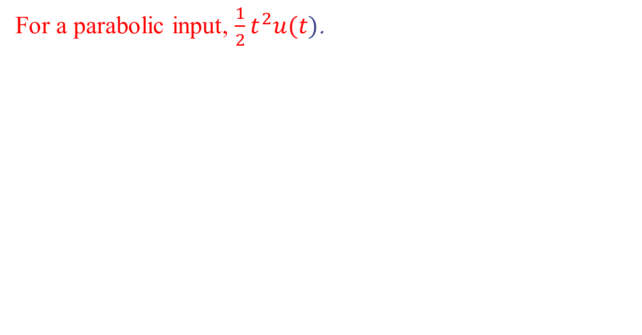
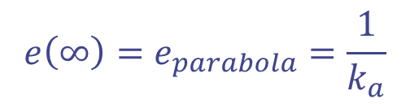

Static Error Constants
For a parabolic input, $\frac{1}{2}t^{2}u(t)$.
$k_{a}$:accelration constant
$$e\left(∞\right)=e_{parabola}=\frac{1}{k_{a}}$$

Slide 20
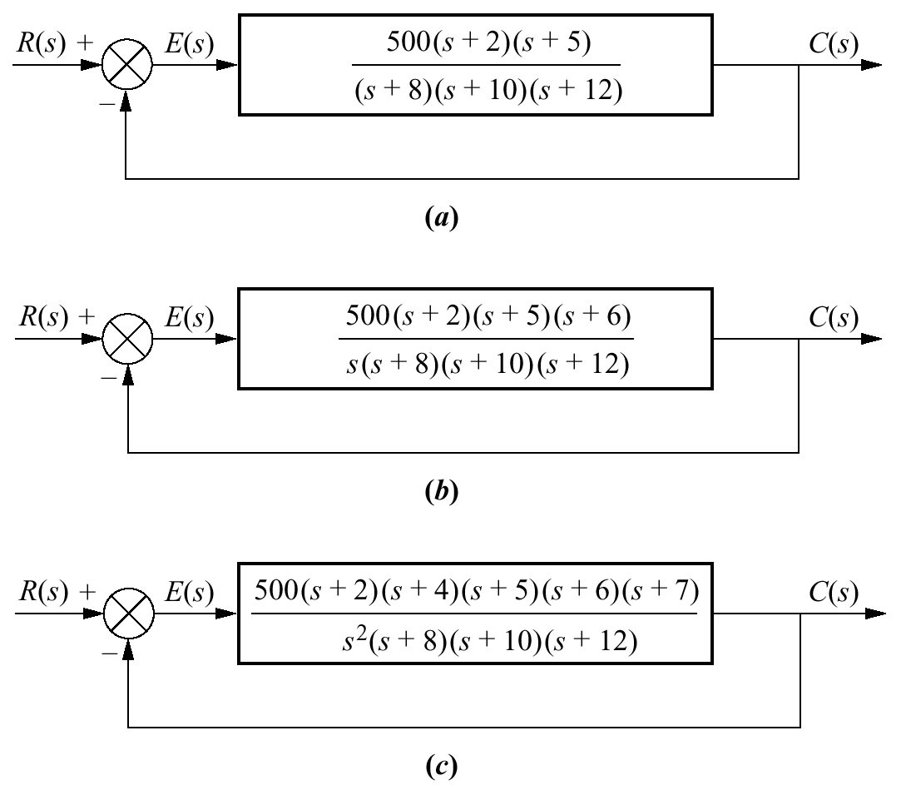
Example 7.4 P 350
PROBLEM: For each system in the Figure below , evaluate the static error constants and find the expected error for the standard step, ramp, and parabolic inputs.

Slide 21
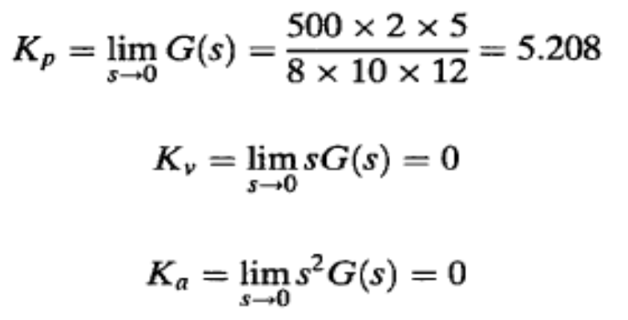
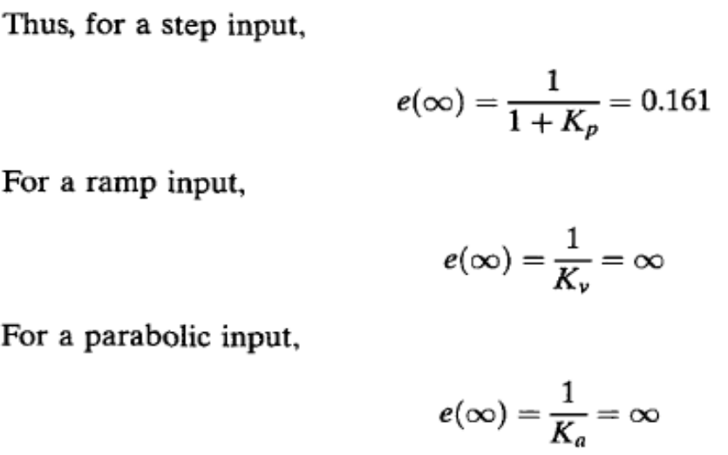
Example 7.4 P 350
SOLUTION: First verify that all closed-loop systems shown are indeed stable.
a)

Slide 22
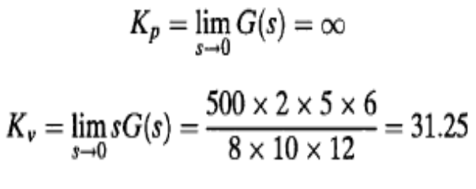
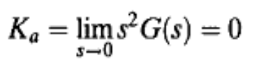

Example 7.4 P 350
b)

Slide 23


Example 7.4 P 350
C)

Slide 24

System Type
The values of the static error constants,, depend upon the form of G(s), especially the number of pure integrations in the forward path. Since steady-state errors are dependent upon the number of integrations in the forward path.
we define system type to be the value of n in the denominator or, equivalently, the number of pure integrations in the forward path.
Therefore, a system with n = 0 is a Type 0 system. If n = 1 or n = 2, the corresponding system is a Type 1 or Type 2 system, respectively.

Slide 25


Example
Type 1
Type 2
Type 3

Slide 26

Relationships between input and system type
Type | Step Input | Ramp Input | Parabola Input
0 | $$\frac{1}{1+k_{P}}$$ | $$∞$$ | $$∞$$
1 | 0 | $$\frac{1}{k_{v}}$$ | $$∞$$
2 | 0 | 0 | $$\frac{1}{k_{a}}$$
3 | 0 | 0 | 0

Slide 27




Example
Find $e_{ss}$ for given system , with inputs step, ramp, parabola
The closed loop
poles are
-11.6063
-0.1968 + 0.6261i
-0.1968 - 0.6261i
Solution: The system is stable and of type 2
Zero SS error for step and ramp input
For parabolic input

Slide 28

7.4 Steady-State Error Specifications
Static error constants can be used to specify the steady-state error characteristics of control systems. Just as damping ratio, ζ, settling time, Ts, peak time, Tp, and percent overshoot, % OS, are used as specifications for a control system's transient response, so the position constant, Kp, velocity constant, Kv, and acceleration constant, Ka, can be used as specifications for a control system's steady-state errors.
For example, if a control system has the specification Kv = 1000, we can draw several conclusions:
1. The system is stable
2. The system is of Type 1
3. A ramp input is the test signal.
${4. e}_{ss}$ is $\frac{1}{k_{v}}$

Slide 29

Example 7.5 P. 354
PROBLEM: What information is contained in the specification Kp = 1000?
SOLUTION: The system is stable. The system is Type 0, since only a Type 0 system has a finite Kp. Type 1 and Type 2 systems have Kp = ∞ . The input test signal is a step, since Kp is specified. Finally, the error per unit step is

Slide 30



Example 7.6 P 355
PROBLEM: Given the control system in Figure, find the value of K so that there is 10% error in the steady state.
SOLUTION: Since the system is Type 1, the error stated in the problem must apply to a ramp input; only a ramp yields a finite error in a Type 1 system. Thus,
k= 672

Slide 31

7.5 Steady-State Error for Disturbances
Feedback control systems are used to compensate for disturbances or unwanted inputs that enter a system. The advantage of using feedback is that regardless of these disturbances, the system can be designed to follow the input with small or zero error.

Slide 32






7.5 $e_{ss}$ for Disturbances
1
But
2
Substituting Eq. (2) into Eq. (1) and solving for E(s), we obtain
3
To find the steady-state value of the error, we apply the final value theorem3 to Eq. (3) and obtain

Slide 33




Example 7.7 P.357
PROBLEM: Find the $e_{ss}$component due to a step disturbance for the system shown.
SOLUTION: The system is stable.
The steady-state error component due to a step disturbance is found to be

Slide 34

7.6 Steady-State Error for Nonunity Feedback Systems
Control systems often do not have unity feedback because of the compensation used to improve performance or because of the physical model for the system.

Slide 35

Example 7.8 P. 359
PROBLEM: For the system shown, find the system type, the appropriate error constant associated with the system type, and the steady-state error for a unit step input. Assume input and output units are the same.
SOLUTION: After determining that the system is indeed stable, one may impulsively declare the system to be Type 1. This may not be the case, since there is a nonunity feedback element,
The first step in solving the problem is to convert the system into an equivalent unity feedback system.

Slide 36





Example 7.8 P. 359
we find
Thus, the system is Type 0, since there are no pure integrations in above Eq. The appropriate static error constant is then Kp, whose value is
The steady-state error, e(∞) is

Slide 37
7.7 Sensitivity
During the design process, the engineer may want to consider the extent to which changes in system parameters affect the behavior of a system.
Ideally, parameter changes due to heat or other causes should not appreciably affect a system's performance.
The degree to which changes in system parameters affect system transfer functions, and hence performance, is called sensitivity.
A system with zero sensitivity (that is, changes in the system parameters have no effect on the transfer function) is ideal.

Slide 38
7.7 Sensitivity
For example, assume the function F = K/(K + a)
If K = 10 and a = 100, then F = 0.091.
If parameter a triples to 300, then F = 0.032.
We see that a fractional change in parameter
a of (300 — 100)/100 = 2 (a 200% change),
yields a change in the function
F of (0.032 - 0.091)/0.091 = -0.65 (-65% change).
Thus, the function F has reduced sensitivity to changes in parameters.

Slide 39
Sensitivity and Robustness
• Parameter uncertainty: nominal design cannot be implemented exactly.
• System must perform satisfactorily for perturbed system
• Robust system: behavior does not significantly deteriorate due to parameter perturbations.
• Sensitivity: measure of changes in a system property due to changes in a parameter value.

Slide 40


7.7 Sensitivity
Sensitivity is the ratio of the fractional change in the function to the fractional change in the parameter as the fractional change of the parameter approaches zero. That is,
which reduces to

Slide 41



Example 7.10 P. 362
PROBLEM: Given the system shown, calculate the sensitivity of the closed-loop transfer function to changes in the parameter a. How would you reduce the sensitivity?
SOLUTION: The closed-loop transfer function is
which is, in part, a function of the value of s. For any value of s, however, an increase in K reduces the sensitivity of the closed-loop transfer function to changes in the parameter a.

Slide 42






Example 7.11 P. 363
PROBLEM: For the system shown, find the sensitivity of the steady-state error to changes in parameter K and parameter a with ramp inputs.
SOLUTION: The steady-state error for the system is
The sensitivity of e($∞$) to changes in parameter a is
The sensitivity of e($∞$) to changes in parameter K is
Thus, changes in either parameter a or parameter K are directly reflected in e($∞$) and there is no reduction or increase in sensitivity.
The negative sign, indicates a decrease in e($∞$) for an increase in K.

Slide 43
7.8 Steady-State Error for Systems in State Space
Up to this point, we have evaluated the steady-state error for systems modeled as transfer functions.
In this section, we will discuss how to evaluate the steady-state error for systems represented in state space (analysis via final value theorem)

Slide 44





Analysis via Final Value Theorem
A single-input, single-output system represented in state space can be analyzed for steady-state error using the final value theorem and the closed-loop transfer
Consider the closed-loop system represented in state space:
The Laplace transform of the error is
where T(s) is the closed-loop transfer function, we obtain
Applying the final value theorem, we have

Slide 45



Example 7.13 P. 365
PROBLEM: Evaluate the steady-state error for the system shown for unit step and unit ramp inputs. Use the final value theorem.
SOLUTION:
For a unit step, R(s) = 1/s, and e($∞$) = 4/5. For a unit ramp, R(s) = 1/$s^{2}$, and e($∞$) = $∞$. Notice that the system behaves like a Type 0 system

Slide 46

Example: Step Input
Find steady state error for step input

Slide 47


Example: Step Input

