Slide 1
Control Systems
Lect.6 Stability
Basil Hamed

Slide 2
Chapter 6
After completing this chapter the student will be able to:
Make and interpret a basic Routh table to determine the stability of a system (Sections 6.1-6.2)
Make and interpret a Routh table where either the first element of a row is zero or an entire row is zero (Sections 6.3-6.4)
Use a Routh table to determine the stability of a system represented in state space (Section 6.5)

Slide 3
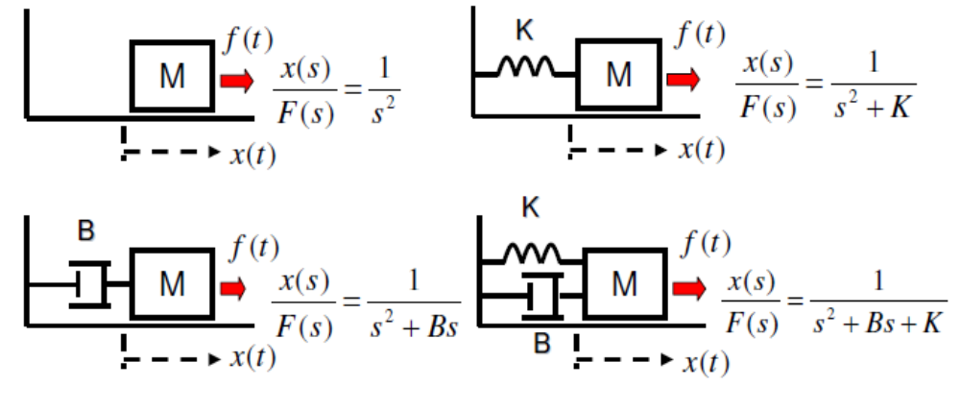
Stability – A Simple Example
We want the mass to stay at x = 0, but wind gave some initial speed (f(t) = 0). What will happen?
How to characterize different behaviors with TF?

Slide 4
Stability – Importance
• The most basic and important specification in control analysis
and synthesis!
• Unstable systems have to be stabilized by feedback.
• Unstable closed-loop systems are useless.
– What happens if a system is unstable?
• may hit mechanical/electrical “stops” (saturation)
• may break down or burn out

Slide 5
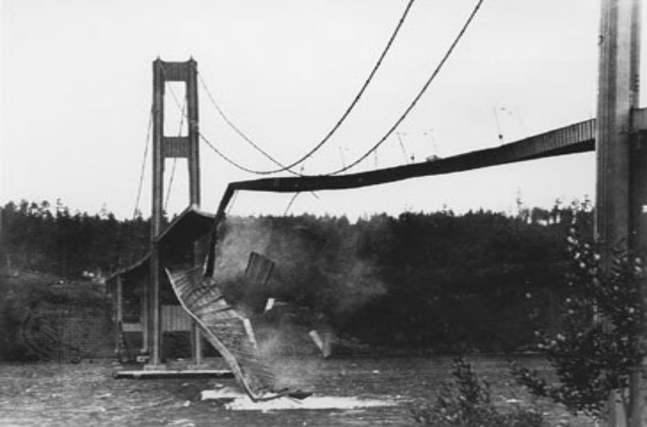
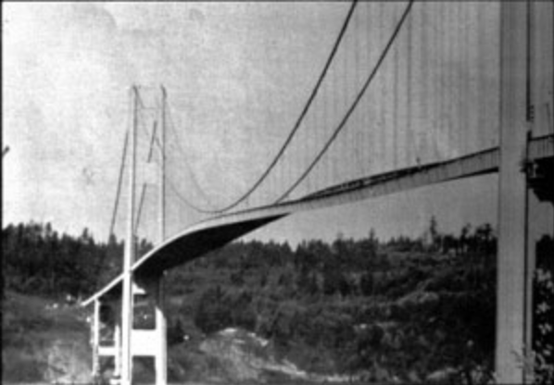

Stability–What Will Happen to Unstable Systems?
Tacoma Narrows Bridge (July 1-Nov.7, 1940)
Wind-induced vibration
Collapsed!
2008…

Slide 6
6.1 Introduction
Three requirements enter into the design of a control system: transient response, stability, and steady-state errors. Thus far we have covered transient response, which we will revisit in Chapter 8. We are now ready to discuss the next requirement, stability.
Stability is the most important system specification. If a system is unstable, transient response and steady-state errors are moot points.
An unstable system cannot be designed for a specific transient response or steady-state error requirement.

Slide 7
6.1 Introduction
What is stability?
There are many definitions for stability, depending upon the kind of system or the point of view. In this section, we limit ourselves to linear, time-invariant systems.
A system is stable if every bounded input yields a bounded output. We call this statement the bounded-input, bounded-output (BIBO) definition of stability.
A system is unstable if any bounded input yields an unbounded output.

Slide 8
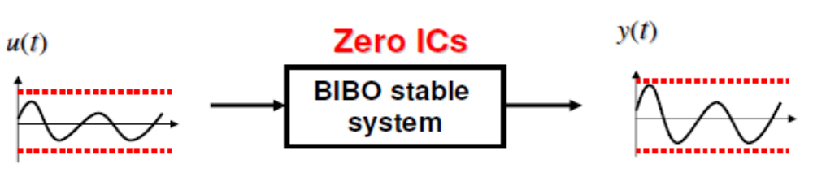
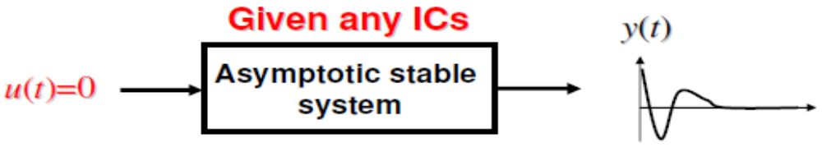
Stability – Definition
BIBO (Bounded-Input-Bounded-Output) stability : Any bounded input generates a bounded output
Asymptotic stability :
Any ICs generates y(t) converging to zero.

Slide 9
6.1 Introduction
we present the following definitions of stability, instability, and marginal stability:
A linear, time-invariant system is stable if the natural response approaches zero as time approaches infinity.
A linear, time-invariant system is unstable if the natural response grows without bound as time approaches infinity.
A linear, time-invariant system is marginally stable if the natural response neither decays nor grows but remains constant or oscillates as time approaches infinity.

Slide 10
6.1 Introduction
How do we determine if a system is stable? Let us focus on the natural response definitions of stability
Stable systems have closed-loop transfer functions with poles only in the left half-plane.
If the closed-loop system poles are in the right half of the s-plane and hence have a positive real part, the system is unstable.

Slide 11
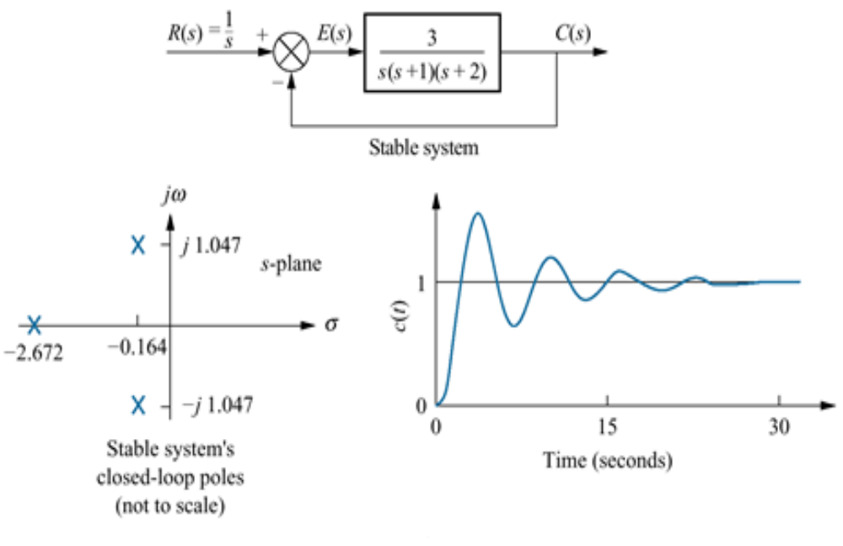
6.1 Introduction

Slide 12
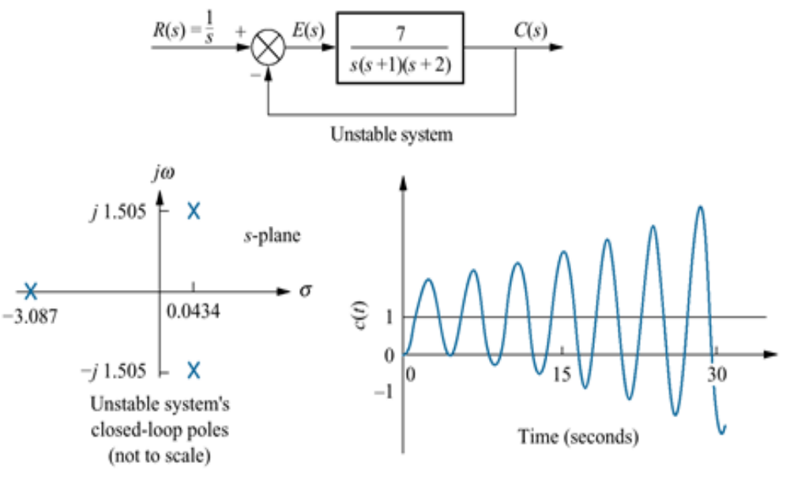
6.1 Introduction

Slide 13

Stability – “s” Domain Stability
For a system represented by a transfer
function G(s),
system is BIBO stable
All the poles of G(s) are in the open
left half of the complex plane
system is asymptotically stable

Slide 14
Stability – Remarks on Stability Definition
For a general system (nonlinear etc.), BIBO stability condition and asymptotic stability condition are different.
For linear time-invariant (LTI) systems (to which we can use Laplace transform and we can obtain a transfer function), the conditions happen to be the same.
In this course, we are interested in only LTI systems, we use simply “stable” to mean both BIBO and asymptotic stability.

Slide 15
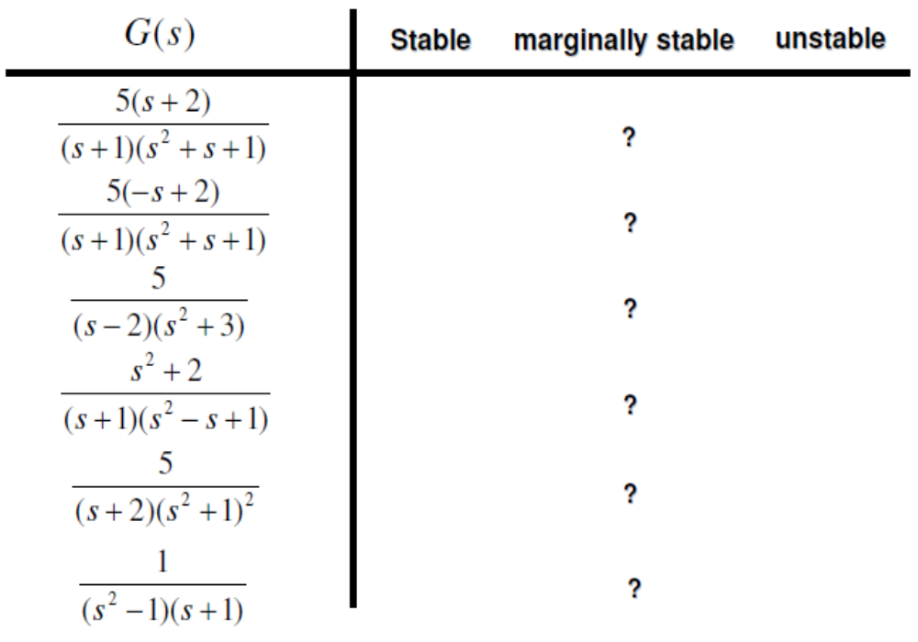
Stability – Examples

Slide 16
Stability – Summary
• Stability for LTI systems
– (BIBO and asymptotically) stable, marginally stable,
unstable
– Stability for G (s) is determined by poles of G.
• Next
– Routh-Hurwitz stability criterion to determine stability
without explicitly computing the poles of a system.

Slide 17
6.2 Routh-Hurwitz Criterion
In this section, we learn a method that yields stability information without the need to solve for the closed-loop system poles.
Using this method, we can tell how many closed-loop system poles are in the left half-plane, in the right half-plane, and on the jw-axis. (Notice that we say how many, not where.)
The method requires two steps:
(1) Generate a data table called a Routh table
(2) interpret the Routh table to tell how many closed-loop system poles are in the LHP, the RHP, and on the jw-axis.

Slide 18
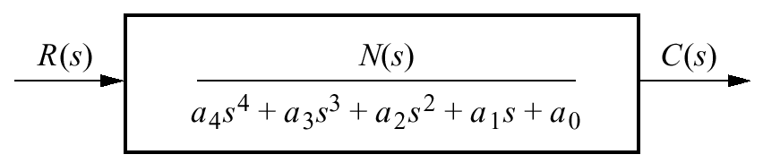
Generating a Basic Routh Table
Look at the equivalent closed-loop transfer function shown in Fig
Since we are interested in the system poles, we focus our attention on the denominator.
In order the above characteristic eq. does not have roots in RHP, it is necessary but not sufficient that the following hold;
All the coefficient of the polynomial have the same sign.
None of the coefficient vanishes.

Slide 19
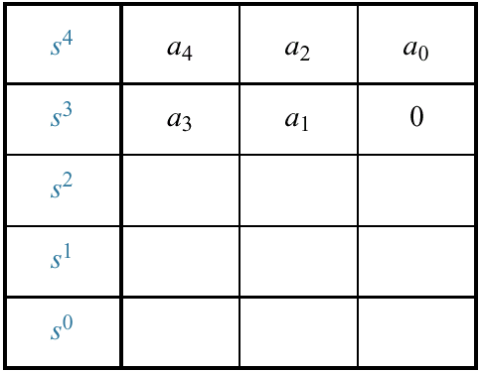
Generating a Basic Routh Table
We first create the Routh table shown in Table below

Slide 20
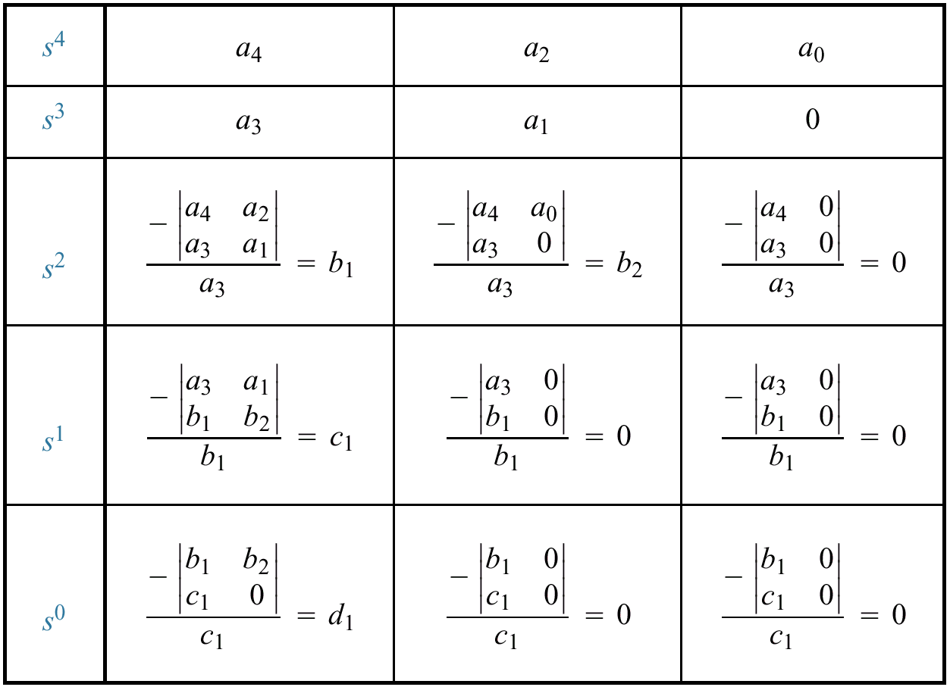
Generating a Basic Routh Table
Only the first 2 rows of the array are obtained from the characteristic eq. the remaining are calculated as follows;

Slide 21
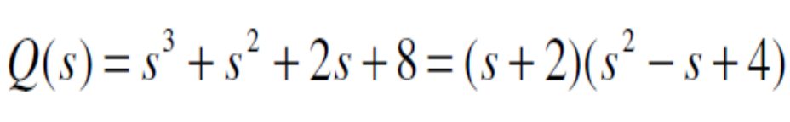
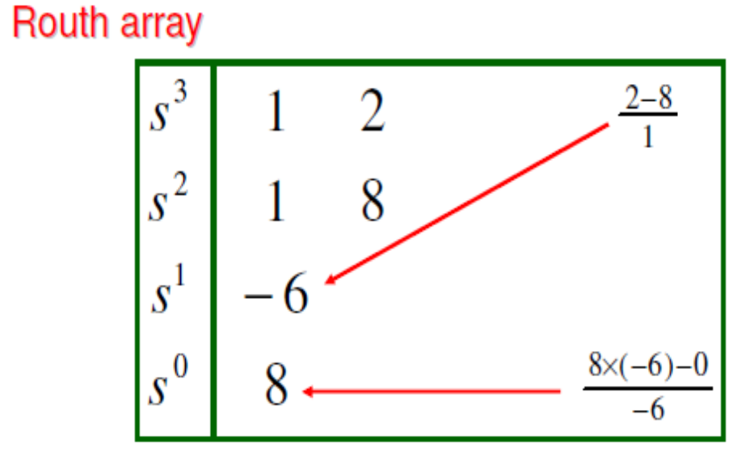
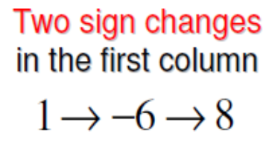
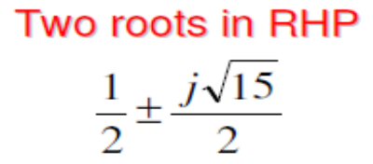
Stability – Routh-Hurwitz Example
Find the stability of the characteristic eq;

Slide 22
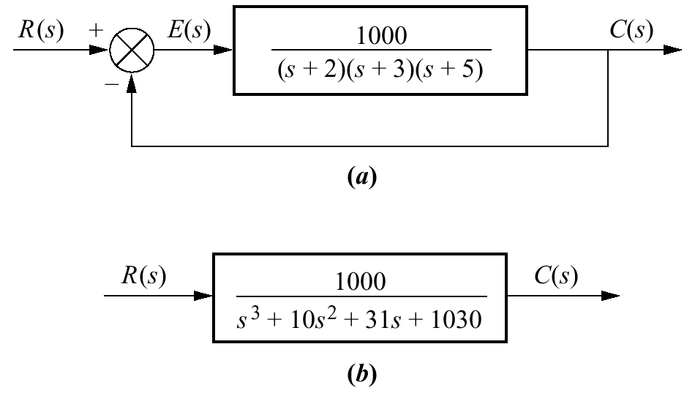
Example 6.1 P. 306
PROBLEM: Make the Routh table for the system shown in Figure

Slide 23
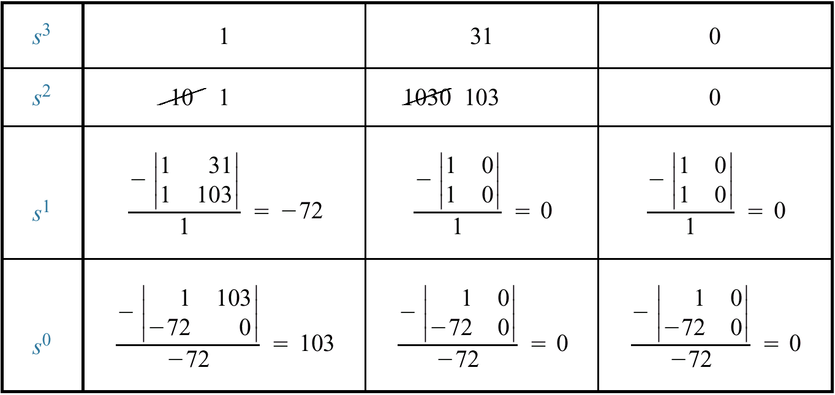
Example 6.1 P. 306
SOLUTION: The first step is to find the equivalent closed-loop system because we want to test the denominator of this function.
System is unstable and has 2 poles in RHP.

Slide 24
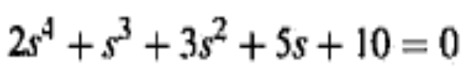
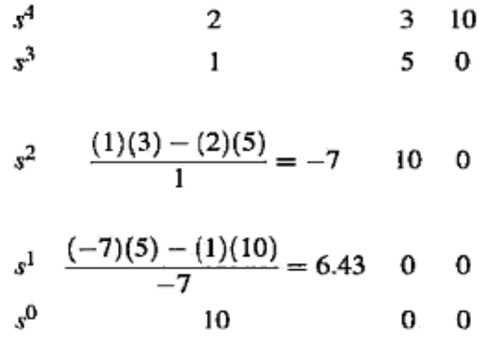


Example
Consider the equation
Solution
Because the equation has no missing terms and the coefficients are all of the same sign, it satisfies the necessary condition
System is unstable because there are two sign changes in the first column of the tabulation, the equation has two roots in the right half of the .y-plane.

Slide 25
6.3 Routh-Hurwitz Criterion: Special Cases
Two special cases can occur:
The Routh table sometimes will have a zero only in the first column of a row, or
The Routh table sometimes will have an entire row that consists of zeros

Slide 26
Zero Only in the First Column
If the first element of a row is zero, division by zero would be required to form the next row.
To avoid this phenomenon, an epsilon, ε, is assigned to replace the zero in the first column.
The value ε is then allowed to approach zero from either the positive or the negative side, after which the signs of the entries in the first column can be determined.

Slide 27
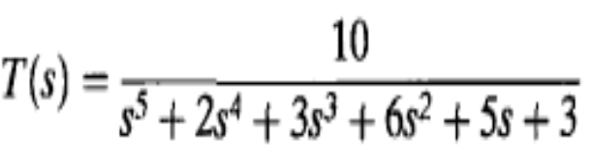
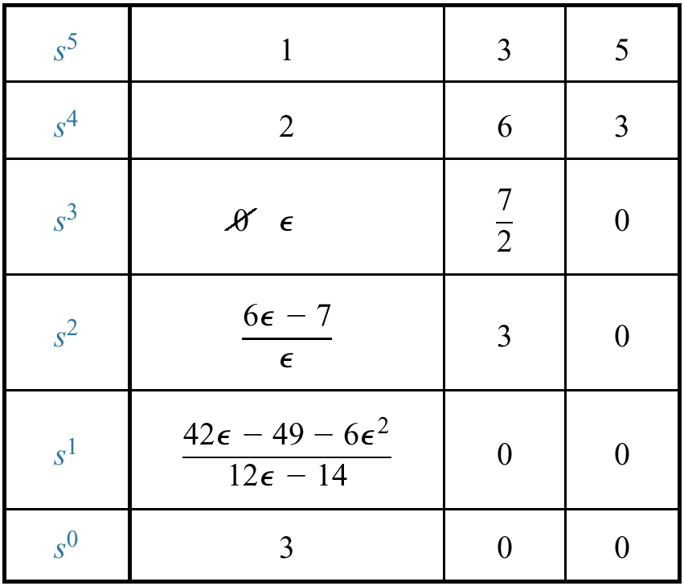
Example 6.2 P.308
PROBLEM: Determine the stability of the closed-loop transfer function
A sign change from the s3 row to the s2 row, and there will be another sign change from the s2 row to the s1 row. Hence, the system is unstable and has two poles in the right half-plane.

Slide 28
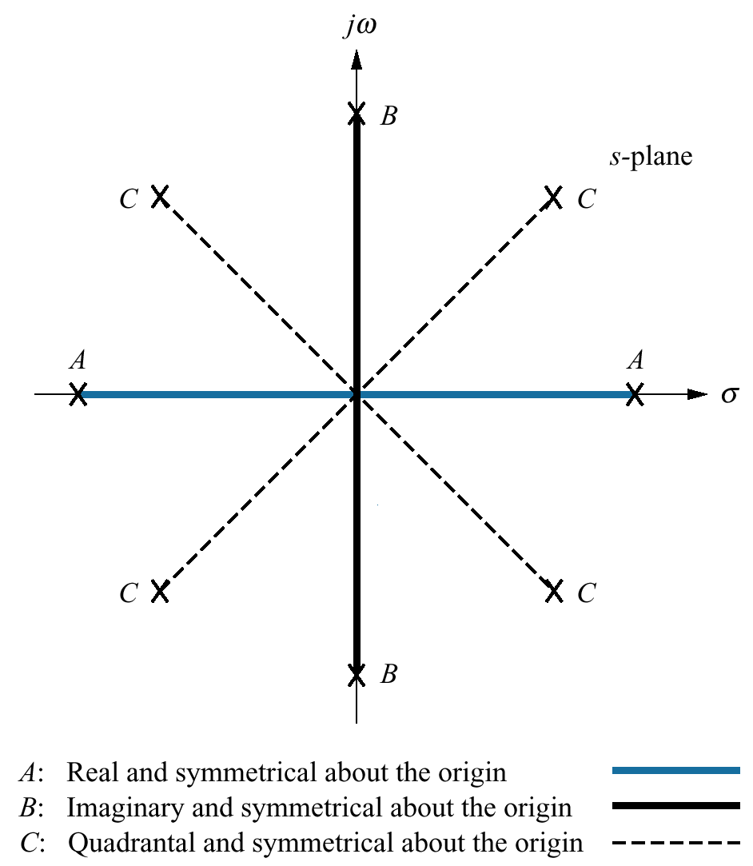
Entire Row is Zero
We now look at the second special case. Sometimes while making a Routh table, we find that an entire row consists of zeros.
Reason for entire row is zero; it indicates one or more of the following exist:
(1) The roots are symmetrical and real,
(2) the roots are symmetrical and
imaginary, or
(3) the roots are quadrantal.

Slide 29
Entire Row is Zero
To continue with Routh's tabulation when a row of zero appears, we conduct the following steps:
1. Form the auxiliary equation P(s) = 0 by using the coefficients from the row just preceding the row of zeros.
2. Take the derivative of the auxiliary equation with respect to s; this gives dP(s)/ds = 0.
3. Replace the row of zeros with the coefficients of dP(s)/ds .
4. Continue with Routh's tabulation in the usual manner with the newly formed row of coefficients replacing the row of zeros.
5. Interpret the change of signs, if any, of the coefficients in the first column of the Routh's tabulation in the usual manner.

Slide 30
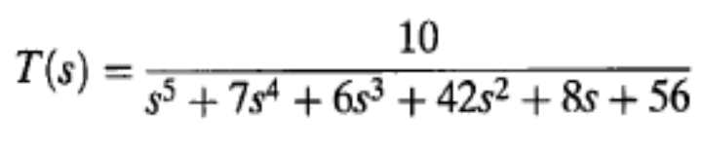
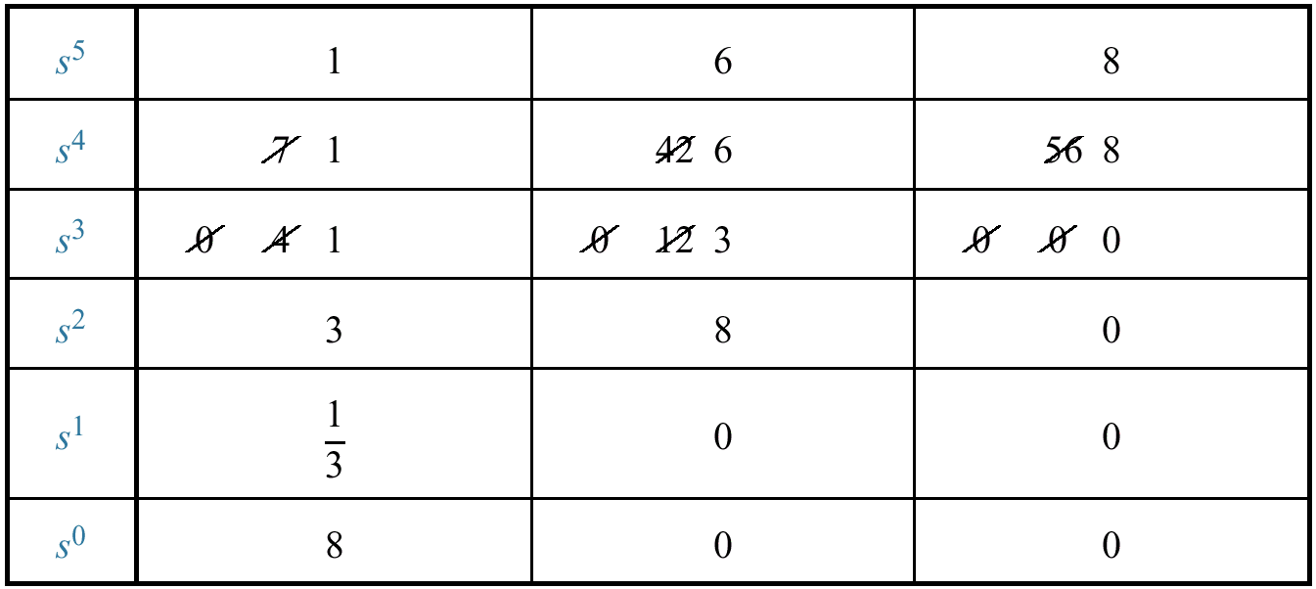
Example 6.4 P. 310
PROBLEM: Determine the number of right-half-plane poles in the closed-loop transfer function
Solution

Slide 31

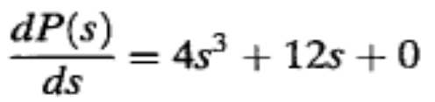
Example 6.4 P. 310

Slide 32
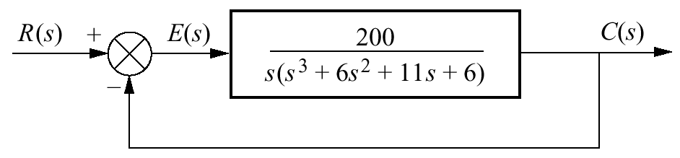
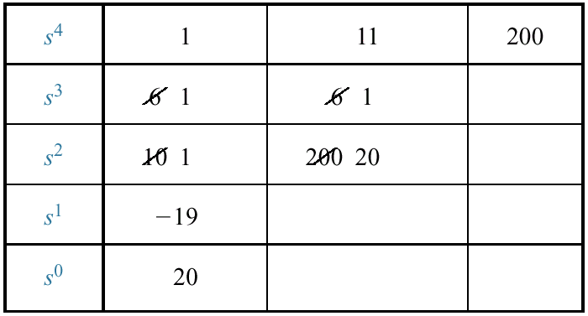
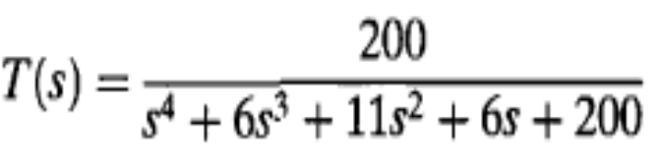
6.4 Routh-Hurwitz Criterion: Additional Examples
Example 6.6 Find the stability of the system shown.
SOLUTION: First, find the closed-loop transfer function as
The system is unstable, since it has two right-half plane poles and two left-half-plane poles.

Slide 33
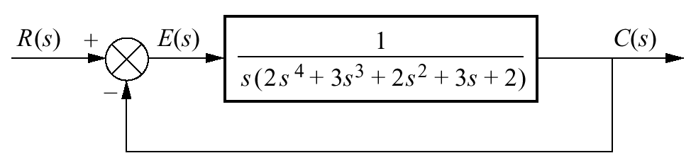
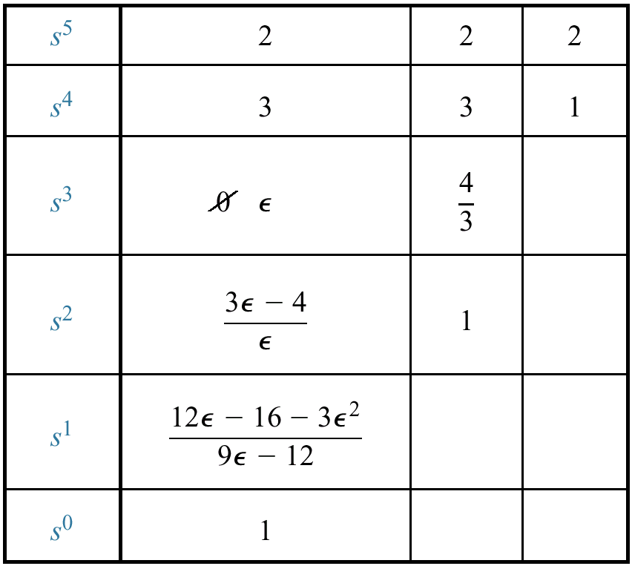
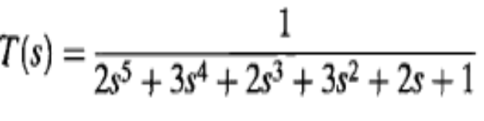
Example 6.7 P.314
Find the stability of the system
SOLUTION: The closed-loop transfer function is
there are two sign changes, and the system is unstable, with two poles in the right half-plane. The remaining poles are in the left half-plane.

Slide 34
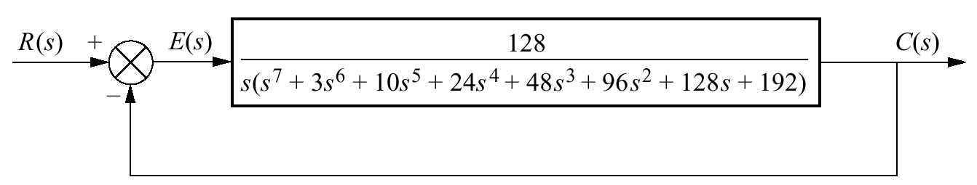
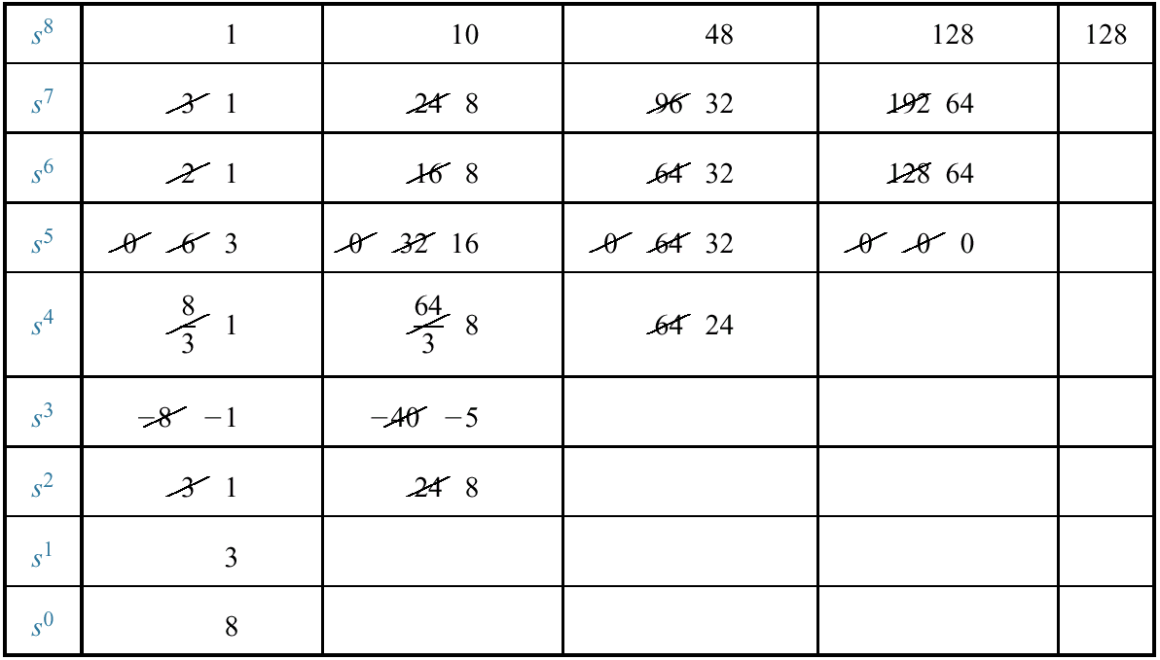
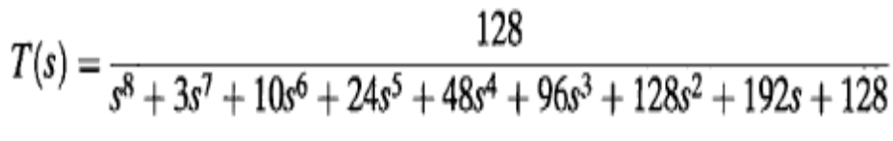

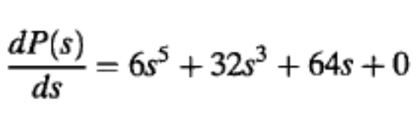
Example 6.8 P.314
Find the stability of the system
SOLUTION: The closed-loop transfer function for the system
The closed-loop system is unstable because of the right-half-plane poles.

Slide 35
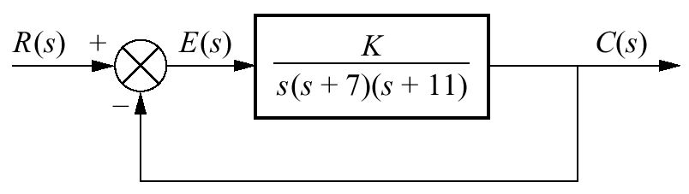
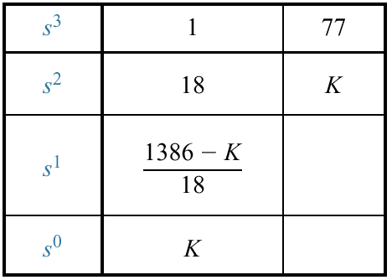
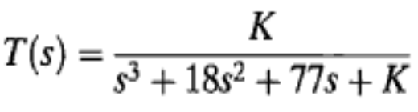
Example 6.9 P. 318
PROBLEM: Find the range of gain, K, for the system shown, that will cause the system to be stable, unstable, and marginally stable. Assume K > 0.
SOLUTION: First find the closed-loop transfer function as
For stable System 0>k>1386
For Unstable System k <1386
For marginal stable k= 1386

Slide 36
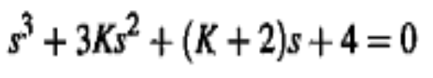
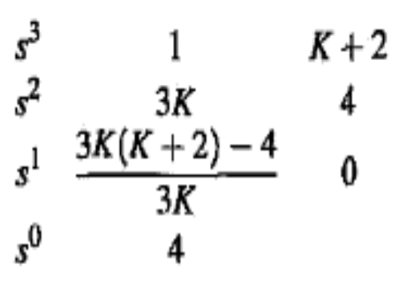
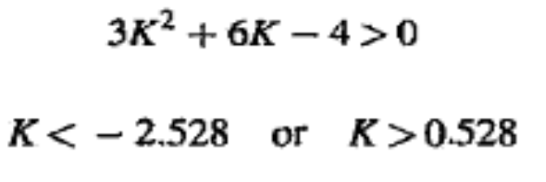
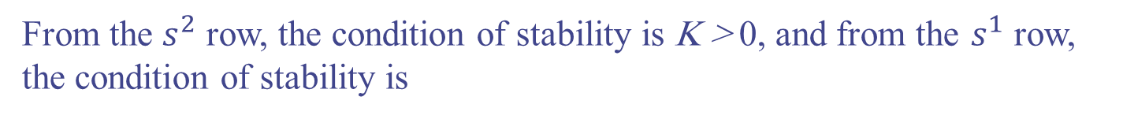
Example
Consider that the characteristic equation of a closed-loop control system is
Solution: It is desired to find the range of K so that the system is stable.
From the $s^{2}$ row, the condition of stability is K > 0, and from the $s^{1}$ row, the condition of stability is

Slide 37
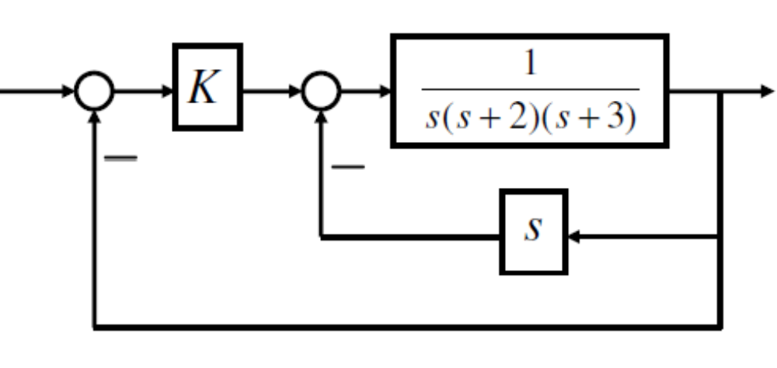
Stability – Control Example
.
Determine the range of K that stabilize the closed-loop system

Slide 38
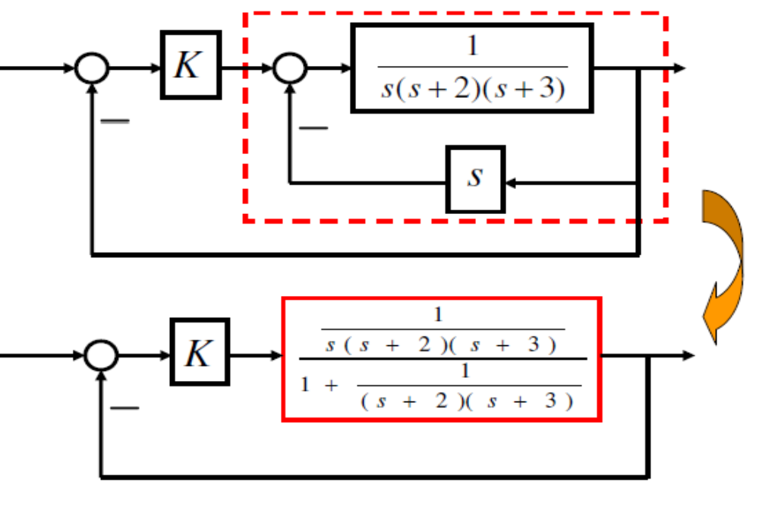
Stability – Control Example

Slide 39
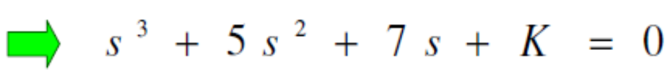
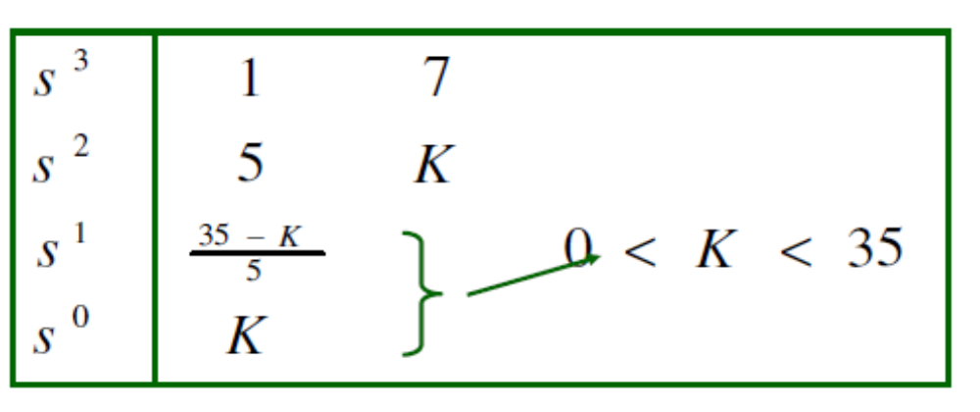
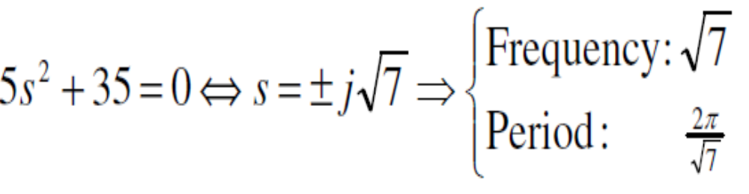
Stability – Control Example
Characteristic equation
If K = 35, oscillation frequency is obtained by the auxiliary equation

Slide 40
6.5 Stability in State Space
Up to this point we have examined stability from the s-plane viewpoint. Now we look at stability from the perspective of state space.
Stability of State Space depends on eigenvalues of matrix A. Because the values of the system's poles are equal to the eigenvalues of the system matrix, A.
eigenvalues of matrix A is found by det(sI - A) = 0

Slide 41
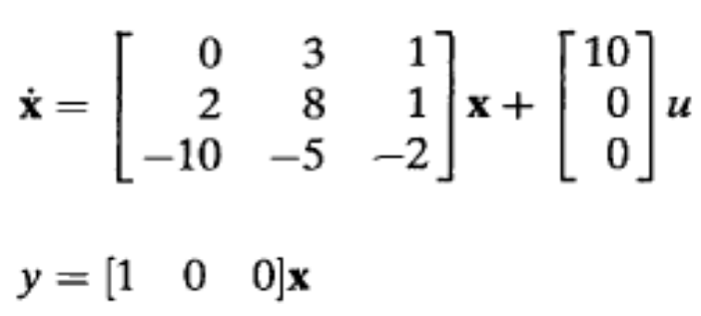
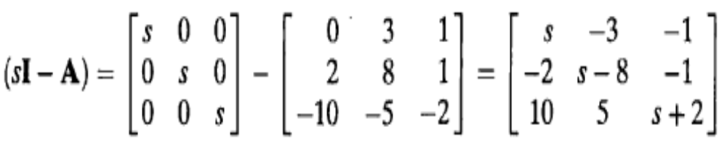
Example 6.11 P. 321
PROBLEM: Given the system
Find out how many poles are in the left half-plane, in the right half-plane, and on the jw-axis.
SOLUTION: First form (sI - A):

Slide 42
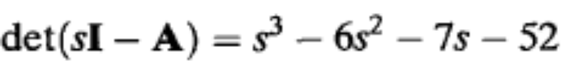

Example 6.11 P. 321
Now find the det(sI — A):
Since there is one sign change in the first column, the system has one right half- plane pole and two left-half-plane poles. It is therefore unstable.

