Slide 1
Control Systems
Lect.5 Reduction of Multiple Subsystems Basil Hamed

Slide 2
Chapter Learning Outcomes
After completing this chapter the student will be able to:
Reduce a block diagram of multiple subsystems to a single block representing the TF (Sections 5.1-5.2)
Analyze and design transient response for a system consisting of multiple subsystems (Section 5.3)
Convert block diagrams to signal-flow diagrams (Section 5.4)
Find the TF of multiple subsystems using Mason's rule (Section 5.5)
Represent state equations as signal-flow graphs (Section 5.6)
Perform transformations between similar systems using transformation matrices;State Space and diagonalize a system matrix (Section 5.8)

Slide 3
5.1 Introduction
We have been working with individual subsystems represented by a block with its input and output. More complicated systems, however, are represented by the interconnection of many subsystems.
Since the response of a single transfer function can be calculated, we want to represent multiple subsystems as a single transfer function.
In this chapter, multiple subsystems are represented in two ways: as block diagrams and as signal-flow graphs.
Signal-flow graphs represent transfer functions as lines, and signals as small circular nodes. Summing is implicit.

Slide 4
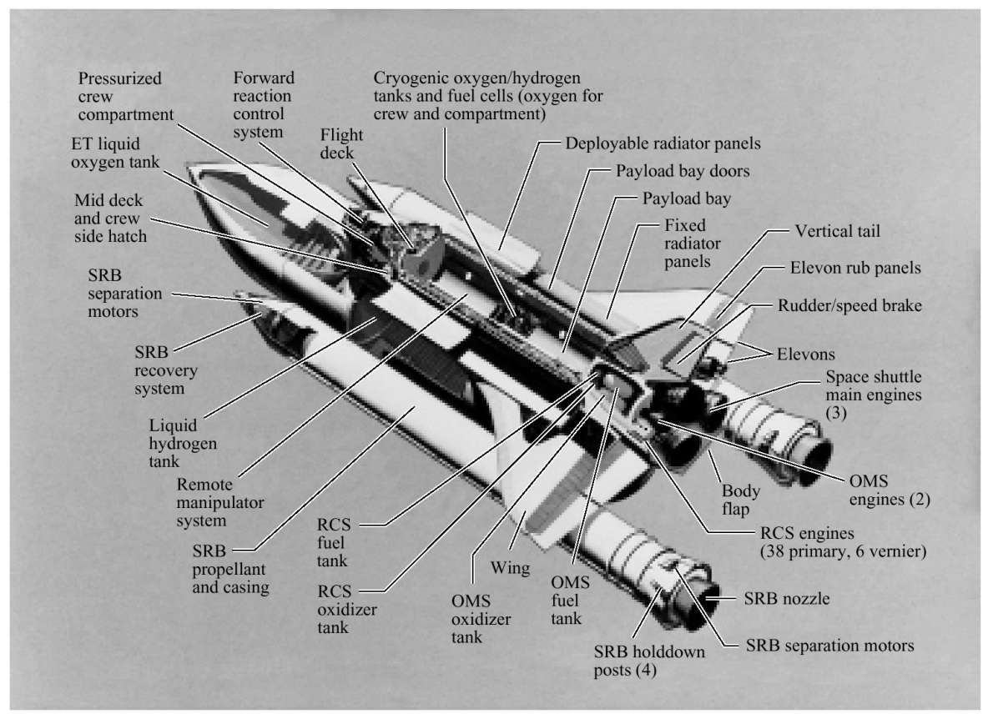
5.2 Block Diagrams
As you already know, a subsystem is represented as a block with an input, an output, and a transfer function. Many systems are composed of multiple subsystems, as in Figure below.

Slide 5
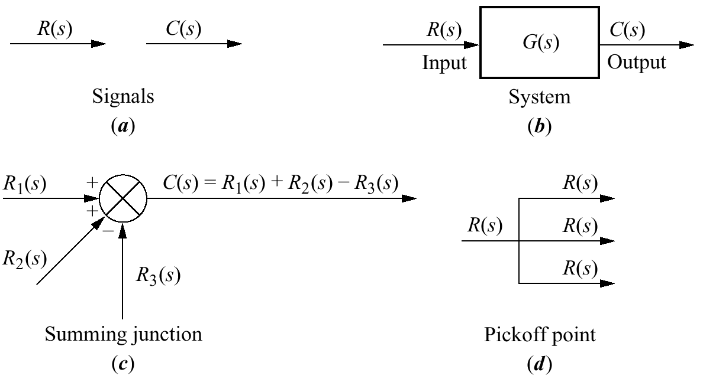
5.2 Block Diagrams
When multiple subsystems are interconnected, a few more schematic elements must be added to the block diagram. These new elements are summing junctions and pickoff points. All component parts of a block diagram for a linear, time-invariant system are shown in Figure below.

Slide 6
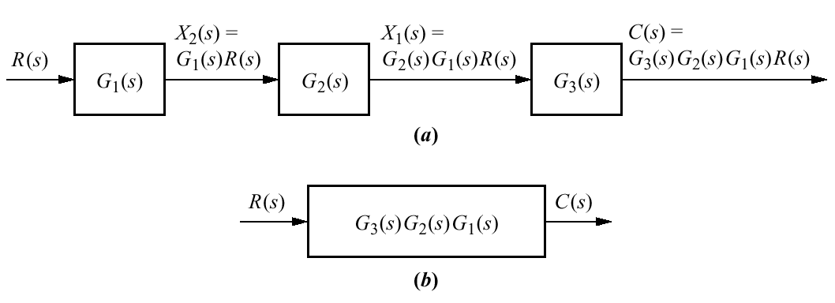
Cascade Form

Slide 7
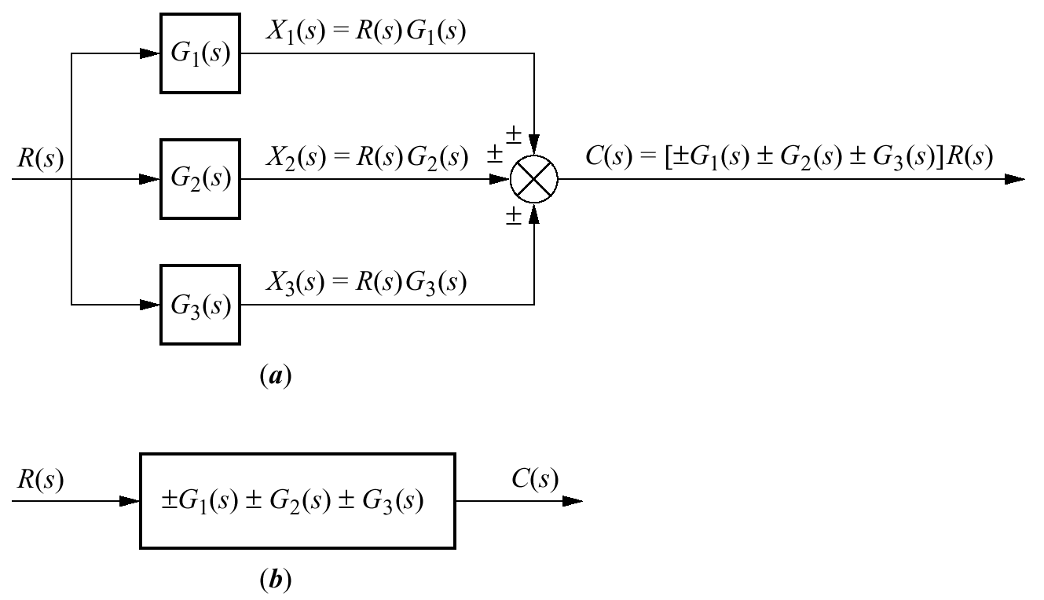
Parallel Form

Slide 8
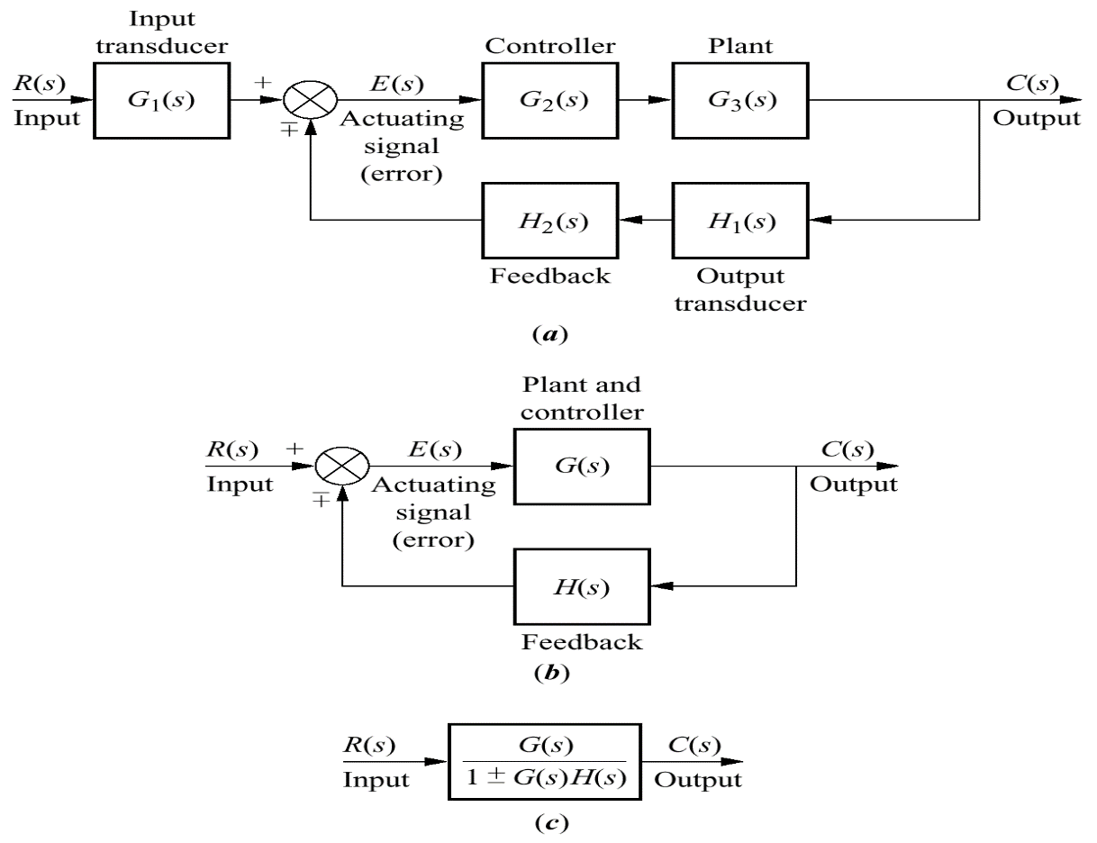
Feedback Form
The typical feedback system, is shown in Figure (a); a simplified model is shown in Figure (b).

Slide 9
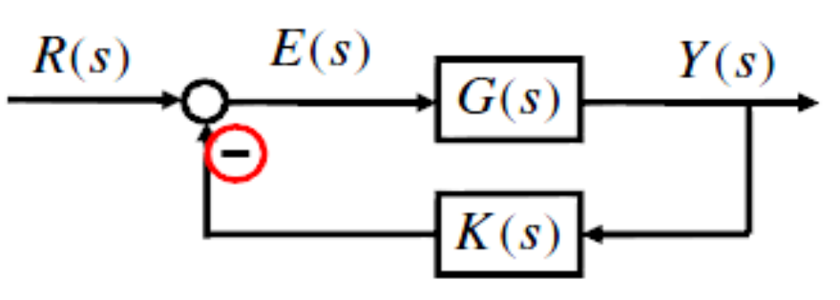
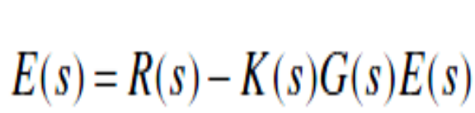
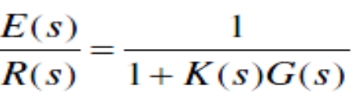

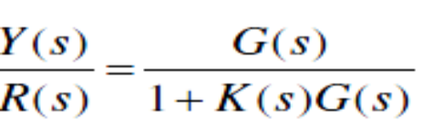

Feedback Form

Slide 10
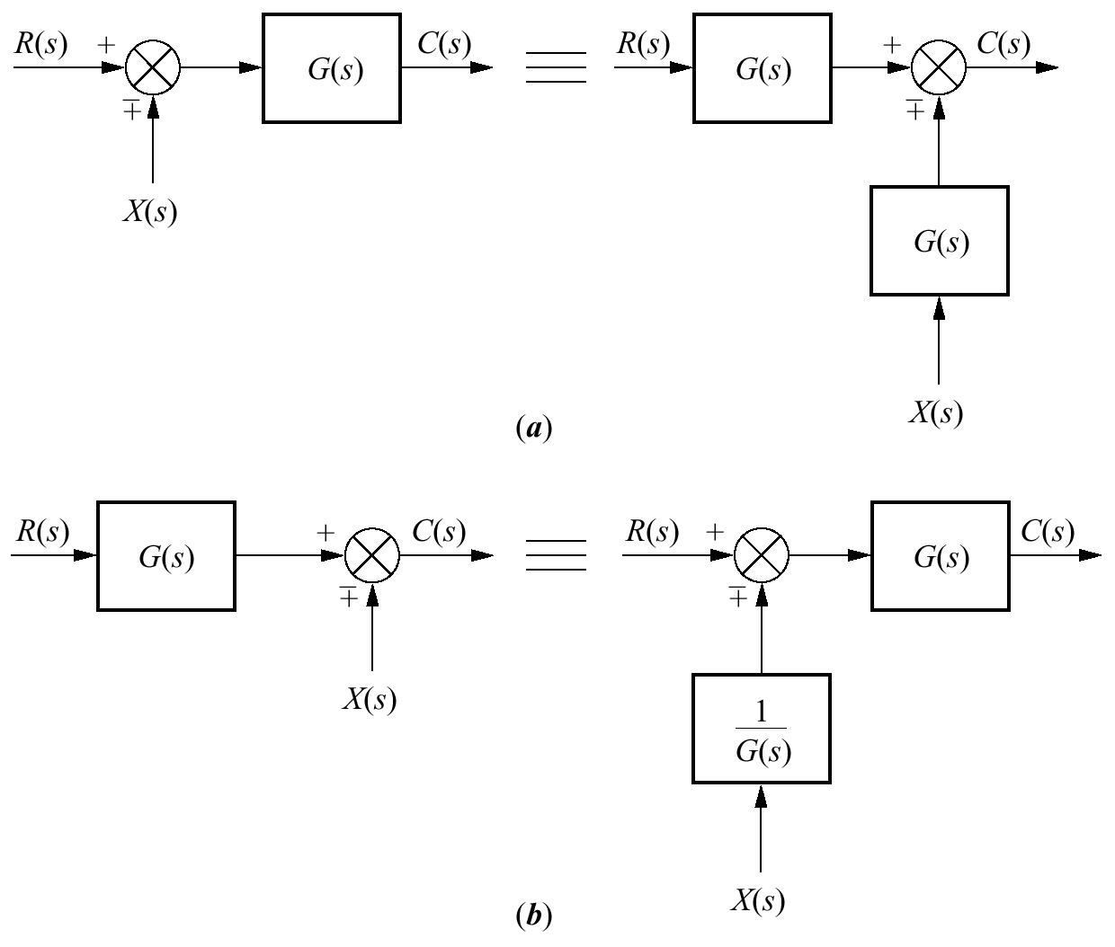
Moving Blocks to Create Familiar Forms
This subsection will discuss basic block moves that can be made in order to establish familiar forms when they almost exist. In particular, it will explain how to move blocks left and right past summing junctions and pickoff points.

Slide 11
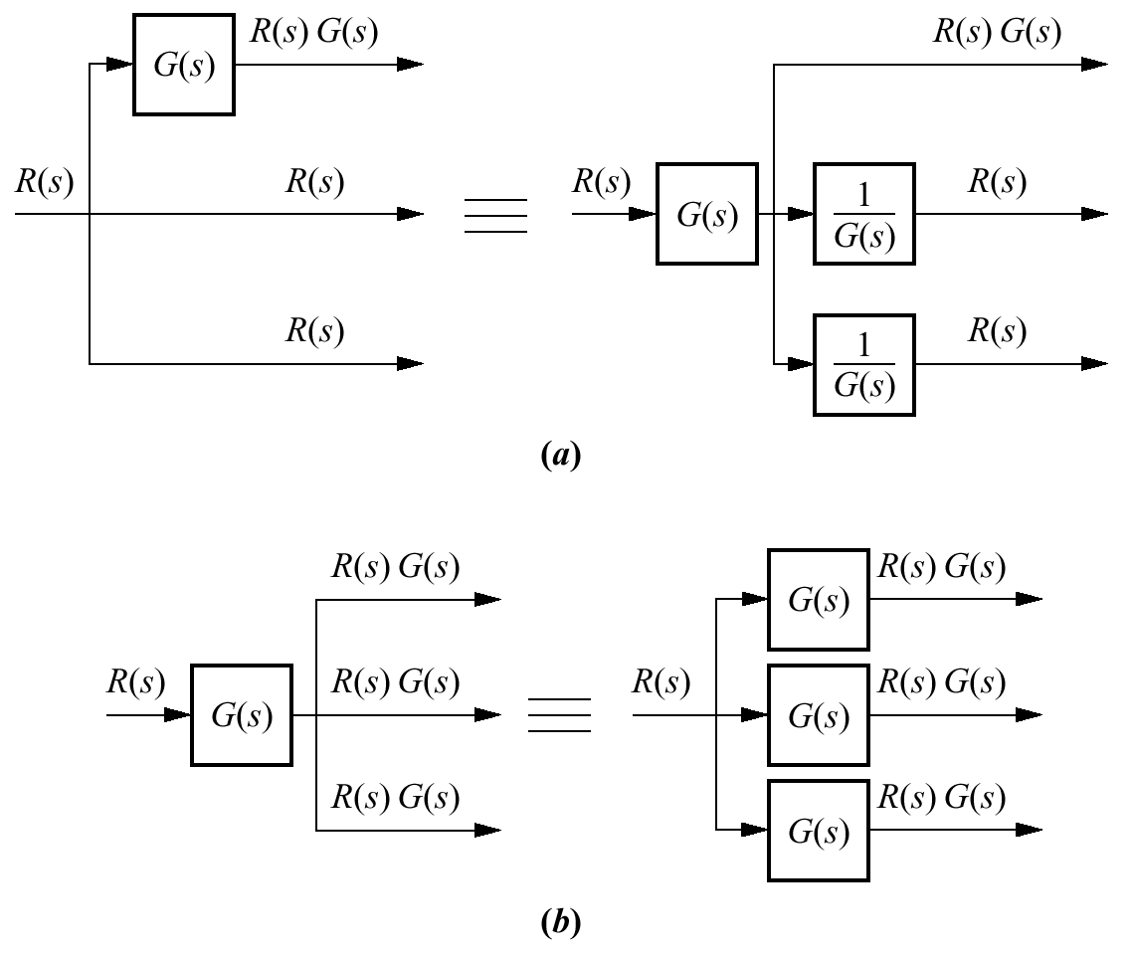
Moving Blocks to Create Familiar Forms

Slide 12
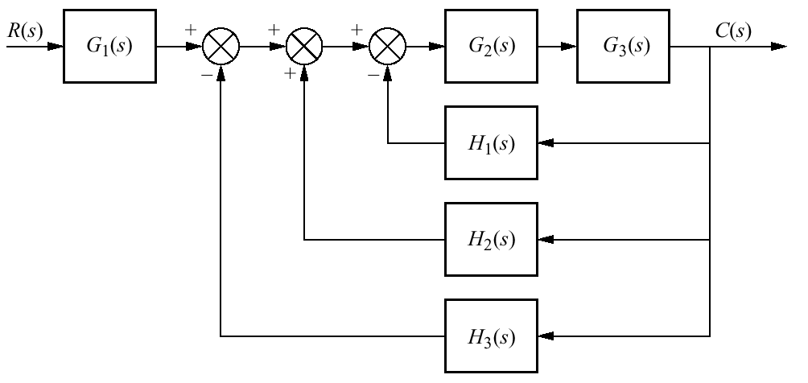
Example 5.1P.242
PROBLEM: Reduce the block diagram shown to a single T.F.

Slide 13

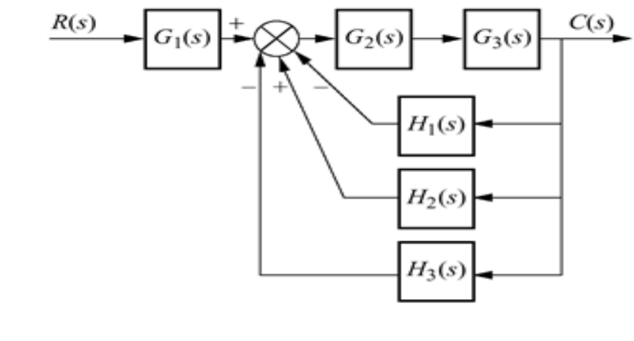
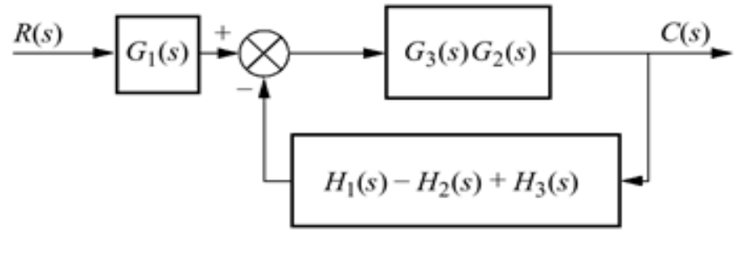
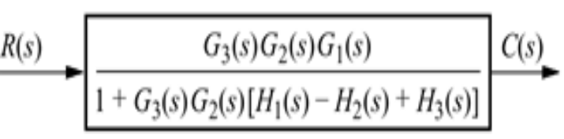
Example 5.1P.242
SOLUTION:

Slide 14
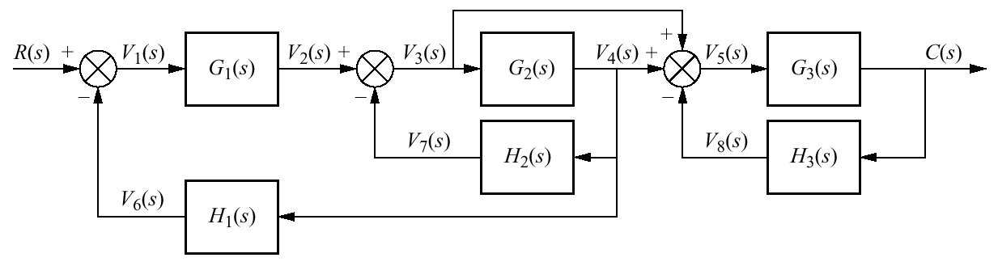
Example 5.2 P.243
PROBLEM: Reduce the system shown to a single T.F.

Slide 15

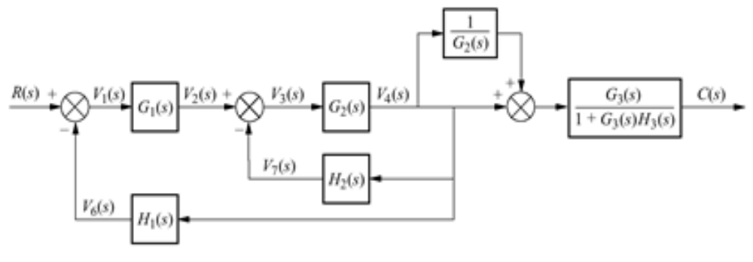
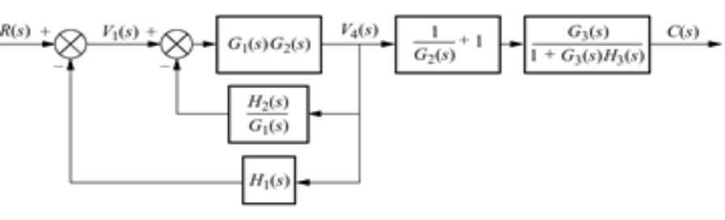
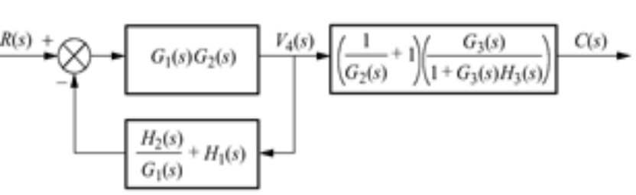
Example 5.2 P.243
SOLUTION:

Slide 16

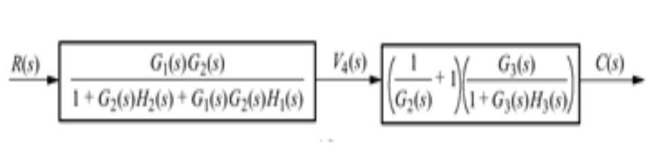
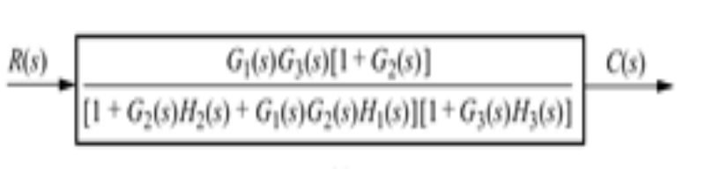
Example 5.2 P.243

Slide 17
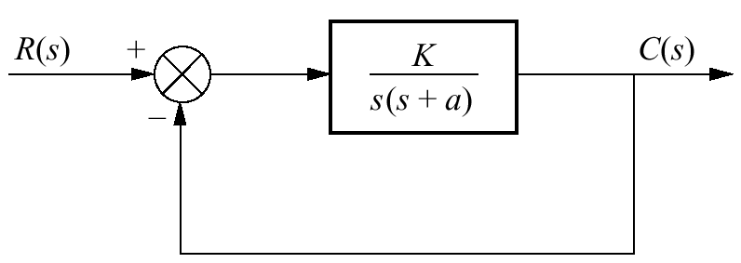
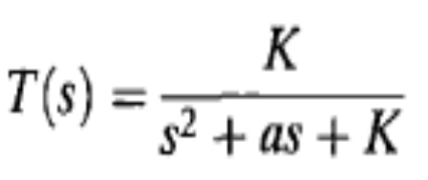
5.3 Analysis and Design of Feedback
Systems
Consider the system shown, which can model a control system such as the antenna azimuth position control system.
where K models the amplifier gain, that is, the ratio of the output voltage to the input voltage.

Slide 18
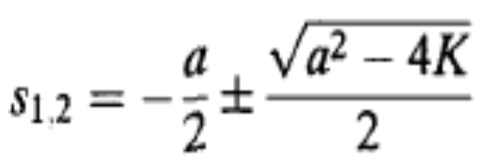
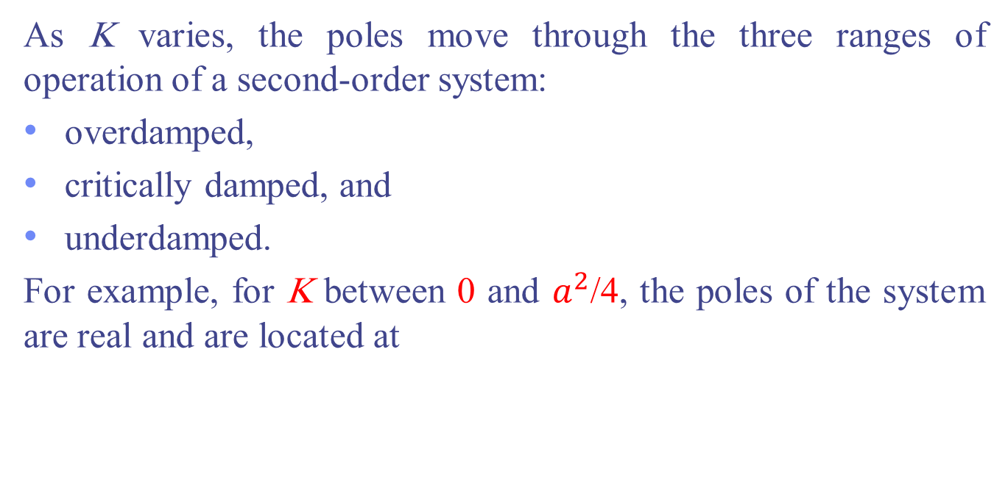
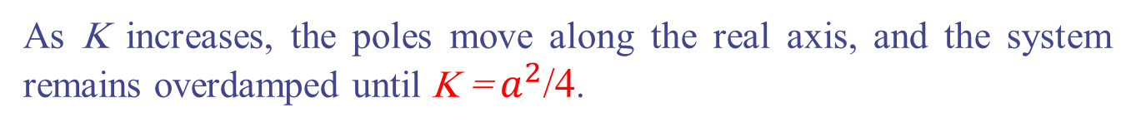
5.3 Analysis and Design of Feedback
Systems
As K varies, the poles move through the three ranges of operation of a second-order system:
overdamped,
critically damped, and
underdamped.
For example, for K between 0 and $a^{2}$/4, the poles of the system are real and are located at
As K increases, the poles move along the real axis, and the system remains overdamped until K = $a^{2}$/4.

Slide 19
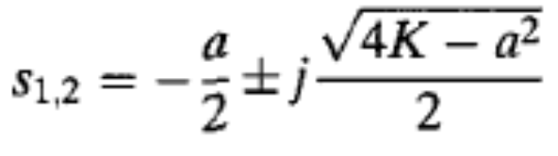
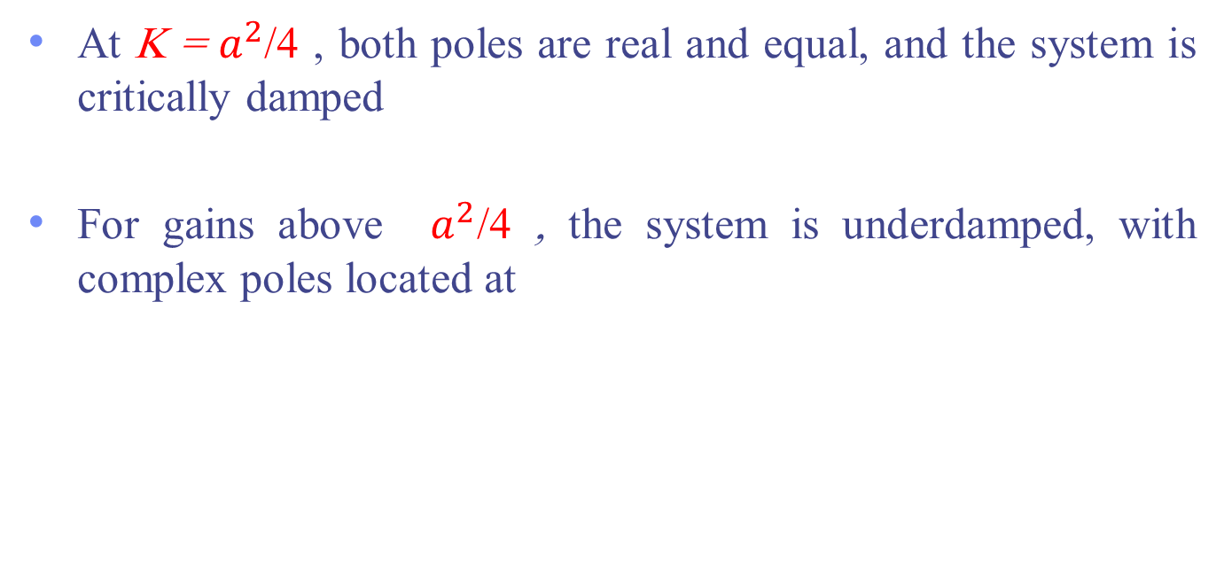
5.3 Analysis and Design of Feedback
Systems
At K = $a^{2}$/4 , both poles are real and equal, and the system is critically damped
For gains above $a^{2}$/4 , the system is underdamped, with complex poles located at

Slide 20
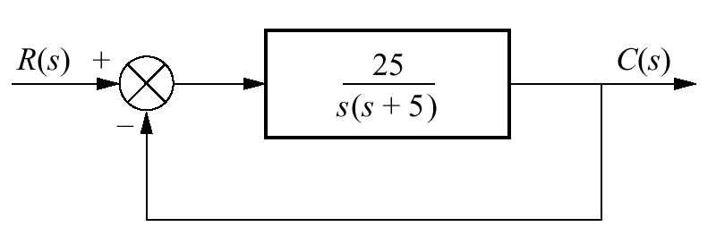
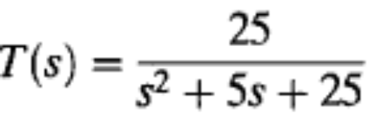
Example 5.3 P. 246
PROBLEM: For the system shown, find the peak time, percent overshoot, and settling time.
Solution: The closed-loop transfer function found

Slide 21
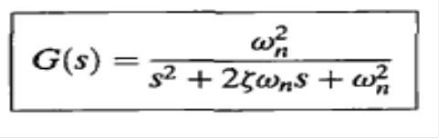
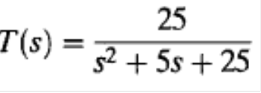
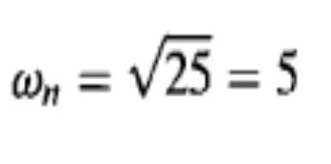
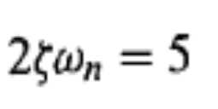
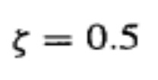
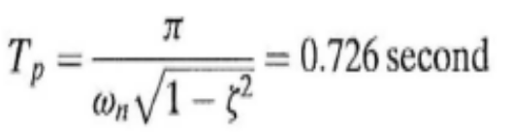
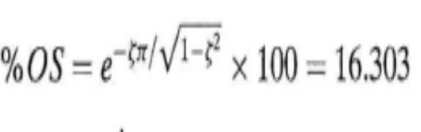
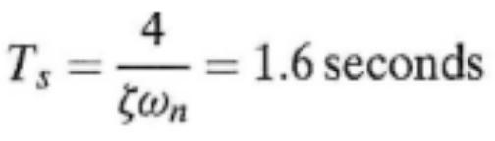
Example 5.3 P. 246

Slide 22
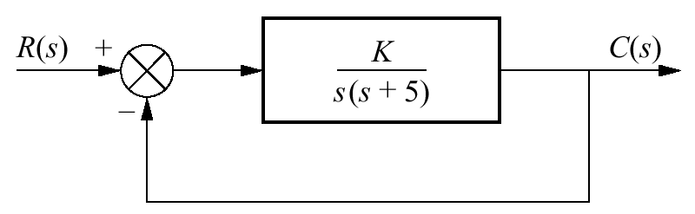

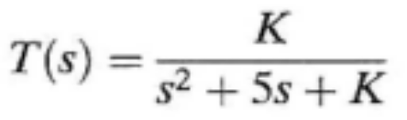
Example 5.4 P 246
PROBLEM: Design the value of gain. K, for the feedback control system of Figure below so that the system will respond with a 10% overshoot.
SOLUTION: The closed-loop transfer function of the system is

Slide 23
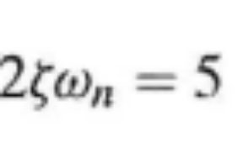
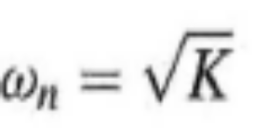
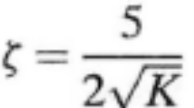
Example 5.4 P 246
A 10% overshoot implies that ξ = 0.591. Substituting this value for the
damping ratio into above Eq. and solving for K yields;
K=17.9

Slide 24
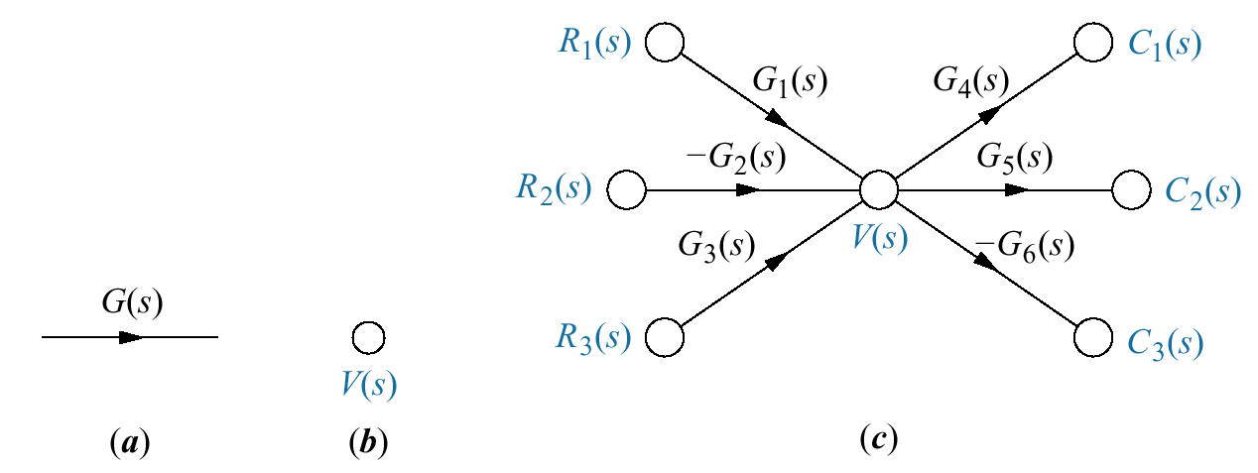
5.4 Signal-Flow Graphs
Signal-flow graphs are an alternative to block diagrams.
Unlike block diagrams, which consist of blocks, signals, summing junctions, and pickoff points, a signal-flow graph consists only of
branches, which represent systems, and
nodes, which represent signals.

Slide 25
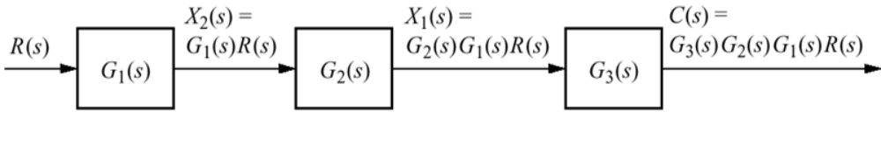
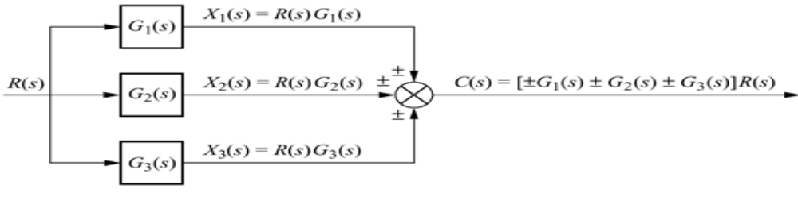
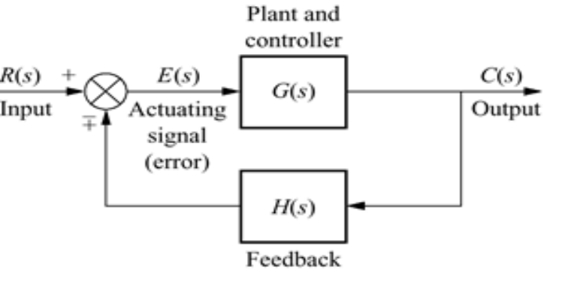
Example 5.5 P. 249
PROBLEM: Convert the cascaded, parallel, and feedback forms of the block diagrams shown in Figures below, respectively, into signal-flow graphs.

Slide 26
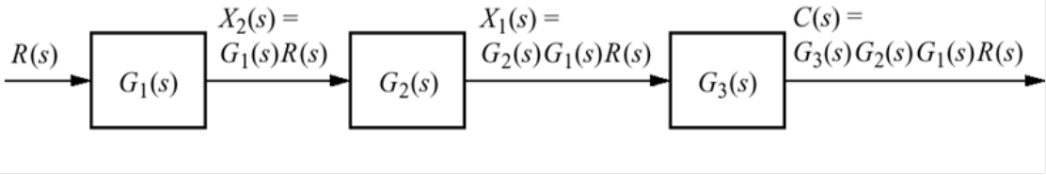
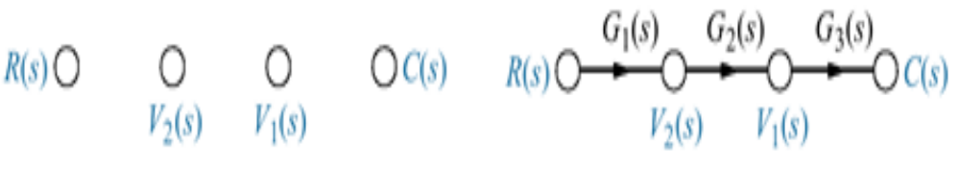
Example 5.5 P. 249
SOLUTION: In each case, we start by drawing the signal nodes for that system. Next we interconnect the signal nodes with system branches.

Slide 27
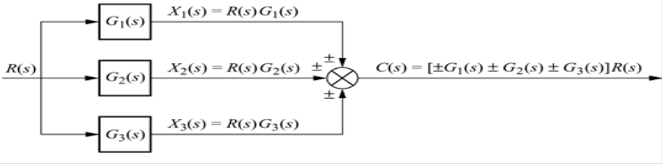

Example 5.5 P. 249

Slide 28


Example 5.5 P. 249

Slide 29
Example 5.6 P 250
PROBLEM: Convert the block diagram shown to a signal-flow graph.

Slide 30


Example 5.6 P 250

Slide 31
5.5 Mason's Rule
In this section will discuss a technique for reducing signal-flow graphs to single transfer functions that relate the output of a system to its input.
The block diagram reduction technique we studied in Section 5.2 requires successive application of fundamental relationships in order to arrive at the system transfer function.
On the other hand, Mason's rule for reducing a signal-flow graph to a single transfer function requires the application of one formula.

Slide 32
5.5 Mason's Rule
Mason's formula has several components that must be evaluated. First, we must be sure that the definitions of the components are well understood.
Definitions
Input Node(Source): is a node that has only outgoing branches
Output Node (Sink): is a node that has only incoming branches.
Path: is continuous connection of branches from one node to another with arrowhead in the same direction.
Forward Path: is a path connects a source node to a sink node.
Loop: is closed path(originate and terminates on the same node).
Path gain: is the product of T.F of all branches that form path.
Loop Gain: is the product of T.F of all branches that form loop.

Slide 33


5.5 Mason's Rule
The transfer function, C(s)/R(s), of a system represented by a signal-flow graph is
$$G\left(s\right)=\frac{C(s)}{R(s)}=\frac{1}{∆}\sum_{k=1}^{P}{M_{k}∆_{k}}$$
P= number of forward paths
$M_{k}$ = the kth forward-path gain
$∆$ = 1 - $\sum{loop}$ gains + $\sum{nontouching}$-loop gains taken two at a time -
$\sum{nontouching}$-loop gains taken three at a time + ...
$∆_{k}=∆−\sum{loop}$ gain terms in $∆$ that touch the kth forward path. In other words, $∆_{k}$ is formed by eliminating from $∆$ those loop gains that touch the kth forward path.

Slide 34

Example 5.7 P 252
PROBLEM: Find the transfer function, C(s)/R(s) for the signal-flow graph shown below

Slide 35





Example 5.7 P 252
Solution: P=1; $M_{1}$=$G_{1}G_{2}G_{3}G_{4}G_{5}$ , Loops=4
Nontouching loops taken two at time
Nontouching loops taken three at time

Slide 36




Example 5.7 P 252

Slide 37

Example
Find T.F C(s)/R(s)

Slide 38

Example
Find T.F y7 /y1

Slide 39


5.6 Signal-Flow Graphs of State Equations
In this section, we draw signal-flow graphs from state equations.
Consider the following state and output equations:
First, identify three nodes to be the three state variables, X1, X2, and X3; also identify three nodes, placed to the left of each respective state variable, to be the derivatives of the state variables,

Slide 40




5.6 Signal-Flow Graphs of State Equations

Slide 41
5.7 Alternative Representations in State Space
In Chapter 3, systems were represented in state space in:
Direct Form
Cascade Form
Parallel Form
system modeling in state space can take on many representations. Although each of these models yields the same output for a given input, an engineer may prefer a particular one for several reasons.

Slide 42




Example
Find state space model using parallel form for shown system
Solution
$\left[\begin{matrix}\dot{X_{1}} \\ \dot{X_{2}} \\ \dot{X_{3}}\end{matrix}\right]=\left[\begin{matrix}−1 & 1 & 0 \\ 0 & −1 & 0 \\ 0 & 0 & −2\end{matrix}\right]\left[\begin{matrix}X_{1} \\ X_{2} \\ X_{3}\end{matrix}\right]+\left[\begin{matrix}0 \\ 1 \\ 1\end{matrix}\right]r(t)$
$C=\left[\begin{matrix}2 & −1 & 1\end{matrix}\right]\left[\begin{matrix}X_{1} \\ X_{2} \\ X_{3}\end{matrix}\right]+0r(t)$

Slide 43

5.8 Similarity Transformations
we saw that systems can be represented with different state variables even though the transfer function relating the output to the input remains the same. These systems are called similar systems.
We can make transformations between similar systems from one set of state equations to another without using the transfer function and signal-flow graphs.
A system represented in state space as

Slide 44



5.8 Similarity Transformations
can be transformed to a similar system,
where, for 2 space,
and

Slide 45


Example 5.9 P. 267
PROBLEM: Given the system represented in state space by Eqs.
transform the system to a new set of state variables, z, where the new state variables are related to the original state variables, x, as follows:

Slide 46






Example 5.9 P. 267
SOLUTION:
Therefore, the transformed system is

Slide 47

Diagonalizing a System Matrix
In Section 5.7, we saw that the parallel form of a signal-flow graph can yield a diagonal system matrix. A diagonal system matrix has the advantage that each state equation is a function of only one state variable. Hence, each differential equation can be solved independently of the other equations. We say that the equations are decoupled.
Rather than using partial fraction expansion and signal-flow graphs, we can decouple a system using matrix transformations. If we find the correct matrix, P, the transformed system matrix, $P^{−1 }$AP, will be a diagonal matrix.
Where P is eigenvector

Slide 48




Diagonalizing a System Matrix
Eigenvector: The eigenvectors of the matrix A are all vectors, $x_{i}≠0$, which under the transformation A become multiples of themselves; that is,
The eigenvalues of the matrix A are the values of A, that satisfy above Eq. for $x_{i}≠0$.
To find the eigenvectors, we rearrange above Eq. Eigenvectors, $x_{i}$, satisfy

Slide 49




Example 5.10 P. 269
PROBLEM: Find the eigenvectors of the matrix
SOLUTION: The eigenvectors, $x_{i}$, satisfy .
First, use ${det(λ}_{i}I−A)$to find the eigenvalues, $λ_{i}$:
from which the eigenvalues are $λ$ = -2, and -4.

Slide 50









Example 5.10 P. 269
Using Eq
$λ_{1}$=-2
$$\left(λ_{i}I−A\right)x_{i}=\left[\begin{matrix}1 & −1 \\ −1 & 1\end{matrix}\right]\left[\begin{matrix}x_{11} \\ x_{21}\end{matrix}\right]=\left[\begin{matrix}0 \\ 0\end{matrix}\right]$$
$x_{11}−x_{21}=0 ,$ ${−x}_{11}+x_{21}=0$
$$x_{11}=x_{21}$$
$$x_{1}=\left[\begin{matrix}1 \\ 1\end{matrix}\right]$$
$λ_{2}$=-4
$$\left(λ_{i}I−A\right)x_{i}=\left[\begin{matrix}−1 & −1 \\ −1 & −1\end{matrix}\right]\left[\begin{matrix}x_{12} \\ x_{22}\end{matrix}\right]=\left[\begin{matrix}0 \\ 0\end{matrix}\right]$$
${−x}_{12}−x_{22}=0 ,$ $x_{12}={−x}_{22}$
$$x_{2}=\left[\begin{matrix}1 \\ −1\end{matrix}\right]$$
x$=\left[\begin{matrix}x_{1} & x_{2}\end{matrix}\right]=\left[\begin{matrix}1 & 1 \\ 1 & −1\end{matrix}\right]$

Slide 51



Example 5.11 P 270
PROBLEM: Given the system shown, find the diagonal system that is similar.
SOLUTION: First find the eigenvalues and the eigenvectors. This step was performed in Example 5.10. Next form the transformation matrix P, whose columns consist of the eigenvectors.
P= x$=\left[\begin{matrix}x_{1} & x_{2}\end{matrix}\right]=\left[\begin{matrix}1 & 1 \\ 1 & −1\end{matrix}\right]$

Slide 52



Example 5.11 P 270
diagonal system is

Slide 53





Example
$A=\left[\begin{matrix}0 & 1 & 0 \\ 0 & 0 & 1 \\ −6 & −11 & −6\end{matrix}\right]$ Find the diagonal matrix
Solution eigenvalues are $λ_{1}$=-1, $λ_{2}$=-2, $λ_{3}$=-3
$$λ_{1}=−1, \left[\begin{matrix}−1 & −1 & 0 \\ 0 & −1 & −1 \\ 6 & 11 & 5\end{matrix}\right]\left[\begin{matrix}P_{11} \\ P_{21} \\ P_{31}\end{matrix}\right]=\left[\begin{matrix}0 \\ 0 \\ 0\end{matrix}\right]$$
$$P_{1}=\left[\begin{matrix}1 \\ −1 \\ 1\end{matrix}\right]$$
Same way we find: $P_{2}=\left[\begin{matrix}1 \\ −2 \\ 4\end{matrix}\right]$, $P_{3}=\left[\begin{matrix}1 \\ −3 \\ 9\end{matrix}\right]$ , $P=\left[\begin{matrix}1 & 1 & 1 \\ −1 & −2 & −3 \\ 1 & 4 & 9\end{matrix}\right]$
$$P^{−1}AP=\left[\begin{matrix}−1 & 0 & 0 \\ 0 & −2 & 0 \\ 0 & 0 & −3\end{matrix}\right]$$

