Slide 1
Control Systems
Lect.4 Time Response
Basil Hamed

Slide 2
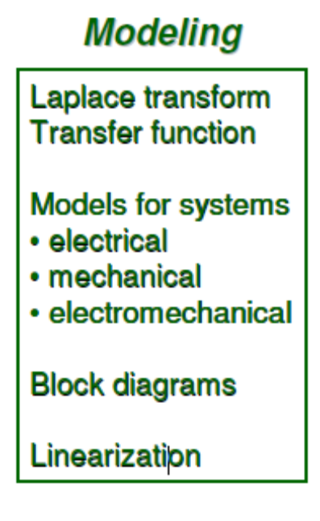
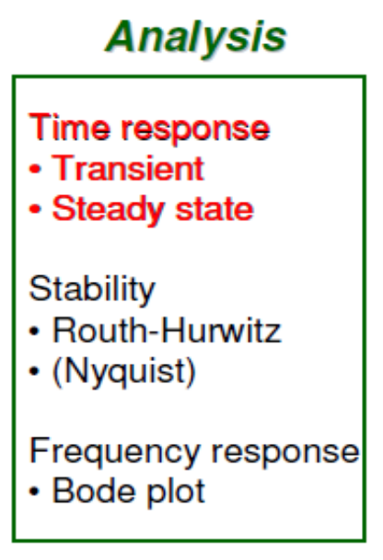
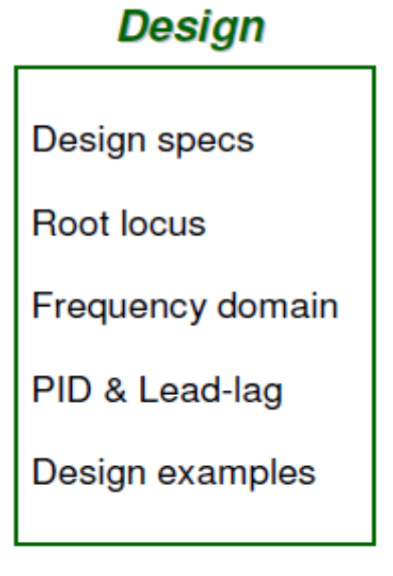
Roadmap (Time Responses)

Slide 3
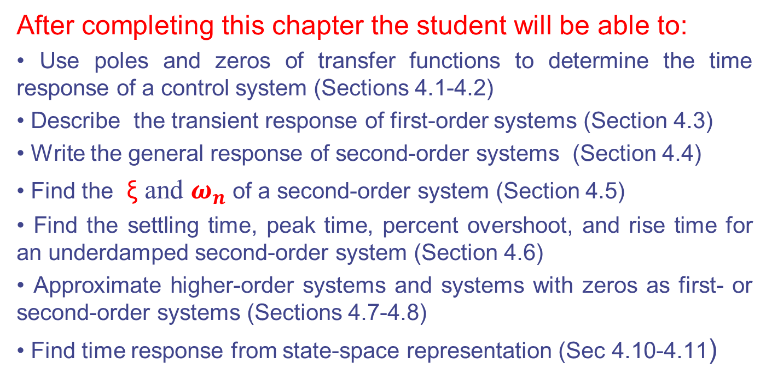
Chapter Learning Outcomes
After completing this chapter the student will be able to:
• Use poles and zeros of transfer functions to determine the time response of a control system (Sections 4.1-4.2)
• Describe the transient response of first-order systems (Section 4.3)
• Write the general response of second-order systems (Section 4.4)
• Find the ξ and $ω_{n}$of a second-order system (Section 4.5)
• Find the settling time, peak time, percent overshoot, and rise time for an underdamped second-order system (Section 4.6)
• Approximate higher-order systems and systems with zeros as first- or second-order systems (Sections 4.7-4.8)
• Find time response from state-space representation (Sec 4.10-4.11)

Slide 4
Why Study Time Responses
• Modeling
– Some parameters in the system can be estimated or identified by time responses.
• Analysis
– Evaluate transient and steady-state responses to see if they meets performance requirement (Satisfactory or not?)
• Design
– Given design specs in terms of transient and steady state
responses, design controllers satisfying all the design specs.

Slide 5
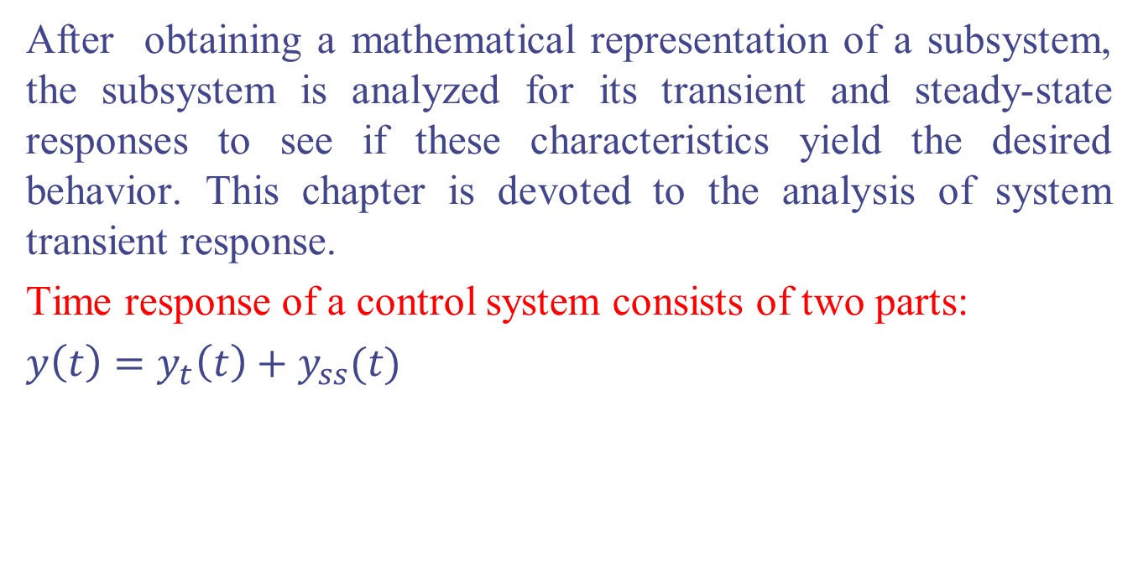
4.1 Introduction
After obtaining a mathematical representation of a subsystem, the subsystem is analyzed for its transient and steady-state responses to see if these characteristics yield the desired behavior. This chapter is devoted to the analysis of system transient response.
Time response of a control system consists of two parts:
$y\left(t\right)=y_{t}\left(t\right)+y_{ss}(t)$
Transient steady state
Transient response is the part of time response that goes to zero t $∞$
Steady state response is the part of the total response that remains after the
transient has died out.

Slide 6
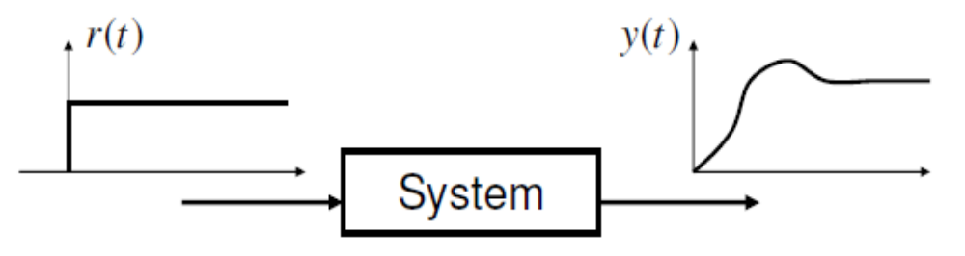
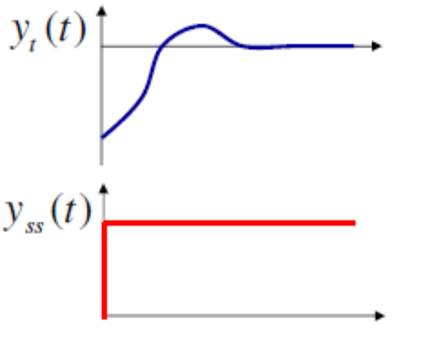
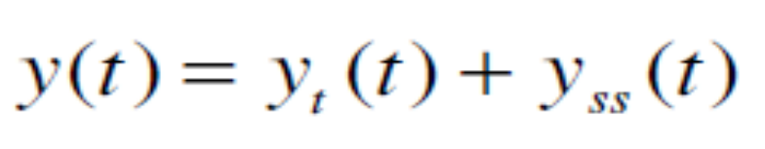
Time Responses – Input and Output
We would like to analyze a system property by applying a test input r(t) and observing a time response y(t).
Time response can be divided as
Transient
response
Steady-state
response

Slide 7
4.2 Poles, Zeros, and System Response
The output response of a system is the sum of two responses: the forced response and the natural response.
Although many techniques, such as solving a differential equation or taking the inverse Laplace transform, enable us to evaluate this output response, these techniques are laborious and time-consuming.
The use of poles and zeros and their relationship to the time response of a system is such a technique.
The concept of poles and zeros, fundamental to the analysis and design of control systems, simplifies the evaluation of a system's response.

Slide 8
4.2 Poles, Zeros, and System Response
Poles of a Transfer Function
the poles of a transfer function are the roots of the characteristic polynomial in the denominator.
Zeros of a Transfer Function
the zeros of a transfer function are the roots of the characteristic polynomial in the nominator.

Slide 9
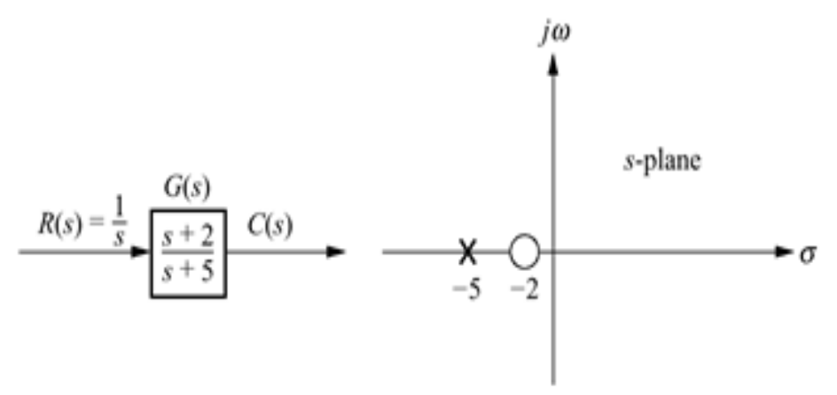
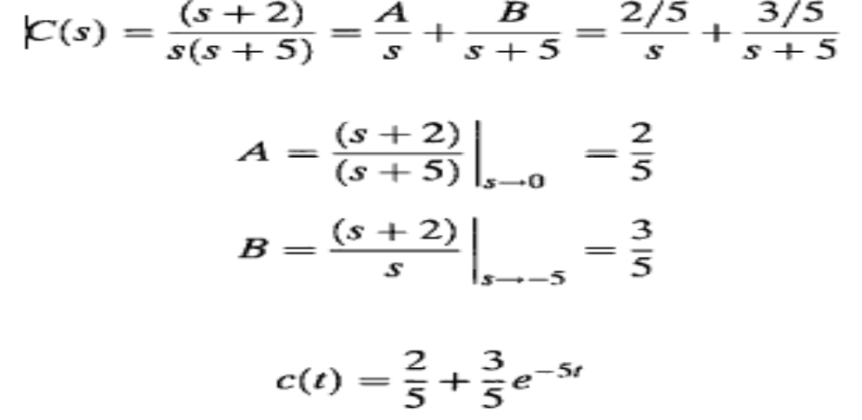
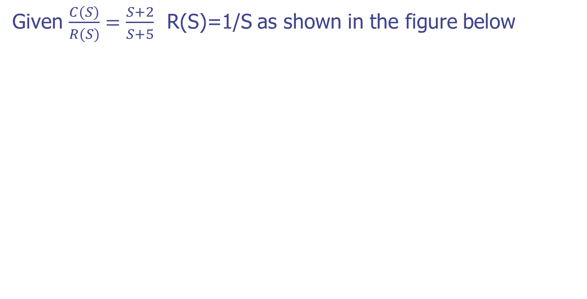
Poles and Zeros of a First-Order System: An Example
Given $\frac{C(S)}{R(S)}=\frac{S+2}{S+5}$ R(S)=1/S as shown in the figure below

Slide 10
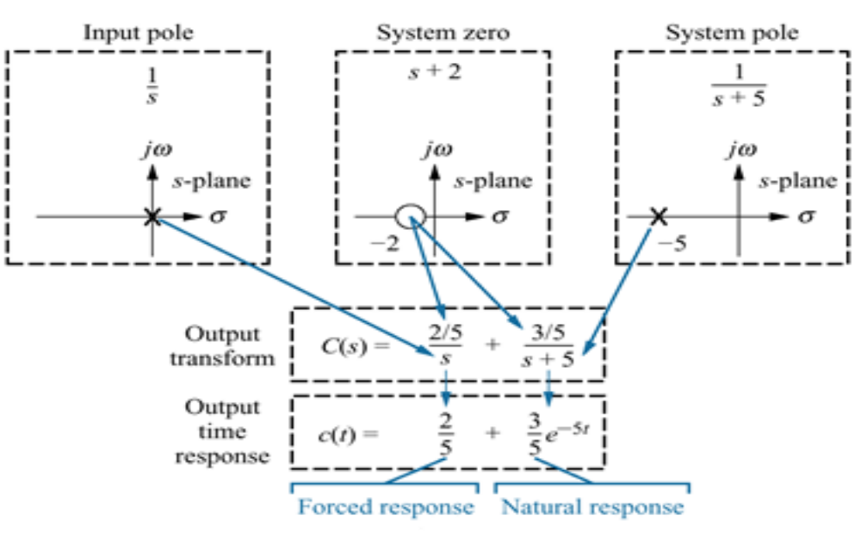
Poles and Zeros of a First-Order System: An Example

Slide 11
Poles and Zeros of a First-Order System: An Example
From the development summarized in pervious Figure, we draw the following conclusions:
A pole of the input function generates the form of the forced response
A pole of the transfer function generates the form of the natural response.
The farther to the left a pole is on the negative real axis, the faster the exponential transient response will decay to zero.
The zeros and poles generate the amplitudes for both the forced and natural responses.

Slide 12
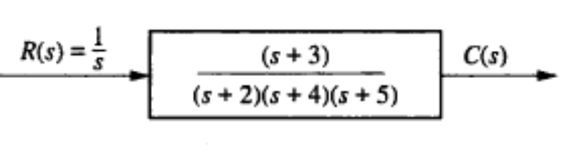
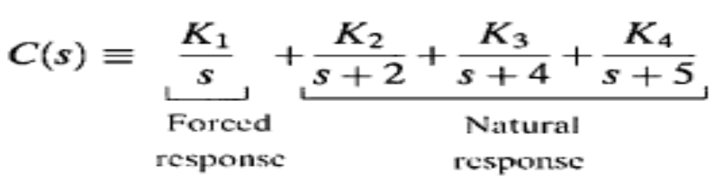


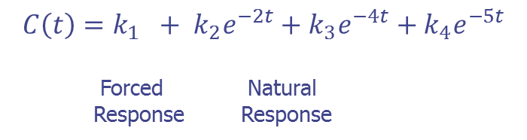
Example 4.1 P 165
PROBLEM: Given the system of Figure below, write the output, c(t), in general terms. Specify the forced and natural parts of the solution.
SOLUTION: By inspection, each system pole generates an exponential as part of the natural response. The input's pole generates the forced response. Thus,
Taking the inverse Laplace transform, we get
$$C\left(t\right)=k_{1} + k_{2}e^{−2t}+k_{3}e^{−4t}+k_{4}e^{−5t}$$
Forced Natural
Response Response

Slide 13
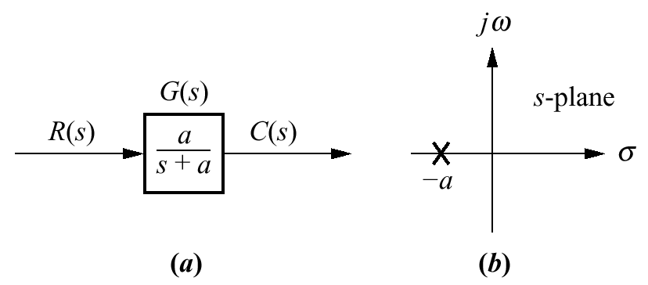
4.3 First-Order Systems
We now discuss first-order systems without zeros to define a performance specification for such a system. A first-order system without zeros can be described by the transfer function shown in Figure below.

Slide 14
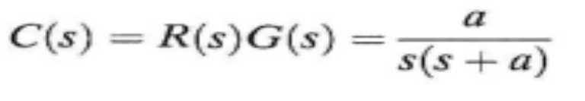
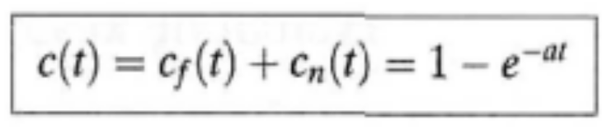
4.3 First-Order Systems
If the input is a unit step, where R(s) = 1/s, the Laplace transform of the step response is C(s), where
Taking the inverse transform, the step response is given by
t | C(t)
0 | 0
1/a | 0.63
2/a | 0.86
3/a | 0.95
4/a | 0.98

Slide 15
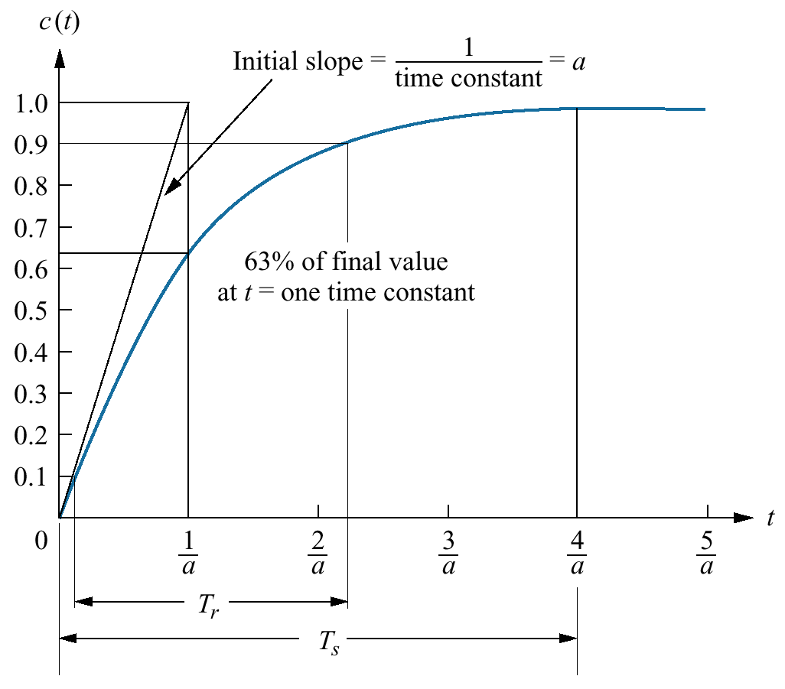
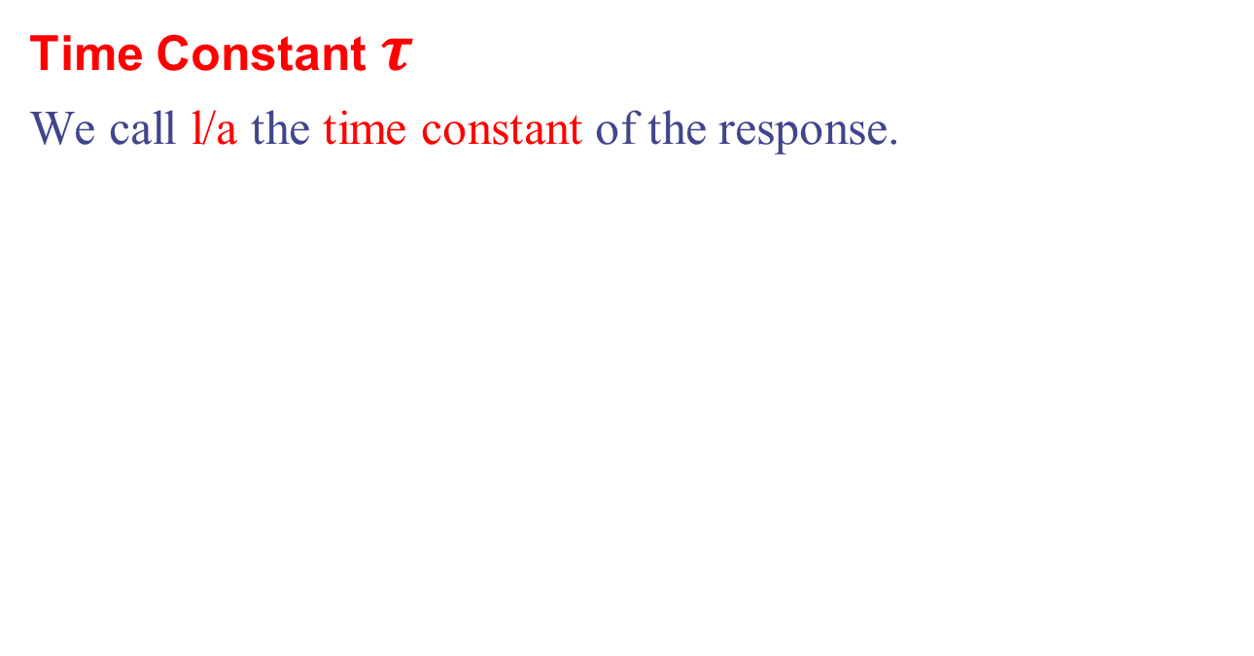
4.3 First-Order Systems
Time Constant $τ$
We call l/a the time constant of the response.

Slide 16
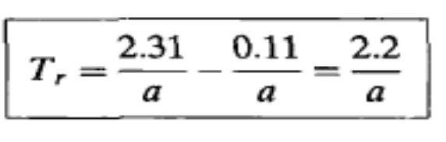
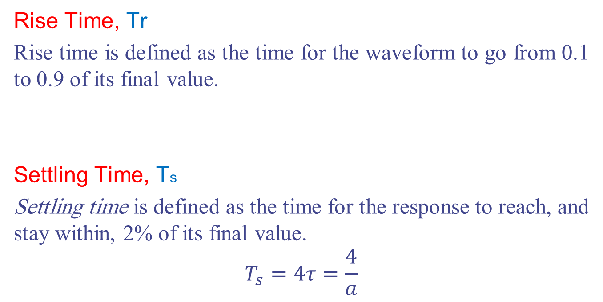
4.3 First-Order Systems
Rise Time, Tr
Rise time is defined as the time for the waveform to go from 0.1 to 0.9 of its final value.
Settling Time, Ts
Settling time is defined as the time for the response to reach, and stay within, 2% of its final value.
$$T_{s}=4τ=\frac{4}{a}$$

Slide 17
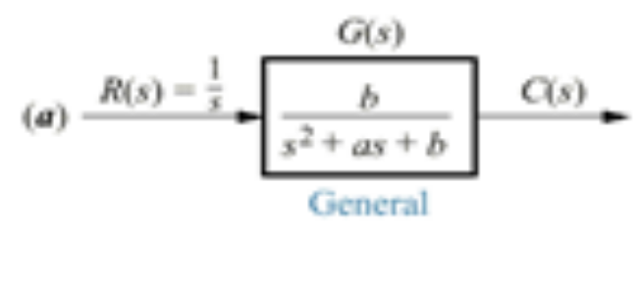
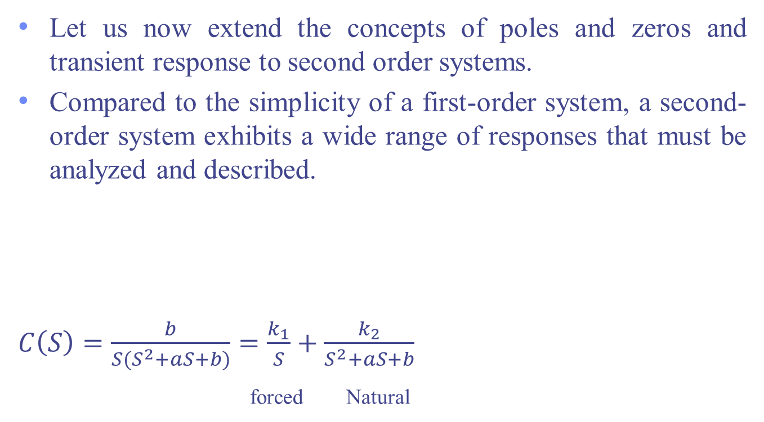
4.4 Second-Order Systems
Let us now extend the concepts of poles and zeros and transient response to second order systems.
Compared to the simplicity of a first-order system, a second-order system exhibits a wide range of responses that must be analyzed and described.
$C\left(S\right)=\frac{b}{S(S^{2}+aS+b)}=\frac{k_{1}}{S}+\frac{k_{2}}{S^{2}+aS+b}$
forced Natural

Slide 18
4.4 Second-Order Systems
There are 4 cases for 2nd order system;
Overdamped Response
Underdamped Response
Undamped Response
Critically Damped Response

Slide 19
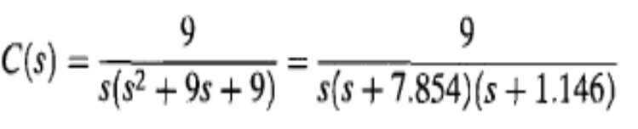
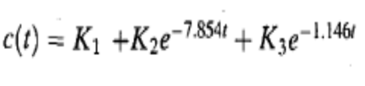
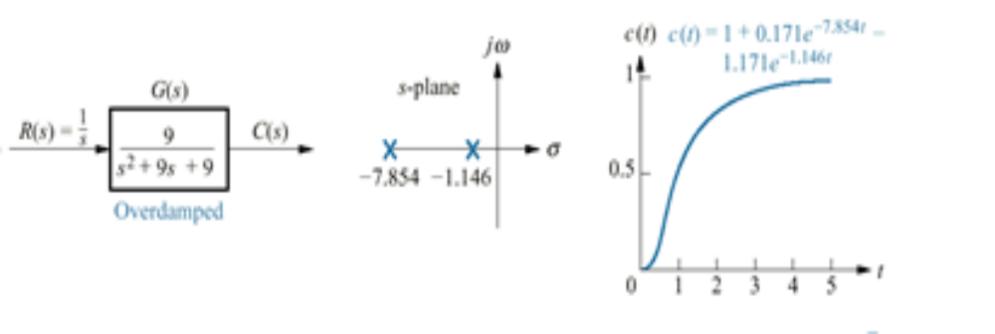
Overdamped Response
This function has a pole at the origin that comes from the unit step input and two real poles that come from the system.
The input pole at the origin generates the constant forced response; each of the two system poles on the real axis generates an exponential natural response whose exponential frequency is equal to the pole location.
Hence, the output initially could have been written as

Slide 20
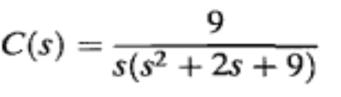
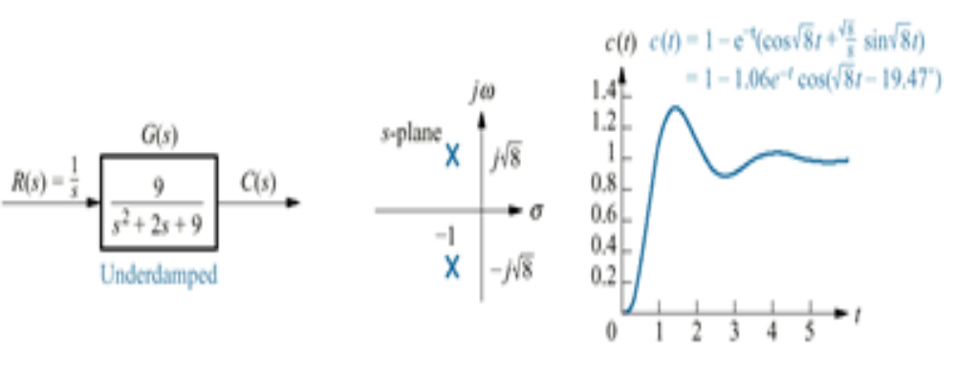
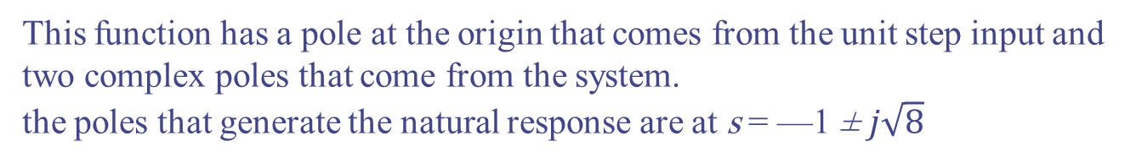
Underdamped Response
This function has a pole at the origin that comes from the unit step input and two complex poles that come from the system.
the poles that generate the natural response are at s = —1 ± $j\sqrt{8}$

Slide 21
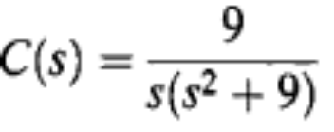
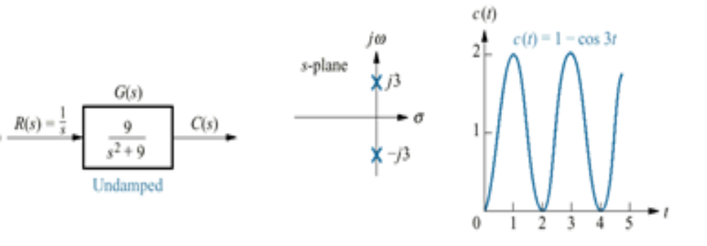
Undamped Response
This function has a pole at the origin that comes from the unit step input and two imaginary poles that come from the system.
The input pole at the origin generates the constant forced response, and the two system poles on the imaginary axis at ±j3 generate a sinusoidal natural response whose frequency is equal to the location of the imaginary poles.
Hence, the output can be estimated as c(t) = K1 + K4 cos(3t - ¢).

Slide 22
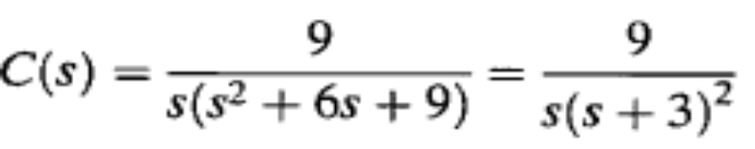
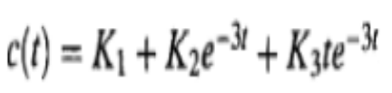
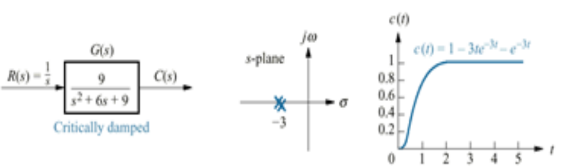
Critically Damped Response
This function has a pole at the origin that comes from the unit step input and two multiple real poles that come from the system.
The input pole at the origin generates the constant forced response, and the two poles on the real axis at —3 generate a natural response consisting of an exponential and an exponential multiplied by time.
Hence, the output can be estimated as

Slide 23
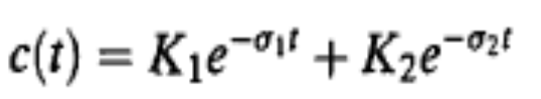
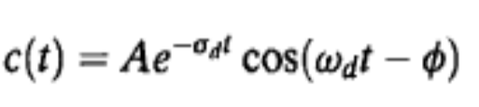


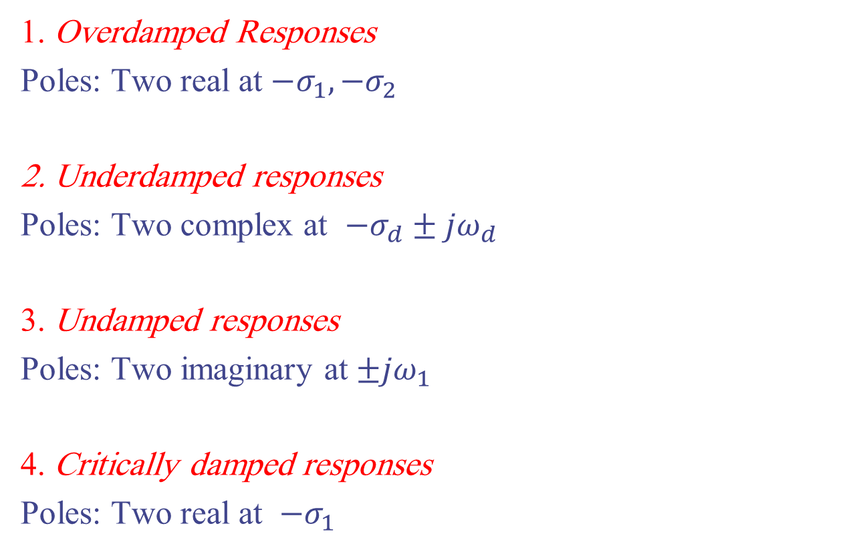
Natural Responses and Found Their Characteristics
1. Overdamped Responses
Poles: Two real at ${−σ}_{1},{−σ}_{2}$
2. Underdamped responses
Poles: Two complex at ${−σ}_{d}±{jω}_{d}$
3. Undamped responses
Poles: Two imaginary at $±{jω}_{1}$
4. Critically damped responses
Poles: Two real at $−σ_{1}$

Slide 24
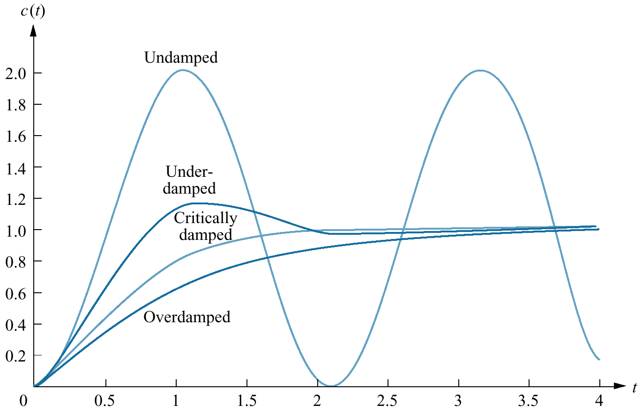
Step Responses for Second-Order System Damping Cases

Slide 25
4.5 The General Second-Order System
In this section, we define two physically meaningful specifications for second-order systems.
These quantities can be used to describe the characteristics of the second-order transient response just as time constants describe the first-order system response.
The two quantities are called natural frequency and damping ratio.

Slide 26
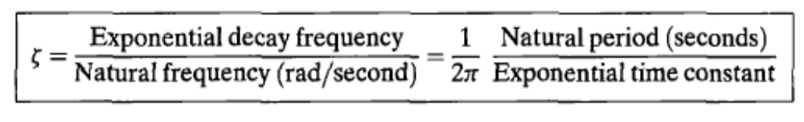
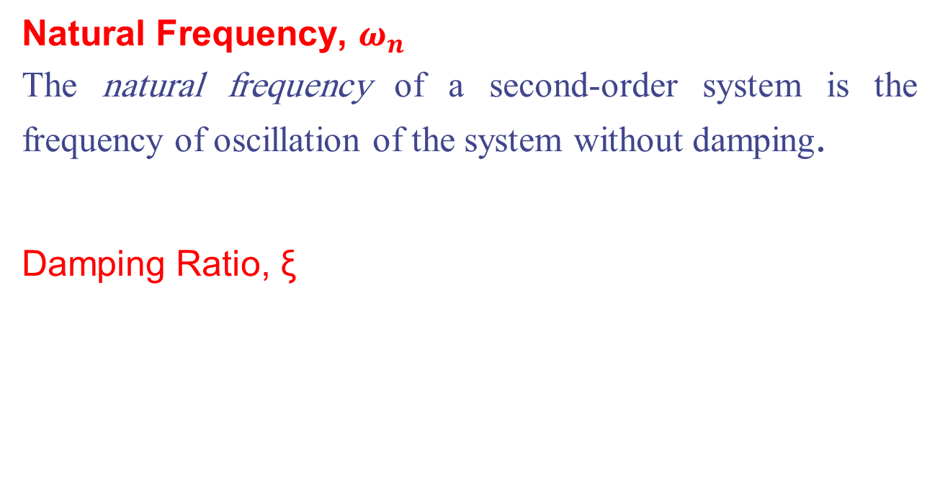
4.5 The General Second-Order System
Natural Frequency, $ω_{n}$
The natural frequency of a second-order system is the frequency of oscillation of the system without damping.
Damping Ratio, ξ

Slide 27
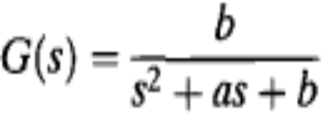
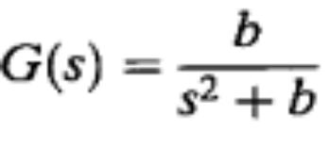
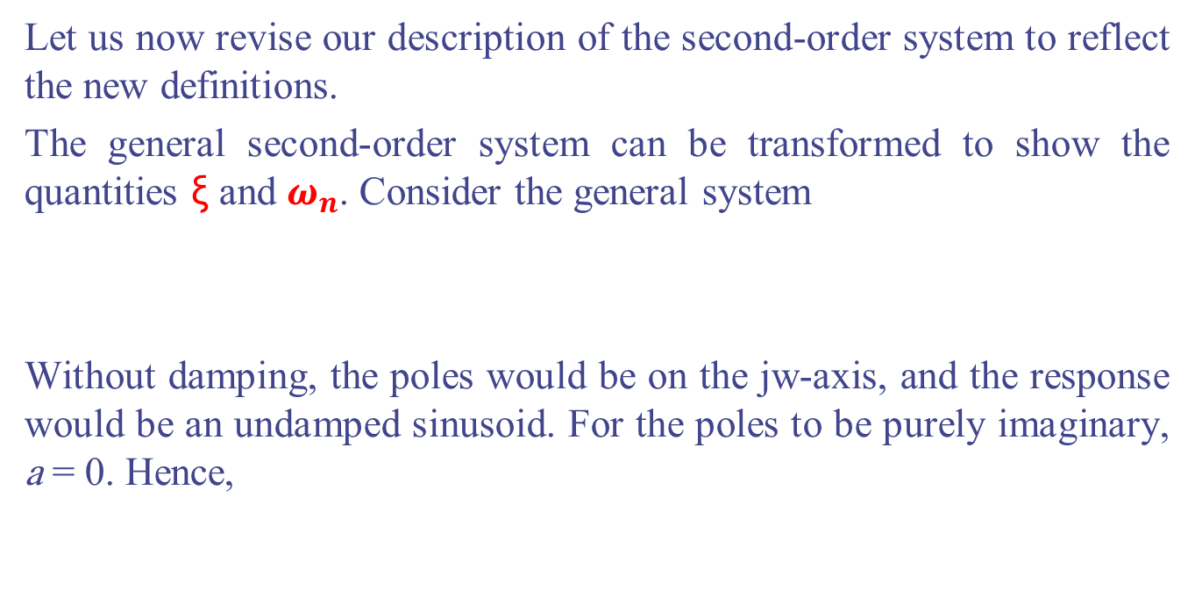
4.5 The General Second-Order System
Let us now revise our description of the second-order system to reflect the new definitions.
The general second-order system can be transformed to show the quantities ξ and $ω_{n}$. Consider the general system
Without damping, the poles would be on the jw-axis, and the response would be an undamped sinusoid. For the poles to be purely imaginary, a = 0. Hence,

Slide 28


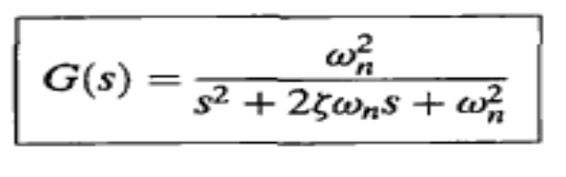
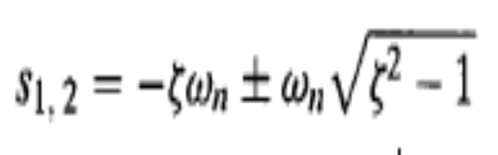
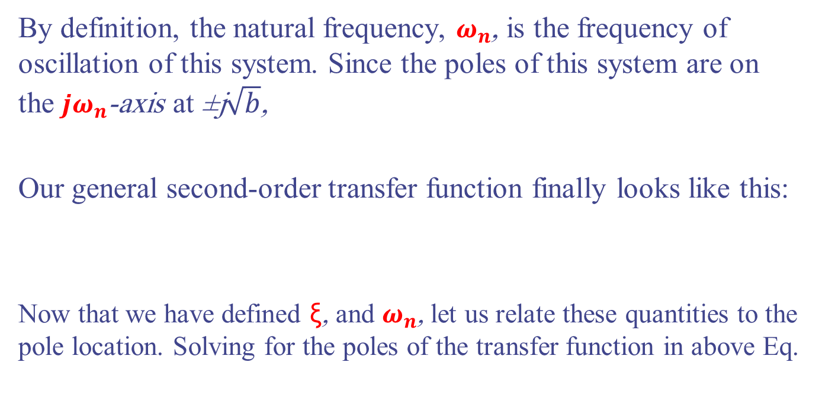
4.5 The General Second-Order System
By definition, the natural frequency, $ω_{n}$, is the frequency of oscillation of this system. Since the poles of this system are on the ${jω}_{n}$-axis at ±j$\sqrt{b}$,
Our general second-order transfer function finally looks like this:
Now that we have defined ξ, and $ω_{n}$, let us relate these quantities to the pole location. Solving for the poles of the transfer function in above Eq.

Slide 29
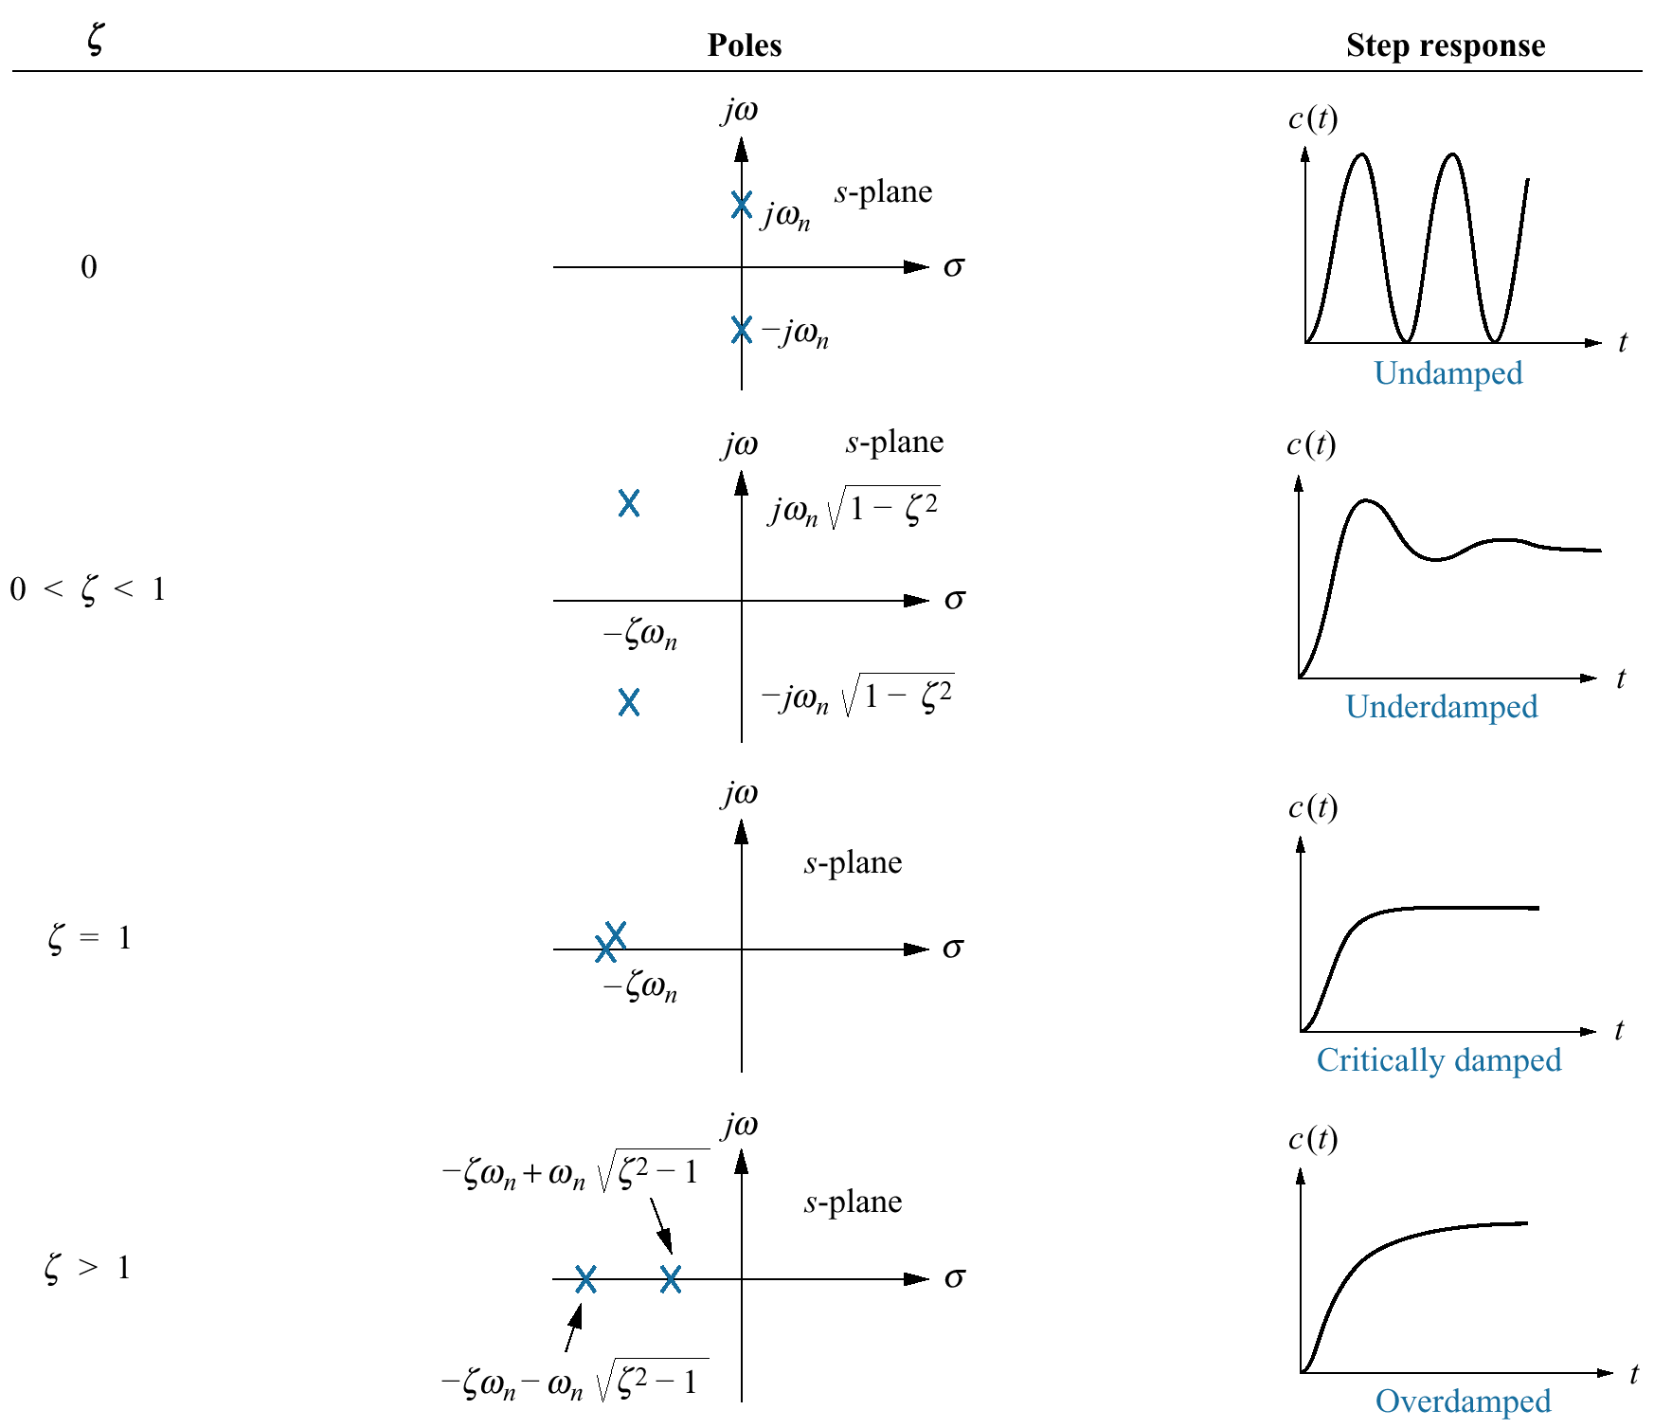
Second-Order Response as a Function of Damping Ratio

Slide 30
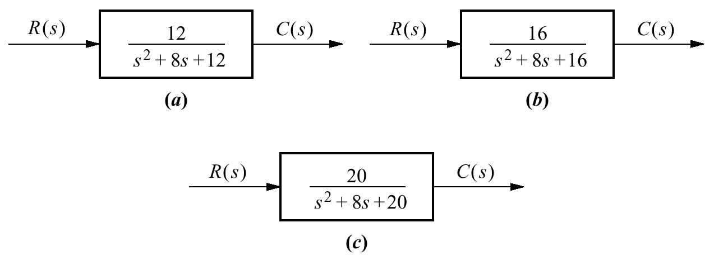
Example 4.4 P. 176
PROBLEM: For each of the systems shown below, find the value of ξ and report the kind of response expected.

Slide 31
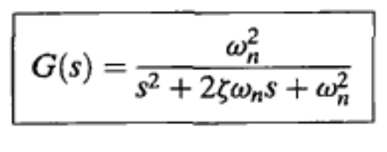
Example 4.4 P. 176
SOLUTION: First match the form of these systems to the forms shown in Eqs.
we find
ξ = 1.155 for system (a), which is thus overdamped, since ξ > 1;
ξ = 1 for system (b), which is thus critically damped; and
ξ = 0.894 for system (c), which is thus underdamped, since ξ < 1.

Slide 32

4.6 Underdamped Second-Order Systems
Now that we have generalized the second-order transfer function in terms of ξ and $ω_{n}$let us analyze the step response of an underdamped second-order system.
Not only will this response be found in terms of ξ and $ω_{n}$, but more specifications indigenous to the underdamped case will be defined.
A detailed description of the underdamped response is necessary for both analysis and design.
Our first objective is to define transient specifications associated with underdamped responses. Next we relate these specifications to the pole location, drawing an association between pole location and the form of the underdamped second-order response

Slide 33




4.6 Underdamped Second-Order Systems
Let us begin by finding the step response for the general second-order system of Eq.
The transform of the response, C(s), is the transform of the input times the transfer function, or
Taking the inverse Laplace transform,

Slide 34

4.6 Underdamped Second-Order Systems
A plot of this response appears in Figure below for various values of ξ , plotted along a time axis normalized to the natural frequency.
The lower the value of ξ, the more oscillatory the response.

Slide 35

4.6 Underdamped Second-Order Systems
We have defined two parameters associated with second-order systems, ξ and $ω_{n} .$Other parameters associated with the underdamped response are rise time, peak time, percent overshoot, and settling time. These specifications are defined as follows:
Rise time, $T_{r}:$The time required for the waveform to go from 0.1 of the final value to 0.9 of the final value.
Peak time, Tp: The time required to reach the first, or maximum, peak.
Percent overshoot, %OS: The amount that the waveform overshoots the steady state, or final, value at the peak time, expressed as a percentage of the steady-state value.
Settling time:Ts. The time required for the transient's damped oscillations to reach and stay within ±2% of the steady-state value.

Slide 36

Second-Order Underdamped Response Specifications

Slide 37

Typical Unit Step Response

Slide 38

Typical Unit Step Response

Slide 39




Second-Order Underdamped Response Specifications
Peak time, Tp
Percent overshoot, %OS:

Slide 40



Second-Order Underdamped Response Specifications
Settling time, Ts:
Rise time, $T_{r}$:
$T_{r}=\frac{2.2}{ω_{n}}$

Slide 41

Peak Value, Peak Time, and Overshoot (%)

Slide 42

Delay, Rise, and Settling Times

Slide 43

2nd Order System Properties

Slide 44
2nd Order System Remarks
Percent overshoot depends on ζ, but NOT ωn.
From 2nd-order transfer function, analytic expressions of delay & rise time are hard to obtain.
Time constant is 1/(ζωn), indicating convergence speed.
For ζ >1, we cannot define peak time, peak value, percent overshoot (no overshoot).

Slide 45



Example 4.5 P. 182
PROBLEM: Given the transfer function
find Tp, %OS, Ts, and Tr.
SOLUTION: Using
ξ and $ω_{n}$are calculated as 0.75 and 10, respectively.
Now substitute ξ and $ω_{n}$into Eqs. and find, respectively, that
Tp = 0.475 second, %OS = 2.838, and Ts, = 0.533 second.

Slide 46


Pole plot for an underdamped second-order system
The pole plot for a general, underdamped second-order system, is shown in Figure below.
Poles (0<ζ<1)
cos θ=ξ

Slide 47






Example 4.6 P.184
PROBLEM: Given the pole plot shown in Figure below, find ξ and $ω_{n}$, Tp, %OS, and Ts.
SOLUTION: The damping ratio is given by ξ=cos θ = 0.394
$ω_{n}=\sqrt{7^{2}+3^{2}}$=7.616

Slide 48


Example 4.6 P.184

Slide 49



Example 4.7 P185
PROBLEM: Given the system shown below, find J and D to yield 20% overshoot and a settling time of 2 seconds for a step input of torque T(t).
SOLUTION: First, the transfer function for the system is

Slide 50







Example 4.7 P185
From the transfer function,
from the problem statement,
a 20% overshoot implies ξ = 0.456. Therefore
From the problem statement, K = 5 N-m/rad., D = 1.04 N-m-s/rad, and J = 0.26 kg-m2.

Slide 51
4.7 System Response with Additional Poles
In the last section, we analyzed systems with one or two poles. It must be emphasized that the formulas describing percent overshoot, settling time, and peak time were derived only for a system with two complex poles and no zeros.
If a system that has more than two poles or has zeros, we cannot use the formulas to calculate the performance specifications that we derived.
However, under certain conditions, a system with more than two poles or with zeros can be approximated as a second-order system that has just two complex dominant poles.
Once we justify this approximation, the formulas for percent overshoot, settling time, and peak time can be applied to these higher-order systems by using the location of the dominant poles.

Slide 52




4.7 System Response with Additional Poles
In this section, we investigate the effect of an additional pole on the second-order response.
Consider a three-pole system with complex poles and a third pole on the real axis.
Assuming that the complex poles are at and the real pole is at -$α_{r}$,
the step response of the system can be determined from a partial-fraction expansion. Thus, the output transform is
or, in the time domain,

Slide 53




4.7 System Response with Additional Poles
The component parts of c(t) are shown below for three cases of -$α_{r}$.
Case I If $α_{r}$ is not much greater than ${ξω}_{n}$, the real pole's transient response will not decay to insignificance at the peak time or settling time generated by the second-order pair. In this case, the exponential decay is significant, and the system cannot
be represented as a second-order system.
Case II If $α_{r} ≫{ξω}_{n}$, the pure exponential will die out much more rapidly than the second-order underdamped step response.

Slide 54


4.7 System Response with Additional Poles
Case III If $α_{r}$=$∞$, such parameters as percent overshoot, settling time, and peak time will be generated by the second-order underdamped step response component
The next question is, How much farther from the
dominant poles does the third pole have to be for
its effect on the second-order response to be
negligible?
The answer of course depends on the accuracy for which you are looking. However, this book assumes that the exponential decay is negligible after five time constants.

Slide 55

Example 4.8 P 189
PROBLEM: Find the step response of each of the transfer functions shown in below and compare them.
SOLUTION: The step response, Ci(s), for the transfer function, Ti(s), can be found by multiplying the transfer function by 1/S, a step input, and using partial-fraction expansion

Slide 56


Example 4.8 P 189
the results are
The three responses are plotted below. Notice that c2(t), with its third pole at -10 and farthest from the dominant poles, is the better approximation of c1(t),

Slide 57

4.8 System Response With Zeros
Now that we have seen the effect of an additional pole, let us add a zero to the second-order system.
Starting with a two-pole system with poles at (-1 ±j2.828), we consecutively add zeros at - 3 , - 5 , and -10.
The results, are plotted below
We can see that the closer the zero is to the dominant poles, the greater its effect on the transient response. As the zero moves away from the dominant poles, the response approaches that of the two-pole system.

Slide 58





4.10 Laplace Transform Solution of State Equations
Taking the Laplace transform of both sides of the state equation yields
Taking the Laplace transform of the output equation yields

Slide 59

Eigenvalues and Transfer Function Poles
We have
The roots of denominator are the poles of the system
The system poles = eigenvalues= det(sI - A) = 0.

Slide 60

Example 4.11 P. 200
PROBLEM: Given the system represented in state space
do the following:
a. Solve the preceding state equation and obtain the output for the given exponential input.
b. Find the eigenvalues and the system poles.

Slide 61






Example 4.11 P. 200
SOLUTION: we have
then
Since U(s) (the Laplace transform for $e^{t}$) is 1/(s + 1), X(s) can be calculated.

Slide 62



Example 4.11 P. 200
The output equation is found
b. The denominator of Eq., which is det(sI - A), is also the denominator of the system's transfer function. Thus, det(.sl - A) = 0 furnishes both the poles of the system and the eigenvalues - 2 , - 3, and -4.

Slide 63


4.11 Time Domain Solution of State
Equations
We now look at another technique for solving the state equations. Rather than using the Laplace transform, we solve the equations directly in the time domain using a method closely allied to the classical solution of differential equations.
We have $\dot{x}\left(t\right)=Ax\left(t\right)+Bu(t)$
Homogenous Forcing
Need to solve the Homogenous part first
$$\dot{x}\left(t\right)=\frac{dx}{dt}=Ax(t)$$
From Diff. Eq. $x\left(t\right)=e^{At}x(0)$ OR sx(s)-x(0)=Ax(s)
$x\left(t\right)=∅(t)$x(0) $x\left(t\right)=\{l^{−1}\left[(sI−A)^{−1}\right]$}x(0)
$∅\left(t\right)=e^{At}=l^{−1}\left[(sI−A)^{−1}\right]$
Where $∅(t)$: State transition matrix (represent the free response of the system

Slide 64

4.11 Time Domain Solution of State
Equations
$∅\left(t\right)=e^{At}=l^{−1}\left[(sI−A)^{−1}\right]$
Where $∅(t)$: State transition matrix, The state-transition matrix is defined as a matrix that satisfies the linear homogeneous state equation.
${ e}^{At}=I+At+\frac{1}{2}A^{2}t^{2}+…$
Because the state-transition matrix satisfies the homogeneous state equation, it represents the free response of the system. In other words, it governs the response that is excited by the initial conditions only
the state-transition matrix $∅\left(t\right)$completely defines the transition of the states from the initial time t = 0 to any time t when the inputs are zero.

Slide 65

4.11 Time Domain Solution of State
Equations
Now we can solve the whole State Eq. (State transition Eq.)
$\dot{x}\left(t\right)=Ax\left(t\right)+Bu(t)$
We have $x\left(s\right)=(sI−A)^{−1}x\left(0\right)+(sI−A)^{−1}Bu(s)$
Taking the Laplace inverse $∅(s)$
$x\left(t\right)=l^{−1}\left[(sI−A)^{−1}\right]x\left(0\right)+l^{−1}\left\{(sI−A)^{−1}Bu(s)\right\}$
$x\left(t\right)= ∅\left(t\right)x\left(0\right) + ∅\left(t\right)∗Bu\left(t\right)$
$$x\left(t\right)=∅\left(t\right)x\left(0\right)+\int_{0}^{t}{∅\left(t−τ\right)Bu\left(τ\right)dτ}$$
Natural
Zero Input Response
Forced
Zero State
Response

Slide 66



Example 4.12 P 204
PROBLEM: For the state equation and initial state vector shown below, where u(t) is a unit step, find the state-transition matrix and then solve for x(t).
SOLUTION: Since the state equation is in the form
$∅\left(t\right)=l^{−1}\left[(sI−A)^{−1}\right]$
$$∅\left(t\right)=l^{−1}\left\{\left[\begin{matrix}\frac{s+6}{s^{2}+6s+8} & \frac{1}{s^{2}+6s+8} \\ \frac{−8}{s^{2}+6s+8} & \frac{s}{s^{2}+6s+8}\end{matrix}\right]\right\}$$

Slide 67




Example 4.12 P 204

Slide 68




Example 4.12 P 204

Slide 69



Example
Consider the state equation
The problem is to determine the state-transition matrix $∅\left(t\right)$and the state vector x(t) for t > 0 when the input is u(t) = 1 for t > 0.
Solution: The coefficient matrices are identified to be

Slide 70



Example
The state-transition matrix of A is found by taking the inverse Laplace transform of above eq.

Slide 71



Example
The state-transition equation for t > 0 is obtained;
OR
As an alternative, the second term of the state-transition equation can be obtained by taking the inverse Laplace transform of (sI- A$)^{−1}$BU(s).

