Slide 1
Control Systems
Lect.3 Modeling in The Time Domain
Basil Hamed

Slide 2
Chapter Learning Outcomes
After completing this chapter, the student will be able to:
• Find a mathematical model, called a state-space representation, for a linear, time invariant system (Sections 3.1-3.3)
• Model electrical and mechanical systems in state space (Section 3.4)
• Convert a transfer function to state space (Section 3.5)
• Convert a state-space representation to a transfer function (Section 3.6)
• Linearize a state-space representation (Section 3.7)

Slide 3
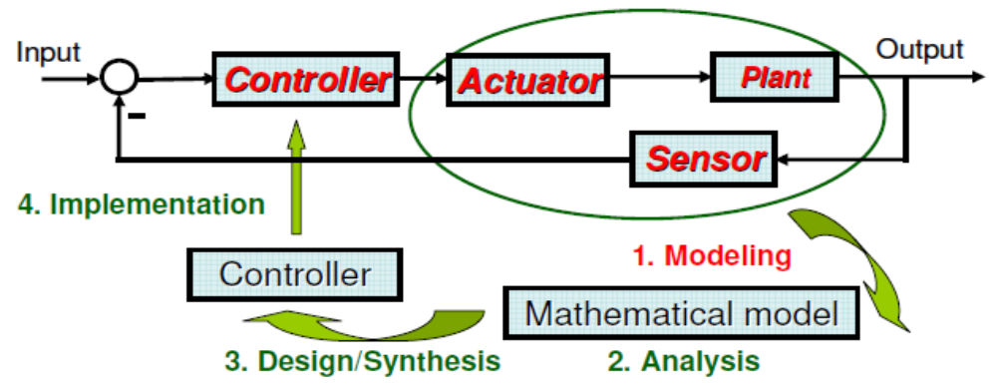
Modeling
Derive mathematical models for
• Electrical systems
• Mechanical systems
• Electromechanical system
Electrical Systems:
• Kirchhoff’s voltage & current laws
Mechanical systems:
• Newton’s laws

Slide 4
3.1 Introduction
Two approaches are available for the analysis and design of feedback control systems. The first, which we began to study in Chapter 2, is known as the classical, or frequency-domain, technique.
The 1st approach is based on converting a system's differential equation to a transfer function, thus generating a mathematical model of the system that algebraically relates a representation of the output to a representation of the input.
The primary disadvantage of the classical approach is its limited applicability: It can be applied only to linear, time-invariant systems or systems that can be approximated as such.

Slide 5
3.1 Introduction
The 2nd approach is state-space approach (also referred to as the modern, or time-domain, approach) is a unified method for modeling, analyzing, and designing a wide range of systems.
For example, the state-space approach can be used to represent nonlinear systems, Time-varying systems, Multiple-input, multiple-output systems.
The time-domain approach can also be used for the same class of systems modeled by the classical approach.

Slide 6
3.2 Some Observations
We proceed now to establish the state-space approach as an alternate method for representing physical systems.
In general, an nth-order differential equation can be decomposed into n first-order differential equations.
Because, in principle, first-order differential equations are simpler to solve than higher-order ones, first-order differential equations are used in the analytical studies of control systems.

Slide 7
3.2 Some Observations
Definition of State Variables
The state of a system refers to the past, present, and future conditions of the system. From a mathematical perspective, it is convenient to define a set of state variables and state equations to model dynamic systems. As it turns out, the variables x1(t), x2(t), ...,x„(t) are the state variables of the nth-order system

Slide 8
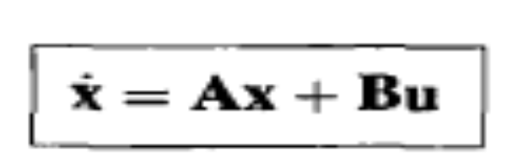
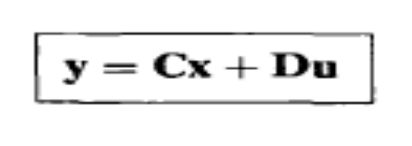
3.3The General State-Space Representation
State space model composed of 2 equations;
1. State equation
State
Space Model
2. Output equation

Slide 9
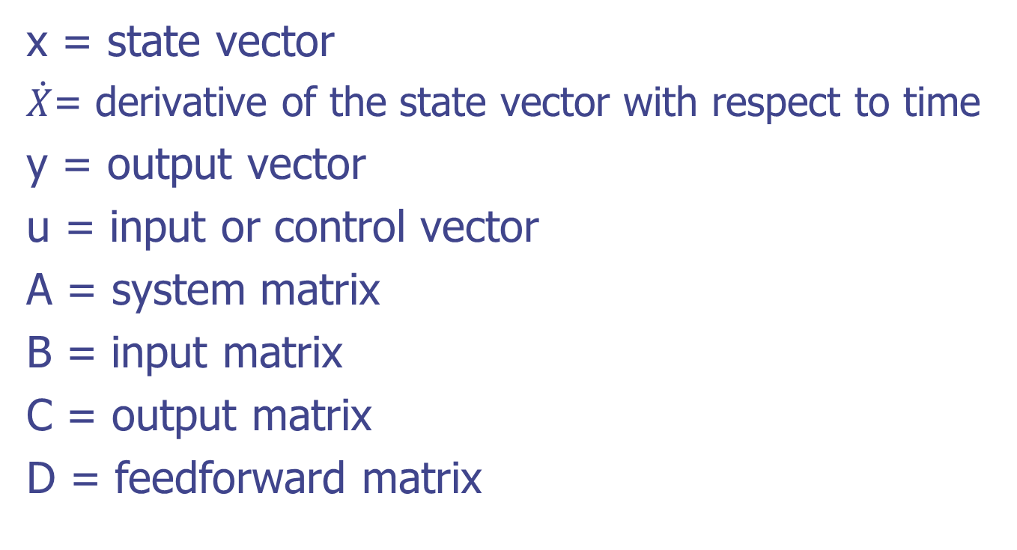
3.3The General State-Space Representation
x = state vector
$\dot{X}$= derivative of the state vector with respect to time
y = output vector
u = input or control vector
A = system matrix
B = input matrix
C = output matrix
D = feedforward matrix

Slide 10
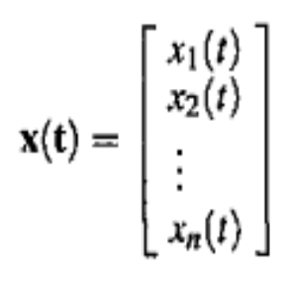
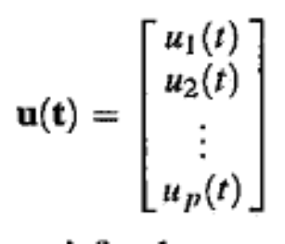
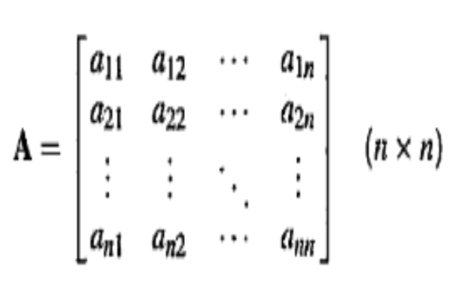
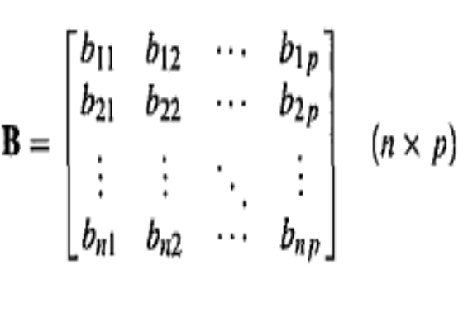
3.3The General State-Space Representation
Where
The state variables of a system are defined as a minimal set of variables, x1(t),x2(t), ... ,xn(t), such that knowledge of these variables at any time to and information on the applied input at time t0 are sufficient to determine the state of the system at any time t > to

Slide 11
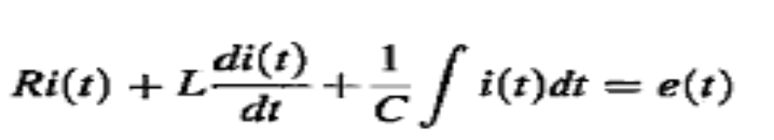
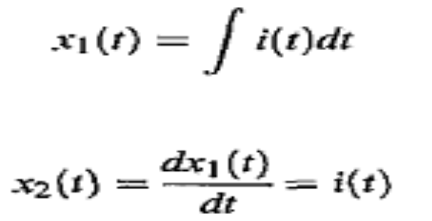
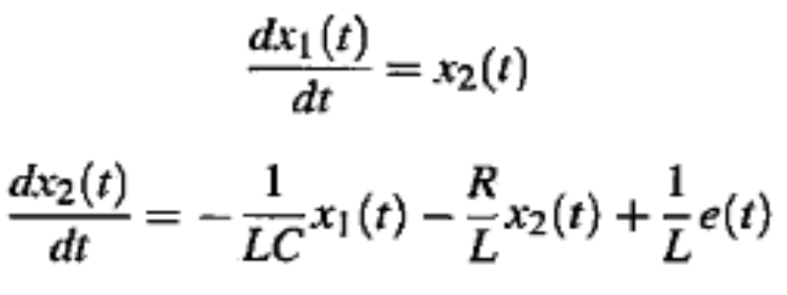
Example
Given 2nd order Diff Eq.
1
Above eq. can be transform into state eq;
Let
then Eq. (1) is decomposed into the following two first-order differential equations:

Slide 12
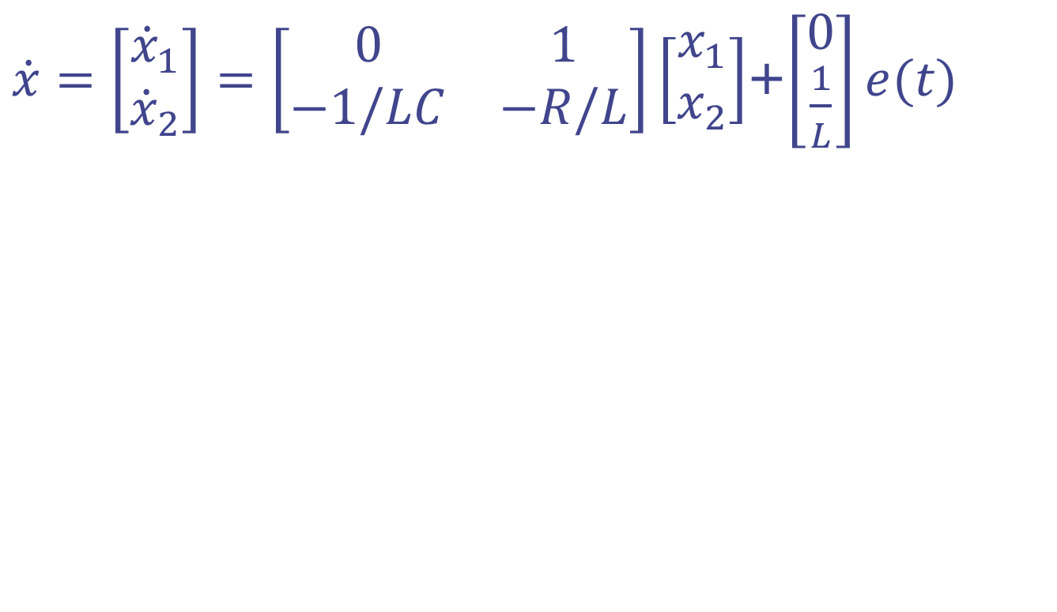
Example
$\dot{x}=\left[\begin{matrix}{\dot{x}}_{1} \\ {\dot{x}}_{2}\end{matrix}\right]=\left[\begin{matrix}0 & 1 \\ −1/LC & −R/L\end{matrix}\right]\left[\begin{matrix}x_{1} \\ x_{2}\end{matrix}\right]$+$\left[\begin{matrix}0 \\ \frac{1}{L}\end{matrix}\right]e(t)$

Slide 13
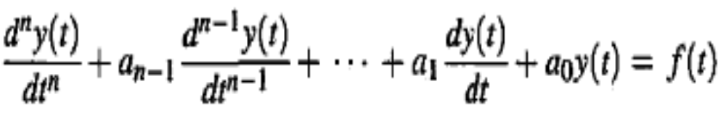
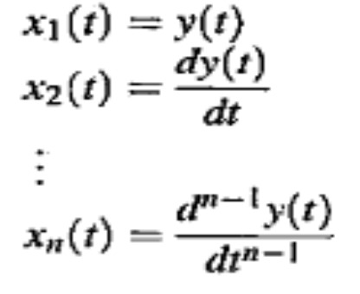
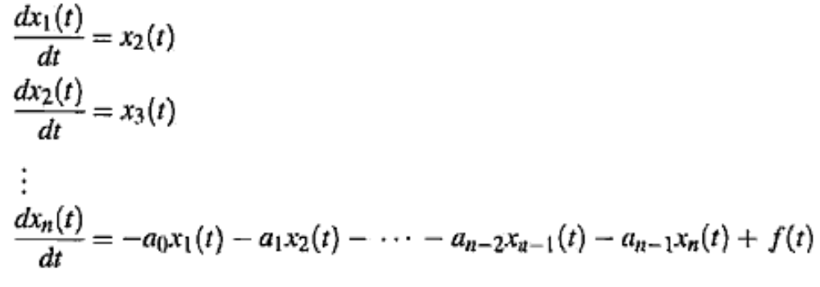
General form of state Space model
In general, the differential equation of an nth-order system is written
let us define
then the nth-order differential equation is decomposed into n first-order differential equations:

Slide 14
3.4 Applying the State-Space Representation
In this section, we apply the state-space formulation to the representation of more complicated physical systems. The first step in representing a system is to select the state vector, which must be chosen according to the following considerations:
1. A minimum number of state variables must be selected as components of the state vector. This minimum number of state variables is sufficient to describe completely the state of the system.
2. The components of the state vector (that is, this minimum number of state variables) must be linearly independent.

Slide 15
Linearly Independent State Variables
The components of the state vector must be linearly independent. For example, following the definition of linear independence, if x1, x2, and x3 are chosen as state variables, but x3 = 5x1 + 4x2, then x3 is not linearly independent of x1and x2, since knowledge of the values of x1 and x2 will yield the value of x3.

Slide 16
Minimum Number of State Variables
Typically, the minimum number required equals the order of the differential equation describing the system. For example, if a third-order differential equation describes the system, then three simultaneous, first-order differential equations are required along with three state variables.
From the perspective of the transfer function, the order of the differential equation is the order of the denominator of the transfer function after canceling common factors in the numerator and denominator.

Slide 17
Minimum Number of State Variables
In most cases, another way to determine the number of state variables is to count the number of independent energy-storage elements in the system.
The number of these energy-storage elements equals the order of the differential equation and the number of state variables.

Slide 18
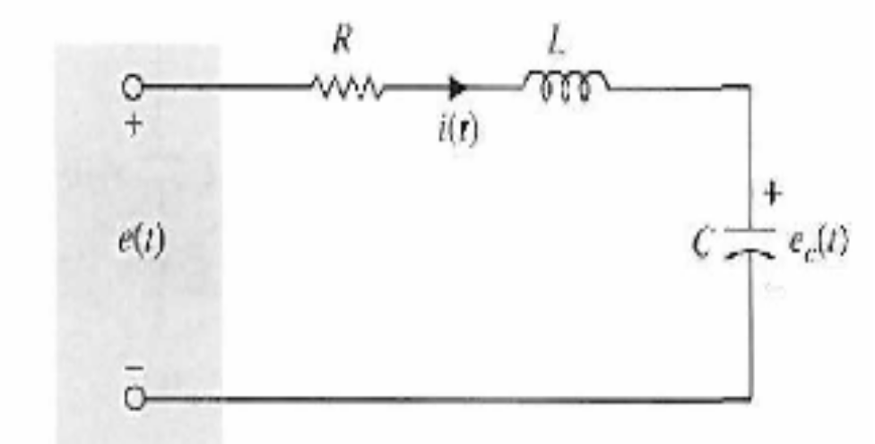
Example
Find state model of System shown in the Fig.
Solution
A practical approach is to assign the current in the inductor L, i(t), and the voltage across the capacitor C, ec(t), as the state variables.
The reason for this choice is because the state variables are directly related to the energy-storage element of a system. The inductor stores kinetic energy, and the capacitor stores electric potential energy.
By assigning i(t) and ec(t) as state variables, we have a complete description of the past history (via the initial states) and the present and future states of the network.

Slide 19
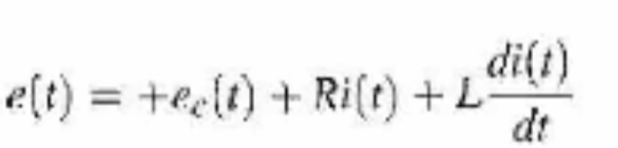
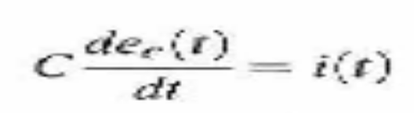
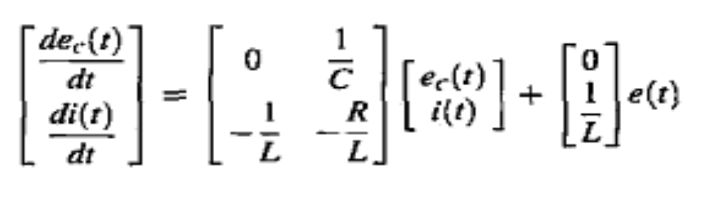
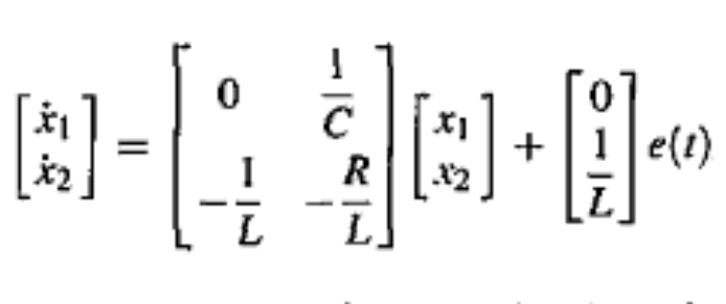
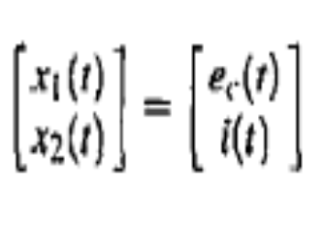
Example
The state equation:
This format is also known as the state form if we set
OR

Slide 20
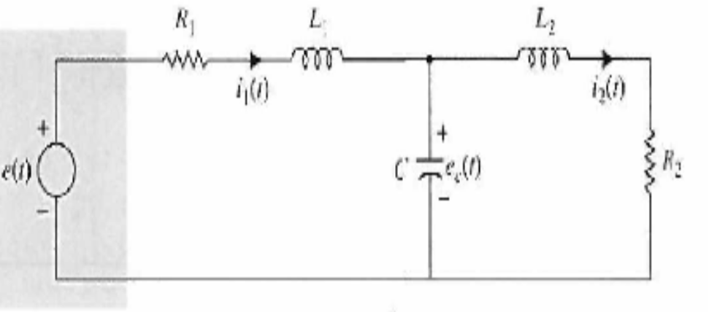
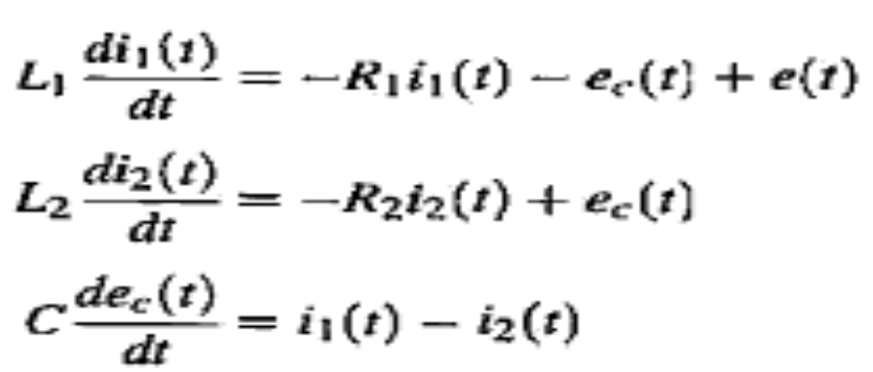
Example
write the state equations of the electric network shown in the Fig.
Solution: The state equations of the network are obtained by writing the voltages across the inductors and the currents in the capacitor in terms of the three state variables. The state equations are

Slide 21
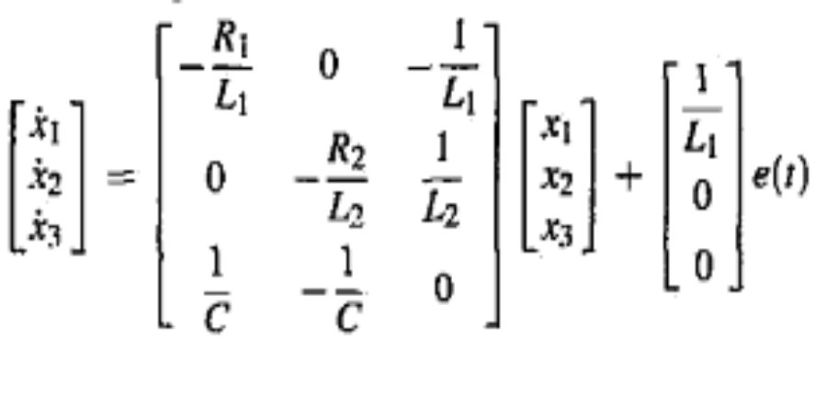
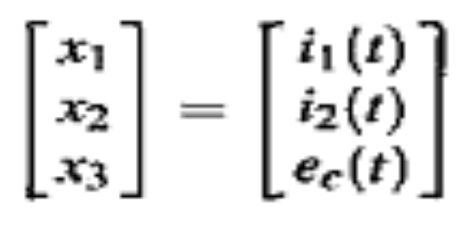
Example
In vector-matrix form, the state equations are written as
Where

Slide 22
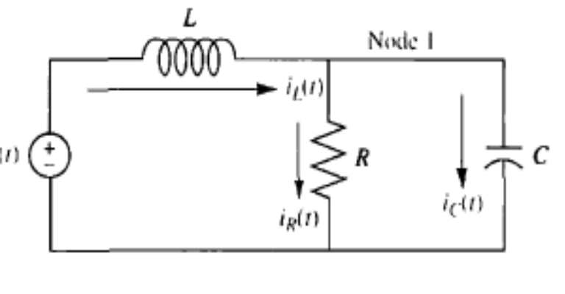
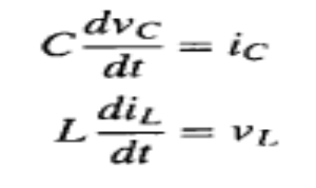
Example 3.1 P.138
PROBLEM: Given the electrical network of Figure shown, find a state-space representation if the output is the current through the resistor.
Solution
Select the state variables by writing the derivative equation for all energy storage elements, that is, the inductor and the capacitor. Thus,
1
2

Slide 23
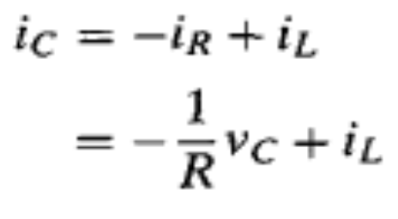
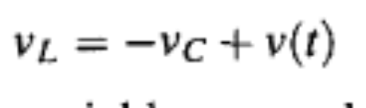
Example 3.1
Apply network theory, such as Kirchhoffs voltage and current laws, to obtain ic and vL in terms of the state variables, vc and iL. At Node 1,
3
which yields ic in terms of the state variables, vc and iL . Around the outer loop,
4

Slide 24
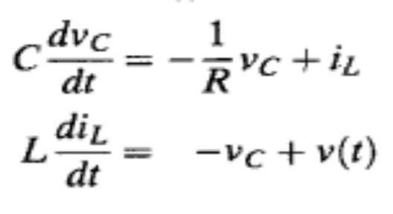
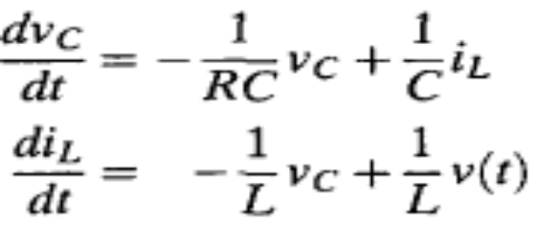
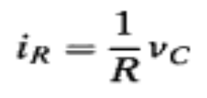
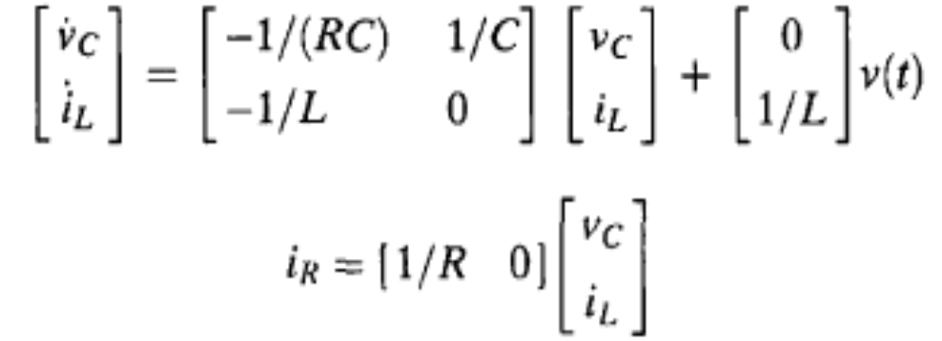
Example 3.1
Substitute the results of Eqs. (3) and (4) into Eqs. (1) and (2) to obtain the following state equations:
OR
Find the output eq. since the output is iR(t)
The final result for the state-space representation is

Slide 25
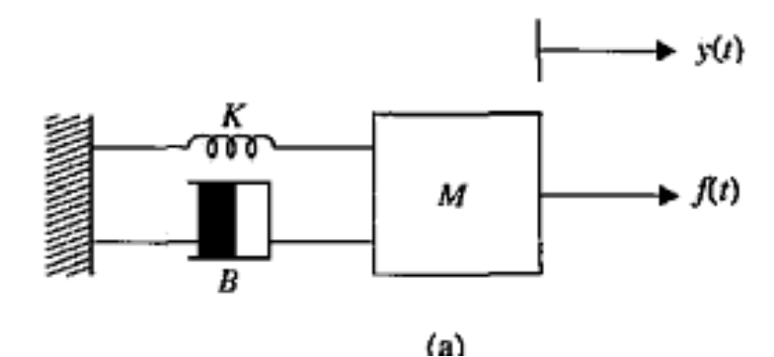
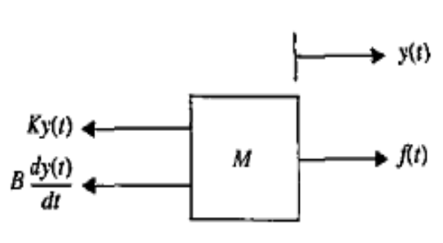
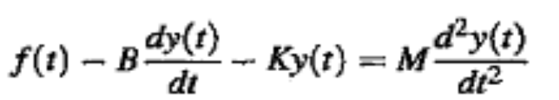
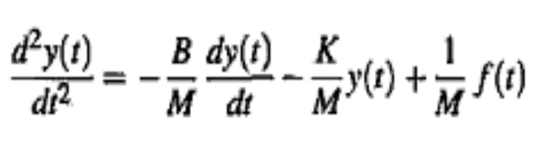

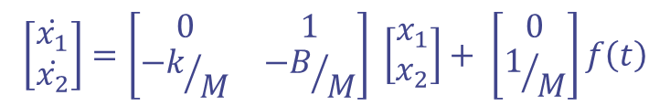

Example
Find the state eq. of the mechanical system shown
Solution
$$let x\left(t\right)=y\left(t\right) and \dot{x}\left(t\right)=\dot{y}(t)$$
$$\left[\begin{matrix}\dot{x_{1}} \\ \dot{x_{2}}\end{matrix}\right]=\left[\begin{matrix}0 & 1 \\ {−k}/M & {−B}/M\end{matrix}\right] \left[\begin{matrix}x_{1} \\ x_{2}\end{matrix}\right]+ \left[\begin{matrix}0 \\ 1/M\end{matrix}\right]f\left(t\right)$$
$$y(t)=\left[\begin{matrix}1 & 0\end{matrix}\right]\begin{matrix}\left[\begin{matrix}x_{1} \\ x_{2}\end{matrix}\right] & \end{matrix}$$

Slide 26
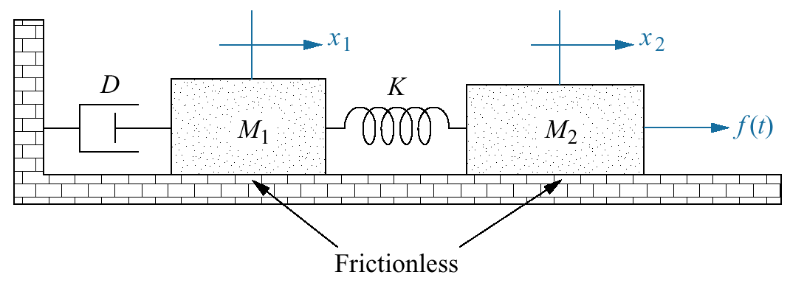
Example 3.3 P.142
PROBLEM: Find the state equations for the translational mechanical system shown in Figure.

Slide 27
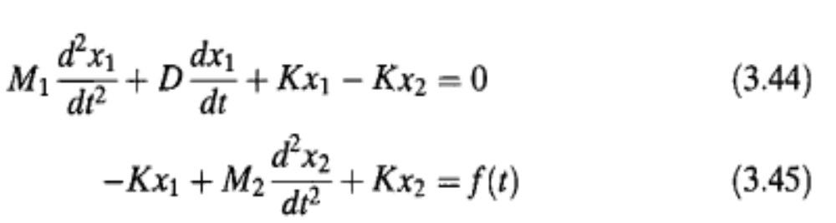
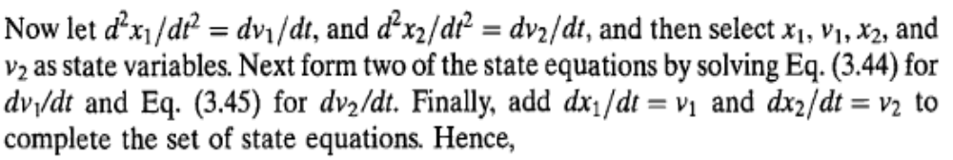
Example 3.3 P.142
SOLUTION: First write the differential equations for the network in Figure, using the methods of Chapter 2 to find the Laplace-transformed equations of motion.

Slide 28
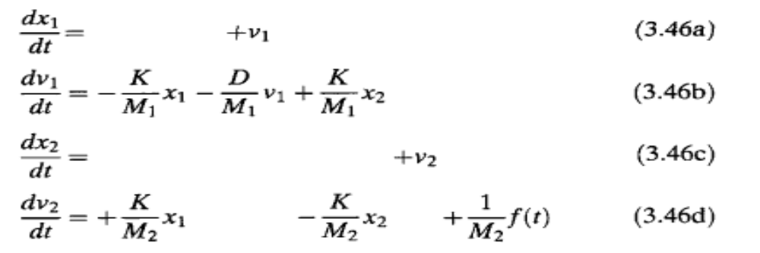
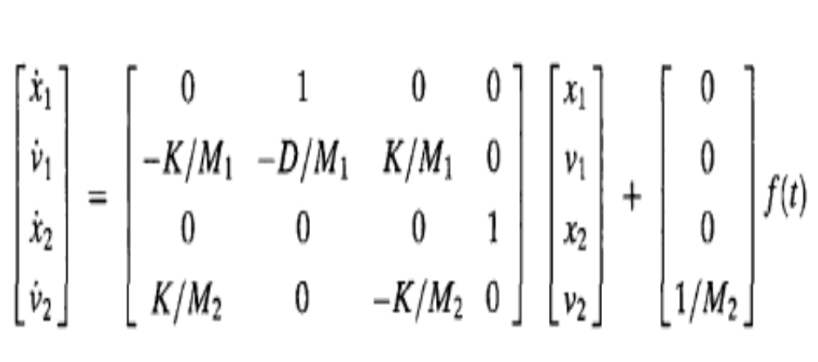
Example 3.3 P.142
In Vector Matrix

Slide 29
3.5 Converting a Transfer Function to State Space
In the last section, we applied the state-space representation to electrical and mechanical systems. We learn how to convert a transfer function representation to a state-space representation in this section.
One advantage of the state-space representation is that it can be used for the simulation of physical systems on the digital computer. Thus, if we want to simulate a system that is represented by a transfer function, we must first convert the transfer function representation to state space.

Slide 30
Converting T.F to S.S
System modeling in state space can take on many representations
Although each of these models yields the same output for a given input, an engineer may prefer a particular one for several reasons.
Another motive for choosing a particular set of state variables and state-space model is ease of solution.

Slide 31
Converting T.F to S.S
There are many ways of converting T.F into S.S but the most useful and famous are:
Direct Decomposition
Cascade Decomposition
Parallel Decomposition

Slide 32
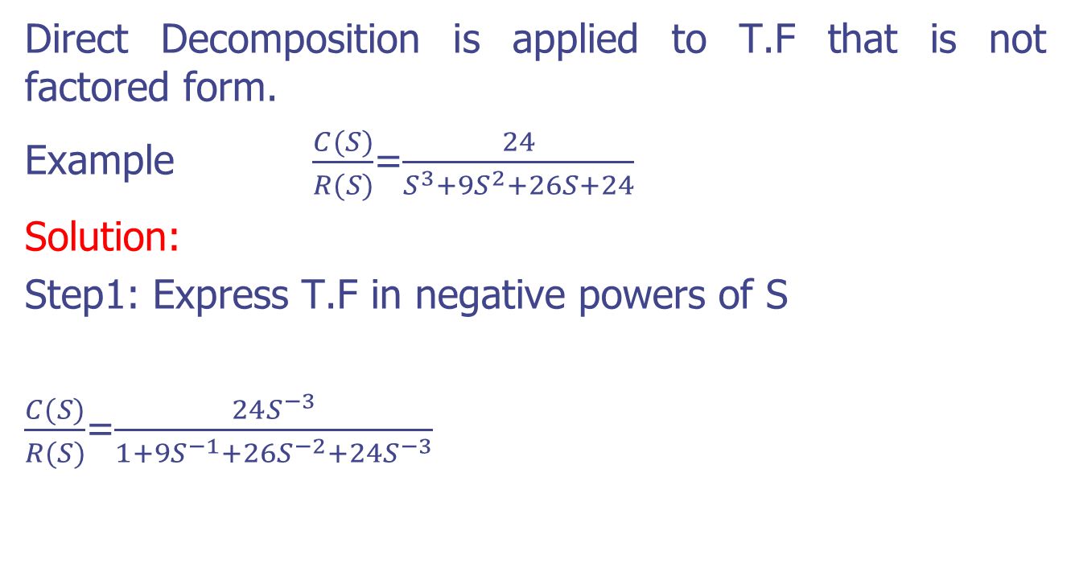
Direct Decomposition
Direct Decomposition is applied to T.F that is not factored form.
Example $\frac{C(S)}{R(S)}$=$\frac{24}{S^{3}+9S^{2}+26S+24}$
Solution:
Step1: Express T.F in negative powers of S
$\frac{C(S)}{R(S)}$=$\frac{24S^{−3}}{1+9S^{−1}+26S^{−2}+24S^{−3}}$

Slide 33
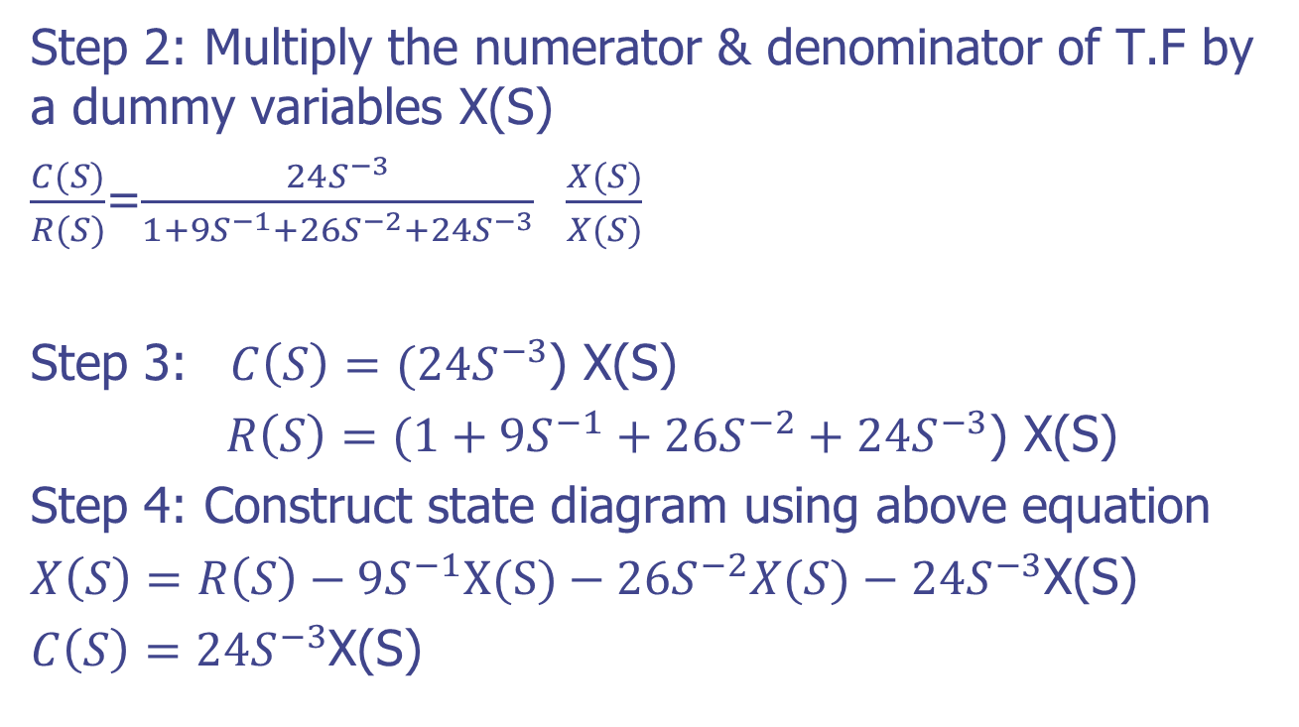
Direct Decomposition
Step 2: Multiply the numerator & denominator of T.F by a dummy variables X(S)
$\frac{C(S)}{R(S)}$=$\frac{24S^{−3}}{1+9S^{−1}+26S^{−2}+24S^{−3}}$ $\frac{X(S)}{X(S)}$
Step 3: $C\left(S\right)=(24S^{−3}$) X(S)
$R\left(S\right)=(1+9S^{−1}+26S^{−2}+24S^{−3}$) X(S)
Step 4: Construct state diagram using above equation
$X\left(S\right)=R\left(S\right)−9S^{−1}X(S)−26S^{−2}X(S)−24S^{−3}$X(S)
$C\left(S\right)=24S^{−3}$X(S)

Slide 34
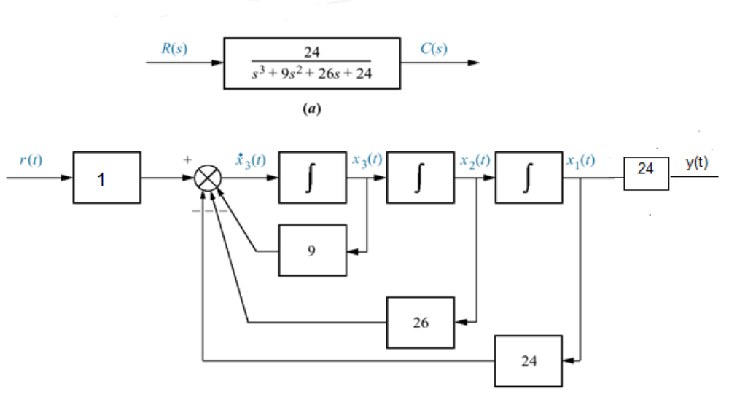
Direct Decomposition

Slide 35
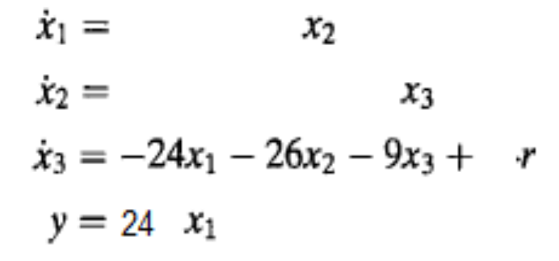
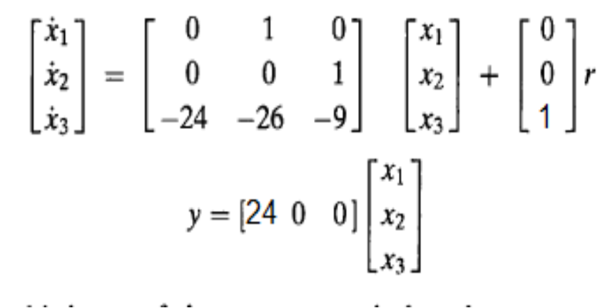
Direct Decomposition
From State diagram
In vector-matrix form,

Slide 36
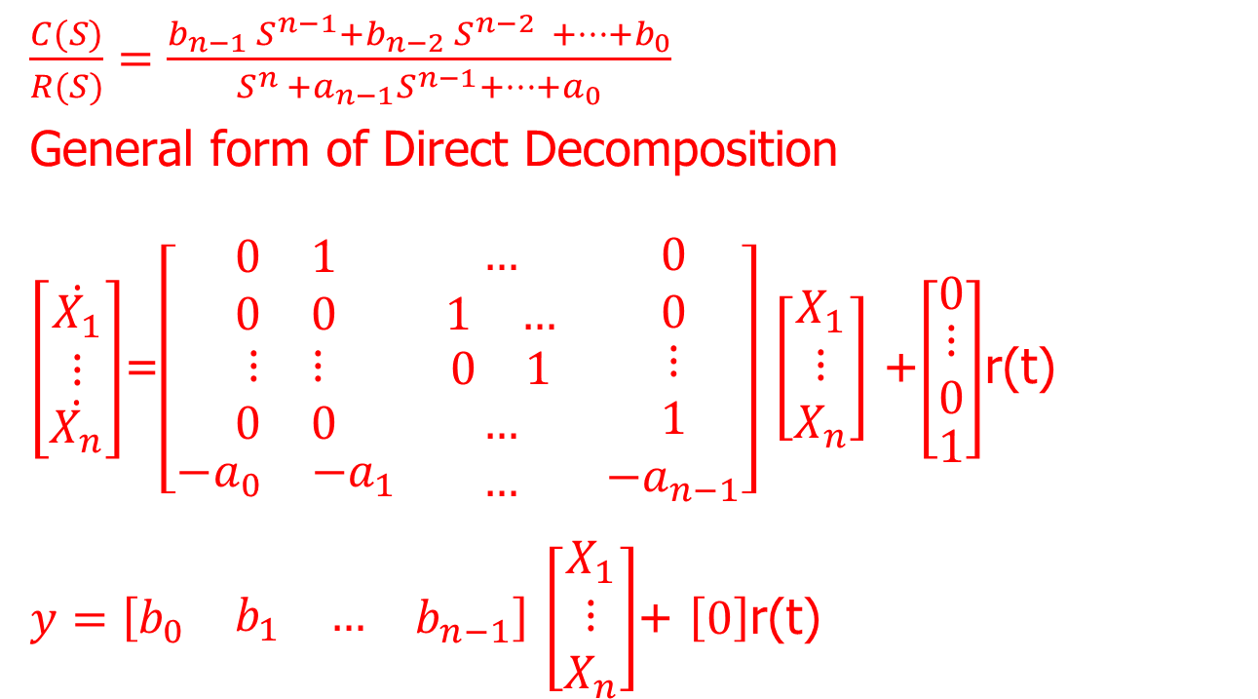
Direct Decomposition
$\frac{C(S)}{R(S)}=\frac{b_{n−1} S^{n−1}+b_{n−2} S^{n−2 } +…+b_{0}}{S^{n }+a_{n−1}S^{n−1}+…+a_{0}}$
General form of Direct Decomposition
$\left[\begin{matrix}\dot{X_{1}} \\ ⋮ \\ \dot{X_{n}}\end{matrix}\right]$=$\left[\begin{matrix}\begin{matrix}0 & 1\end{matrix} & … & 0 \\ \begin{matrix}0 & 0\end{matrix} & \begin{matrix}1 & …\end{matrix} & 0 \\ \begin{matrix}\begin{matrix}⋮ & ⋮\end{matrix} \\ \begin{matrix}0 & 0\end{matrix} \\ \begin{matrix}−a_{0} & −a_{1}\end{matrix}\end{matrix} & \begin{matrix}\begin{matrix}0 & 1\end{matrix} \\ … \\ …\end{matrix} & \begin{matrix}⋮ \\ 1 \\ −a_{n−1}\end{matrix}\end{matrix}\right]$ $\left[\begin{matrix}X_{1} \\ ⋮ \\ X_{n}\end{matrix}\right]$ +$\left[\begin{matrix}0 \\ \begin{matrix}⋮ \\ 0\end{matrix} \\ 1\end{matrix}\right]$r(t)
$y=\left[\begin{matrix}b_{0} & \begin{matrix}b_{1} & …\end{matrix} & b_{n−1}\end{matrix}\right]$ $\left[\begin{matrix}X_{1} \\ ⋮ \\ X_{n}\end{matrix}\right]$+ $\left[0\right]$r(t)

Slide 37
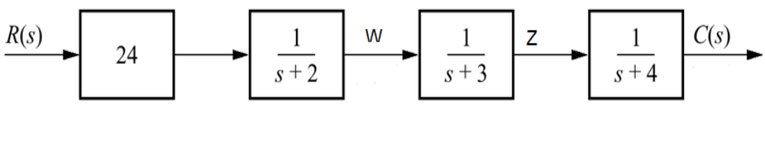

Cascade (Series) Decomposition
May applied to T.F that are written as product of simple first or 2nd Order components (factored form)
Example $\frac{C(S)}{R(S)}$=$\frac{24}{S^{3}+9S^{2}+26S+24}$ =$\frac{24}{(S+2)(S+3)(S+4)}$

Slide 38

Cascade (Series) Decomposition
$\frac{W}{24R}$=$\frac{1}{S+2}$ =$\frac{S^{−1}}{1+2S^{−1}}$ $\frac{V_{1}}{V_{1}}$
$$W\left(S\right)=S^{−1}V_{1}$$
$V_{1 }=24R−2S^{−1}V_{1}$ (1)
$\frac{Z}{W }=\frac{1}{S+3}=\frac{S^{−1} }{1+3S^{−1} }\frac{V_{2}}{V_{2}}$
$Z\left(S\right)=S^{−1}V_{2}$ (2)
$$V_{2}=W\left(S\right)−3S^{−1}V_{2}$$

Slide 39


Cascade (Series) Decomposition
$\frac{C(S)}{Z(S)}=\frac{1}{S+4}=\frac{S^{−1}}{1+4S^{−1}} \frac{V_{3}}{V_{3}}$
$C\left(S\right)=S^{−1}V_{3}$
$V_{3}=Z\left(S\right)−4S^{−1}V_{3}$ (3)

Slide 40



Cascade (Series) Decomposition
Now write the state equations for the new representation of the system.
The state-space representation is completed by rewriting above Eqs in vector-matrix form:

Slide 41

Parallel Decomposition
Parallel subsystems have a common input and an output formed by the algebraic sum of the outputs from all of the subsystems.

Slide 42


Parallel Decomposition
Example

Slide 43

Parallel Decomposition
$\frac{X_{1}}{R}=\frac{1}{S+2}$ $\dot{X_{1}}=r−2X_{1}$
$\frac{X_{2}}{R}=\frac{1}{S+3}$ $\dot{X_{2}}=r−3X_{2}$
$\frac{X_{3}}{R}=\frac{1}{S+4}$ $\dot{X_{3}}=r−4X_{3}$
$C=12X_{1}−24X_{2}+12X_{3}$

Slide 44

Parallel Decomposition
$\left[\begin{matrix}\dot{X_{1}} \\ \dot{X_{2}} \\ \dot{X_{3}}\end{matrix}\right]=\left[\begin{matrix}−2 & 0 & 0 \\ 0 & −3 & 0 \\ 0 & 0 & −4\end{matrix}\right]\left[\begin{matrix}X_{1} \\ X_{2} \\ X_{3}\end{matrix}\right]+\left[\begin{matrix}1 \\ 1 \\ 1\end{matrix}\right]r(t)$
$C=\left[\begin{matrix}12 & −24 & 12\end{matrix}\right]\left[\begin{matrix}X_{1} \\ X_{2} \\ X_{3}\end{matrix}\right]+0r(t)$
Thus, our third representation of the system yields a diagonal system matrix. What is the advantage of this representation? Each equation is a first-order differential equation in only one variable. Thus, we would solve these equations independently. The equations are said to be decoupled.

Slide 45

3.6 Converting from State Space to a
Transfer Function
In Chapters 2 and 3, we have explored two methods of representing systems: the transfer function representation and the state-space representation. In the last section, we united the two representations by converting transfer functions into state-space representations. Now we move in the opposite direction and convert the state-space representation into a transfer function.
Given the state and output equations
$\dot{X}$ = Ax + Bu
y = Cx + Du

Slide 46


Converting From S.S to T.F
Take the Laplace transform assuming zero initial conditions:
SX(s) = AX(s) + BU(s)
Y(s) = CX(s) + DU(s)
Solving for X(s) ,
(SI- A)X(s) = BU(s) X(s) = (SI-A$)^{−1}$BU(s)
where I is the identity matrix.
$Y\left(s\right)=C(SI−A)^{−1}BU\left(s\right)+DU\left(s\right)=\left[C(SI−A)^{−1}B+D\right]U(s)$

Slide 47

Example
$\left[\begin{matrix}\dot{X_{1}} \\ \dot{X_{2}} \\ \dot{X_{3}}\end{matrix}\right]=\left[\begin{matrix}0 & 1 & 0 \\ 0 & 0 & 1 \\ −24 & −26 & −9\end{matrix}\right]\left[\begin{matrix}X_{1} \\ X_{2} \\ X_{3}\end{matrix}\right]+\left[\begin{matrix}0 \\ 0 \\ 1\end{matrix}\right]r(t)$
$C=\left[\begin{matrix}24 & 0 & 0\end{matrix}\right]\left[\begin{matrix}X_{1} \\ X_{2} \\ X_{3}\end{matrix}\right]+0r(t)$
Find T.F

Slide 48

Example
$(SI−A)^{−1}={\left[\begin{matrix}S & −1 & 0 \\ 0 & S & −1 \\ 24 & 26 & S+9\end{matrix}\right]}^{−1}$
$A^{−1}=\frac{adi A}{\left|A\right|}$
$C(SI−A)^{−1}B$ =$\frac{24}{S^{3}+9S^{2}+26S+24}$

Slide 49


Example 3.6
PROBLEM: Given the system defined below, find the transfer function, T(s) = Y(s)/U(s),
SOLUTION: The solution revolves around finding the term ( S I - A $)^{−1}$

Slide 50





Example 3.6
we obtain the final result for the transfer function:

Slide 51
3.7 Linearization
A prime advantage of the state-space representation over the transfer function representation is the ability to represent systems with nonlinearities.
A linearized model is valid only for limited range of operation, and often only at the operating point at which the linearized is carried out.

Slide 52
Why Linearization
Lack of systematic design methodology for direct design of nonlinear control system.
Linear analysis methodology available
The Laplace transform cannot be used to solve nonlinear Diff. EQ.

Slide 53

Linearization Steps
Get a nonlinear dynamic model of the system
Establish steady state equilibrium (operating) cond.
let us represent a nonlinear system by the following vector matrix state equations:
$$\frac{dx(t)}{dt}=F\left[X\left(t\right), r(t)\right]$$
where x(t) represents the n x 1 state vector; r(t), the p x 1 input vector; and f[x(t), r(t)], an n x 1 function vector. In general, f is a function of the state vector and the input
vector.

Slide 54

Linear Approximation

Slide 55

Example of Nonlinear
Because nonlinear systems are usually difficult to analyze and design, it is desirable to perform a linearization whenever the situation justifies it.
A linearization process that depends on expanding the nonlinear state equations into a Taylor series about a nominal operating point or trajectory

Slide 56






Linearization
where
$∆\dot{x}$=

Slide 57

Example
Given nonlinear system below, find linearized model
$\dot{X_{1} }$=$X_{2}$
$\dot{X_{2}}$ =$−X_{1}X_{2}−X_{2}+u\left(t\right),$ $X_{0}=\left[X_{01}X_{02}\right]=\left[1 0\right]$,$u_{0}=0$
Solution
$\dot{X_{1} }$=$X_{2}=f_{1}$
$\dot{X_{2}}$ =$−X_{1}X_{2}−X_{2}+u\left(t\right)=f_{2}$

Slide 58

Example
$A^{∗} =[\begin{matrix}\frac{{∂f}_{1}}{∂x_{1}} & \frac{∂f_{1}}{∂x_{2}} \\ \frac{∂f_{2}}{∂x_{1}} & \frac{∂f_{2}}{∂x_{2}}\end{matrix}]_{x_{0}u_{0}}$= $\left[\begin{matrix}0 & 1 \\ −X_{2} & −X_{1}−1\end{matrix}\right]$= $\left[\begin{matrix}0 & 1 \\ 0 & −2\end{matrix}\right]$
$B^{∗}=\left[\begin{matrix}\frac{{∂f}_{1}}{∂u} \\ \frac{{∂f}_{2}}{∂u}\end{matrix}\right]$ =$\left[\begin{matrix}0 \\ 1\end{matrix}\right]$
$∆\dot{x_{1}}$=$x_{2}$
$∆\dot{x_{2}}$=$−2x_{2}+u$ as shown the system is linear

Slide 59



Example
Given the nonlinear system below, find the linearized model
Nominal point;
$u_{0}=\frac{1}{\sqrt{2}}, x_{01} =\frac{π}{4}$ , $x_{02}=0$
$\dot{X_{1} }$=$X_{2}$
$\dot{X_{2}}$ =$−SinX_{1}−.1X_{2}+u\left(t\right)$

Slide 60

Example
Solution
$\dot{X_{1} }$=$X_{2}$=$f_{1}$
$\dot{X_{2}}$ =$−SinX_{1}−.1X_{2}+u\left(t\right)=f_{2}$
$A^{∗} =[\begin{matrix}\frac{{∂f}_{1}}{∂x_{1}} & \frac{∂f_{1}}{∂x_{2}} \\ \frac{∂f_{2}}{∂x_{1}} & \frac{∂f_{2}}{∂x_{2}}\end{matrix}]_{x_{0}u_{0}}$= $\left[\begin{matrix}0 & 1 \\ −{cosx}_{1} & −0.1\end{matrix}\right]$= $\left[\begin{matrix}0 & 1 \\ −0.707 & −.1\end{matrix}\right]$
$B^{∗}=\left[\begin{matrix}\frac{{∂f}_{1}}{∂u} \\ \frac{{∂f}_{2}}{∂u}\end{matrix}\right]$ =$\left[\begin{matrix}0 \\ 1\end{matrix}\right]$ ; $∆\dot{x_{1}}$=$x_{2}$
$∆\dot{x_{2}}$=$−0.707x_{1}−.1x_{2}+u$

Slide 61



Example

Slide 62

Example
Solution:
Let $x_{1}=y, x_{2}={\dot{x}}_{1}=\dot{y}$
Substitute in the differential equation
$\dot{X_{1} }$=$X_{2}$
$\dot{X_{2}}$ =$−SinX_{1}−.1X_{2}+u\left(t\right)$
$∆\dot{x_{1}}$=$x_{2}$
$∆\dot{x_{2}}$=$−0.707x_{1}−.1x_{2}+u$

Slide 63

Example
• Linearize the nonlinear state equation
• Equilibrium at 0

Slide 64




Example
Solution
$\left[\begin{matrix}x_{1} \\ x_{2}\end{matrix}\right]$+$\left[\begin{matrix}0 \\ 2\end{matrix}\right]u(t)$

