Slide 1
Control Systems
Lect.2 Modeling in The Frequency Domain
Basil Hamed

Slide 2
Chapter Learning Outcomes
• Find the Laplace transform of time functions and the inverse
Laplace transform (Sections 2.1-2.2)
• Find the transfer function from a differential equation and solve
the differential equation using the transfer function (Section 2.3)
• Find the transfer function for linear, time-invariant electrical
networks (Section 2.4)
• Find the transfer function for linear, time-invariant translational
mechanical systems (Section 2.5)
• Find the transfer function for linear, time-invariant rotational
mechanical systems (Section 2.6)
•Find the transfer function for linear, time-invariant
electromechanical systems (Section 2.8)

Slide 3
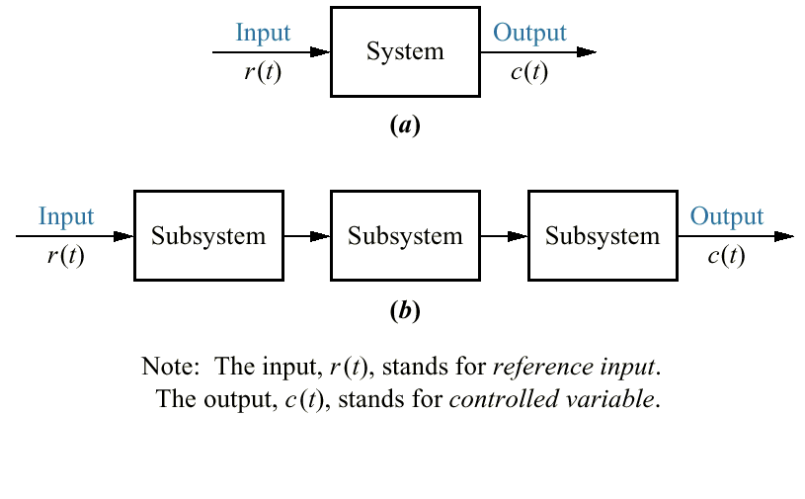
2.1 Introduction

Slide 4
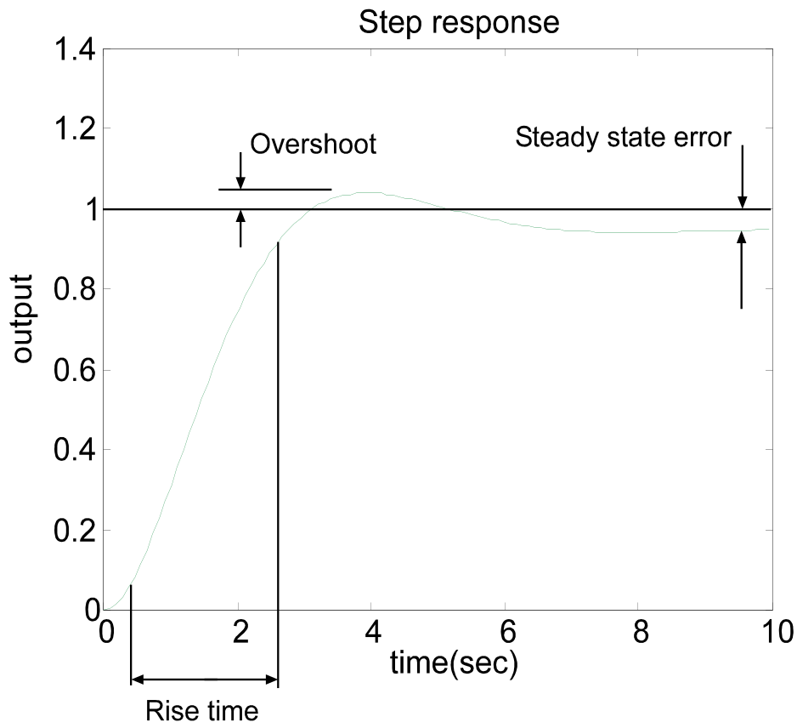
Mathematical Modelling
To understand system performance, a mathematical model of the plant is required
This will eventually allow us to design control systems to achieve a particular specification

Slide 5
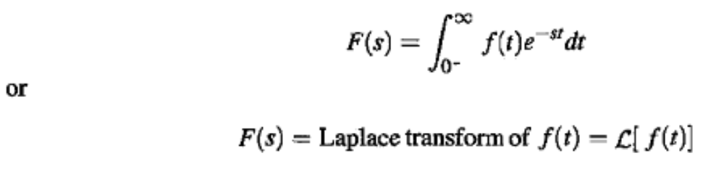
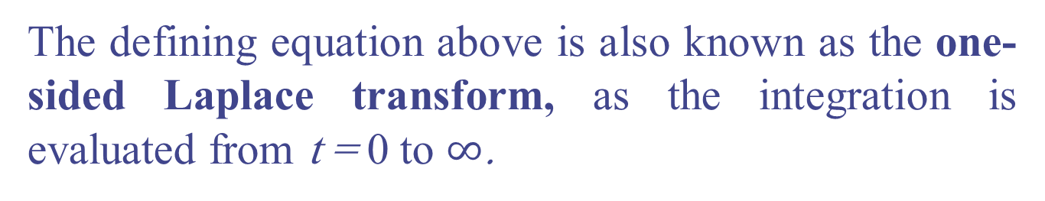
2.2 Laplace Transform Review
The defining equation above is also known as the one-sided Laplace transform, as the integration is evaluated from t = 0 to $∞$.

Slide 6
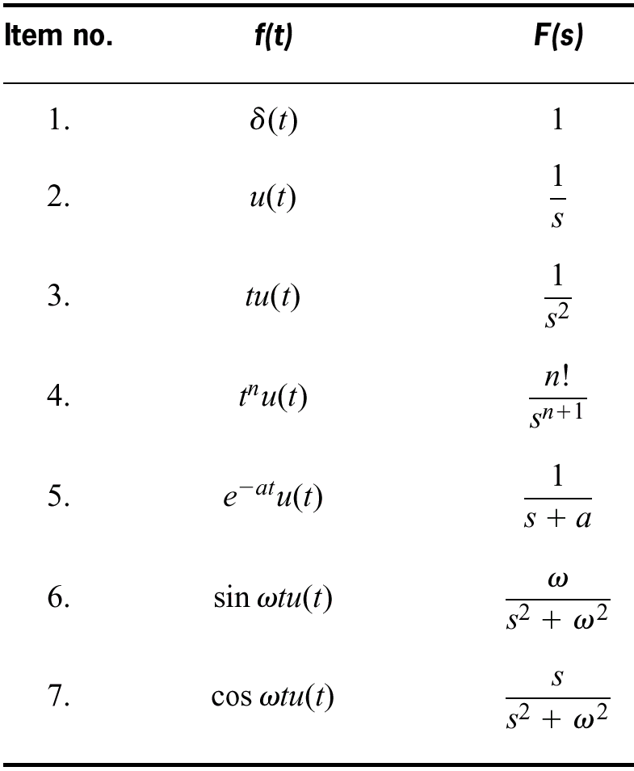
Laplace Transform Review
Laplace Table

Slide 7
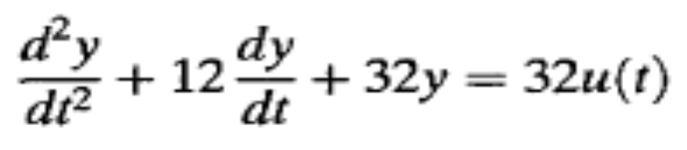
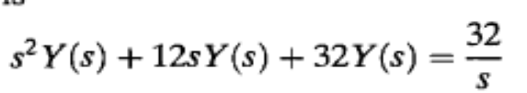
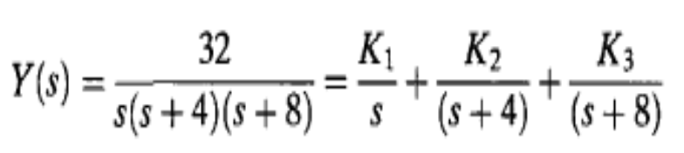
Laplace Transform Review
Example 2.3 P.39
PROBLEM: Given the following differential equation, solve for y(t) if all initial conditions are zero. Use the Laplace transform.
Solution
Solving for the response, Y(s), yields

Slide 8
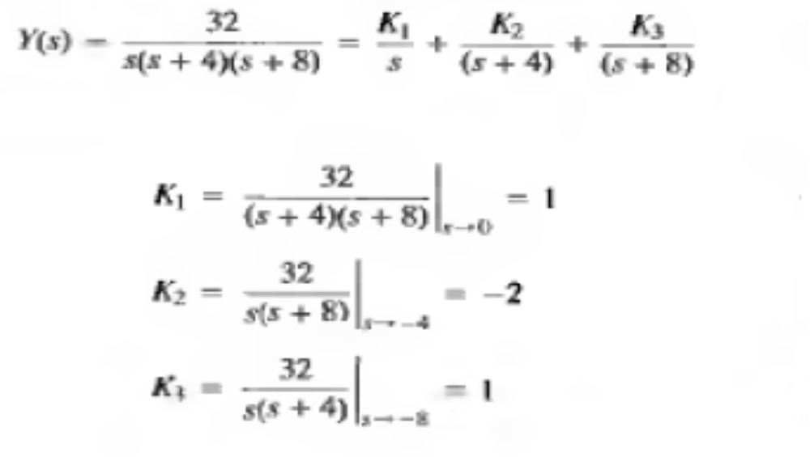
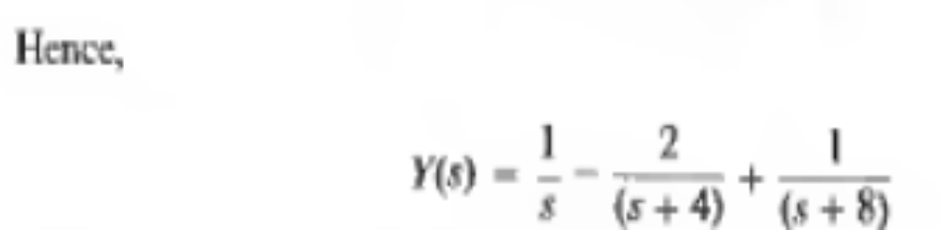
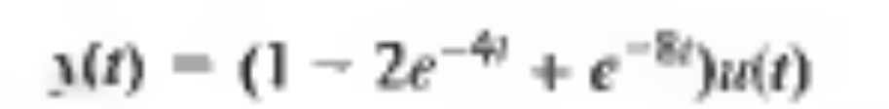
Laplace Transform Review

Slide 9
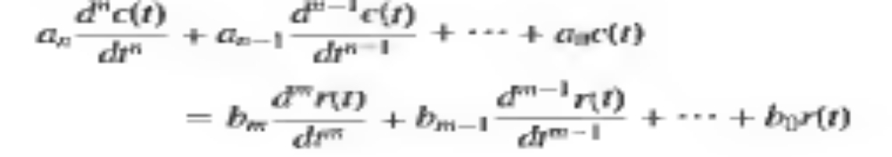
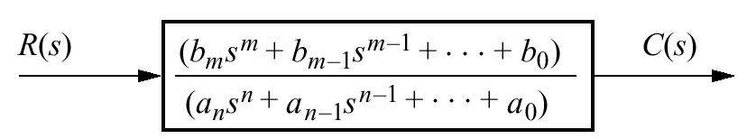
2.3 Transfer Function
T.F of LTI system is defined as the Laplace transform of the impulse response, with all the initial condition set to zero

Slide 10


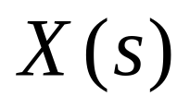
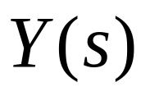
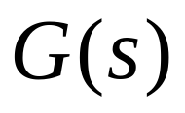
Transfer Functions
Transfer Function G(s) describes system component
Described as a Laplace transform because

Slide 11
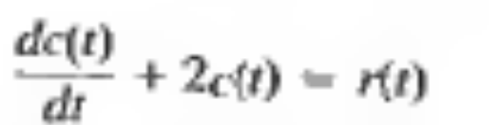
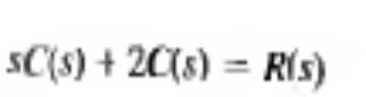
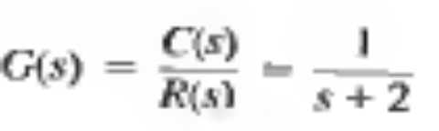
Transfer Function
Example 2.4 P.45 Find the T.F
Solution

Slide 12
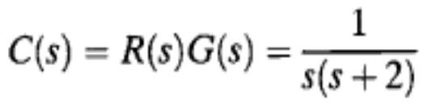
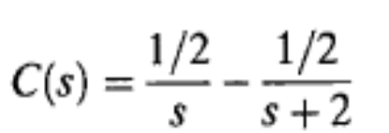
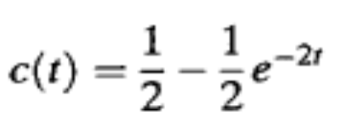
T.F
Example 2.5 P. 46
PROBLEM: Use the result of Example 2.4 to find the response, c(t) to an input, r(t) = u(t), a unit step, assuming zero initial conditions.
SOLUTION: To solve the problem, we use G(s) = l/(s + 2) as found in Example 2.4. Since r(t) = u(t), R(s) = 1/s, from Table 2.1. Since the initial conditions are zero,
Expanding by partial fractions, we get

Slide 13
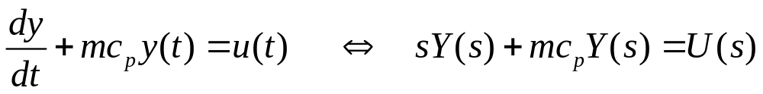
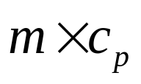
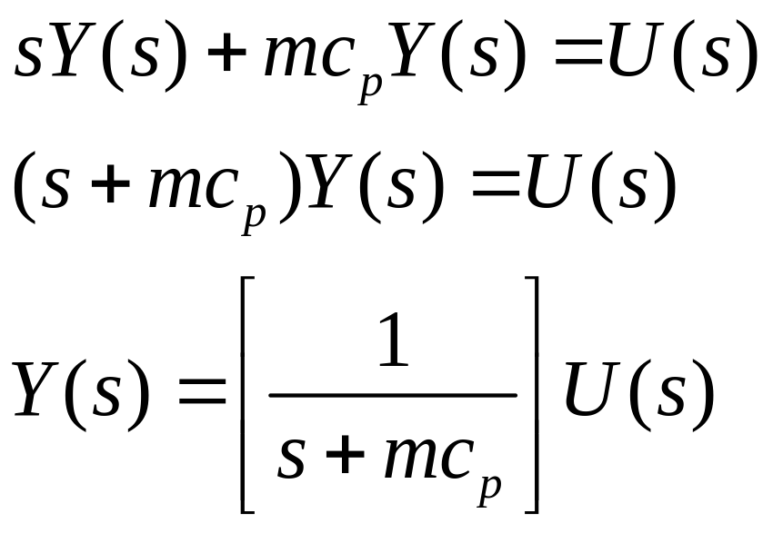
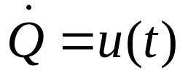

Laplace Example
Physical model

Slide 14

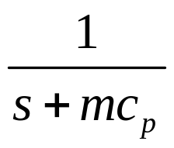
Laplace Example
Block Diagram model
Physical model

Slide 15
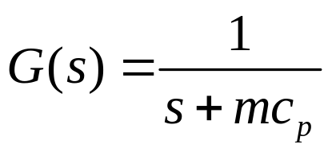
Laplace Example
Physical model
Transfer Function

Slide 16
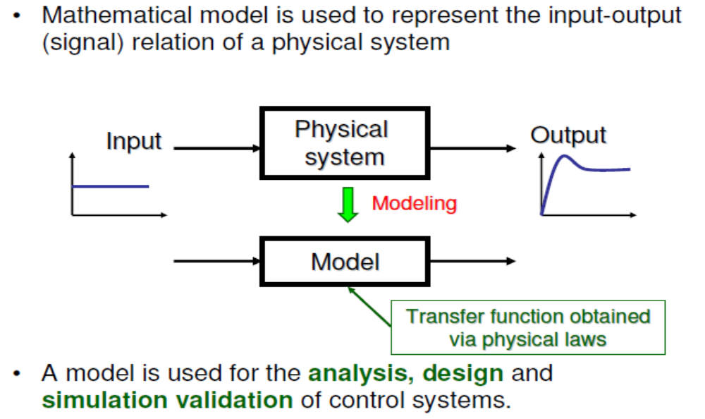
Modeling Physical Systems - Overview

Slide 17
Modeling – Remarks
• Modeling is the most important and difficult task in control system design.
• No mathematical model exactly represents a physical system.
Math Model ≠ Physical System
Math Model ≈ Physical System
• Do not confuse models with physical systems!
• In this course, we may use the term “system” or “plant” to mean a mathematical model.

Slide 18
2.4 Electric Network Transfer Function
In this section, we formally apply the transfer function to the mathematical modeling of electric circuits including passive networks
Equivalent circuits for the electric networks that we work with first consist of three passive linear components: resistors, capacitors, and inductors.“
We now combine electrical components into circuits, decide on the input and output, and find the transfer function. Our guiding principles are Kirchhoff s laws.

Slide 19
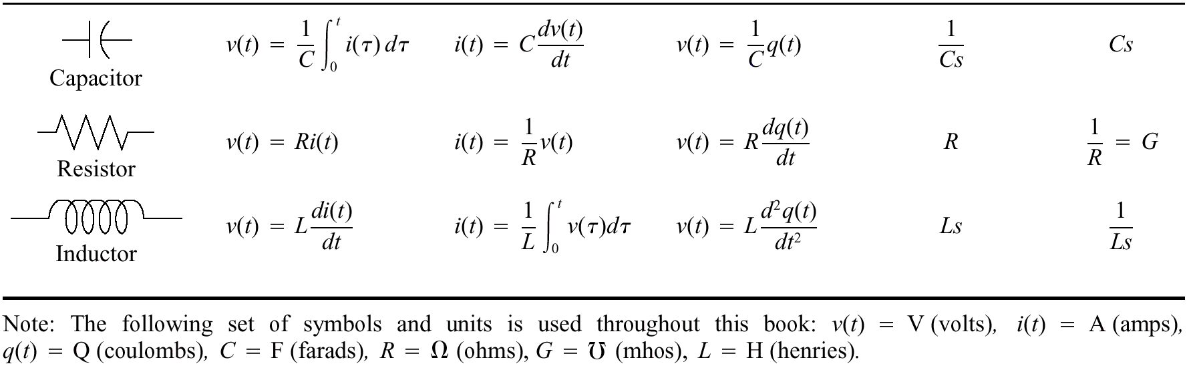
2.4 Electric Network Transfer Function
Table 2.3 Voltage-current, voltage-charge, and impedance relationships for capacitors, resistors, and inductors

Slide 20
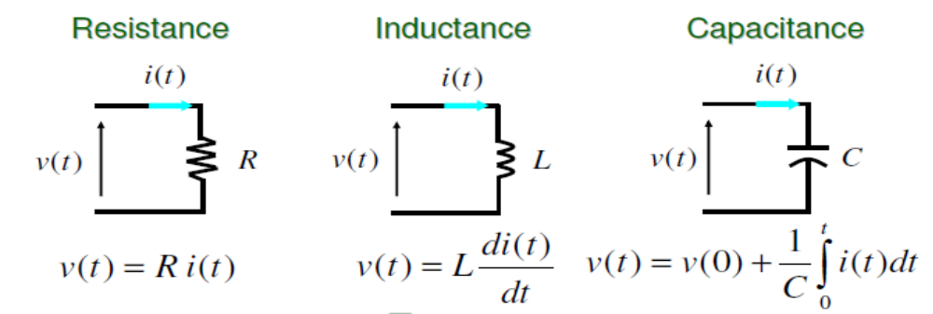
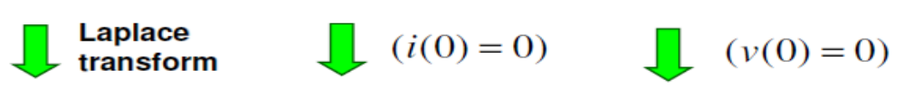
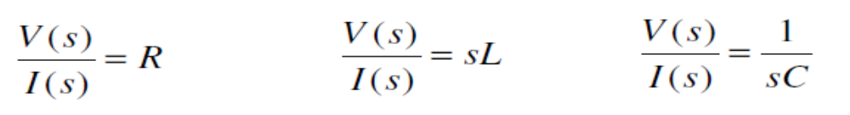
Modeling – Electrical Elements

Slide 21
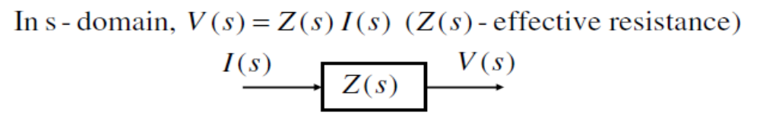
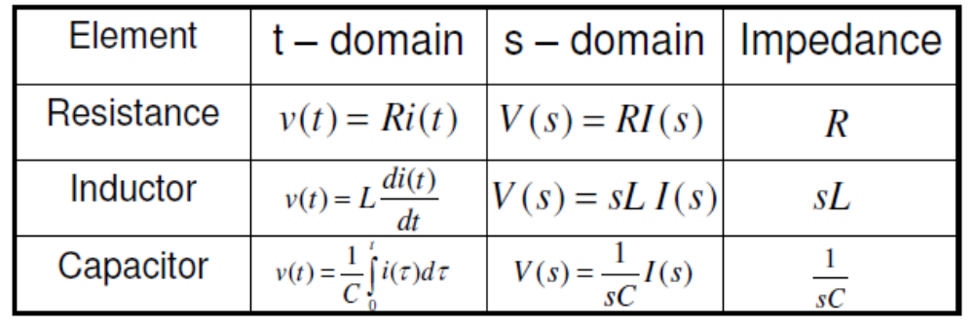
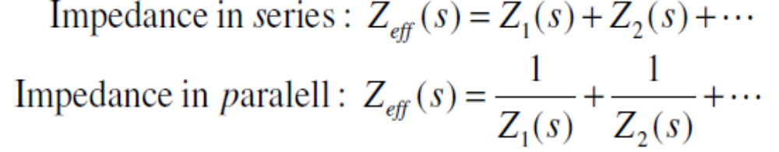
Modeling – Impedance

Slide 22
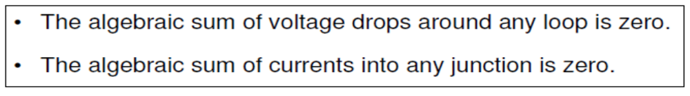
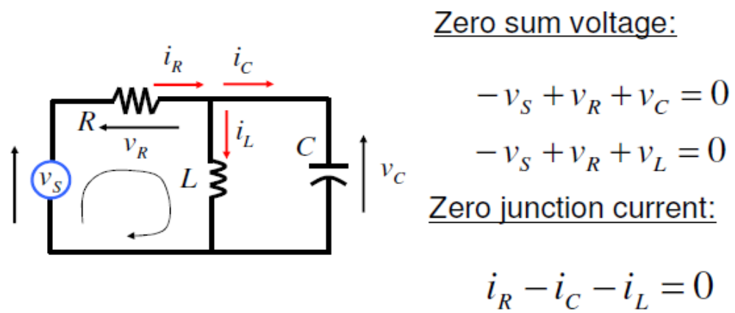
Modeling – Kirchhoff’s Voltage & Current Laws

Slide 23
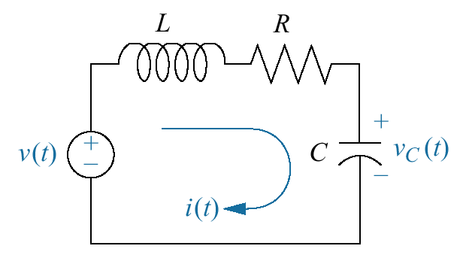
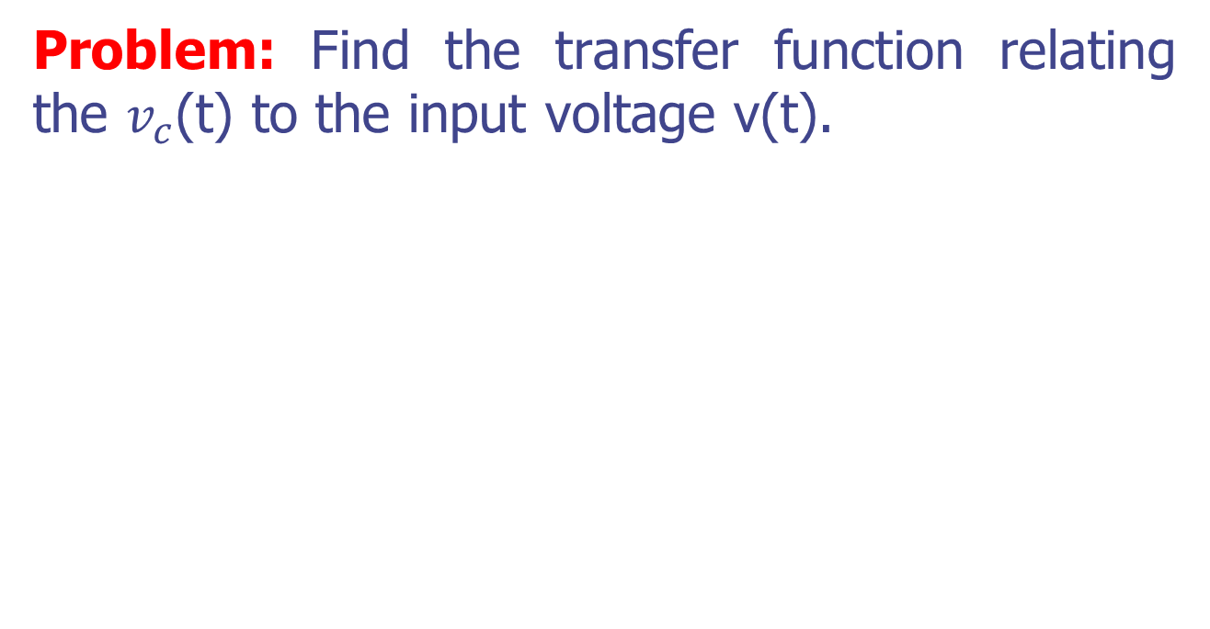
Example 2.6 P. 48
Problem: Find the transfer function relating the $v_{c}$(t) to the input voltage v(t).

Slide 24
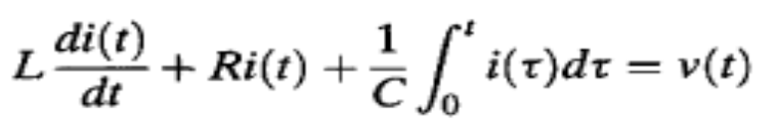
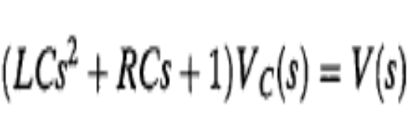
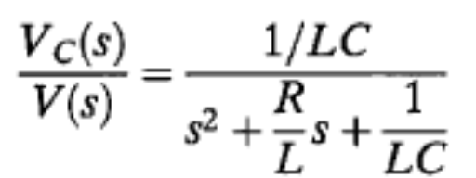
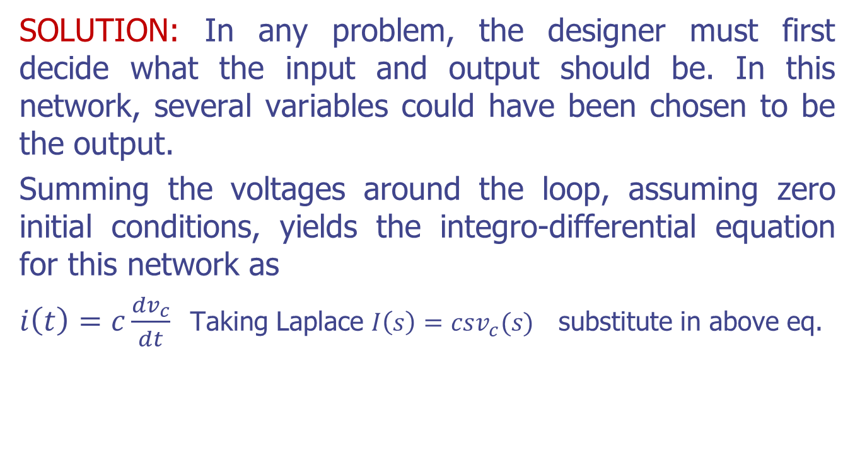
Example 2.6 P. 48
SOLUTION: In any problem, the designer must first decide what the input and output should be. In this network, several variables could have been chosen to be the output.
Summing the voltages around the loop, assuming zero initial conditions, yields the integro-differential equation for this network as
$i\left(t\right)=c\frac{dv_{c}}{dt}$ Taking Laplace $I\left(s\right)=csv_{c}(s)$ substitute in above eq.

Slide 25
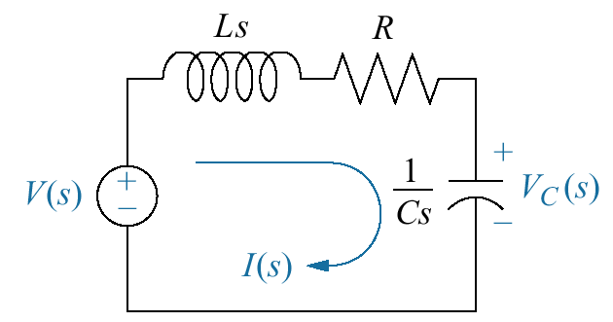
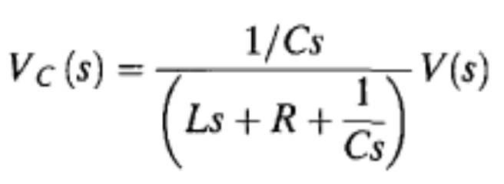
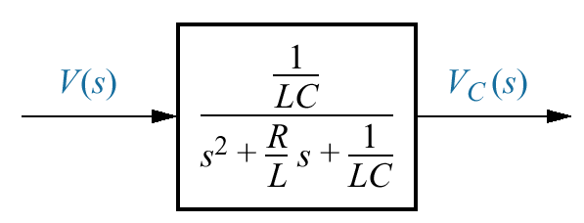
Example 2.9 P. 51
PROBLEM: Repeat Example 2.6 using the transformed circuit.
Solution
using voltage division

Slide 26
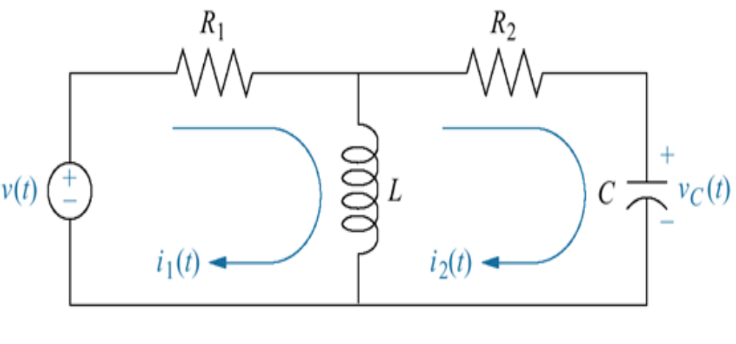
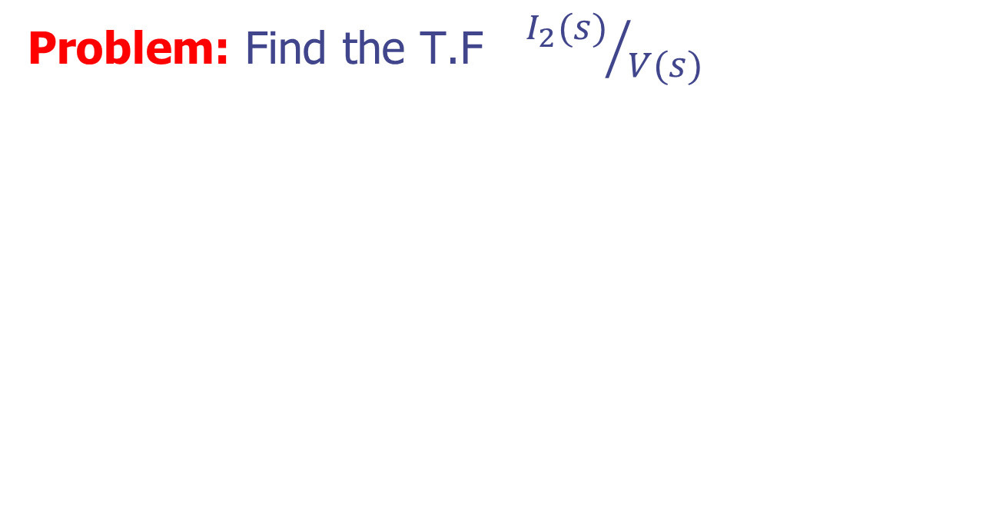
Example 2.10 P. 52
Problem: Find the T.F ${I_{2}(s)}/{V(s)}$

Slide 27
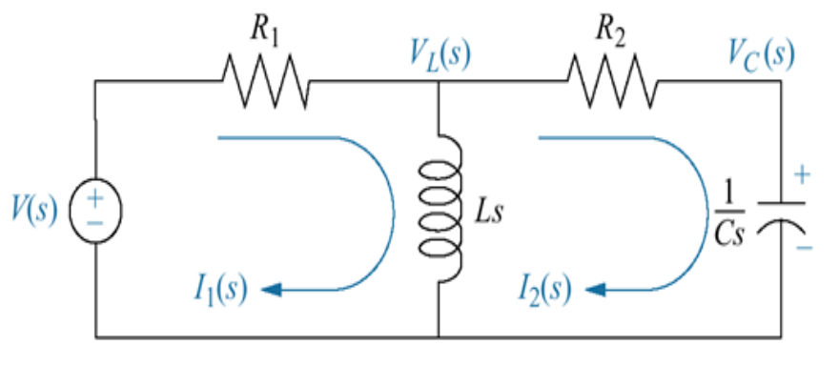


Example 2.10 P. 52
Solution:
Using mesh current
$$\left(R_{1}+LS\right)I_{1}−LSI_{2}=V\left(s\right)$$
-LS$I_{1}$ + $\left(R_{2}+LS+1/CS\right)I_{2}$ =0

Slide 28
Modeling – Summary (Electrical System)
• Modeling
– Modeling is an important task!
– Mathematical model
– Transfer function
– Modeling of electrical systems
• Next, modeling of mechanical systems

Slide 29
2.5 Translational Mechanical System T.F
The motion of Mechanical elements can be described in various dimensions as translational, rotational, or combinations of both.
Mechanical systems, like electrical systems have three passive linear components.
Two of them, the spring and the mass, are energy-storage elements; one of them, the viscous damper, dissipate energy.
The motion of translation is defined as a motion that takes place along a straight or curved path. The variables that are used to describe translational motion are acceleration, velocity, and displacement.

Slide 30

2.5 Translational Mechanical System T.F
Newton's law of motion states that the algebraic sum of external forces acting on a rigid body in a given direction is equal to the product of the mass of the body and its acceleration in the same direction. The law can be expressed as
$$\sum{Forces=Ma}$$

Slide 31

2.5 Translational Mechanical System T.F
Table 2.4 Force-velocity, force-displacement, and impedance translational relationships for springs, viscous dampers, and mass

Slide 32

Modeling – Mechanical Elements

Slide 33


Modeling – Spring-Mass-Damper Systems

Slide 34



Modeling – Free Body Diagram

Slide 35



Modeling – Spring-Mass-Damper System

Slide 36

Example 2.16 P. 70
Problem: Find the transfer function X(S)/F(S)

Slide 37



Example 2.16 P. 70
Solution:

Slide 38

Example
Write the force equations of the linear translational systems shown in Fig below;

Slide 39


Example
Solution
Rearrange the following equations

Slide 40


Example 2.17 P. 72
Problem: Find the T.F ${X_{2}(S)}/{F(S)}$

Slide 41


Example 2.17 P. 72
Solution:

Slide 42


Example 2.17 P. 72

Slide 43

Example 2.17 P. 72
Transfer Function

Slide 44
2.6 Rotational Mechanical System T.F
Rotational mechanical systems are handled the same way as translational mechanical systems, except that torque replaces force and angular displacement replaces translational displacement.
The mechanical components for rotational systems are the same as those for translational systems, except that the components undergo rotation instead of translation

Slide 45

2.6 Rotational Mechanical System T.F
The rotational motion of a body can be defined as motion about a fixed axis.
The extension of Newton's law of motion for rotational motion :
$\sum{Torques=Jα}$
where J denotes the inertia and α is the angular acceleration.

Slide 46

2.6 Rotational Mechanical System T.F
The other variables generally used to describe the motion of rotation are torque T, angular velocity ω, and angular displacement θ. The elements involved with the rotational motion are as follows:
• Inertia. Inertia, J, is considered a property of an element that stores the kinetic energy of rotational motion. The inertia of a given element depends on the geometric composition about the axis of rotation and its density. For instance, the inertia of a circular disk or shaft, of radius r and mass M, about its geometric axis is given by
$$J=1/2Mr^{2}$$

Slide 47

2.6 Rotational Mechanical System T.F
Table 2.5
Torque-angular velocity, torque-angular displacement,
and impedance
rotational relationships for springs, viscous dampers, and inertia

Slide 48

Modeling – Rotational Mechanism

Slide 49



Example
Problem: The rotational system shown in Fig below consists of a disk mounted on a shaft that is fixed at one end. Assume that a torque is applied to the disk, as shown.
Solution:

Slide 50


Modeling – Torsional Pendulum System

Slide 51


Modeling – Free Body Diagram

Slide 52



Modeling – Torsional Pendulum System

Slide 53

Example
Problem: Fig below shows the diagram of a motor coupled to an inertial load through a shaft with a spring constant K. A non-rigid coupling between two mechanical components in a control system often causes torsional resonances that can be transmitted to all parts of the system.

Slide 54



Example
Solution:

Slide 55

Example 2.19 P.78
PROBLEM: Find the transfer function, θ2(s)/T(s), for the rotational system shown below. The rod is supported by bearings at either end and is undergoing torsion. A torque is applied at the left, and the displacement is measured at the right.

Slide 56



Example 2.19 P.78
Solution:
$$T\left(t\right)=J_{1}\ddot{θ_{1}}+B_{1}\dot{θ_{1}}+k(θ_{1}−θ_{2})$$
$$k\left(θ_{1}− θ_{2}\right)=J_{2}\ddot{θ_{2}}+B_{2}\dot{θ_{2}}$$

Slide 57

Example 2.20 P.80
PROBLEM: Write, but do not solve, the Laplace transform of the equations of motion for the system shown.

Slide 58

Example 2.20 P.80
Solution:

Slide 59
2.8 Electromechanical System Transfer Functions
Now, we move to systems that are hybrids of electrical and mechanical variables, the electromechanical systems.
A motor is an electromechanical component that yields a displacement output for a voltage input, that is, a mechanical output generated by an electrical input.
We will derive the transfer function for one particular kind of electromechanical system, the armature-controlled dc servomotor.
Dc motors are extensively used in control systems

Slide 60

Modeling – Electromechanical Systems
What is DC motor?
An actuator, converting electrical energy into rotational mechanical energy

Slide 61
Modeling – Why DC motor?
• Advantages:
– high torque
– speed controllability
– portability, etc.
• Widely used in control applications: robot, tape drives,
printers, machine tool industries, radar tracking system,
etc.
• Used for moving loads when
– Rapid (microseconds) response is not required
– Relatively low power is required

Slide 62

DC Motor

Slide 63

Modeling – Model of DC Motor

Slide 64
Dc Motor
ia(t) = armature current Ra = armature resistance
Ei(t) = back emf TL(t) = load torque
Tm(t) = motor torque θm(t) = rotor displacement
Ki — torque constant La = armature inductance
ea(t) = applied voltage Kb = back-emf constant
ωm magnetic flux in the air gap θm(t) — rotor angular velocity
Jm = rotor inertia Bm = viscous-friction coefficient

Slide 65


The Mathematical Model Of Dc Motor
The relationship between the armature current, ia(t), the applied armature voltage, ea(t), and the back emf, vb(t), is found by writing a loop equation around the Laplace transformed armature circuit
The torque developed by the motor is proportional to the armature current; thus
where Tm is the torque developed by the motor, and Kt is a constant of proportionality, called the motor torque constant, which depends on the motor and magnetic field characteristics.

Slide 66



The Mathematical Model Of Dc Motor
Mechanical System
Since the current-carrying armature is rotating in a magnetic field, its voltage is proportional to speed. Thus,
Taking Laplace Transform

Slide 67




The Mathematical Model Of Dc Motor
We have
Electrical System
GIVEN
Mechanical System

Slide 68




The Mathematical Model Of Dc Motor
To find T.F
If we assume that the armature inductance, La, is small compared to the armature resistance, Ra, which is usual for a dc motor, above Eq. Becomes
the desired transfer function of DC Motor:

Slide 69
2.10 Nonlinearities
The models thus far are developed from systems that can be described approximately by linear, time-invariant differential equations. An assumption of linearity was implicit in the development of these models.
A linear system possesses two properties: superposition and homogeneity. The property of superposition means that the output response of a system to the sum of inputs is the sum of the responses to the individual inputs

Slide 70


Modeling – What Is a Linear System?
A system having Principle of Superposition
A nonlinear system does not satisfy the principle of superposition.

Slide 71
Modeling – Why Linear System?
• Easier to understand and obtain solutions
• Linear ordinary differential equations (ODEs),
– Homogeneous solution and particular solution
– Transient solution and steady state solution
– Solution caused by initial values, and forced solution
• Easy to check the Stability of stationary states (Laplace Transform)

Slide 72
2.11 Linearization
The electrical and mechanical systems covered thus far were assumed to be linear. However, if any nonlinear components are present, we must linearize the system before we can find the transfer function.

Slide 73
Modeling – Why Linearization
Actual physical systems are inherently nonlinear. (Linear systems do not exist!)
TF models are only for Linear Time-Invariant (LTI) systems.
Many control analysis/design techniques are available only for linear systems.
Nonlinear systems are difficult to deal with mathematically.
Often we linearize nonlinear systems before analysis and design.

