Slide 1
KULLIYYAH OF ENGINEERING
INTERNATIONAL ISLAMIC UNIVERSITY MALAYSIA
Computer Aided Drawing
INTRODUCTION TO
COMPUTER AIDED DRAWING

Slide 2

OUTLINE
Introduction to CAD
Scales & lines
Geometrical Dimension & Tolerance (GD&T)

Slide 3
1. INTRODUCTION TO
CAD

Slide 4
INTRODUCTION TO
ENGINEERING DRAWING / CAD
CAD serves as an aid to shape and communicate an abstract idea in your imagination into a 3D or 2D model for others to understand.
CAD enables the development, modification, and optimization of the design process.
CAD enables the development, modification, and optimization of the design process.
Engineers can make more accurate representations and modify them easily to improve design quality.

Slide 5
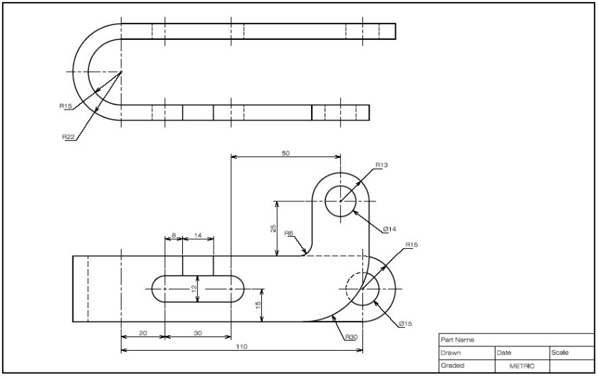
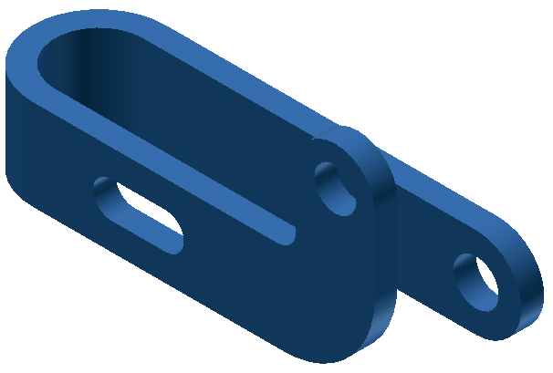
CREATE A DRAWING :
Using a computer
Usually made by commercial software such as SolidWorks, Catia, AutoCaD, Alibre etc.
2D Drawing
Solid Modeling

Slide 6
PLANNING YOUR SKETCH
When laying out a drawing sheet, you will need to consider:
The size and scale of the object you will show the sheet size.
The measurement system (units) for the drawing.
The space necessary for standard notes and title block.
Note: The object you are drawing is the “star” of the sketch. Keep the object near the center of the sheet. It should be boldly drawn, using thick visible lines. Make it large enough to fill most of the sheet so that the details are clearly visible.

Slide 7
2. SCALES & LINES

Slide 8
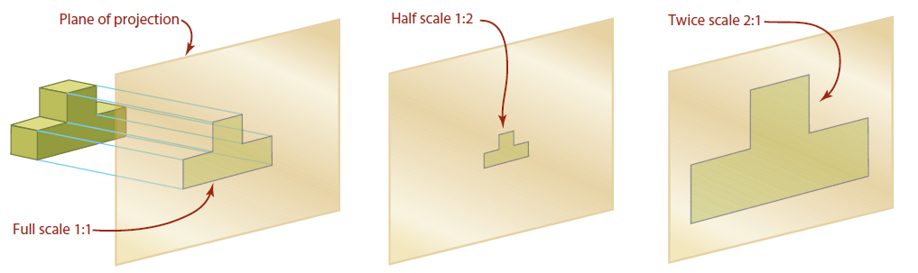
ENGINEERING DRAWING BASICS: Drawing Scale
Drawing scale is the reduction or enlargement of the drawn object relative to the real object
Drawing
Real Measurement
SCALE 1 : 2
Designation of a scale consists of the word “SCALE” followed by the indication of its ratio as follows:
  SCALE 1:1 for full size
  SCALE X:1 for enlargement scales (i.e. X > 1)
  SCALE 1:X for reduction scales (i.e. X< 1)

Slide 9
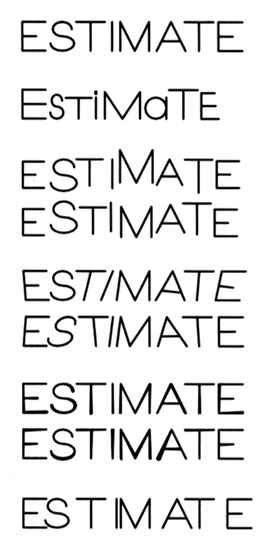
ENGINEERING DRAWING BASICS: Drawing Scale
Text’s style on the drawing must have the following 2 properties
Examples
GOOD
Legibility/clarity
Not uniform in style.
- Shape
Space between letters
Space between words
Not uniform in height.
Not uniformly vertical.
Not uniform in
thickness of stroke.
Uniformity
- Size (or text height)
- line thickness
Inappropriate space
between letters

Slide 10
MEANING AND TYPES OF BASIC LINES
1. Dimension line
2. Extension line
3. Leader line
Thickness Style | Thick | Thin
Continuous
Dash
Chain
Visible line
Hidden line
Center line
Visible line: represent features that can be seen in the current view.
Dimension line, Extension line & Leader line: indicate the sizes and location of features.
Hidden line: represent features that can not be seen in the current view.
Center line: represents symmetry, path of motion, centers of circles, axis of axisymmetrical parts

Slide 11
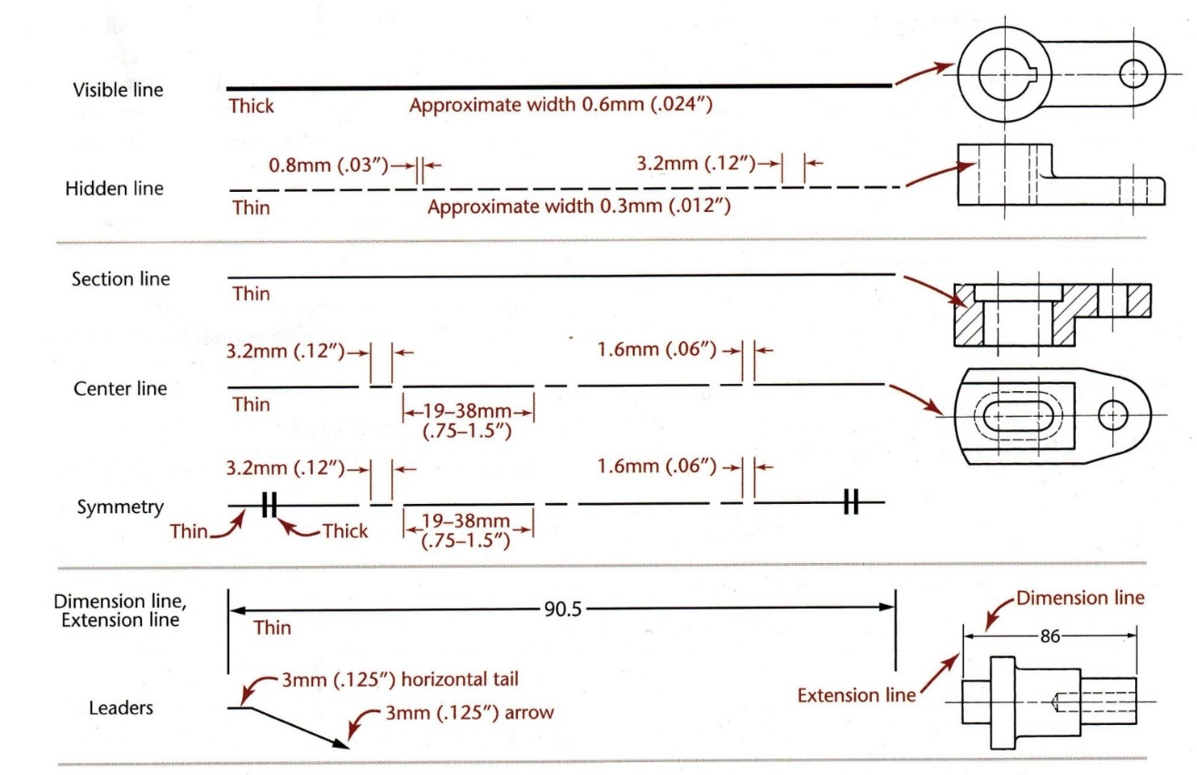
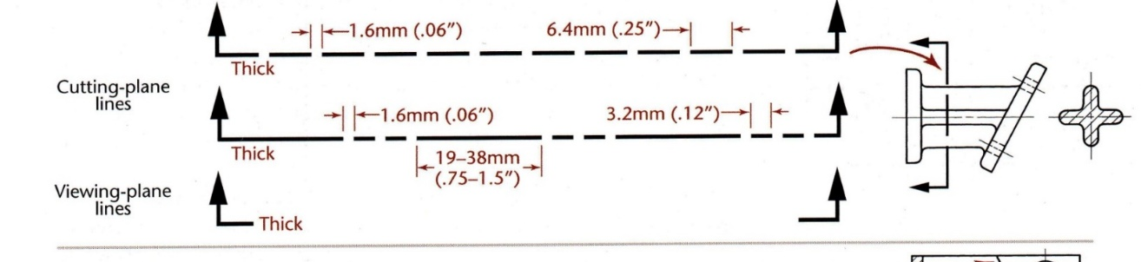
TYPES OF LINES

Slide 12
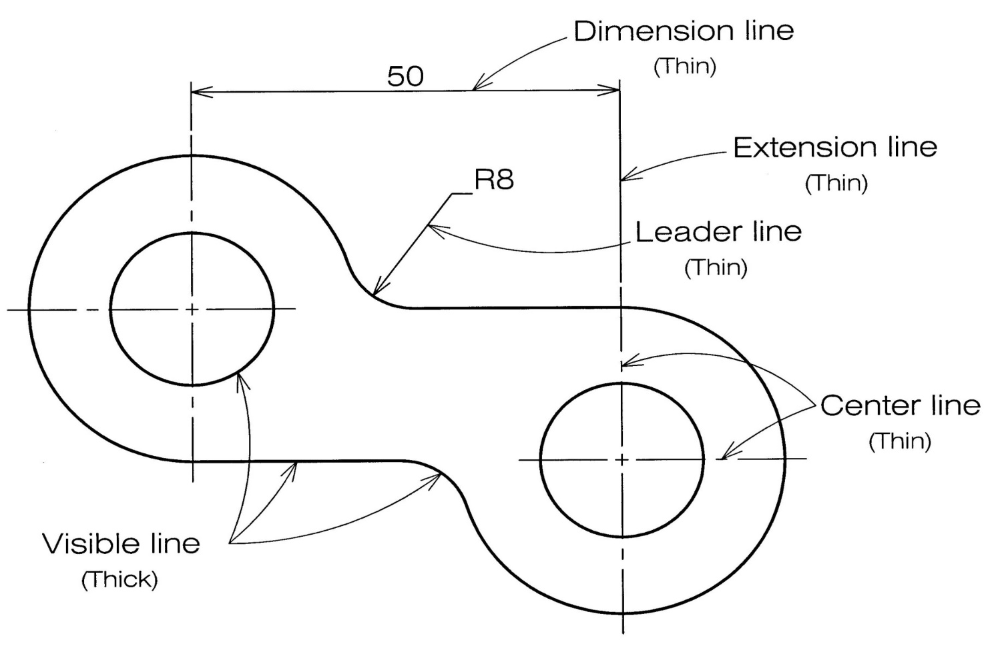
EXAMPLE :

Slide 13
ENGINEERING DRAWING BASICS : Dimensioning
Dimensioning is the process of specifying part’s information by using of lines, number, symbols and notes.

Slide 14
DIMENSIONING COMPONENTS
Extension lines
indicate the location on the object’s features that are dimensioned.
Dimension lines (with arrowheads)
indicate the direction and extent of a dimension, and inscribe dimension numbers.
Dimension numbers (or dimension figures)
Leader lines
indicate details of the feature with a local note.
Notes
local or general notes.
Example
20
φ10
R16
123º
13

Slide 15
DIMENSIONING
~ Recommended Practice ~

Slide 16
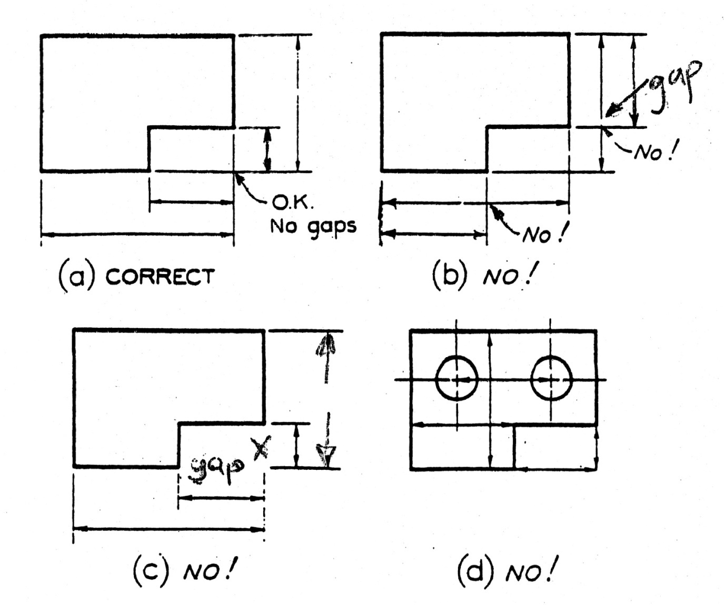
ENGINEERING DRAWING BASIC DIMENSIONING

Slide 17
EXTENSION LINE
Always leave a visible gap (≈ 1 mm) from a view or center lines before start drawing a line.
Extend the lines beyond the (last) dimension line 2-3 mm.
Good practice
Poor practice
3
2
2
1
4

Slide 18
EXTENSION LINE
Do not break the extension lines as they cross any line types, e.g. visible line, hidden line or center line, i.e. extension line always a continuous line.
Good practice
Poor practice
1
3
2

Slide 19
DIMENSION LINE
Dimension lines should be appropriately spaced apart from each other and the view.
Poor practice
Good practice
Too close
30
34
30
34
25
25
Too far
At least 2 times
of a font size
30
34
At least 1 time
of a font size
25

Slide 20
DIMENSION NUMBER : General
The height of numbers is suggested to be 2.5~3 mm.
Place the numbers at about 1 mm above and at a middle of a
dimension line (for ISO dimensioning).
Poor practice
Good practice
30
34
30
25
25
34

Slide 21
3. GEOMETRICAL DIMENSION & TOLERANCE (GD&T)

Slide 22
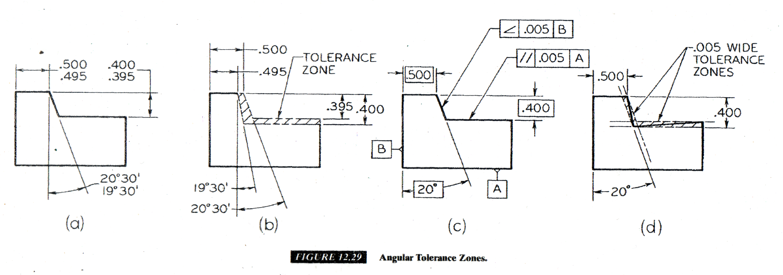
Geometrical Dimension and Tolerance

Slide 23
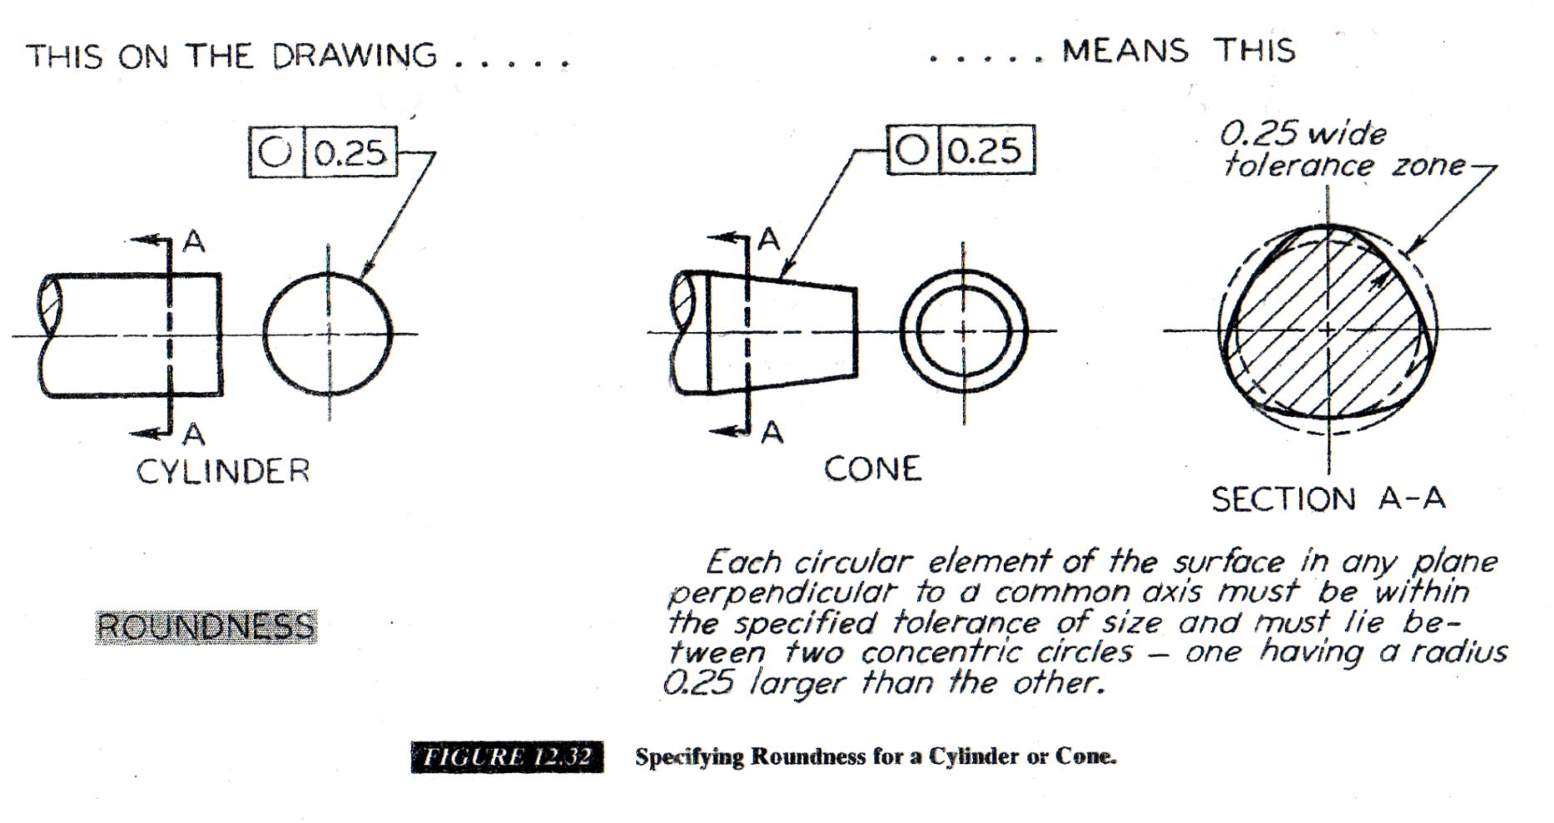
Geometrical Dimension and Tolerance

Slide 24
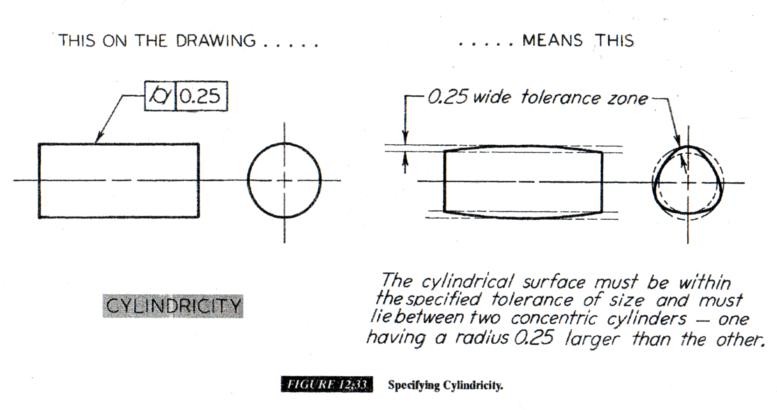
Geometrical Dimension and Tolerance

Slide 25
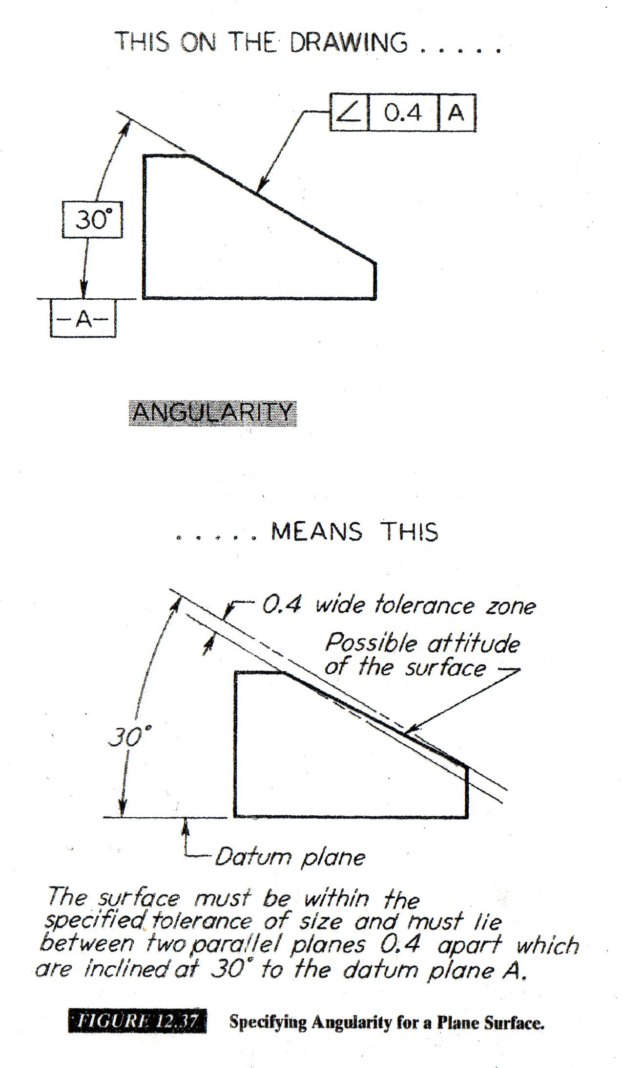
Geometrical Dimension and Tolerance

Slide 26
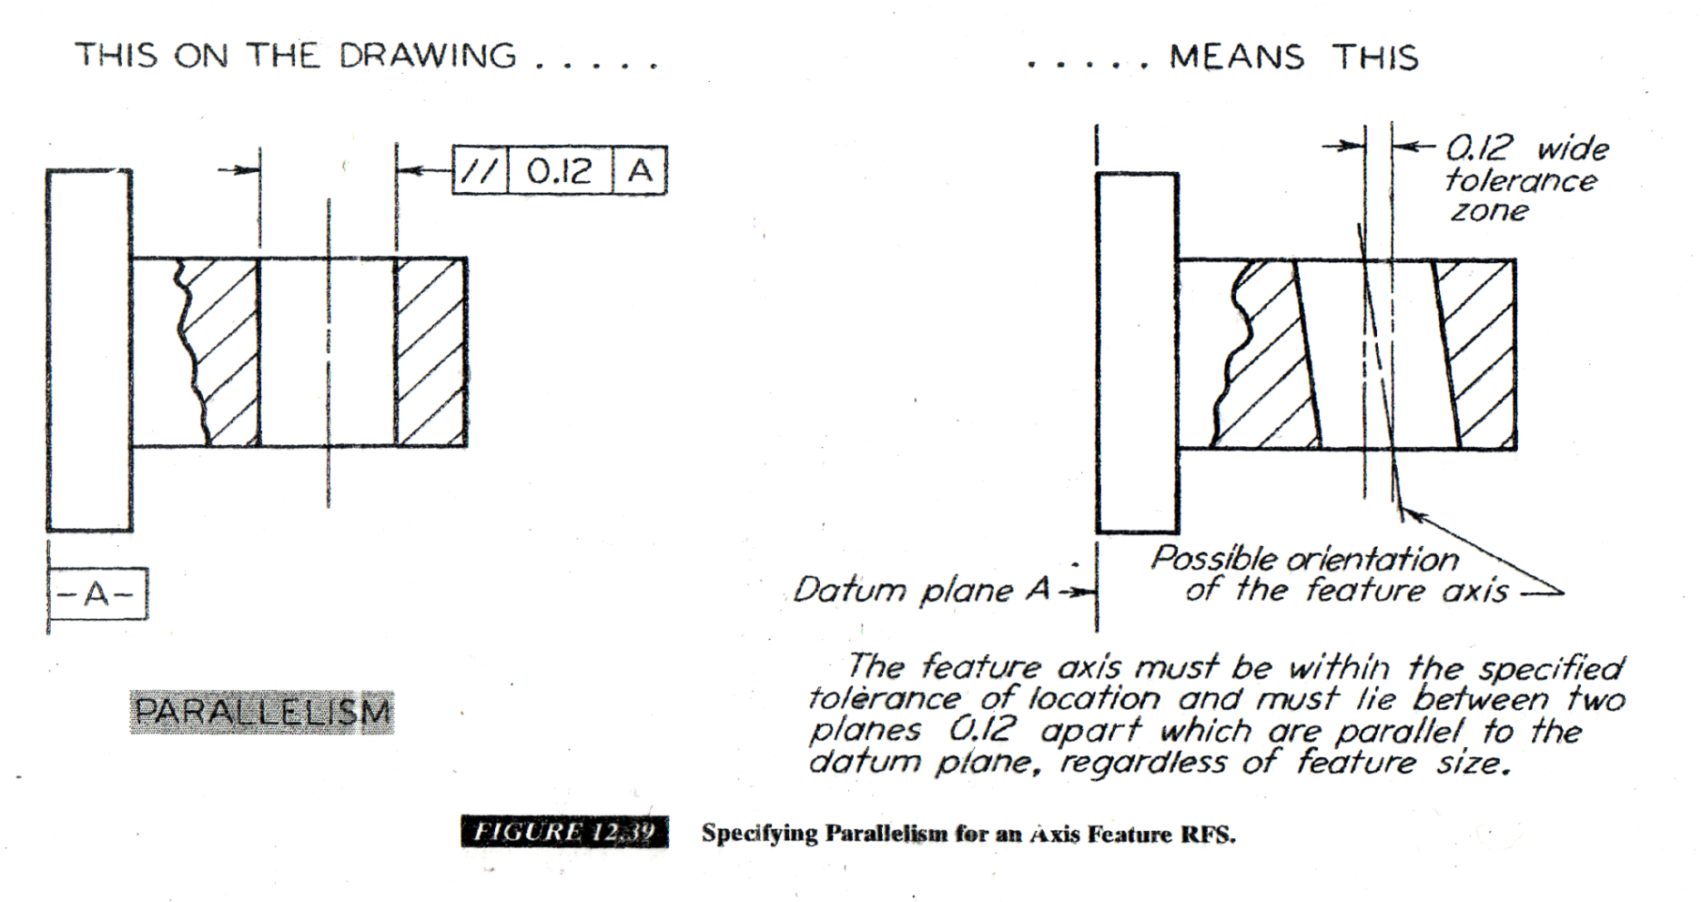
Geometrical Dimension and Tolerance

Slide 27
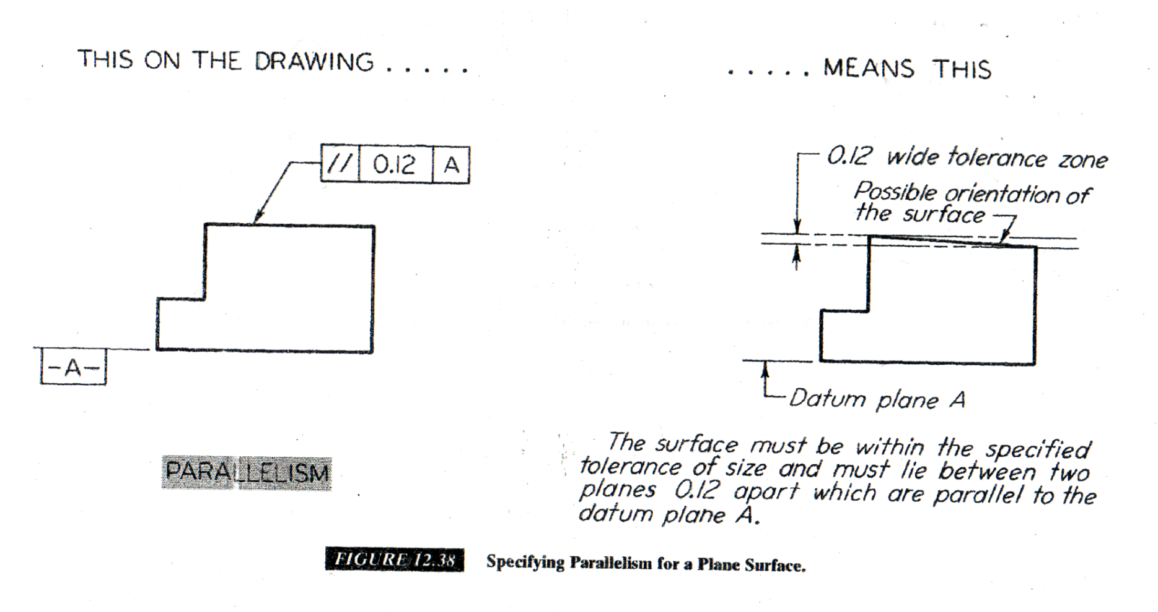
Geometrical Dimension and Tolerance

Slide 28
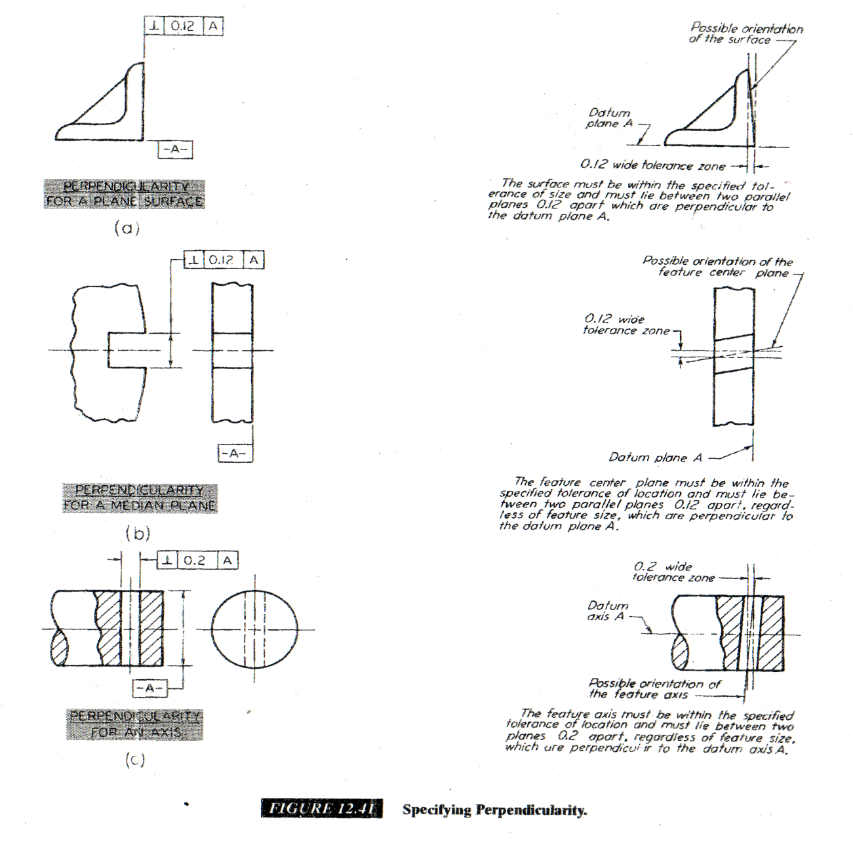
Geometrical Dimension and Tolerance

Slide 29
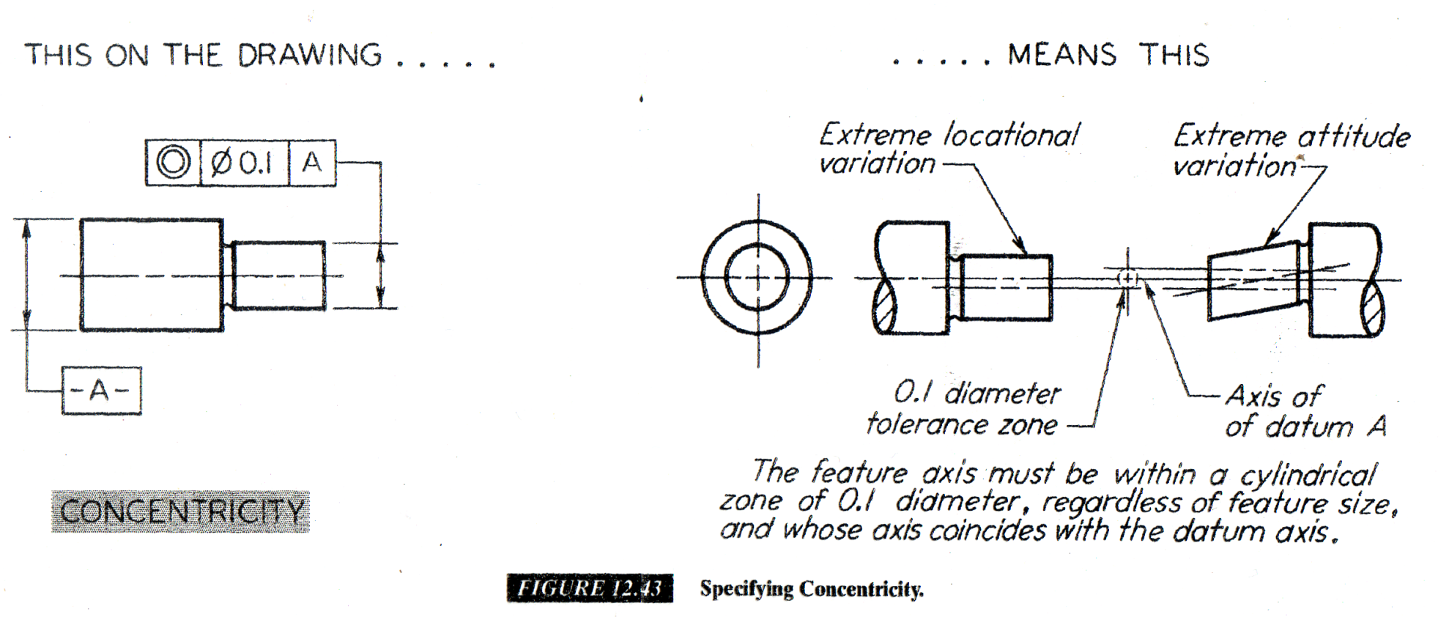
Geometrical Dimension and Tolerance

Slide 30
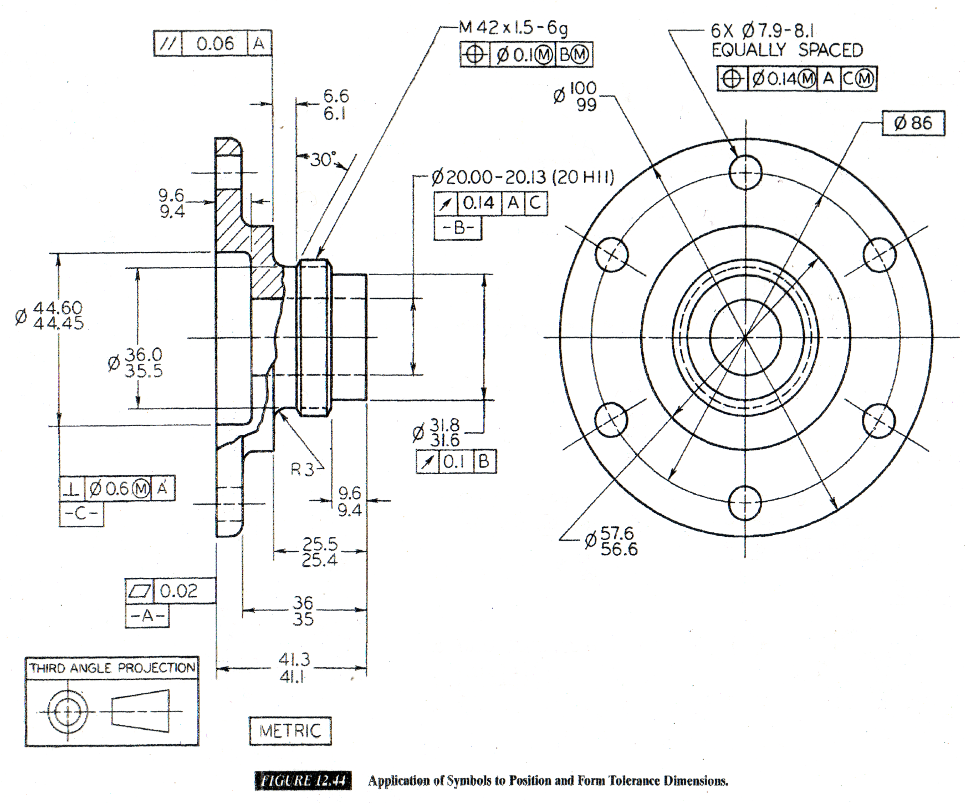
Geometrical Dimension and Tolerance

Slide 31
Thank You

