Slide 1

Chapter 13
Files and Exception Handling
Prof. Dr. Mohammed Alhanjouri
Professor of Artificial Intelligence Engineering

Slide 2
Motivations
Data stored in the program are temporary; they are lost when the program terminates. To permanently store the data created in a program, you need to save them in a file on a disk or other permanent storage. The file can be transported and can be read later by other programs. There are two types of files: text and binary. Text files are essentially strings on disk.
This chapter introduces how to read/write data from/to a text file.
When a program runs into a runtime error, the program terminates abnormally. How can you handle the runtime error so that the program can continue to run or terminate gracefully?
This is the subject we will introduce in this chapter.

Slide 3
Objectives
To open a file, read/write data from/to a file (§13.2)
To use file dialogs for opening and saving data (§13.3).
To develop applications with files (§13.4)
To read data from a Web resource (§13.5).
To handle exceptions using the try/except/finally clauses (§13.6)
To raise exceptions using the raise statements (§13.7)
To become familiar with Python’s built-in exception classes (§13.8)
To access exception object in the handler (§13.8)
To define custom exception classes (§13.9)
To perform binary IO using the pickle module (§13.10)

Slide 4
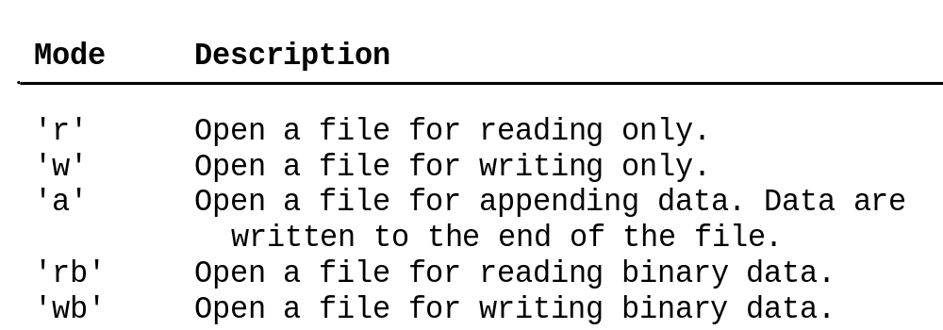
Open a File
How do you write data to a file and read the data back from a file? You need to create a file object that is associated with a physical file. This is called opening a file. The syntax for opening a file is as follows:
fileVariable = open(filename, mode)

Slide 5
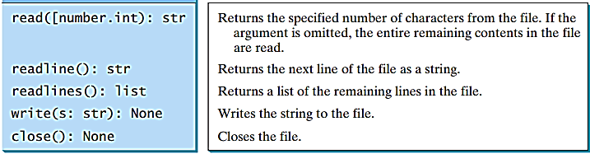
Write to a File
outfile = open("test.txt", "w")
outfile.write("Welcome to Python")

Slide 6
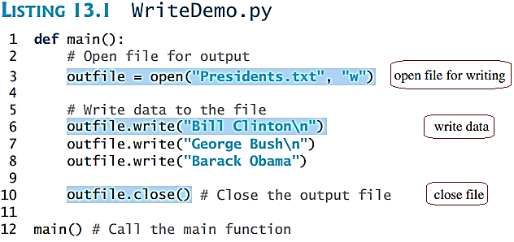
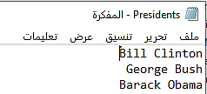
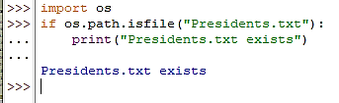
Write to a File & Testing File Existence
Testing File Existence

Slide 7
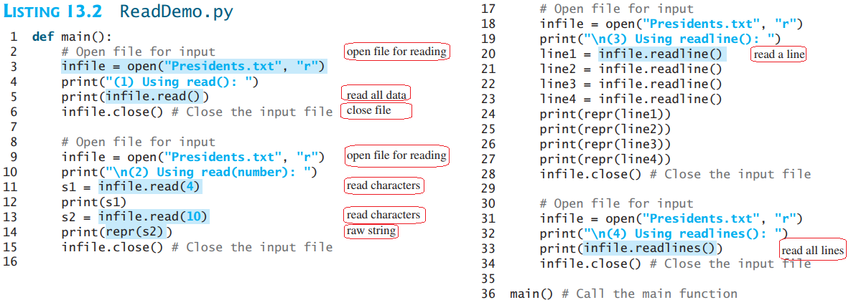
Read from a File
After a file is opened for reading data, you can use the read method to read a specified number of characters or all characters, the readline() method to read the next line, and the readlines() method to read all lines into a list.

Slide 8
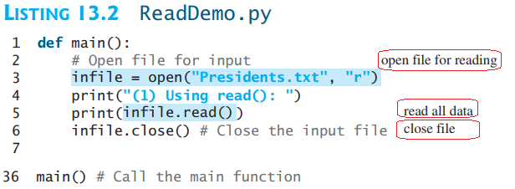

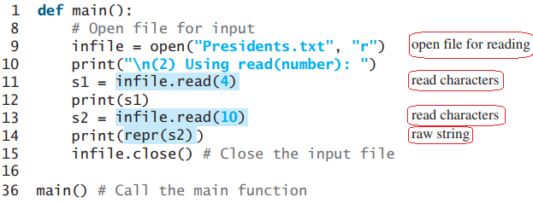

Read from a File

Slide 9
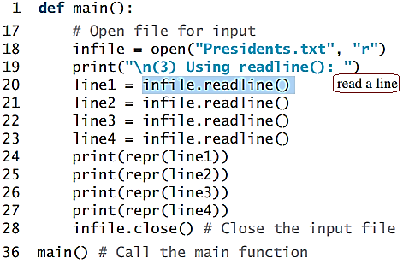
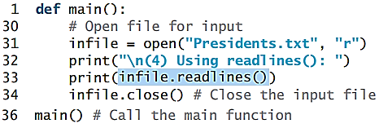

Read from a File

Slide 10
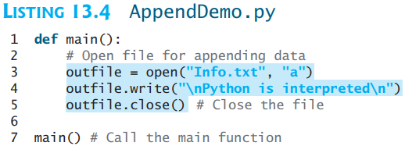
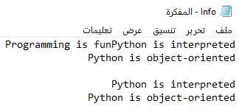
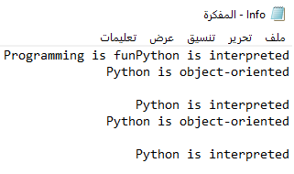
Append Data to a File
You can use the 'a' mode to open a file for appending data to an existing file.
Pefore After

Slide 11
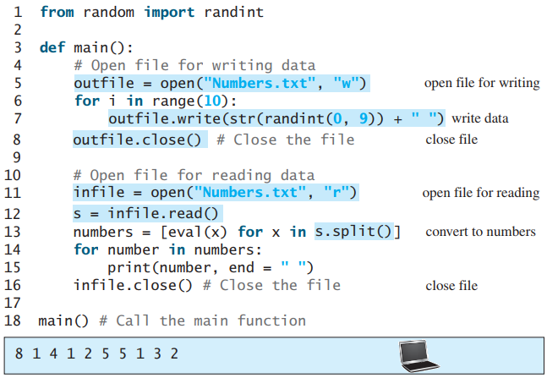
Writing/Reading Numeric Data
To write numbers, convert them into strings, and then use the write method to write them to a file. In order to read the numbers back correctly, you should separate the numbers with a whitespace character such as ' ‘ , '\n'.

Slide 12
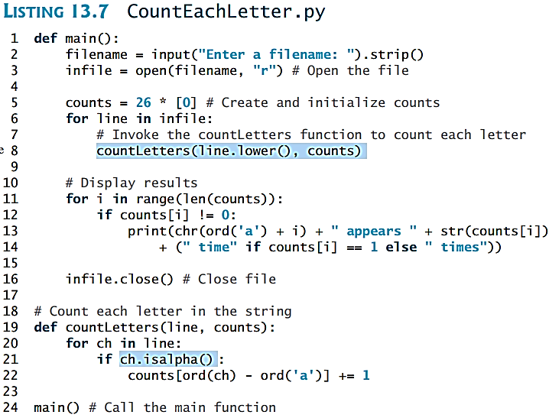
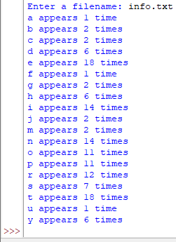
Problem: Counting Each Letter in a File
The problem is to write a program that prompts the user to enter a file and counts the number of occurrences of each letter in the file regardless of case.

Slide 13
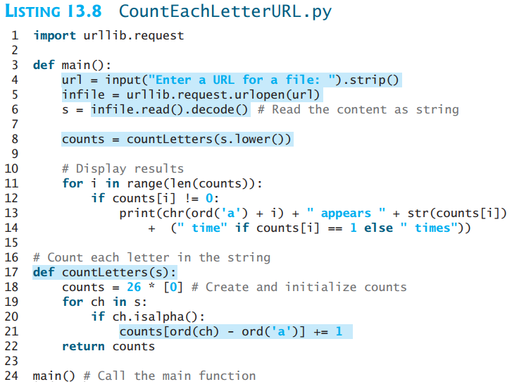
Retrieving Data from the Web
Using Python, you can write simple code to read data from a Website. All you need to do is to open a URL link using the urlopen function as follows:
infile = urllib.request.urlopen('http://www.yahoo.com')
import urllib.request
infile = urllib.request.urlopen('http://www.yahoo.com/index.html')
print(infile.read().decode())

Slide 14
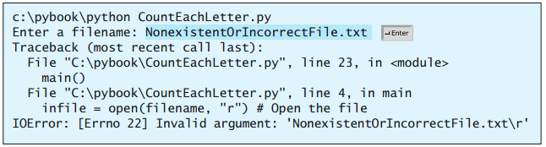
Exception Handling
When you run the program in Listing 11.7 or Listing 11.8, what happens if the user enters a file or an URL that does not exist? The program would be aborted and raises an error. For example, if you run Listing 11.3 with an incorrect input, the program reports an IO error as shown below:

Slide 15

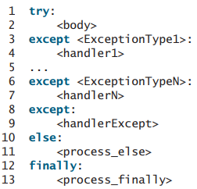
The try ... except Clause

Slide 16
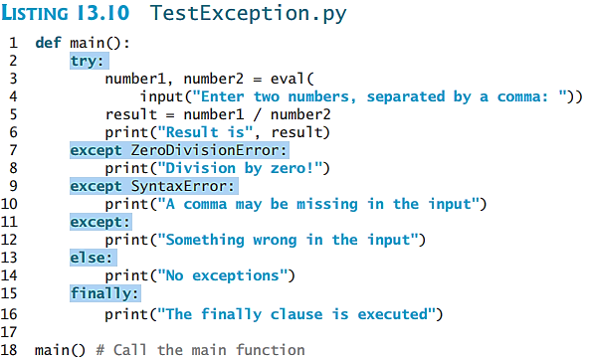
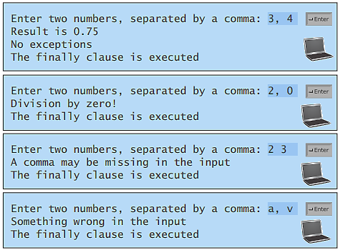
The try ... except Clause

Slide 17
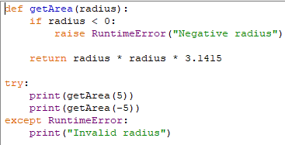
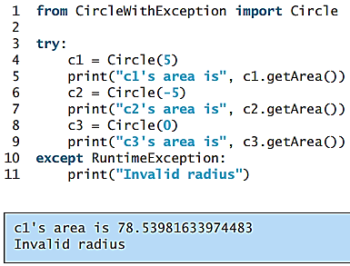
Raising Exceptions
You learned how to write the code to handle exceptions in the preceding section. Where does an exception come from? How is an exception created? Exceptions are objects and objects are created from classes. An exception is raised from a function. When a function detects an error, it can create an object of an appropriate exception class and raise the object, using the following syntax: raise ExceptionClass("Something is wrong")

Slide 18
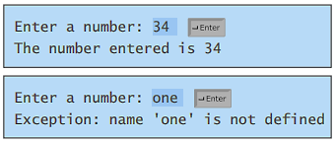
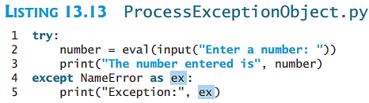
Processing Exceptions Using Exception Objects
You can access the exception object in the except clause.
try
<body>
except ExceptionType as ex:
<handler>

Slide 19
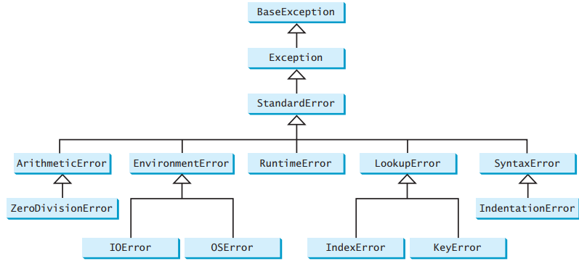
Defining Custom Exception Classes

Slide 20
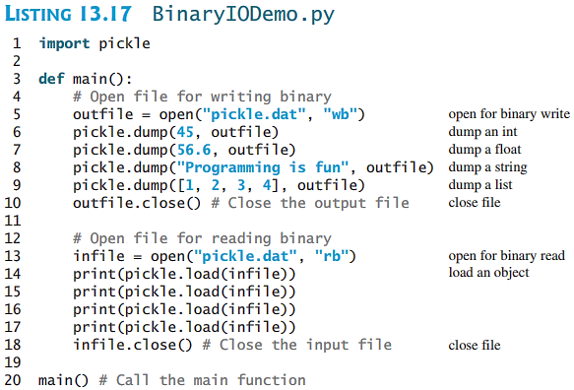
Binary IO Using Pickling
To perform binary IO using pickling, open a file using the mode 'rb' or 'wb' for reading binary or writing binary and invoke pickle module’s dump and load functions to write and read data.

Slide 21
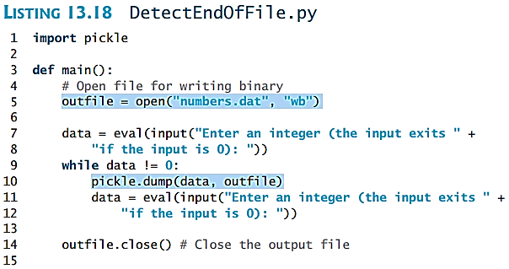
Detecting End of File
If you don’t know how many objects are in the file, how do you read all the objects? You can repeatedly read an object using the load function until it throws an EOFError exception. When this exception is raised, catch it and process it to end the file reading process.

Slide 22
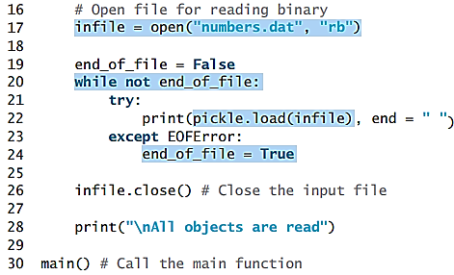
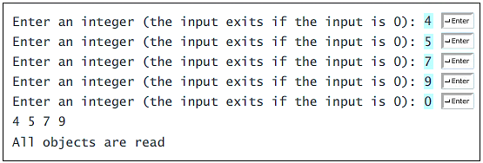
Detecting End of File
If you don’t know how many objects are in the file, how do you read all the objects? You can repeatedly read an object using the load function until it throws an EOFError exception. When this exception is raised, catch it and process it to end the file reading process.
Results

