Slide 1

Chapter 10
Lists
Prof. Dr. Mohammed Alhanjouri
Professor of Artificial Intelligence Engineering

Slide 2
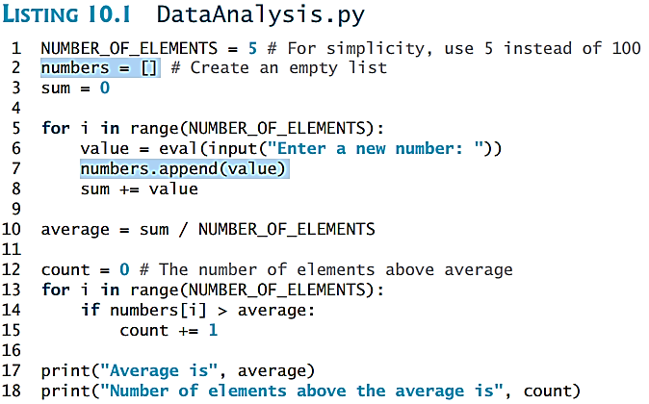
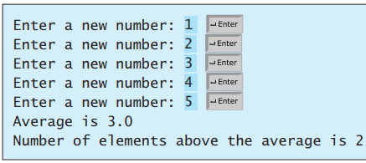
Opening Problem
Read one hundred numbers, compute their average, and find out how many numbers are above the average.

Slide 3
Objectives
To create lists (§10.2.1).
To invoke list’s append, insert, extend, remove, pop, index, count, sort, reverse methods (§10.2.2).
To use the len, min/max, sum, and random.shuffle functions for a list (§10.2.3).
To access list elements using indexed variables (§10.2.4).
To obtain a sublist using the slicing operator [start:end] (§10.2.5).
To use +, *, and in/not in operators on lists (§10.2.6).
To traverse elements in a list using a for-each loop (§10.2.7).
To create lists using list comprehension (§10.2.8).
To compare lists using comparison operators (§10.2.9).
To split a string to a list using the str’s split method (§10.2.10).
To sort a list using the insertion sort (§10.11.2).
To use lists in the application development (§§10.3–10.5).

Slide 4
Objectives
To copy contents from one list to another (§10.6).
To develop and invoke functions with list arguments and return value (§10.7–10.9).
To search elements using the linear (§10.10.1) or binary (§10.10.2) search algorithm.
To sort a list using the selection sort (§10.11.1)
To give examples of representing data using two-dimensional lists (§11.1).
To access elements in a two-dimensional list using row and column indexes (§11.2).
To program common operations for two-dimensional lists (displaying lists, summing all elements, finding min and max elements, and random shuffling) (§11.2).
To pass two-dimensional lists to functions (§11.3).
To write a program for grading multiple-choice questions using two-dimensional lists (§11.4).
To solve the closest-pair problem using two-dimensional lists (§§11.5-11.6).
To use multidimensional lists (§11.9).

Slide 5
Creating Lists
Creating list using the list class
list1 = list() # Create an empty list
list2 = list([2, 3, 4]) # Create a list with elements 2, 3, 4
list3 = list(["red", "green", "blue"]) # Create a list with strings
list4 = list(range(3, 6)) # Create a list with elements 3, 4, 5
list5 = list("abcd") # Create a list with characters a, b, c, d
For convenience, you may create a list using the following syntax:
list1 = [] # Same as list()
list2 = [2, 3, 4] # Same as list([2, 3, 4])
list3 = ["red", "green"] # Same as list(["red", "green"])
list4 = [2, "three", 4]

Slide 6
List Methods
Result | List (s or d)
Add an item x to the end of the list. | s.append(x: object)
Insert an item x at a given index. Note that the first element in the list has index 0. | s.insert(index: int, x: object)
Remove the first occurrence of the item x from the list. | remove(x: object) return
Return the index of the item x in the list. | s.index(x: object)
Return the number of times item x appears in the list. | s.count(x: object)
Sort the items in the list. | s.sort()
Reverse the items in the list. | s.reverse()
Append all the items in d to the list s | s.extend(d) or y = s + d
Remove the item at the given position and return it. If no index is specified, remove and return the last item in the list. | s.pop(index:int) s.pop()

Slide 7
List Methods
Result | Operation
True if element x is in sequence s. | x in s
True if element x is not in sequence s. | x not in s
n copies of sequence s concatenated | s * n, n * s
ith element in sequence s. | s[i]
Slice of sequence s from index i to j–1. | s[i : j]
Length of sequence s, i.e., the number of elements in s. | len(s)
Smallest element in sequence s. | min(s)
Largest element in sequence s. | max(s)
Sum of all numbers in sequence s. | sum(s)
Traverses elements from left to right in a for loop. | for item in s: print(item)

Slide 8
Functions for lists - examples
>>> list1 = [2, 3, 4, 1, 32]
>>> len(list1)
5
>>> max(list1)
32
>>> min(list1)
1
>>> sum(list1)
42
>>> import random
>>> random.shuffle(list1) # Shuffle the items in the list
>>> list1
[4, 1, 2, 32, 3]

Slide 9
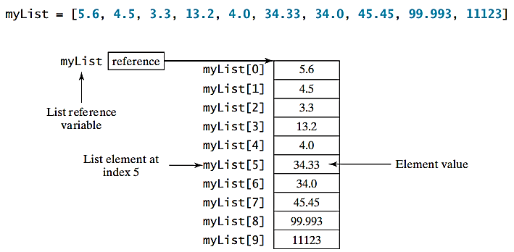
Indexer Operator [ ]

Slide 10
off-by-one Error
The +, *, [ : ], and in Operators and Errors
>>> list1 = [2, 3]
>>> list2 = [1, 9]
>>> list3 = list1 + list2
>>> list3
[2, 3, 1, 9]
>>> list3 = 2 * list1
>>> list3
[2, 3, 2, 3, 2, 3]
>>> list4 = list3[2 : 4]
>>> list4
[2, 3]
>>> list1 = [2, 3, 5, 2, 33, 21]
>>> list1[-1]
21
>>> list1[-3]
2
i = 0
while i<=len(lst):
print(lst[i])
i += 1
>>> list1 = [2, 3, 5, 2, 33, 21]
>>> 2 in list1
True
>>> list1 = [2, 3, 5, 2, 33, 21]
>>> 2.5 in list1
False
Index Error
>>> list1 = [2, 3, 5, 2, 33, 21]
>>> list1[6]
IndexError: list index out of range
>>> list1[-7]
IndexError: list index out of range

Slide 11
List Comprehension
List comprehensions provide a concise way to create items from sequence. A list comprehension consists of brackets containing an expression followed by a for clause, then zero or more for or if clauses. The result will be a list resulting from evaluating the expression. Here are some examples:
>>> list1 = [x for x range(0, 5)] # Returns a list of 0, 1, 2, 4
>>> list1
[0, 1, 2, 3, 4]
>>> list2 = [0.5 * x for x in list1]
>>> list2
[0.0, 0.5, 1.0, 1.5, 2.0]
>>> list3 = [x for x in list2 if x < 1.5]
>>> list3
[0.0, 0.5, 1.0]

Slide 12
Comparing Lists and Splitting a String to a List
>>>list1 = ["green", "red", "blue"]
>>>list2 = ["red", "blue", "green"]
>>>list2 == list1
False
>>>list2 != list1
True
>>>list2 >= list1
False
>>>list2 > list1
False
>>>list2 < list1
True
>>>list2 <= list1
True
items = "Welcome to the US".split()
print(items)
['Welcome', 'to', 'the', 'US']
items = "34#13#78#45".split("#")
print(items)
['34', '13', '78', '45’]
items = "09/20/2012".split("/")
print(items)
['09', '20', '2012']

Slide 13


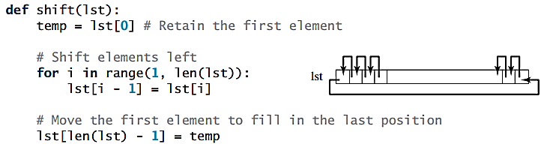

Inputting and Shifting List, simplifying coding
Inputting
Shifting
simplifying

Slide 14
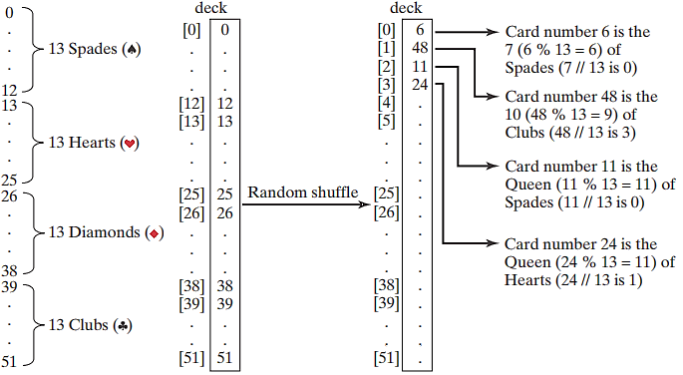
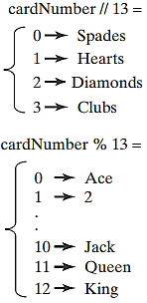
Problem: Deck of Cards
The problem is to write a program that picks four cards randomly from a deck of 52 cards. All the cards can be represented using a list named deck, filled with initial values 0 to 51, as follows: deck = [x for x in range(0, 52)]

Slide 15
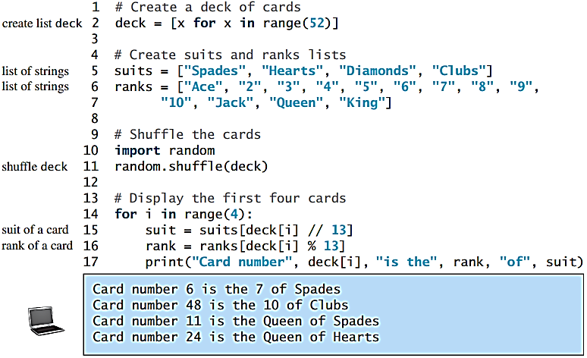
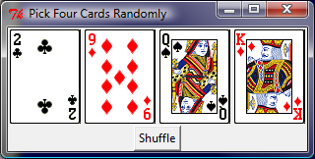
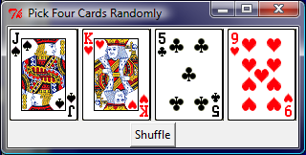
Problem: Deck of Cards, cont.

Slide 16
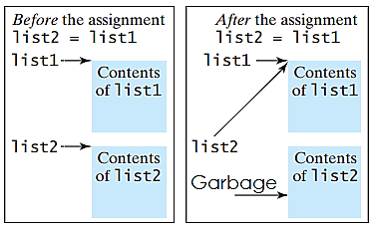
Copying Lists
Often, you need to duplicate a list or a part of a list. In such cases you could attempt to use the assignment statement (=), as follows: list2 = list1;
1 >>> list1 = [1, 2]
2 >>> list2 = [3, 4, 5]
3 >>> id(list1)
4 36207312
5 >>> id(list2)
6 36249848
7 >>>
8 >>> list2 = list1
9 >>> id(list2)
10 36207312
11 >>>
list2 = [x for x in list1]
or simply:
list2 = [] + list1
Correct Solutions

Slide 17

Passing Lists to Functions
Method 1: Invoke the function
lst = [3, 1, 2, 6, 4, 2]
printList(lst)
Method 2: Invoke the function
printList([3, 1, 2, 6, 4, 2])
Anonymous list
The preceding statement creates a list and passes it to the function. There is no explicit reference variable for the list. Such a list is called an anonymous list .

Slide 18
Pass By Value
Python uses pass-by-value to pass arguments to a function. There are important differences between passing the values of variables of numbers and strings and passing lists.
Immutable objects: For an argument of a number or a string, the original value of the number and string outside the function is not changed, because numbers and strings are immutable in Python.
Changeable objects: For an argument of a list, the value of the argument is a reference to a list; this reference value is passed to the function. Semantically, it can be best described as pass-by-sharing, i.e., the list in the function is the same as the list being passed. So if you change the list in the function, you will see the change outside the function.

Slide 19

Simple Example
def main():
x = 1 # x represents an int value
y = [1, 2, 3] # y represents a list
m(x, y) # Invoke f with arguments x and y
print("x is " + str(x))
print("y[0] is " + str(y[0]))
def m(number, numbers):
number = 1001 # Assign a new value to number
numbers[0] = 5555 # Assign a new value to numbers[0]
main()

Slide 20
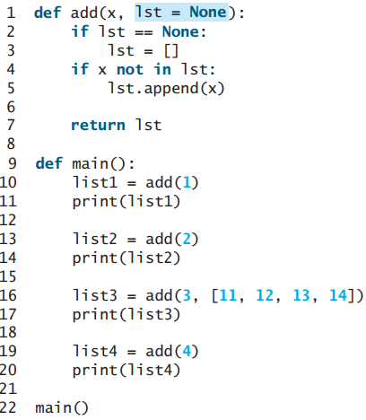
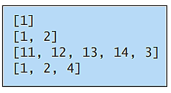
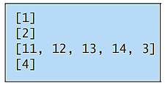
Subtle Issues Regarding Default Arguments
default value is created only once.
def add(x, lst = []):
if not(x in lst):
lst.append(x)
return lst
list1 = add(1)
print(list1)
list2 = add(2)
print(list2)
list3 = add(3, [11, 12, 13, 14])
print(list3)
list4 = add(4)
print(list4)
Output
Output

Slide 21
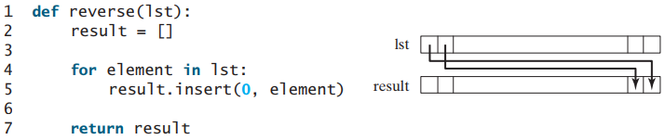
Returning a List from a Function
Note that list already has the reverse method
list.reverse()
list1 = [1, 2, 3, 4, 5, 6]
list2 = reverse(list1)

Slide 22
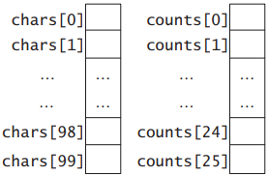
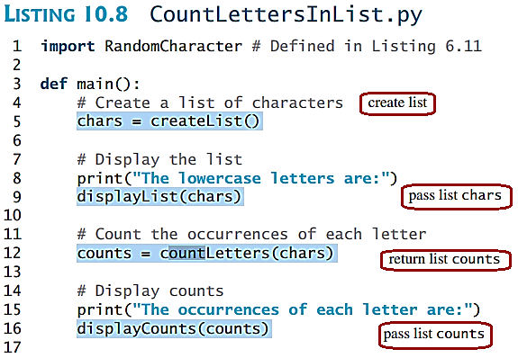
Problem: Counting Occurrence of Each Letter
Generate 100 lowercase letters randomly and assign to a list of characters.
Count the occurrence of each letter in the list.

Slide 23
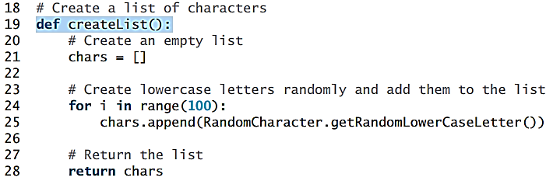
Problem: Counting Occurrence of Each Letter

Slide 24
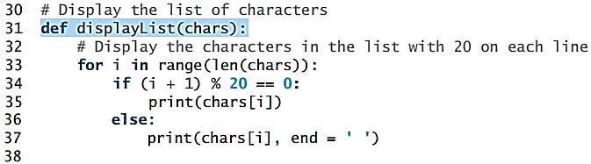
Problem: Counting Occurrence of Each Letter

Slide 25
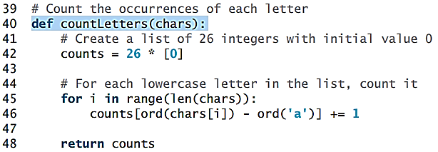
Problem: Counting Occurrence of Each Letter

Slide 26
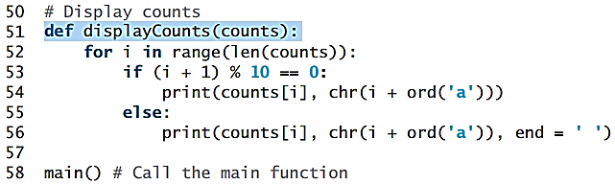
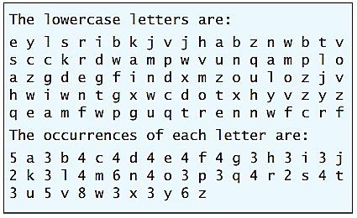
Problem: Counting Occurrence of Each Letter
Output

Slide 27
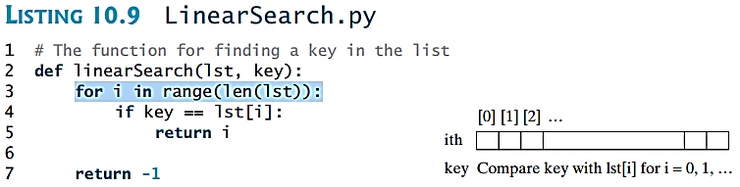
Searching Lists
Searching is the process of looking for a specific element in a list. Searching is a common task in computer programming. There are many algorithms and data structures devoted to searching. In this section, two commonly used approaches are discussed, linear search and binary search.

Slide 28
Linear Search
Key
List
The linear search approach compares the key element, key, sequentially with each element in list. The method continues to do so until the key matches an element in the list or the list is exhausted without a match being found. If a match is made, the linear search returns the index of the element in the list that matches the key. If no match is found, the search returns -1.
3
6 | 4 | 1 | 9 | 7 | 3 | 2 | 8
3
6 | 4 | 1 | 9 | 7 | 3 | 2 | 8
3
6 | 4 | 1 | 9 | 7 | 3 | 2 | 8
3
6 | 4 | 1 | 9 | 7 | 3 | 2 | 8
3
6 | 4 | 1 | 9 | 7 | 3 | 2 | 8
3
6 | 4 | 1 | 9 | 7 | 3 | 2 | 8
Animation for Linear Search is available at: LINK https://liveexample.pearsoncmg.com/dsanimation13ejava/LinearSearcheBook.html

Slide 29
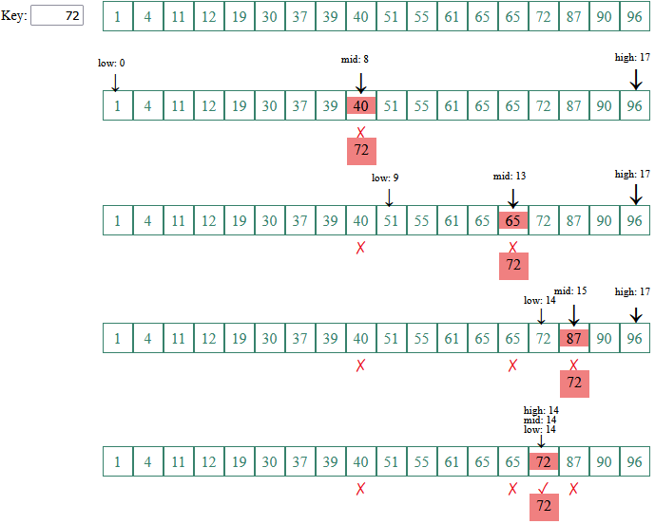
Binary Search
For binary search to work, the elements in the list must already be ordered. Without loss of generality, assume that the list is in ascending order.
The binary search first compares the key with the element in the middle of the list.
Animation for Linear Search is available at: LINK https://liveexample.pearsoncmg.com/dsanimation13ejava/BinarySearcheBook.html

Slide 30
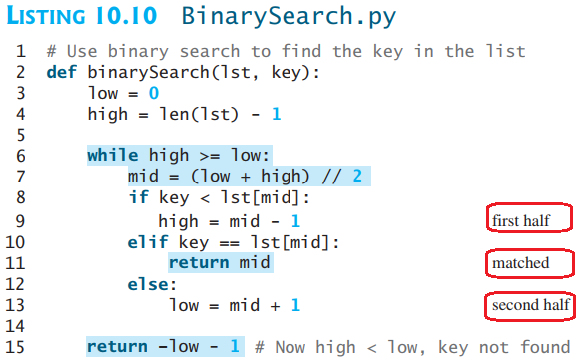
Binary Search, cont.
Linear searches are useful for finding an element in a small list or an unsorted list, but they are inefficient for large lists. Binary searches are more efficient, but they require that the list be presorted
The insertion point is the point at which the key would be inserted into the list.

Slide 31
Sorting Lists
Sorting, like searching, is also a common task in computer programming. Many different algorithms have been developed for sorting. This section introduces two simple, intuitive sorting algorithms: selection sort and insertion sort.

Slide 32
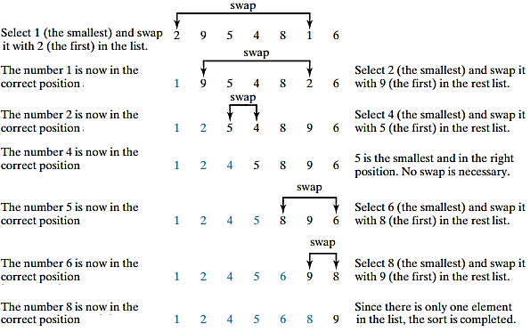
Selection Sorting
A selection sort finds the smallest element in the list and swaps it with the first element. It then finds the smallest element remaining and swaps it with the first element in the remaining list, and so on, until only a single element remains.
Animation Link

Slide 33
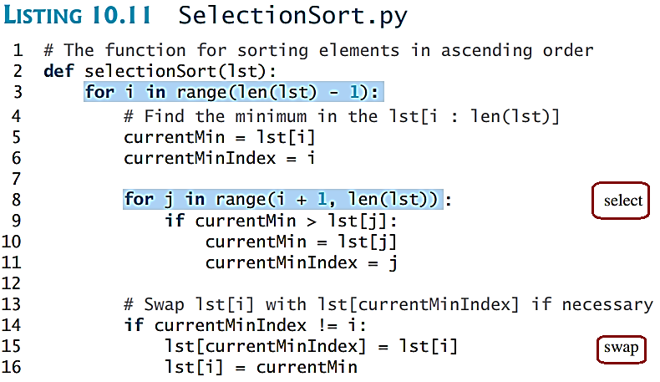
Selection Sorting

Slide 34
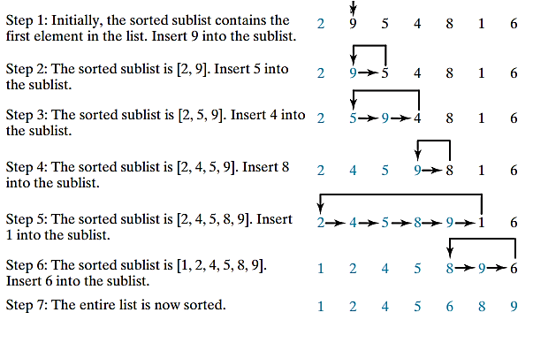
Insertion Sorting
myList = [2, 9, 5, 4, 8, 1, 6]
# Unsorted
The insertion sort algorithm sorts a list of values by repeatedly inserting an unsorted element into a sorted sublist until the whole list is sorted.
Animation Link

Slide 35
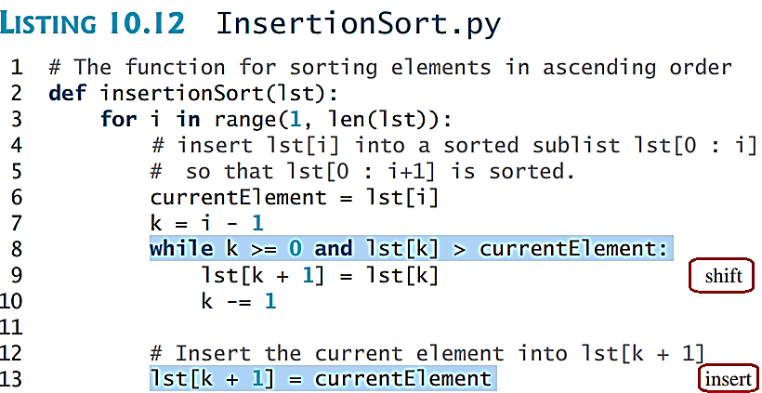
Insertion Sorting

Slide 36
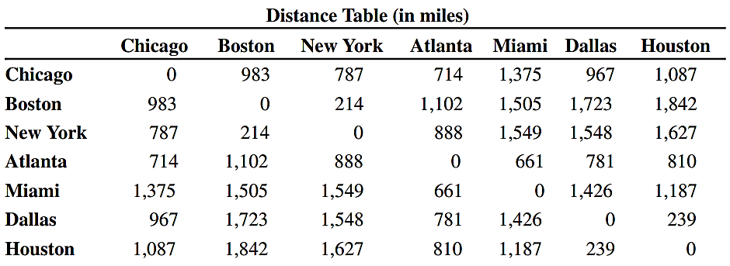
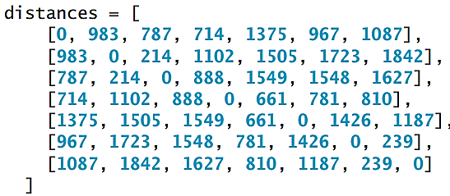
Ch.11: Lists for Multi-dimensional Data

Slide 37
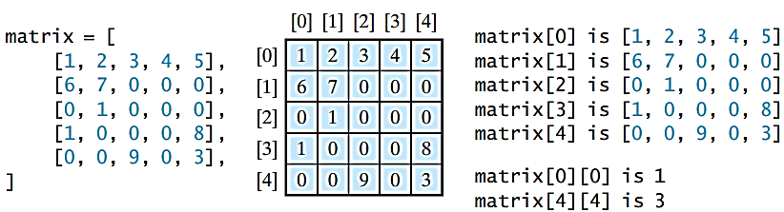
Processing Two-Dimensional lists
You can view a two-dimensional list as a list that consists of rows. Each row is a list that contains the values. The rows can be accessed using the index, conveniently called a row index. The values in each row can be accessed through another index, conveniently called a column index.

Slide 38
Processing Two-Dimensional lists
See the examples in the text.
(Initializing lists with input values)
(Initializing lists with random values)
(Printing lists)
(Summing all elements)
(Summing all elements by column)
(Which row has the largest sum)
(Random shuffling)

Slide 39
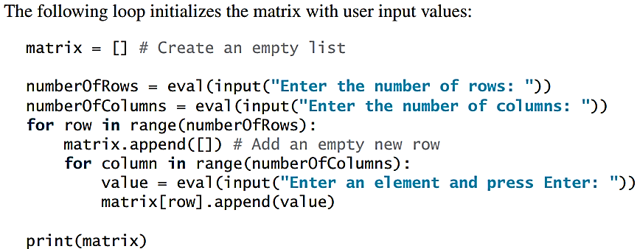
Initializing lists with input values

Slide 40
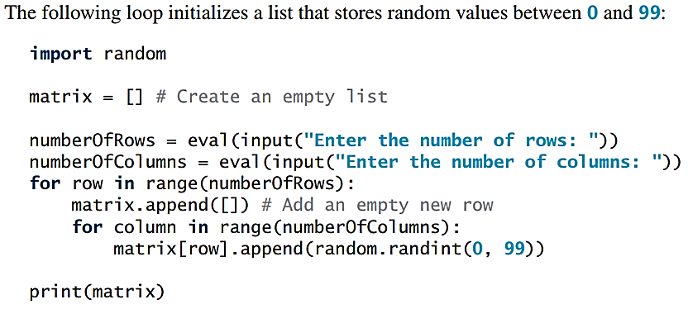
Initializing lists with random values

Slide 41
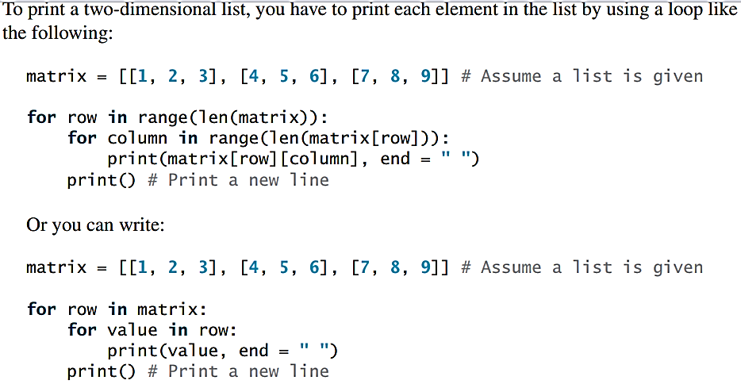
Printing lists

Slide 42
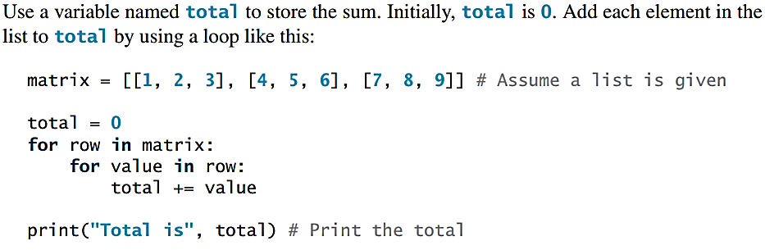
Summing all elements

Slide 43
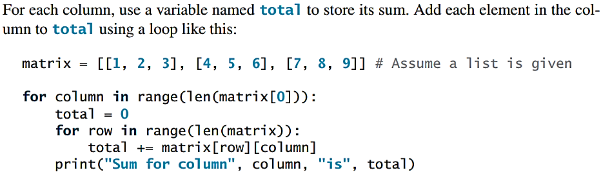
Summing elements by column

Slide 44
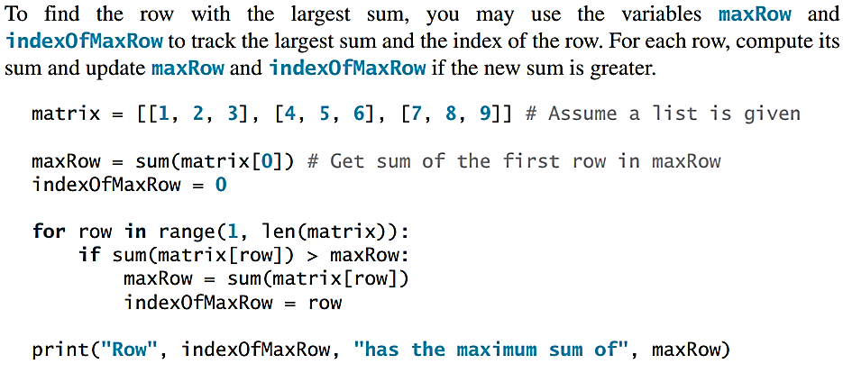
Which row has the largest sum

Slide 45
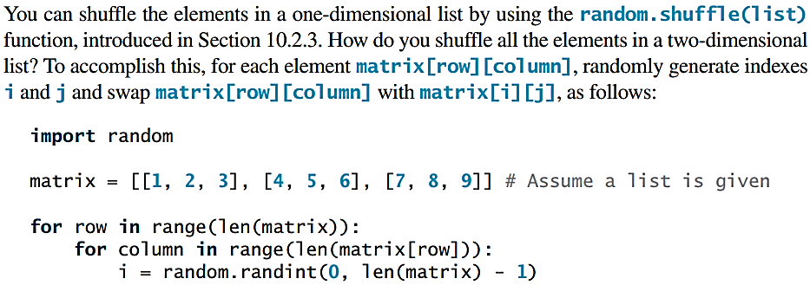
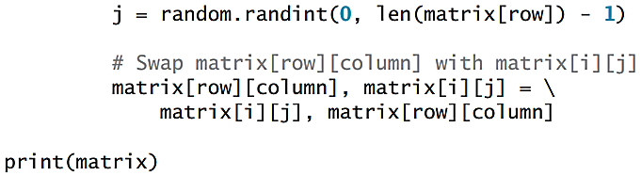
Random shuffling

Slide 46
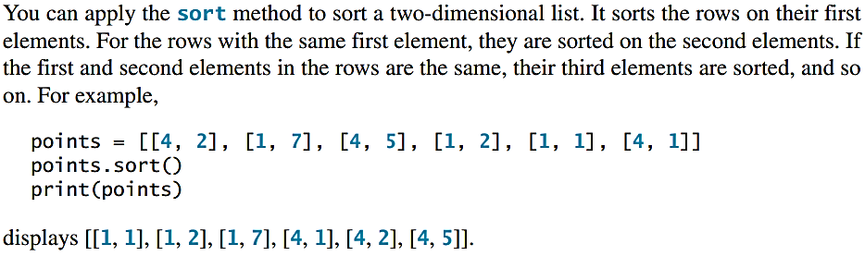
Sorting

Slide 47
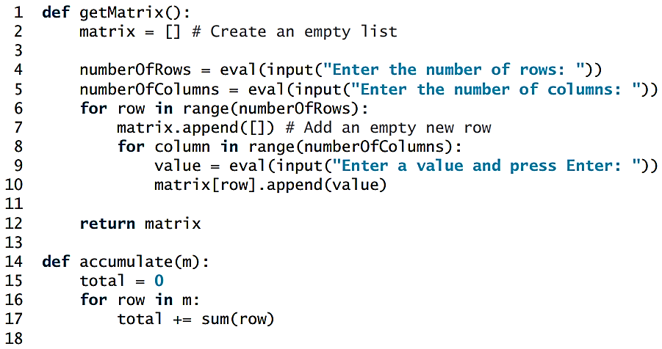
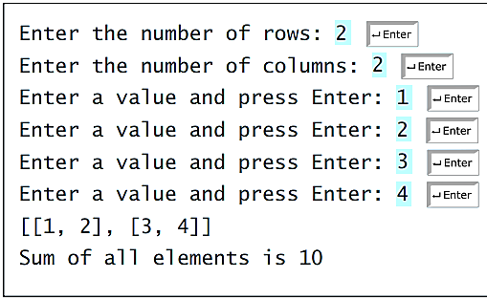
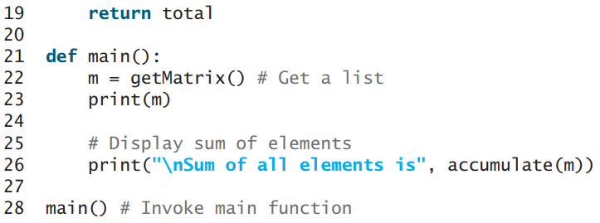
Passing Tow-Dimensional lists to Functions
Results

Slide 48
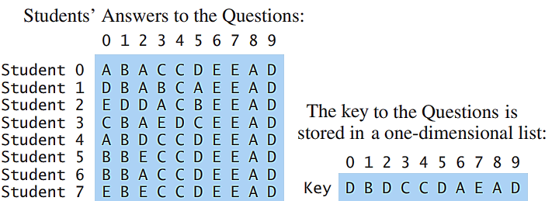
Problem: Grading Multiple-Choice Test
Objective: write a program that grades multiple-choice test.

Slide 49
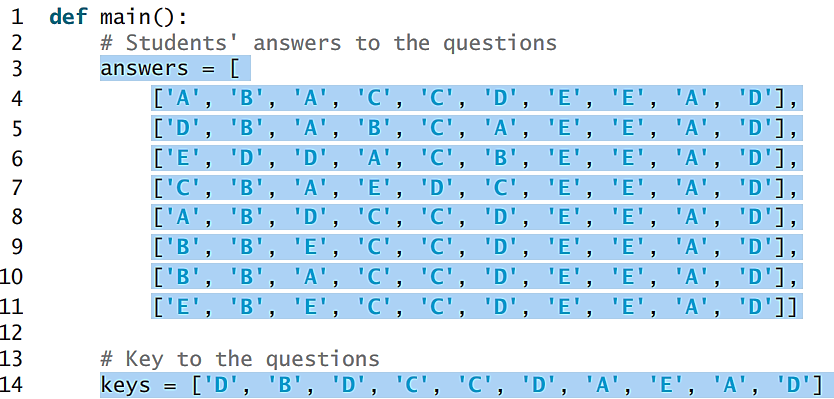
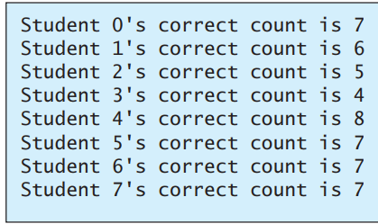
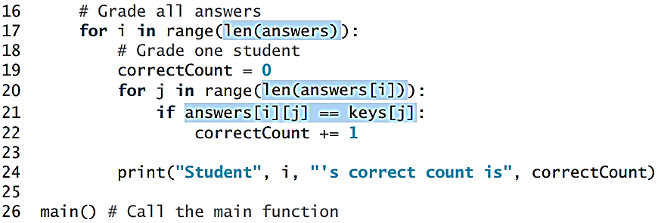
Problem: Grading Multiple-Choice Test
Results

Slide 50
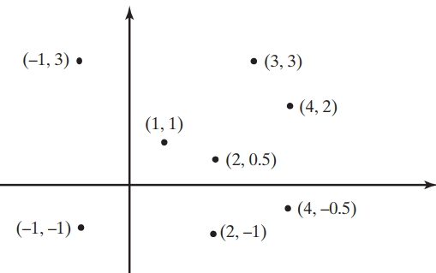
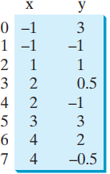
Problem: Finding Two Points Nearest to Each Other

Slide 51
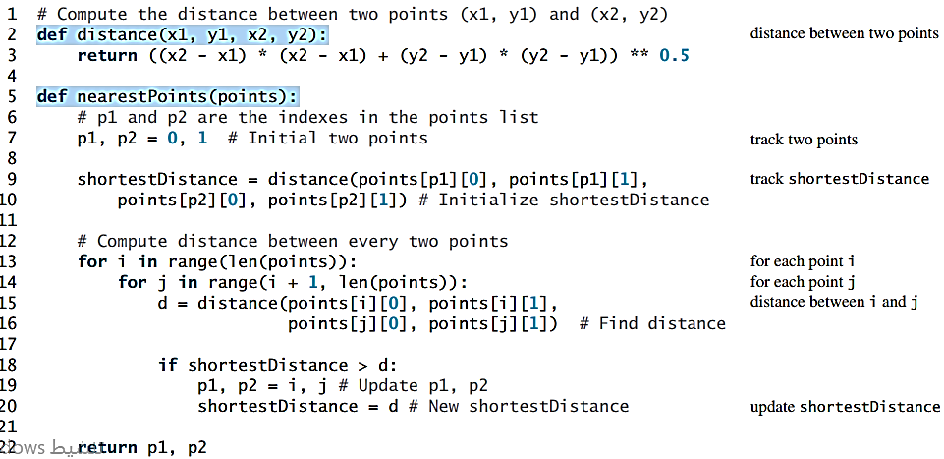
Problem: Finding Two Points Nearest to Each Other

Slide 52


Multidimensional lists

Slide 53

Problem: Guessing Birthday

