Slide 1
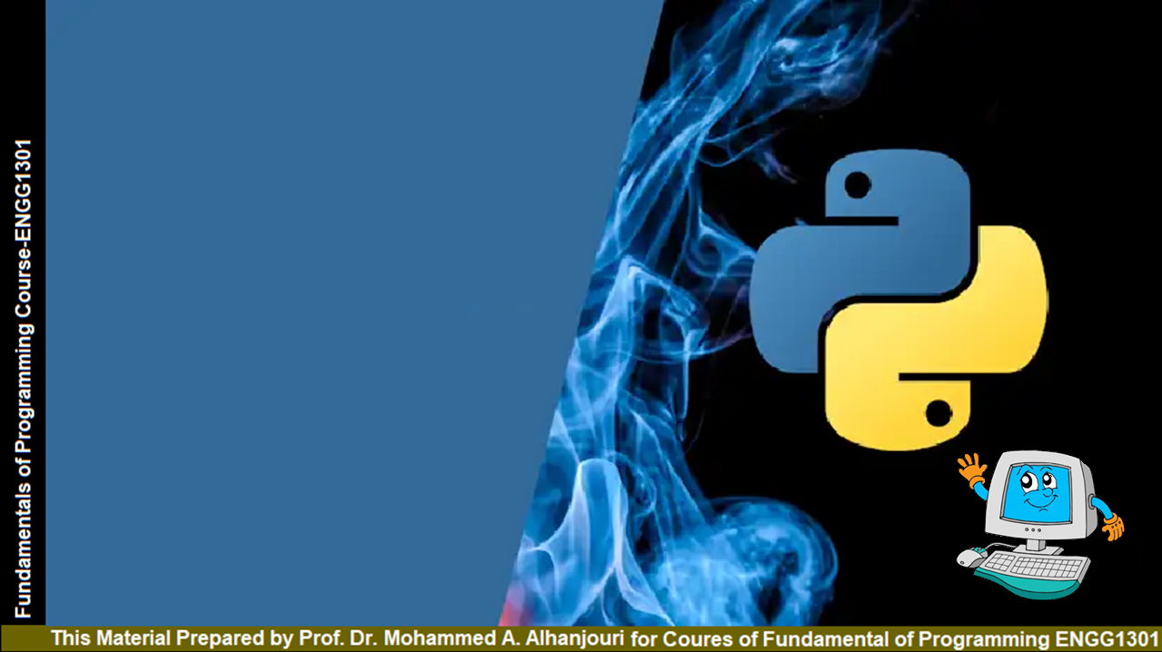
Chapter 6
Functions
Prof. Dr. Mohammed Alhanjouri
Professor of Artificial Intelligence Engineering

Slide 2
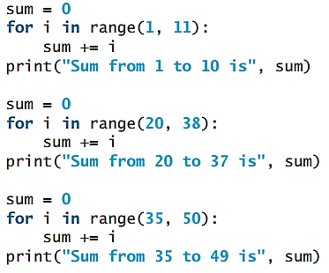
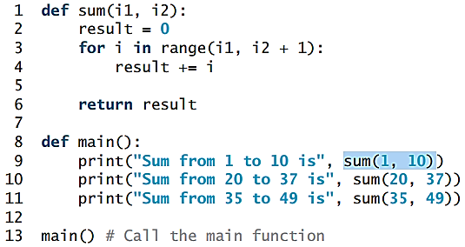
Opening Problem
Find:
the sum of integers from 1 to 10, from 20 to 37, and from 35 to 49, respectively.
Problem
Solution

Slide 3
Objectives
To define functions (§6.2).
To invoke value-returning functions (§6.3).
To invoke functions that does not return a value (§6.4).
To pass arguments by values (§6.5).
To pass arguments by values (§6.6).
To develop reusable code that’s modular, easy to read, easy to debug, and easy to maintain.
To create modules for reusing functions (§§6.7-6.8).
To determine the scope of variables (§6.9).
To define functions with default arguments (§6.10).
To return multiple values from a function (§6.11).
To apply the concept of function abstraction in software development (§6.12).
To design and implement functions using stepwise refinement (§6.13).

Slide 4
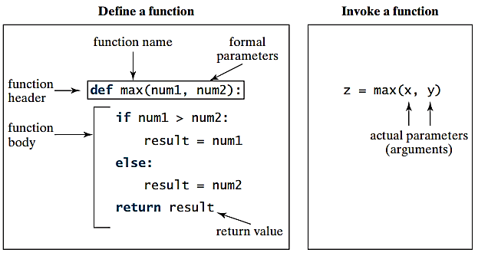
Defining Functions
A function is a collection of statements that are grouped together to perform an operation.

Slide 5
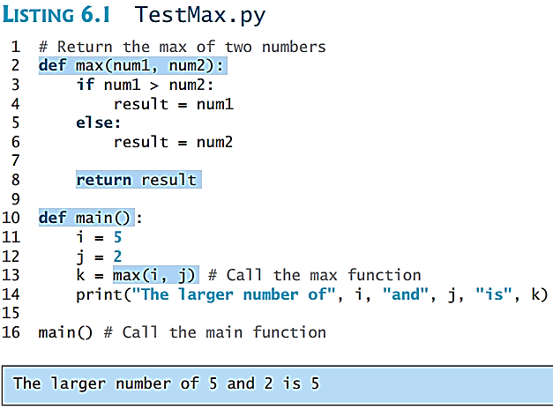
Calling Functions
Testing the max function
This program demonstrates calling a function max to return the largest of the int values

Slide 6
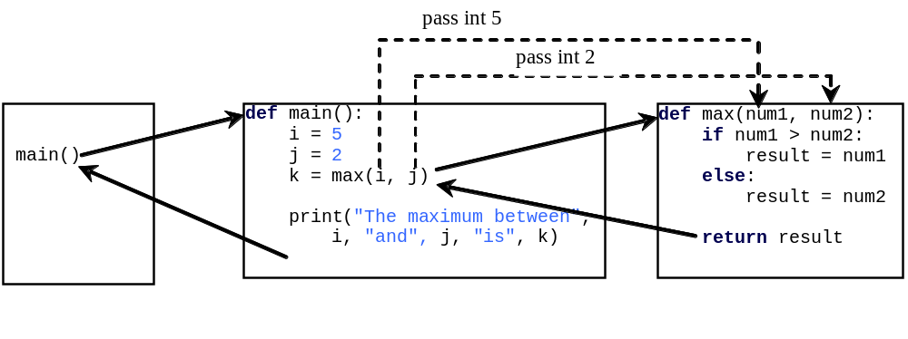
Trace Function Invocation
animation

Slide 7
Trace Function Invocation
animation
Invoke the main function

Slide 8
Trace Function Invocation
animation
i is now 5

Slide 9
Trace Function Invocation
animation
j is now 2

Slide 10
Trace Function Invocation
animation
invoke max(i, j)

Slide 11
Trace Function Invocation
animation
invoke max(i, j)
Pass the value of i to num1
Pass the value of j to num2

Slide 12
Trace Function Invocation
animation
(num1 > num2) is true since num1 is 5 and num2 is 2

Slide 13
Trace Function Invocation
animation
result is now 5

Slide 14
Trace Function Invocation
animation
return result, which is 5

Slide 15
Trace Function Invocation
animation
return max(i, j) and assign the return value to k

Slide 16
Trace Function Invocation
animation
Execute the print statement

Slide 17
Trace Function Invocation
animation
Return to the caller

Slide 18
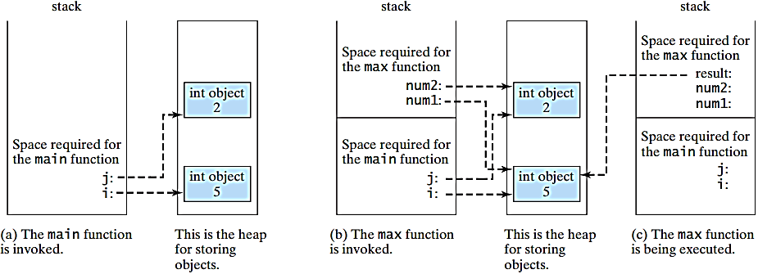
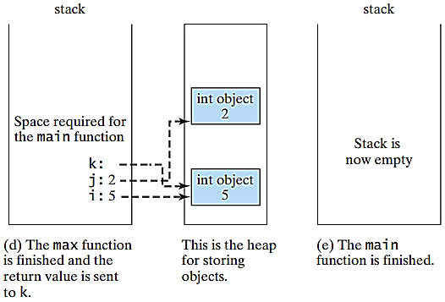
Call Stacks

Slide 19
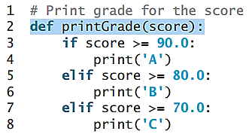
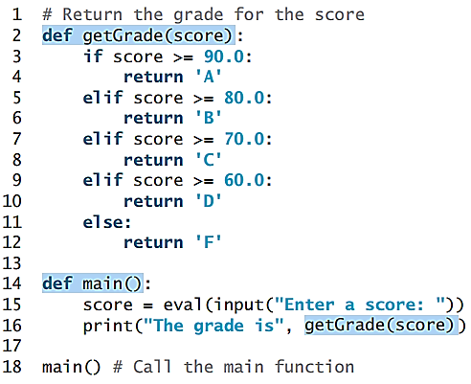
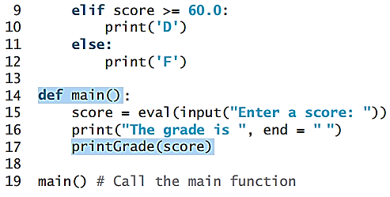

Functions With/Without Return Values
This type of function doesn’t return a value. It performs some actions.

Slide 20
The None Value
A function that does not return a value is known as a void function in other programming languages such as Python , C++, and C#. In Python, such function returns a special value None. It’s also called a None function. The None value assigned to a variable that doesn’t reference any object.
def sum(number1, number2):
total = number1 + number2
print(sum(1, 2))

Slide 21
Passing Arguments
def nPrintln(message, n):
for i in range(0, n):
print(message)
by Positions
by keywords
positional arguments
keyword arguments
Suppose you invoke the function using
  nPrintln(“Welcome to Python”, 5)
What is the output?
Suppose you invoke the function using
  nPrintln(“Computer Science”, 15)
What is the output?
What is wrong
  nPrintln(4, “Computer Science”)
you can invoke the function using
nPrintln(n=4, message=“Good”)
What is wrong
nPrintln(message=“Good”, 4)
Can you invoke the function using?
nPrintln(“Good”, n = 4)

Slide 22
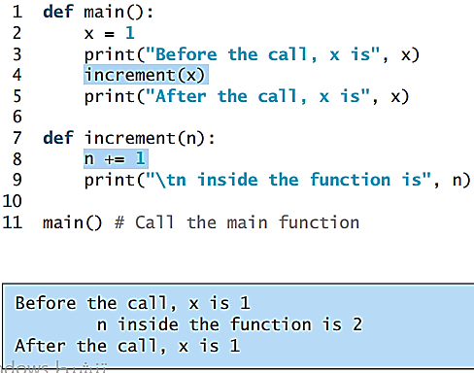
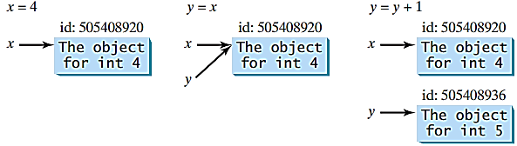
Pass by Value
In Python, all data are objects. A variable for an object is actually a reference to the object. When you invoke a function with a parameter, the reference value of the argument is passed to the parameter. This is referred to as pass-by-value. For simplicity, we say that the value of an argument is passed to a parameter when invoking a function. Precisely, the value is actually a reference value to the object.
If the argument is a number or a string, the argument is not affected, regardless of the changes made to the parameter inside the function.

Slide 23
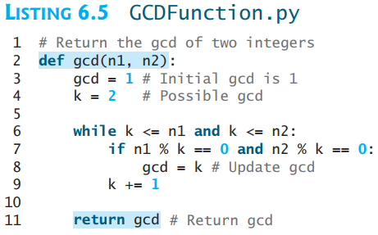
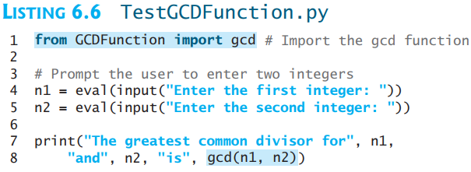
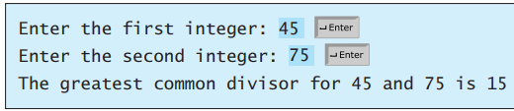
Modularizing Code
Functions can be used to reduce redundant coding and enable code reuse. Functions can also be used to modularize code and improve the quality of the program.

Slide 24
Modularizing Code
By encapsulating the code for obtaining the gcd in a function, this program has several advantages:
1. It isolates the problem for computing the gcd from the rest of the code in the program. Thus, the logic becomes clear and the program is easier to read.
2. Any errors for computing the gcd are confined to the gcd function, which narrows the scope of debugging.
3. The gcd function now can be reused by other programs. What happens if you define two functions with the same name in a module? There is no syntax error in this case, but the latter function definition prevails.

Slide 25
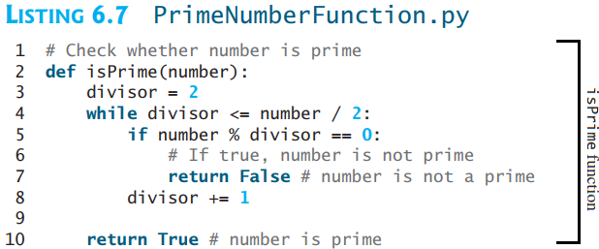
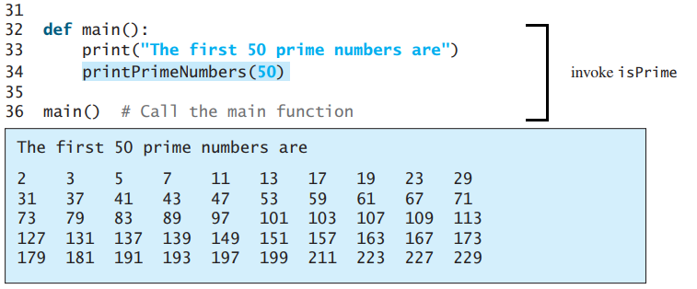
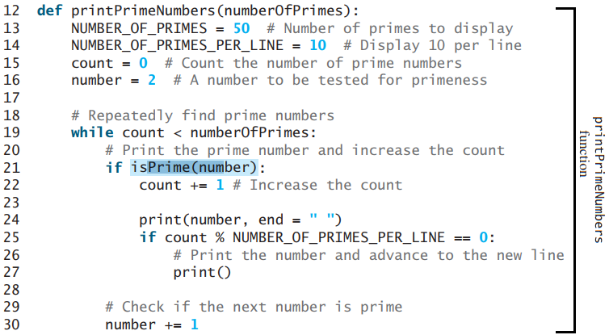
Modularizing Code
This program divides a large problem into two subproblems. As a result, the new program is easier to read and easier to debug. Moreover, the functions printPrimeNumbers and isPrime can be reused by other programs.

Slide 26
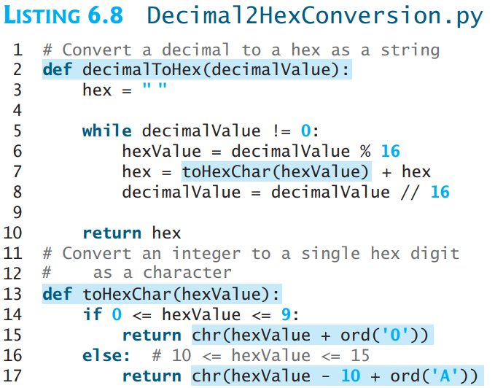
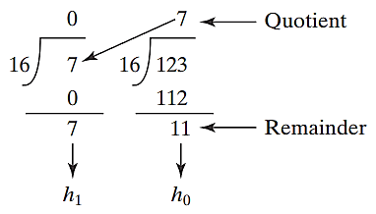
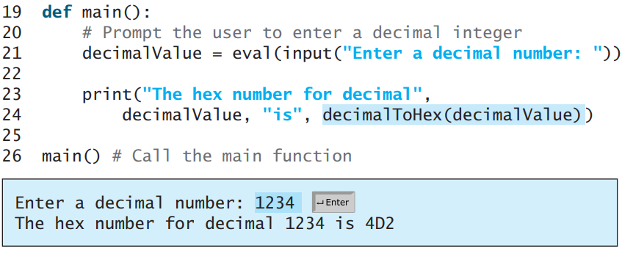
Problem: Converting Decimals to Hexadecimals
Write a function that converts a decimal integer (… d₂ d₁ d₀) to a hexadecimal (… h₂ h₁ h₀).
→ A
→ B
→ C
→ D
→ E
→ F

Slide 27
Scope of Variables
Scope: the part of the program where the variable can be referenced.
A variable created inside a function is referred to as a local variable. Local variables can only be accessed inside a function. The scope of a local variable starts from its creation and continues to the end of the function that contains the variable.
In Python, you can also use global variables. They are created outside all functions and are accessible to all functions in their scope.

Slide 28
Example 1 Example 2
Scope of Variables
globalVar = 1
def f1():
localVar = 2
print(globalVar)
print(localVar)
f1()
print(globalVar)
print(localVar)#Out of scope.
This gives an error
x = 1
def f1():
x = 2
print(x) #Displays 2
f1()
print(x) # Displays 1
Example 3
x = eval(input("Enter a number: "))
if (x > 0):
y = 4
print(y) # This gives an error if y is not created (x <= 0)

Slide 29
Example 4 Example 4
Scope of Variables
sum = 0
for i in range(0, 5):
sum += i
print(i) # Displays 4
x = 1
def increase():
global x
x = x + 1
print(x) # Displays 2
increase()
print(x) # Displays 2
You can bind a local variable in the global scope.
You can also create a variable in a function and use it outside the function.
To do either, use a global statement, as shown in Example 5

Slide 30
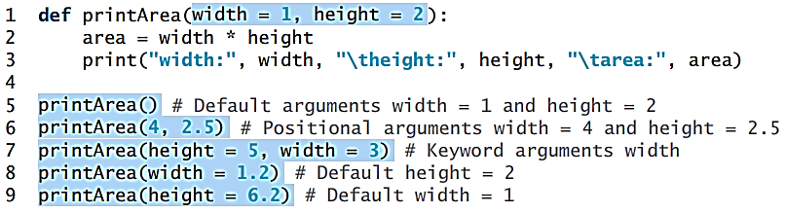
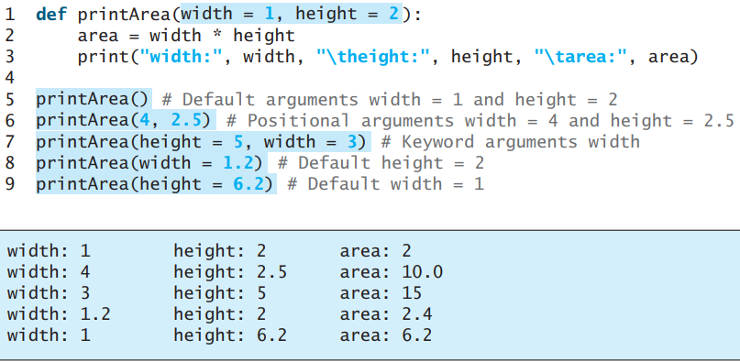
Default Arguments
Python allows you to define functions with default argument values. The default values are passed to the parameters when a function is invoked without the arguments.

Slide 31
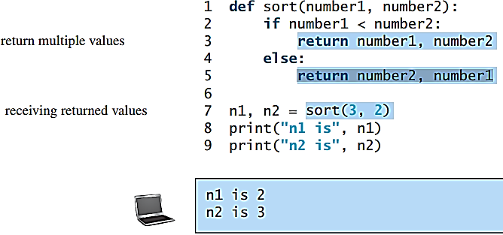
Returning Multiple Values
Python allows a function to return multiple values. Listing 5.9 defines a function that takes two numbers and returns them in non-descending order.

Slide 32
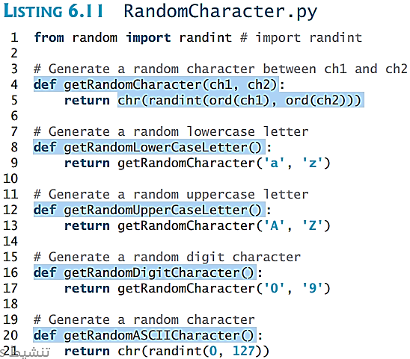
Generating Random Characters

Slide 33
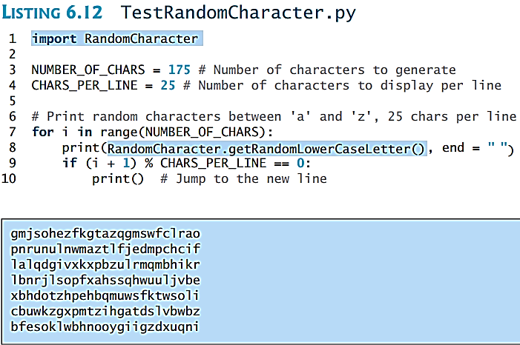
Generating Random Characters

Slide 34
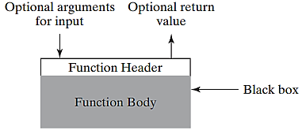
Benefits of Functions
About Functions
Function Abstraction
You can think of the function body as a black box that contains the detailed implementation for the function.
Write a function once and reuse it anywhere.
Information hiding. Hide the implementation from the user.
Reduce complexity.

Slide 35
Stepwise Refinement
The concept of function abstraction can be applied to the process of developing programs.
When writing a large program, you can use the “divide and conquer” strategy, also known as stepwise refinement, to decompose it into sub problems.
The sub problems can be further decomposed into smaller, more manageable problems.

Slide 36
Case Study: Print Calendar
Let us use the PrintCalendar example to demonstrate the stepwise refinement approach.

Slide 37
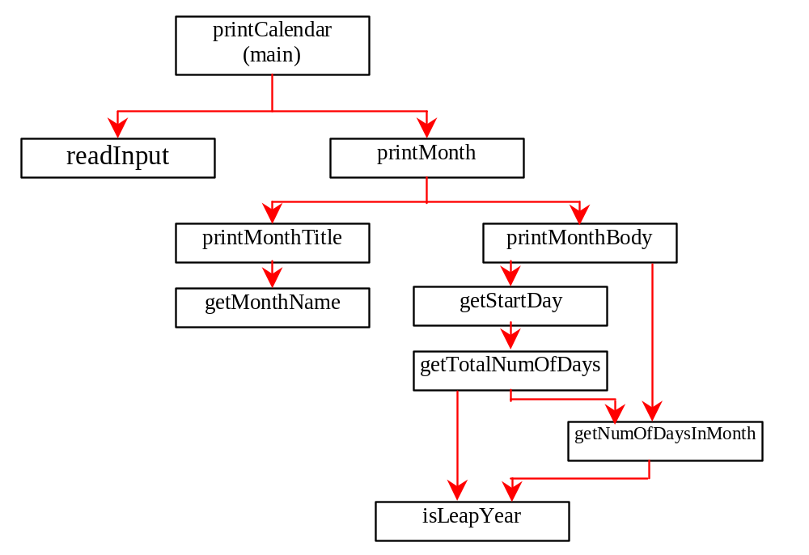
Design Diagram

Slide 38
Design Diagram

Slide 39
Design Diagram

Slide 40
Design Diagram

Slide 41
Design Diagram

Slide 42
Design Diagram

Slide 43
Implementation: Top-Down
Top-down approach is to implement one function in the structure chart at a time from the top to the bottom. Stubs can be used for the functions waiting to be implemented. A stub is a simple but incomplete version of a function. The use of stubs enables you to test invoking the function from a caller. Implement the main function first and then use a stub for the printMonth function. For example, let printMonth display the year and the month in the stub. Thus, your program may begin like this:

Slide 44
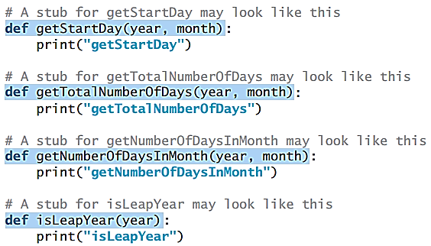
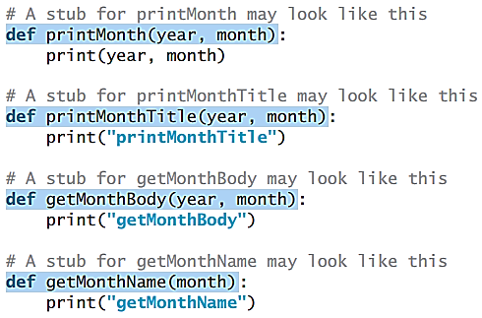
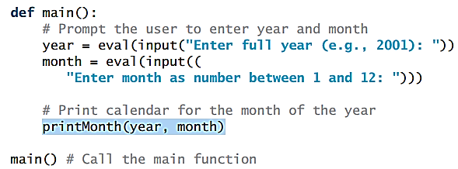
Implementation: Top-Down
Stubs can be used for the functions needed to be implemented.
1 2
3

Slide 45
Implementation: Botton-Up
Bottom-up approach is to implement one function in the structure chart at a time from the bottom to the top. For each function implemented, write a test program, known as the driver, to test it.
Both top-down and bottom-up functions are fine.
Both approaches implement the functions incrementally and help to isolate programming errors and makes debugging easy. Sometimes, they can be used together.

