Slide 1
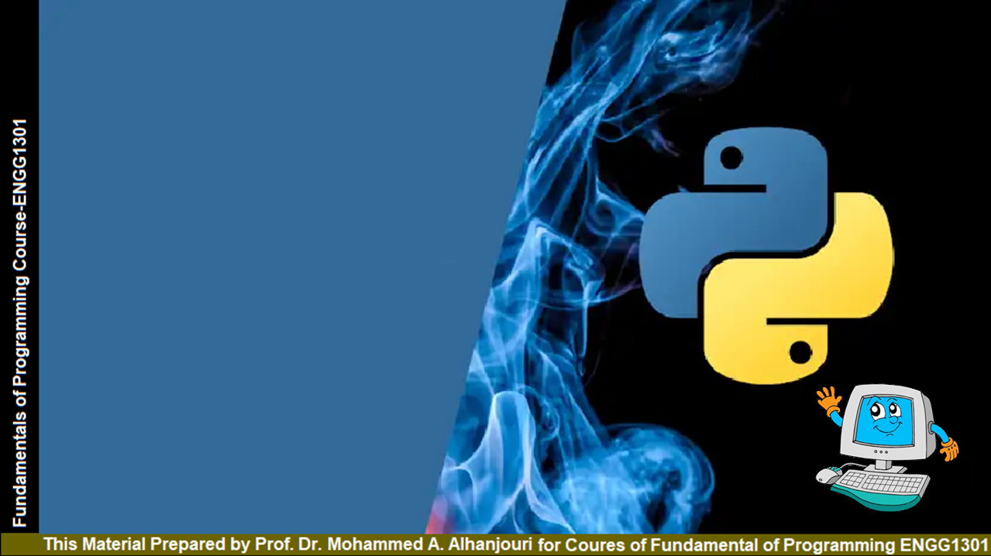
Chapter 5
Loops
Prof. Dr. Mohammed Alhanjouri
Professor of Artificial Intelligence Engineering

Slide 2
Motivations
Suppose that you need to print a string (e.g., "Programming is fun!")
a hundred times. It would be tedious to have to write the following statement a hundred times:

Slide 3
Motivations
Suppose that you need to print a string (e.g., "Programming is fun!")
a hundred times. It would be tedious to have to write the following statement a hundred times:
Problem:
print("Programming is fun!");
print("Programming is fun!");
print("Programming is fun!");
print("Programming is fun!");
print("Programming is fun!");
print("Programming is fun!");
…
…
print("Programming is fun!");
print("Programming is fun!");
print("Programming is fun!");
100 times

Slide 4
So, How do you solve this problem?
Introducing while Loops
Motivations
Suppose that you need to print a string (e.g., "Programming is fun!")
a hundred times. It would be tedious to have to write the following statement a hundred times:
Problem:
print("Programming is fun!");
print("Programming is fun!");
print("Programming is fun!");
print("Programming is fun!");
print("Programming is fun!");
print("Programming is fun!");
…
…
print("Programming is fun!");
print("Programming is fun!");
print("Programming is fun!");
100 times
count = 0
while count < 100:
print("Programming is fun!")
count = count + 1

Slide 5
Objectives
To write programs for executing statements repeatedly by using a while loop (§5.2).
To develop loops following the loop design strategy (§§5.2.1-5.2.3).
To control a loop with the user’s confirmation (§5.2.4).
To control a loop with a sentinel value (§5.2.5).
To obtain a large amount of input from a file by using input redirection instead of typing from the keyboard (§5.2.6).
To use for loops to implement counter-controlled loops (§5.3).
To write nested loops (§5.4).
To learn the techniques for minimizing numerical errors (§5.5).
To learn loops from a variety of examples (GCD, FutureTuition, MonteCarloSimulation, PrimeNumber) (§§5.6, 5.8).
To implement program control with break and continue (§5.7).

Slide 6

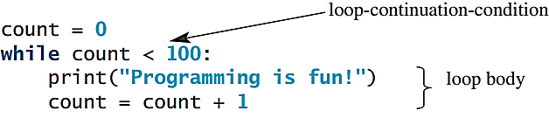
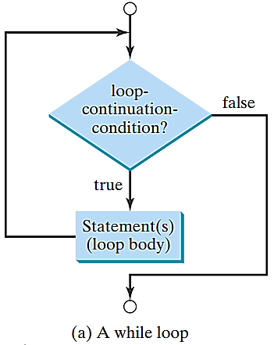
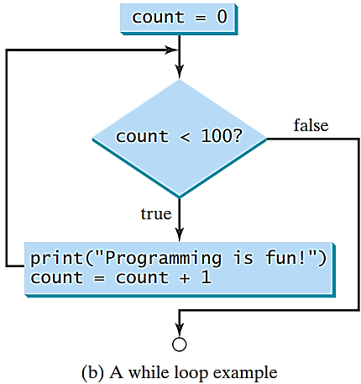
while Loop Flow Chart

Slide 7
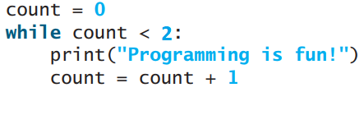
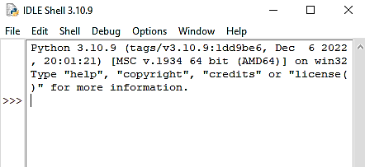
Trace while Loop
animation
Initialize count
Count = 0
The result

Slide 8
Trace while Loop
animation
(count < 2) is true
Count = 0
The result

Slide 9

Trace while Loop
animation
Print Welcome to Python
Count = 0
The result

Slide 10
Trace while Loop
animation
Increase count by 1
Count = 1
The result

Slide 11
Trace while Loop
animation
(count < 2) is still true
Count = 1
The result

Slide 12
Trace while Loop
animation
Print Welcome to Python
Count = 1
The result

Slide 13
Trace while Loop
animation
Increase count by 1
Count = 2
The result

Slide 14
Trace while Loop
animation
(count < 2) is false since count is 2 now
Count = 2
The result

Slide 15
Trace while Loop
animation
The loop exits. Execute the next statement after the loop.
Count = 2
The result

Slide 16
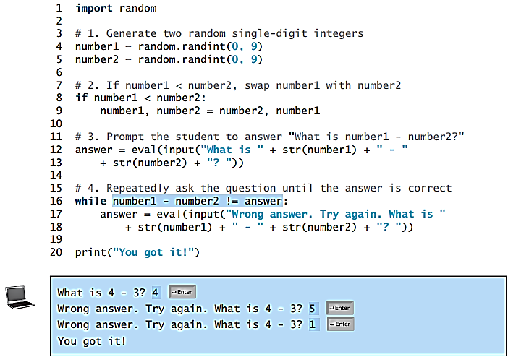
Problem: An Advanced Math Learning Tool
The Math subtraction learning tool program generates just one question for each run. You can use a loop to generate questions repeatedly. This example gives a program that generates five questions and reports the number of the correct answers after a student answers all five questions.

Slide 17
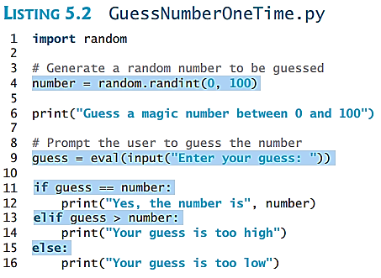
Problem: Guessing Numbers
Write a program that randomly generates an integer between 0 and 100, inclusive. The program prompts the user to enter a number continuously until the number matches the randomly generated number. For each user input, the program tells the user whether the input is too low or too high, so the user can choose the next input intelligently. Here is a sample run:

Slide 18
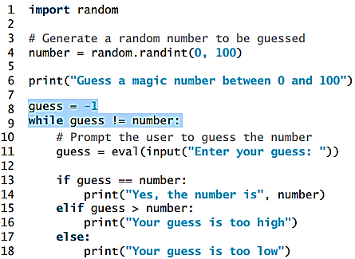
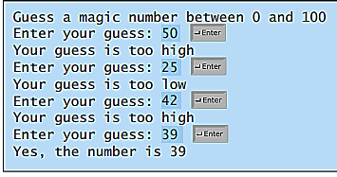
Problem: Guessing Numbers

Slide 19
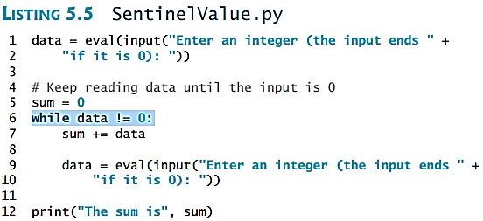
Ending a Loop with a Sentinel Value
Often the number of times a loop is executed is not predetermined. You may use an input value to signify the end of the loop. Such a value is known as a sentinel value.
Write a program that reads and calculates the sum of an unspecified number of integers. The input 0 signifies the end of the input.

Slide 20
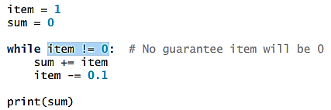
Caution
Don’t use floating-point values for equality checking in a loop control. Since floating-point values are approximations for some values, using them could result in imprecise counter values and inaccurate results. Consider the following code for computing 1 + 0.9 + 0.8 + ... + 0.1:
Variable item starts with 1 and is reduced by 0.1 every time the loop body is executed. The loop should terminate when item becomes 0. However, there is no guarantee that item will be exactly 0, because the floating-point arithmetic is approximated. This loop seems OK on the surface, but it is actually an infinite loop.

Slide 21

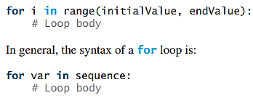
for Loops
for Loops

Slide 22

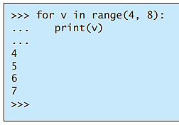
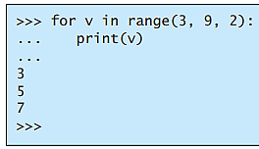
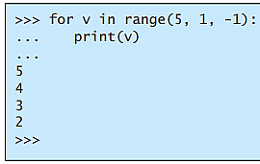
range(a, b, step)
Range types
range(b)
range(a, b)
Note: The numbers in the range function must be integers.

Slide 23
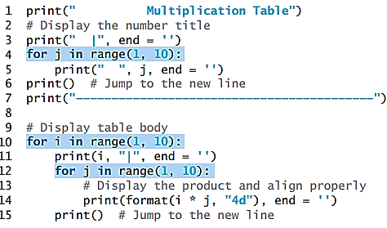
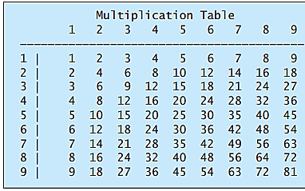
Nested Loops
Problem: Write a program that uses nested for loops to print a multiplication table.

Slide 24
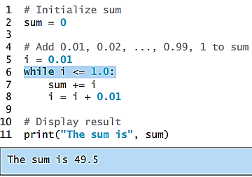
Minimizing Numerical Errors
Numeric errors involving floating-point numbers are inevitable.
This section discusses how to minimize such errors through an example.
Here is an example that sums a series that starts with 0.01 and ends with 1.0. The numbers in the series will increment by 0.01, as follows: 0.01 + 0.02 + 0.03 and so on.

Slide 25
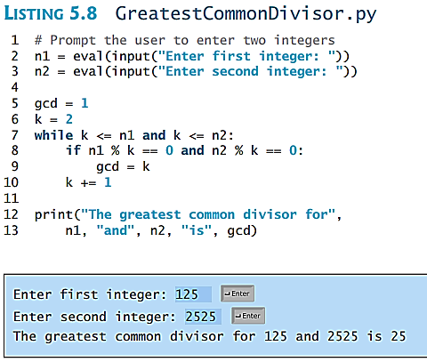
Problem: Finding the Greatest Common Divisor
Problem: Write a program that prompts the user to enter two positive integers and finds their greatest common divisor.
Euclid discovered: For all integers a, b,
gcd(a, b) = gcd((a mod b), b).
Sort a,b so that a >b, and then (given b >1)
(a mod b) < a, so problem is simplified.
EX: gcd(372,164) = gcd(372 mod 164, 164)
372 mod 164 = 44.
= gcd(164,44) = gcd(164 mod 44, 44).
  164 mod 44 = 32.
= gcd(44,32) = gcd(44 mod 32, 32) = gcd(12, 32) = gcd(32 mod 12, 12) = gcd(8,12) = gcd(12 mod 8, 8) = gcd(4,8) = gcd(8 mod 4, 4) = gcd(0,4) = 4.

Slide 26
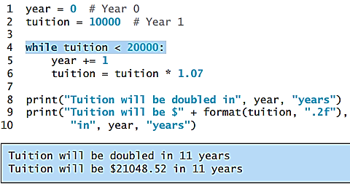
Problem: Predicting the Future Tuition
Problem: Suppose that the tuition for a university is $10,000 this year and tuition increases 7% every year. In how many years will the tuition be doubled?

Slide 27
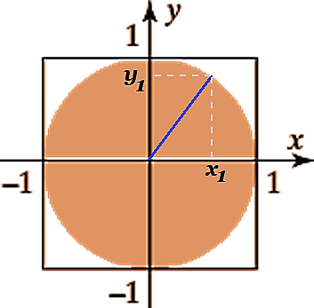

Problem: Monte Carlo Simulation
The Monte Carlo simulation refers to a technique that uses random numbers and probability to solve problems. This method has a wide range of applications in computational mathematics, physics, chemistry, and finance. This section gives an example of using the Monto Carlo simulation for estimating π.
circleArea = π
squareArea = 4
circleArea / squareArea = π / 4.
π can be approximated as
4 * numberOfHits / 1000000.

Slide 28
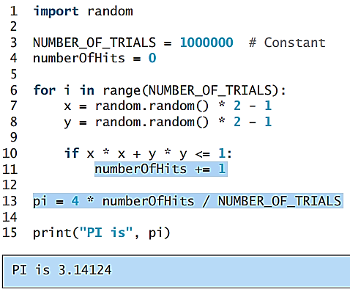
Problem: Monte Carlo Simulation
π can be approximated as
4 * numberOfHits / 1000000.

Slide 29
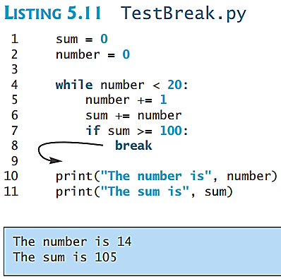
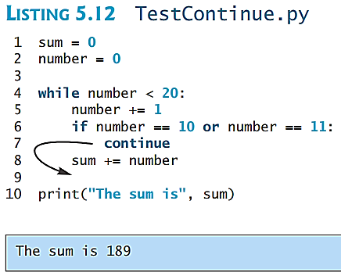
Using break and continue
Examples for using the break and continue keywords:
# break out of the loop
# jump to the end of the iteration

Slide 30
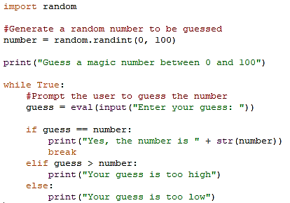
Guessing Number Problem Revisited
Here is a program for guessing a number. You can rewrite it using a break statement.

Slide 31
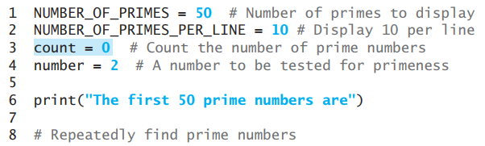
Problem: Displaying Prime Numbers
Problem: Write a program that displays the first 50 prime numbers in five lines, each of which contains 10 numbers. An integer greater than 1 is prime if its only positive divisor is 1 or itself. For example, 2, 3, 5, and 7 are prime numbers, but 4,6,8,9 are not.
Solution: The problem can be broken into the following tasks:
For number = 2, 3, 4, 5, 6, ..., test whether the number is prime.
Determine whether a given number is prime.
Count the prime numbers.
Print each prime number.
print 10 numbers per line.

Slide 32
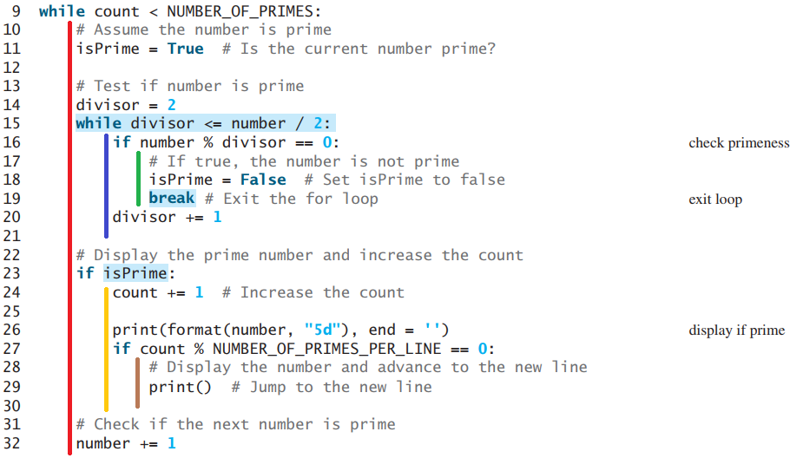

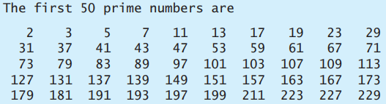
Problem: Displaying Prime Numbers

