Slide 1

Chapter 4 Selections
Prof. Dr. Mohammed Alhanjouri
Professor of Artificial Intelligence Engineering

Slide 2
Objectives
To write Boolean expressions by using comparison operators (§4.2).
To generate random numbers by using the random.randint(a, b) or random.random() functions (§4.3).
To program with Boolean expressions (AdditionQuiz) (§4.3).
To implement selection control by using one-way if statements (§4.4)
To program with one-way if statements (GuessBirthday) (§4.5).
To implement selection control by using two-way if .. else statements (§4.6).
To implement selection control with nested if ... elif ... else statements (§4.7).
To avoid common errors in if statements (§4.8).
To program with selection statements (§4.9–4.10).
To combine conditions by using logical operators (and, or, and not) (§4.11).
To use selection statements with combined conditions (LeapYear, Lottery) (§§4.12–4.13).
To write expressions that use the conditional expressions (§4.14).
To understand the rules governing operator precedence and associativity (§4.15).

Slide 3
Comparison Operators
Boolean Data Types
Often in a program you need to compare two values, such as whether i is greater than j. There are six comparison operators (also known as relational operators) that can be used to compare two values. The result of the comparison is a Boolean value: true or false. b = (1 > 2)
Operator Name
< less than
<= less than or equal to
> greater than
>= greater than or equal to
== equal to
!= not equal to

Slide 4
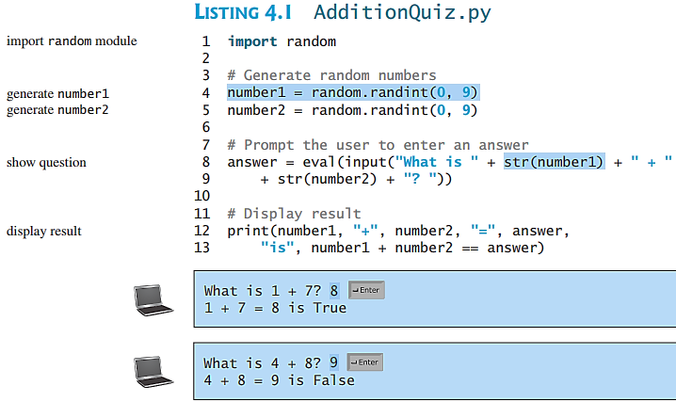
Problem: A Simple Math Learning Tool
This example creates a program to let a first grader practice additions. The program randomly generates two single-digit integers number1 and number2 and displays a question such as “What is 7 + 9?” to the student. After the student types the answer, the program displays a message to indicate whether the answer is true or false.

Slide 5
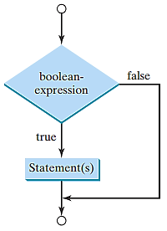
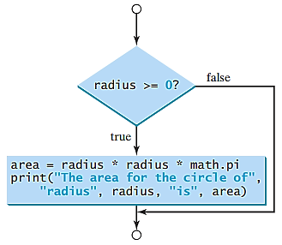
One-way if Statements
if radius >= 0:
area = radius * radius * 3.14159
print("The area for the circle of radius“,
radius, "is“, area)
if Boolean-expression:
statement(s)

Slide 6
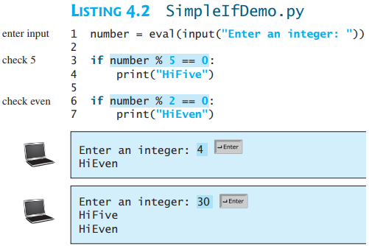
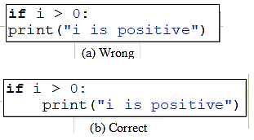
Simple if Demo
Note

Slide 7
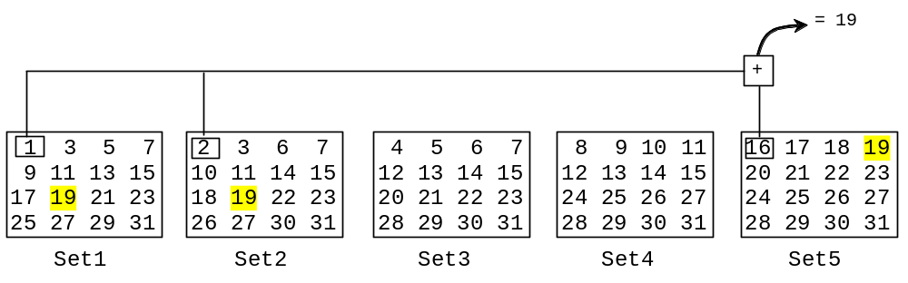
Problem: Guessing Birthday
The program can guess your birth date. Run to see how it works.

Slide 8
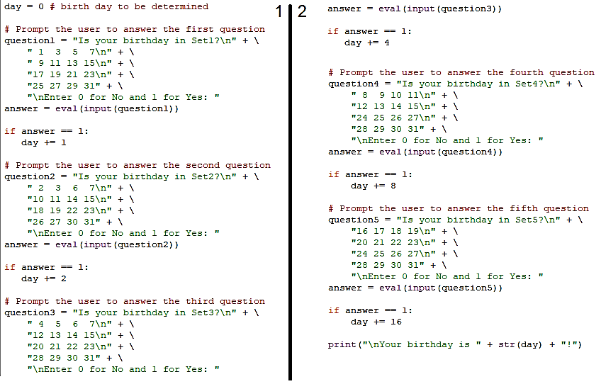
Problem: Guessing Birthday

Slide 9
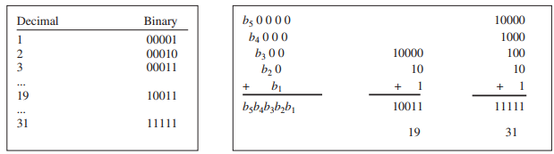
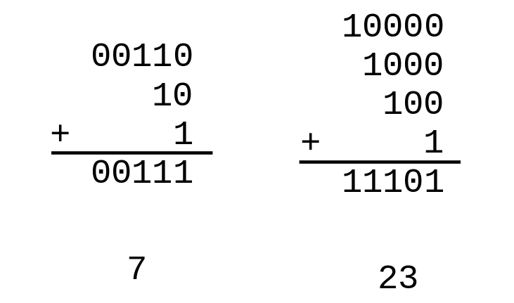
Mathematics Basis for the Game
19 is 10011 in binary. 7 is 111 in binary. 23 is 11101 in binary

Slide 10
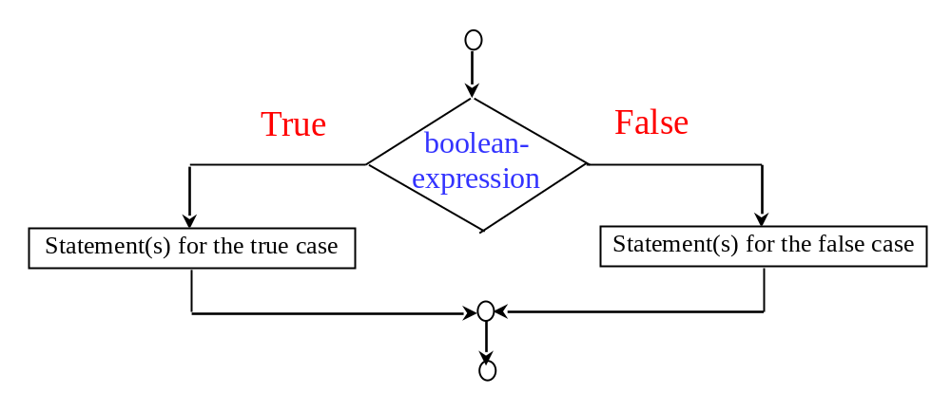
The Two-way if Statement
if boolean-expression:
statement(s)-for-the-true-case
else:
statement(s)-for-the-false-case

Slide 11
if...else Example
if radius >= 0:
area = radius * radius * math.pi
print("The area for the circle of radius", radius, "is", area)
else:
print("Negative input")

Slide 12
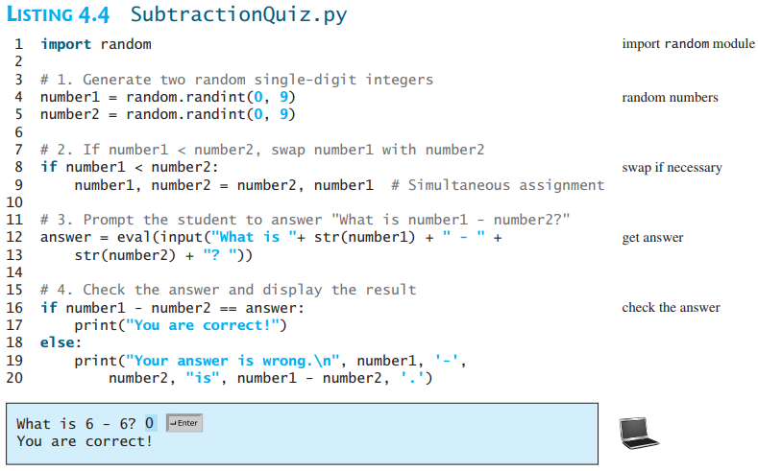
Problem: An Improved Math Learning Tool
This example creates a program to teach a first-grade child how to learn subtractions.

Slide 13
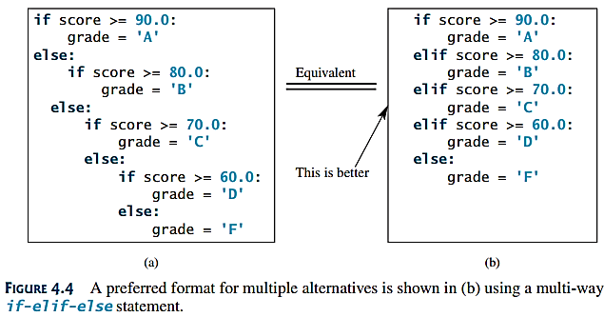
Multiple Alternative if Statements

Slide 14
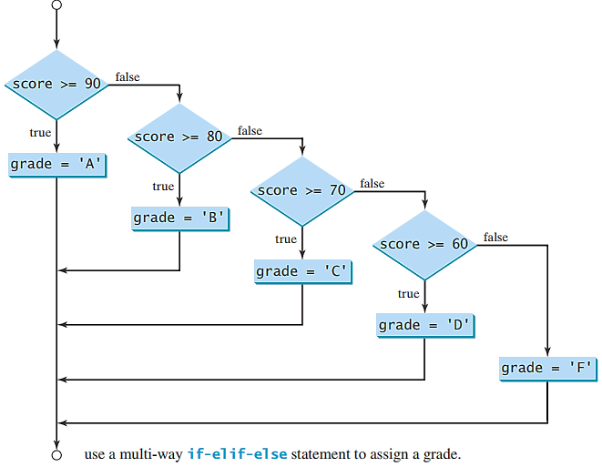
Flowchart

Slide 15
animation
Trace if-else statement
Suppose score is 70.0
The condition is false
if score >= 90.0:
grade = 'A'
elif score >= 80.0:
grade = 'B'
elif score >= 70.0:
grade = 'C'
elif score >= 60.0:
grade = 'D'
else:
grade = 'F'

Slide 16
animation
Trace if-else statement
Suppose score is 70.0
The condition is false
if score >= 90.0:
grade = 'A'
elif score >= 80.0:
grade = 'B'
elif score >= 70.0:
grade = 'C'
elif score >= 60.0:
grade = 'D'
else:
grade = 'F'

Slide 17
animation
Trace if-else statement
Suppose score is 70.0
The condition is true
if score >= 90.0:
grade = 'A'
elif score >= 80.0:
grade = 'B'
elif score >= 70.0:
grade = 'C'
elif score >= 60.0:
grade = 'D'
else:
grade = 'F'

Slide 18
animation
Trace if-else statement
Suppose score is 70.0
grade is C
if score >= 90.0:
grade = 'A'
elif score >= 80.0:
grade = 'B'
elif score >= 70.0:
grade = 'C'
elif score >= 60.0:
grade = 'D'
else:
grade = 'F'

Slide 19
animation
Trace if-else statement
Suppose score is 70.0
Exit the if statement
if score >= 90.0:
grade = 'A'
elif score >= 80.0:
grade = 'B'
elif score >= 70.0:
grade = 'C'
elif score >= 60.0:
grade = 'D'
else:
grade = 'F'

Slide 20
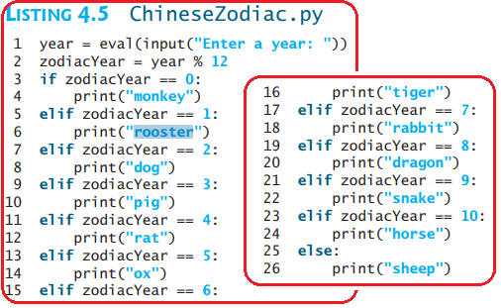
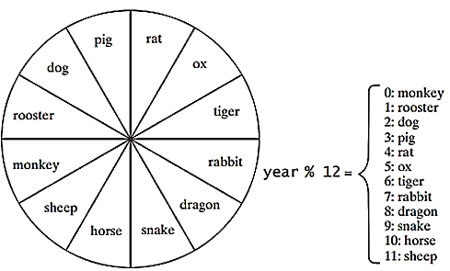
Example
write a program to find out the Chinese Zodiac sign for a given year. The Chinese Zodiac sign is based on a 12-year cycle.

Slide 21
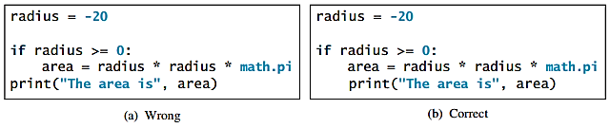
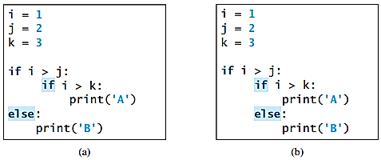

TIP
Common Errors
Syntax error
Logic error

Slide 22
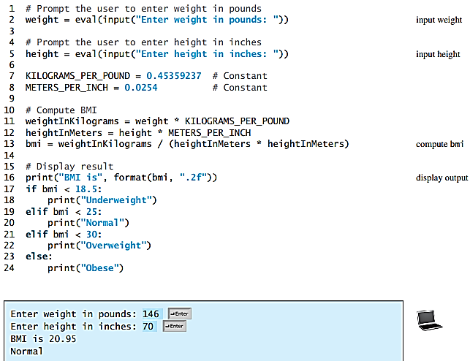
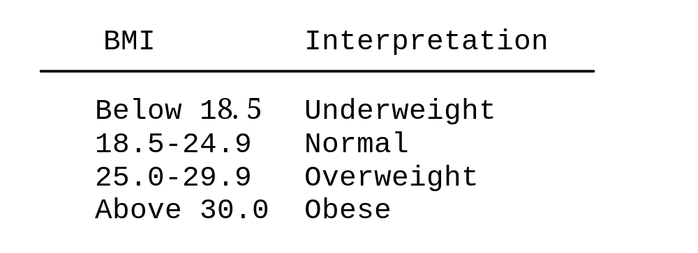
Problem: Body Mass Index
Body Mass Index (BMI) is a measure of health on weight. BMI = weight in kg /(height in m)^2
The BMI for people 16 years or older is as follows:

Slide 23
Problem: Computing Taxes
The US federal personal income tax is calculated based on the filing status and taxable income. There are four filing statuses: single filers, married filing jointly, married filing separately, and head of household. The tax rates for 2009 are shown below.
Marginal Tax Rate | Single | Married Filing Jointly or Qualified Widow(er) | Married Filing Separately | Head of Household
10% | $0 – $8,350 | $0 – $16,700 | $0 – $8,350 | $0 – $11,950
15% | $8,351– $33,950 | $16,701 – $67,900 | $8,351 – $33,950 | $11,951 – $45,500
25% | $33,951 – $82,250 | $67,901 – $137,050 | $33,951 – $68,525 | $45,501 – $117,450
28% | $82,251 – $171,550 | $137,051 – $208,850 | $68,525 – $104,425 | $117,451 – $190,200
33% | $171,551 – $372,950 | $208,851 – $372,950 | $104,426 – $186,475 | $190,201 - $372,950
35% | $372,951+ | $372,951+ | $186,476+ | $372,951+

Slide 24
Problem: Computing Taxes, cont
For four filing statuses: single filers, married filing jointly, married filing separately, and head of household
if status == 0:
# Compute tax for single filers
elif status == 1:
# Compute tax for married filing jointly
elif status == 2:
# Compute tax for married filing separately
elif status == 3:
# Compute tax for head of household
else:
# Display wrong status

Slide 25


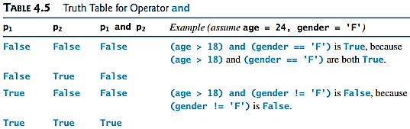
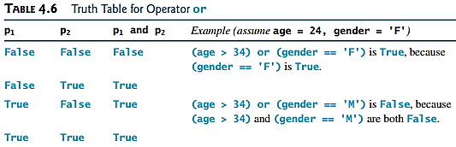
Logical Operators
Truth Tables for Operators

Slide 26
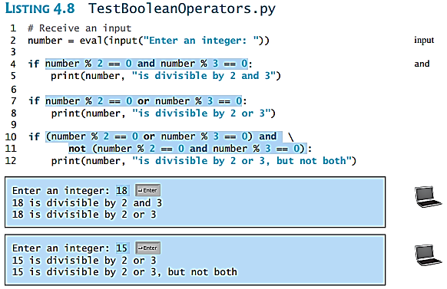
Examples
Here is a program that checks: whether a number is divisible by 2 and 3,
whether a number is divisible by 2 or 3, and
whether a number is divisible by 2 or 3 but not both

Slide 27
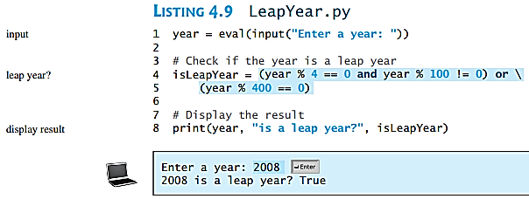
Problem: Determining Leap Year?
The program asks the user to enter a year as an int value to checks if it is a leap year.
A year is a leap year if it is divisible by 4 but not by 100, or it is divisible by 400.
(year % 4 == 0 and year % 100 != 0) or (year % 400 == 0)

Slide 28
Problem: Lottery
Write a program that randomly generates a lottery of a two-digit number, prompts the user to enter a two-digit number, and determines whether the user wins according to the following rule:
If the user input matches the lottery in exact order, the award is $10,000.
If the user input matches the lottery, the award is $3,000.
If one digit in the user input matches a digit in the lottery, the award is $1,000.

Slide 29
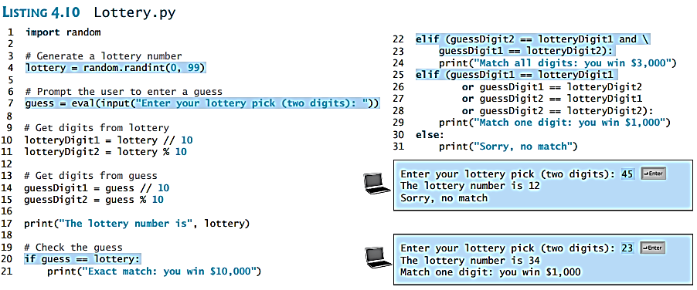
Problem: Lottery

Slide 30

Conditional Operator
EX. 1
expression1 if boolean-expression else expression2
if num % 2 == 0:
print(str(num) + “is even”)
else:
print(str(num) + “is odd”)
EX. 2

Slide 31
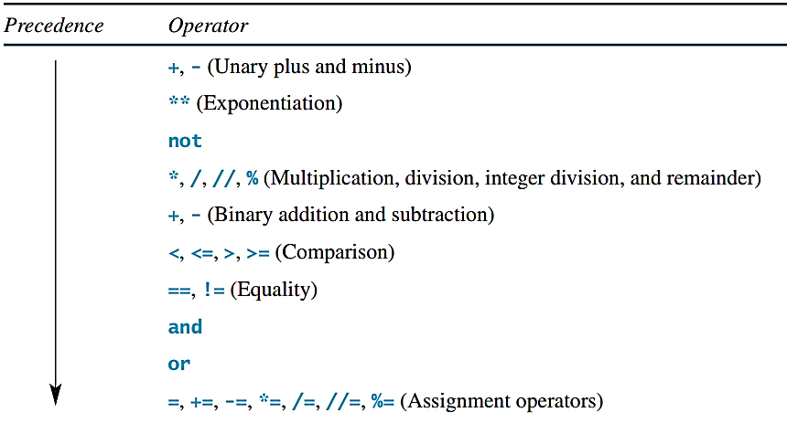
Operator Precedence
( )

Slide 32
Operator Precedence and Associativity
The expression in the parentheses is evaluated first. (Parentheses can be nested, in which case the expression in the inner parentheses is executed first.) When evaluating an expression without parentheses, the operators are applied according to the precedence rule and the associativity rule.
If operators with the same precedence are next to each other, their associativity determines the order of evaluation. All binary operators except assignment operators are left-associative.

Slide 33
Operator Associativity
When two operators with the same precedence are evaluated, the associativity of the operators determines the order of evaluation. All binary operators except assignment operators are left-associative.
a – b + c – d is equivalent to ((a – b) + c) – d
Assignment operators are right-associative. Therefore, the expression
a = b += c = 5 is equivalent to a = (b += (c = 5))

