Slide 1

Chapter 3
Mathematical Functions, Strings, and Objects
Prof. Dr. Mohammed Alhanjouri
Professor of Artificial Intelligence Engineering

Slide 2
Objectives
To solve mathematics problems by using the functions in the math module (§3.2).
To represent and process strings and characters (§§3.3 – 3.4).
To encode characters using ASCII and Unicode (§§3.3.1 – 3.3.2).
To use the ord to obtain a numerical code for a character and chr to convert a numerical code to a character (§3.3.3).
To represent special characters using the escape sequence (§3.3.4).
To invoke the print function with the end argument (§3.3.5).
To convert numbers to a string using the str function (§3.3.6).
To use the + operator to concatenate strings (§3.3.7).
To read strings from the console (§3.3.8).
To introduce objects and methods (§3.5).
To format numbers and strings using the format function (§3.6).
To draw various shapes (§3.7).
To draw graphics with colors and fonts (§3.8).

Slide 3
Built In Functions
https://docs.python.org/3.3/library/functions.html
abs() | dict() | help() | min() | setattr()
all() | dir() | hex() | next() | slice()
any() | divmod() | id() | object() | sorted()
ascii() | enumerate() | input() | oct() | staticmethod()
bin() | eval() | int() | open() | str()
bool() | exec() | isinstance() | ord() | sum()
bytearray() | filter() | issubclass() | pow() | super()
bytes() | float() | iter() | print() | tuple()
callable() | format() | len() | property() | type()
chr() | frozenset() | list() | range() | vars()
classmethod() | getattr() | locals() | repr() | zip()
compile() | globals() | map() | reversed() | __import__()
complex() | hasattr() | max() | round()
delattr() | hash() | memoryview() | set()

Slide 4
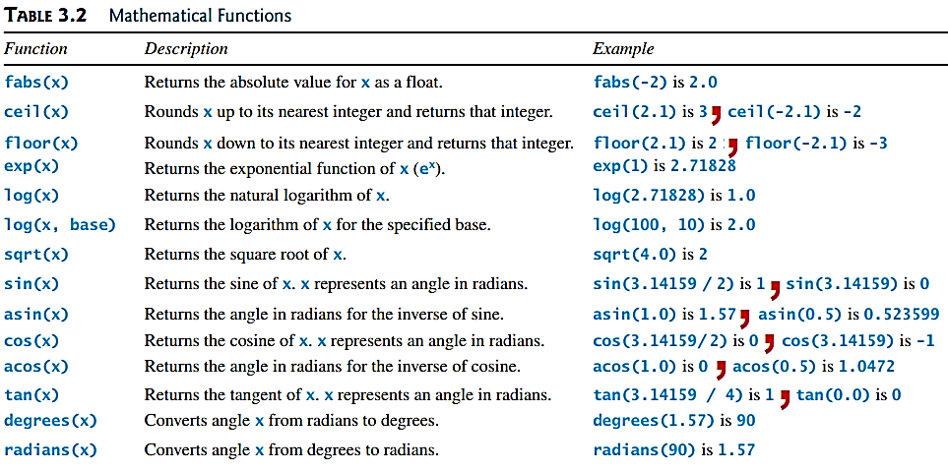
The math Functions

Slide 5
Built-in Functions and math Module
>>> max(2, 3, 4) # Returns a maximum number
4
>>> min(2, 3, 4) # Returns a minimum number
2
>>> round(3.51) # Rounds to its nearest integer
4
>>> round(3.4) # Rounds to its nearest integer
3
>>> abs(-3) # Returns the absolute value
3
>>> pow(2, 3) # Same as 2 ** 3
8

Slide 6
Standard Modules
Python has a large set of standard Modules
When you download Python, you download the standard modules
https://docs.python.org/3.3/library/index.html (LINK)
Example the standard math module
https://docs.python.org/3.3/library/math.html (LINK)

Slide 7
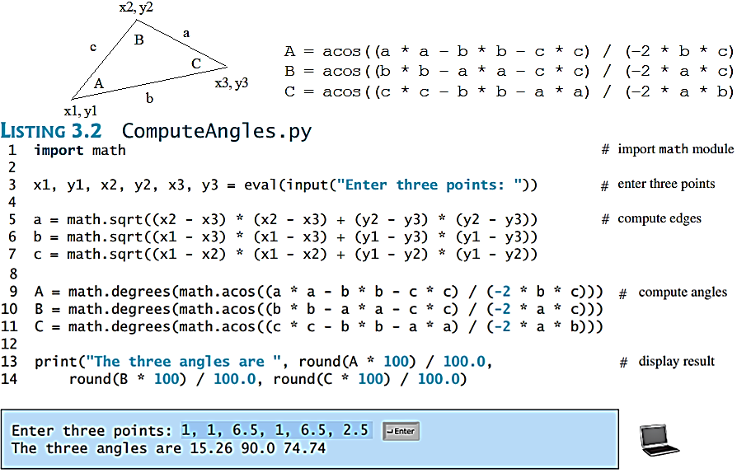
Problem: Compute Angles
Given three points of a triangle, you can compute the angles using the following formula:

Slide 8
Strings and Characters
A string is a sequence of characters. String literals can be enclosed in matching single quotes (') or double quotes ("). Python does not have a data type for characters. A single-character string represents a character.
letter = 'A' # Same as letter = "A"
numChar = '4' # Same as numChar = "4"
message = "Good morning"
# Same as message = 'Good morning'
For consistency, this book uses double quotes for a string with more than one character and single quotes for a string with a single character or an empty string. This convention is consistent with other programming languages. So, it will be easy to convert a Python program to a program written in other languages.

Slide 9
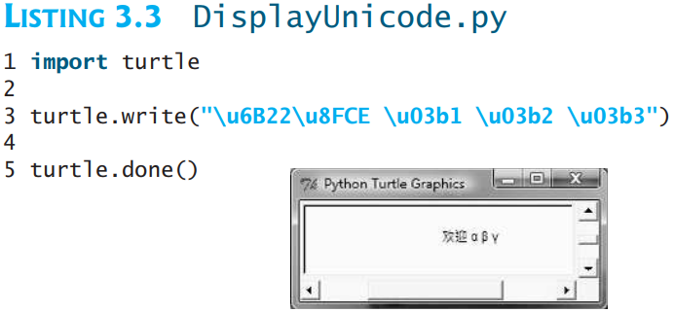
Unicode and ASCII Code
Python characters use Unicode, a 16-bit encoding scheme Python supports Unicode. Unicode is an encoding scheme for representing international characters. ASCII is a small subset of Unicode.

Slide 10
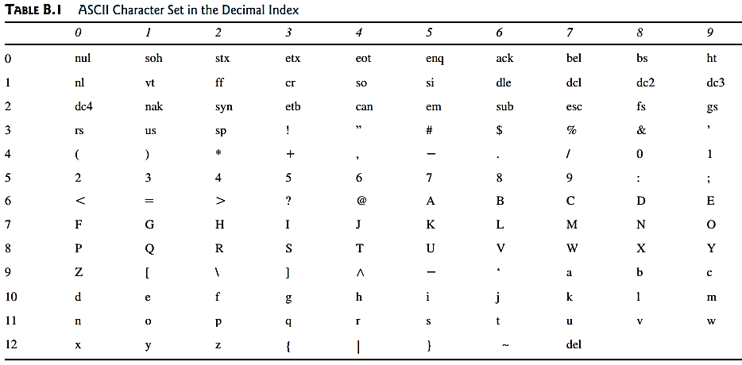
Appendix B: ASCII Character Set
ASCII Character Set is a subset of the Unicode from \u0000 to \u007f

Slide 11
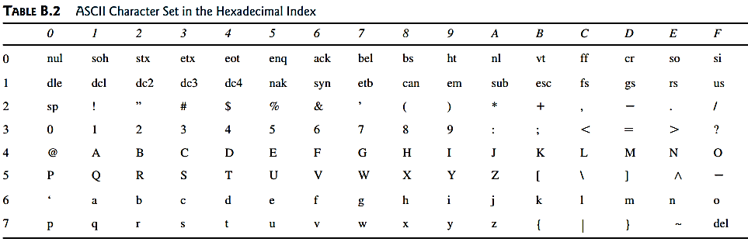
Appendix B: ASCII Character Set
ASCII Character Set is a subset of the Unicode from \u0000 to \u007f

Slide 12
Functions ord and chr
>>> ch = 'a'
>>> ord(ch)
>>> 97
>>> chr(98)
>>> 'b'

Slide 13
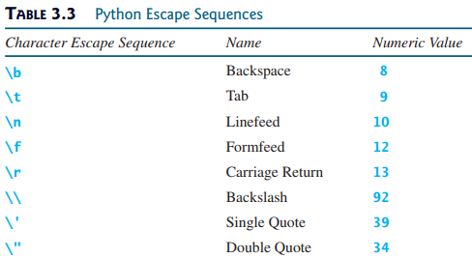
Escape Sequences for Special Characters
Unicode
\u0008
\u0009
\u000A
\u000D
\u005C
\u0027
\u0022

Slide 14

Printing without the Newline
print(item, end = 'anyendingstring')
print("AAA", end = ' ')
print("BBB", end = '')
print("CCC", end = '***')
print("DDD", end = '***')

Slide 15
The str Function
The str function can be used to convert a number into a string. For example,
>>> s = str(3.4) # Convert a float to string
>>> s
'3.4'
>>> s = str(3) # Convert an integer to string
>>> s
'3'
>>>

Slide 16
The String Concatenation Operator
You can use the + operator add two numbers. The + operator can also be used to concatenate (combine) two strings.
examples:
>>> message = "Welcome " + "to " + "Python"
>>> message
'Welcome to Python'
>>> chapterNo = 2
>>> s = "Chapter " + str(chapterNo)
>>> s
'Chapter 2'
>>>

Slide 17
Reading Strings from the Console
To read a string from the console, use the input function. For example, the following code reads three strings from the keyboard:
s1 = input("Enter a string: ")
s2 = input("Enter a string: ")
s3 = input("Enter a string: ")
print("s1 is " + s1)
print("s2 is " + s2)
print("s3 is " + s3)

Slide 18
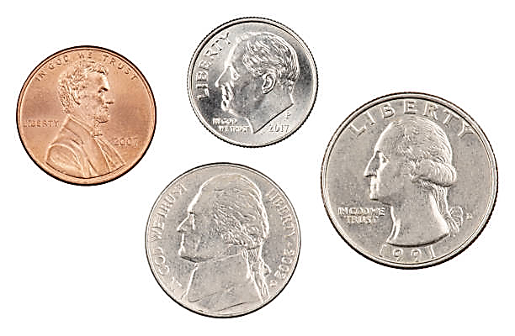
Case Study: Minimum Number of Coins
This program lets the user enter the amount in decimal representing dollars and cents and output a report listing the monetary equivalent in single dollars, quarters, dimes, nickels, and pennies. Your program should report maximum number of dollars, then the maximum number of quarters, and so on, in this order.
4 Quarters = $1
10 Dimes = $1
20 Nickels = $1
100 Pennies = $

Slide 19
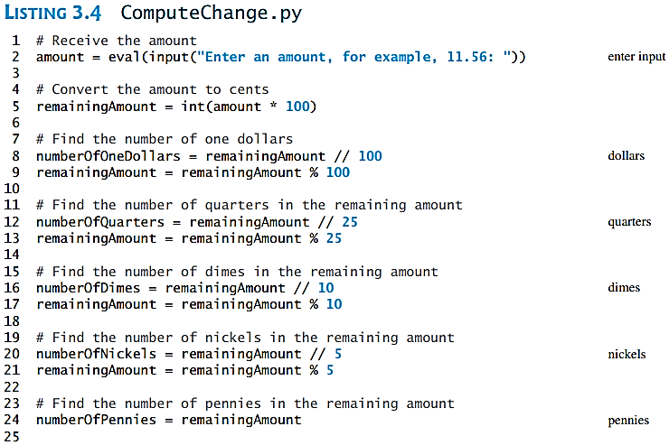
Case Study: Minimum Number of Coins
4 Quarters = $1
10 Dimes = $1
20 Nickels = $1
100 Pennies = $

Slide 20
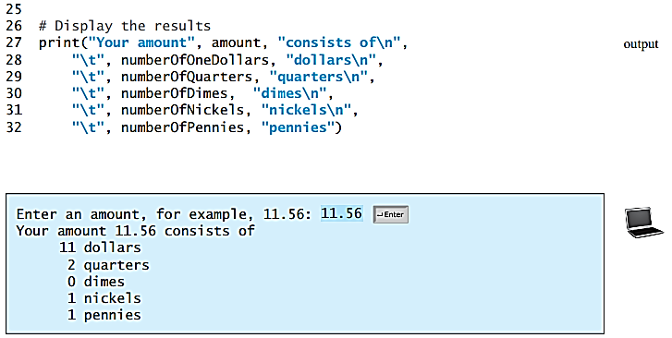
Case Study: Minimum Number of Coins
4 Quarters = $1
10 Dimes = $1
20 Nickels = $1
100 Pennies = $

Slide 21
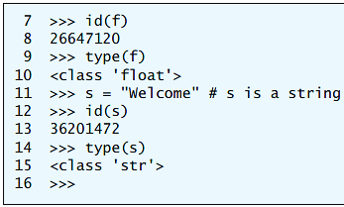
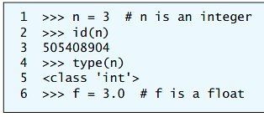
Introduction to Objects and Methods
In Python, a number is an object, a string is an object, and every datum is an object. Objects of the same kind have the same type. You can use the id function and type function to get these pieces of information about an object. For example,
n is a variable that references an int object for value 3
The id and type functions are rarely used in programming, but they are good pedagogical tools for understanding objects.

Slide 22
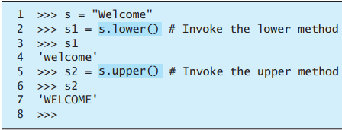
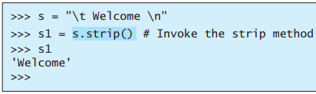
Methods
You can perform operations on an object. The operations are defined using functions.
The functions for the objects are called methods in Python.
Methods can only be invoked from a specific object.
For example, the string type has the methods such as lower() and upper()
What String methods are available?
https://docs.python.org/3.3/library/stdtypes.html#string-methods LINK

Slide 23
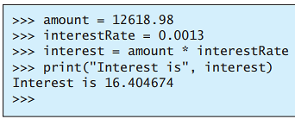

Formatting Numbers and Strings
Often it is desirable to display numbers in certain format. For example, the following code computes the interest, given the amount and the annual interest rate.

Slide 24
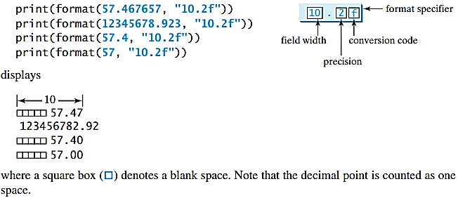
Formatting Floating-Point Numbers

Slide 25
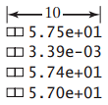

Formatting in Scientific Notation
If you change the conversion code from f to e, the number will be formatted in scientific notation. For example,

Slide 26
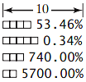

Formatting as a Percentage
You can use the conversion code % to format numbers as a percentage. For example,

Slide 27


Justifying Format
By default, the format is right justified. You can put the symbol < in the format specifier to specify that the item is a left justified in the resulting format within the specified width. For example,

Slide 28
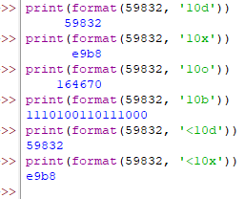

Formatting Integers
You can use the conversion code d, x, o, or b to format an integer in decimal, hexadecimal, octal, or binary. You can specify a width for the conversion. For example,
164670

Slide 29
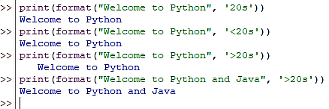
Formatting Strings
You can use the conversion code s to format a string with a specified width. For example,

