Slide 1
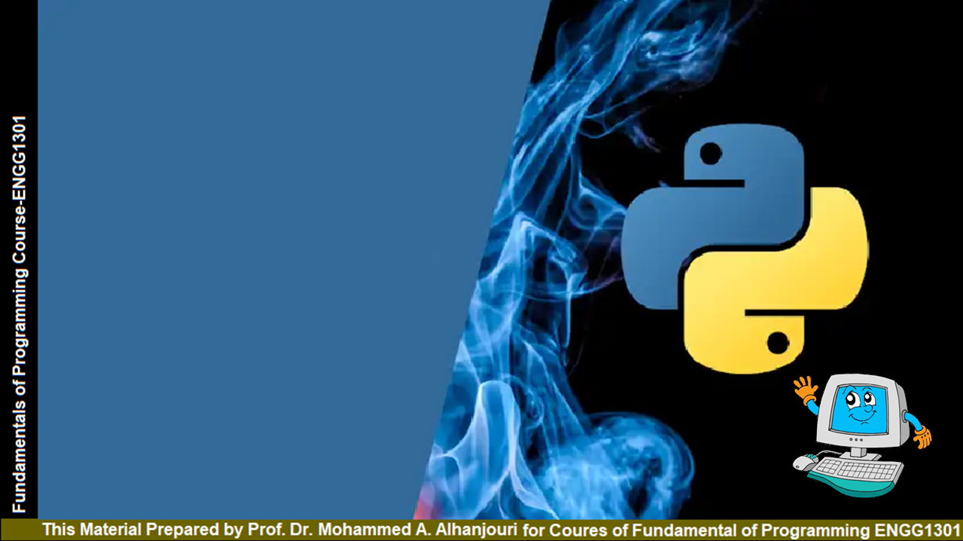
Chapter 2 Elementary Programming
Prof. Dr. Mohammed Alhanjouri
Professor of Artificial Intelligence Engineering

Slide 2
Objectives
To write programs that perform simple computations (§2.2).
To obtain input from a program’s user by using the input function (§2.3).
To use identifiers to name variables (§2.4).
To assign data to variables (§2.5).
To define named constants (§2.6).
To use the operators +, -, *, /, //, %, and ** (§2.7).
To write and evaluate numeric expressions (§2.8).
To use augmented assignment operators to simplify coding (§2.9).
To perform numeric type conversion and rounding by int and round functions (§2.10)
To obtain the current system time by using time.time() (§2.11).
To describe the software development process and apply it to develop the loan payment program (§2.12).
To compute and display the distance between two points (§2.13).

Slide 3
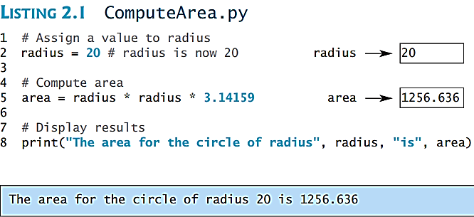
Introducing Programming with an Example
Listing 2.1 Computing the Area of a Circle
This program computes the area of the circle.

Slide 4
animation
Trace a Program Execution
# Assign a radius
radius = 20 # radius is now 20
# Compute area
area = radius * radius * 3.14159
# Display results
print("The area for the circle of radius " +
str(radius) + " is " + str(area))
Assign 20 to radius
radius
20

Slide 5
animation
Trace a Program Execution
# Assign a radius
radius = 20 # radius is now 20
# Compute area
area = radius * radius * 3.14159
# Display results
print("The area for the circle of radius " +
str(radius) + " is " + str(area))
Assign result to area
radius
20
area
1256.636

Slide 6
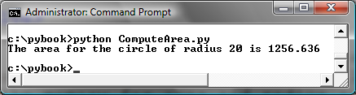
animation
Trace a Program Execution
# Assign a radius
radius = 20 # radius is now 20
# Compute area
area = radius * radius * 3.14159
# Display results
print("The area for the circle of radius " +
str(radius) + " is " + str(area))
radius
20
area
1256.636
print a message to the console
print("The area for the circle of radius "
, str(radius) , " is " , str(area))


print("The area for the circle of radius "
, radius , " is " , area)

Slide 7
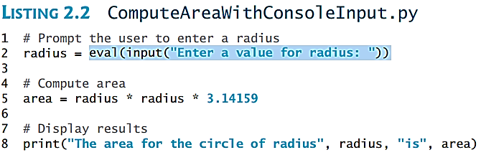
Reading Input from the Console
1. Use the input function variable = input("Enter a string: ")
2. Use the eval function var = eval(stringVariable)
  EX.1 eval("51 + (54 * (3 + 2))") returns 321.
EX.2

Slide 8
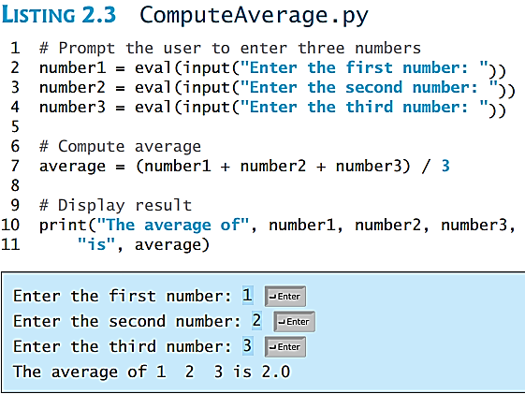
Reading Input from the Console
Using the input and eval
functions
EX.3

Slide 9
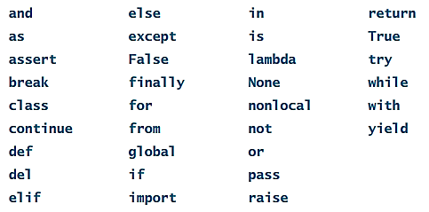
Identifiers
An identifier is a sequence of characters that consists of letters, digits, underscores ( _ ), and asterisk (*).
An identifier must start with a letter or an underscore. It cannot start with a digit.
An identifier cannot be a reserved word. Reserved words have special meanings in Python, which we will later.
An identifier can be of any length.

Slide 10
Variables
# Compute the first area
radius = 1.0
area = radius * radius * 3.14159
print("The area is ", area,
" for radius ", radius)
# Compute the second area
radius = 2.0
area = radius * radius * 3.14159
print("The area is ", area,
" for radius ", radius)
Variables
Variables

Slide 11
Expression
variable = expression
x = 1 # Assign 1 to variable x
radius = 1.0 # Assign 1.0 to variable radius
# Assign the value of the expression to x
x = 5 * (3 / 2) + 3 * 2
x = y + 1 # Assign the addition of y and 1 to x
area = radius * radius * 3.14159 # Compute area
Expression

Slide 12
Assignment Statements
x = 1 # Assign 1 to x
x = x + 1
i = j = k = 1

Slide 13
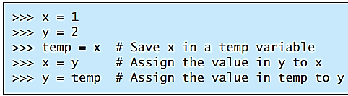

Simultaneous Assignments
var₁, var₂, ..., var_{n} = exp₁, exp₂, ..., exp_{n}
X , y , z = 4 , 6 , 7
Ex: Consider two variables: x and y. How do you write the code to swap their values? A common approach is to introduce a temporary variable as follows:
A common approach
Simultaneous Assignments

Slide 14
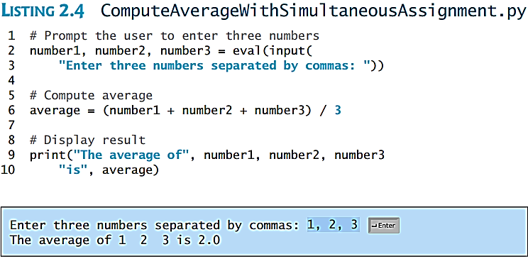
Simultaneous Assignments Example

Slide 15
Named Constants
* The value of a variable may change during the execution of a program, but a named constant or simply constant represents permanent data that never changes.
* Python does not have a special syntax for naming constants.
* You can simply create a variable to denote a constant.
* To distinguish a constant from a variable, use all uppercase letters to name a constant.

Slide 16
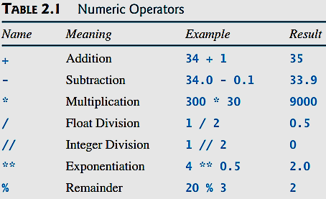
Numerical Data Types and Operators
Integer numbers:
e.g., 3, 4
Float numbers :
e.g., 3.0, 4.0

Slide 17
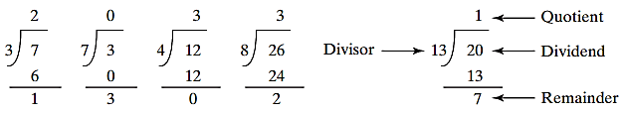
Floor division
The // operator works as expected with positive numbers
  37 // 5 evaluates to 7
37 / 5 is 7 remainder 2 in Euclidian Division
But …
  37 // – 5 evaluates to – 8

Slide 18
Floor division
* Division of integers (/) yields a float, while floor division of integers (//) results in an integer; the result is the ‘floor’ function applied to the result.
3
2
1.95
1.0
– 1.95
– 2.05
– 2.55
math.floor (– 1.95) = ⎣ – 1.95⎦ evaluates to – 2
math.floor (1.95) evaluates to 1
math.floor (1.0) evaluates to 1
math.floor (– 2.05) evaluates to – 3
math.floor (– 2.55) evaluates to – 3
The floor is the integer value "underneath" the number unless it is a whole number
1
0
– 1
– 2
– 3

Slide 19
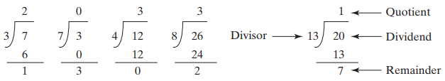
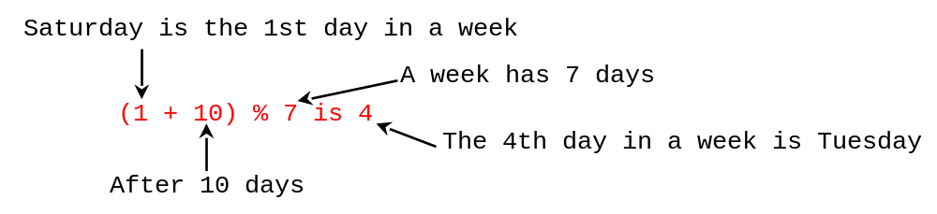
The % Operator = Modulo Operator
is very useful in programming.
For example, an even number % 2 is always 0 and an odd number % 2 is always 1. So, you can determine whether a number is even or odd.
Suppose today is Saturday and you and your friends are going to meet in 10 days. What day is in 10 days? that day is Tuesday using the expression:
1- Saturday
2- Sunday
3- Monday
4- Tuesday
5- Wednesday
6- Thursday
7- Friday

Slide 20
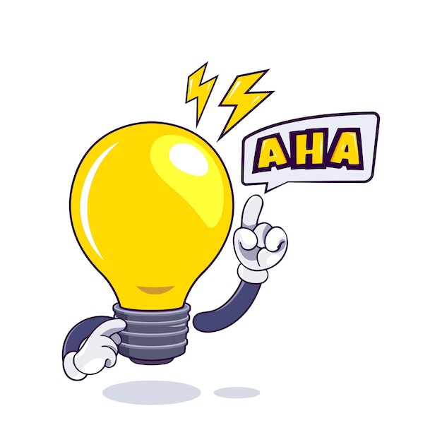
More on the Modulo Operator
For positive values Modulo works as if performing Euclidian Division
37 % 5 evaluates to 2 because 37 / 5 is 7 remainder 2
But with negative values?
37 % -5 evaluates to -3 even though 37 / - 5 is -7 remainder -2
But recall, floor division …
Recall, 37 // -5 evaluates to -8 in Python due to floor division.
So -5 * -8 evaluates to 40, So what do we need to add to -5 * -8 to get 37? -3 !!!! Ah-Ha!!!!
"The floor division and modulo operators are connected by the following identity: x == (x // y) * y + ( x % y)

Slide 21
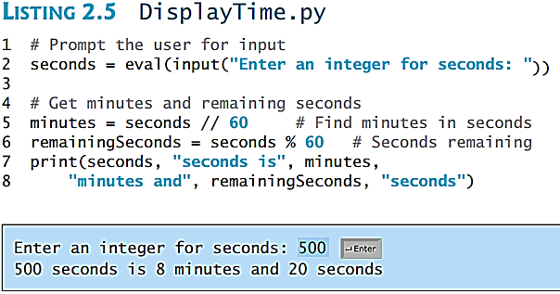
Problem: Displaying Time
Write a program that obtains hours and minutes from seconds.

Slide 22

Overflow and Underflow
When a variable is assigned a value that is too large (in size) to be stored, it causes overflow. For example, executing the following statement causes overflow.
When a floating-point number is too small (i.e., too close to zero) to be stored, it causes underflow. Python approximates it to zero. So normally you should not be concerned with underflow.

Slide 23
Scientific Notation
Floating-point literals can also be specified in scientific notation,
For example, 1.23456e+2, same as 1.23456e2, is equivalent to 123.456,
and 1.23456e–2 is equivalent to 0.0123456.
E (or e) represents an exponent and it can be either in lowercase or uppercase.

Slide 24
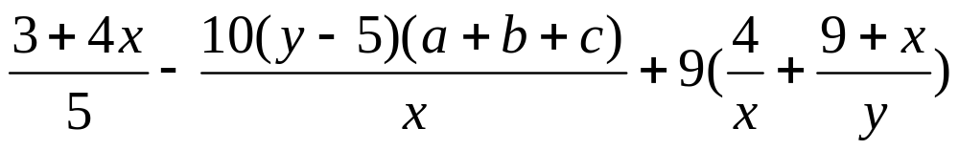
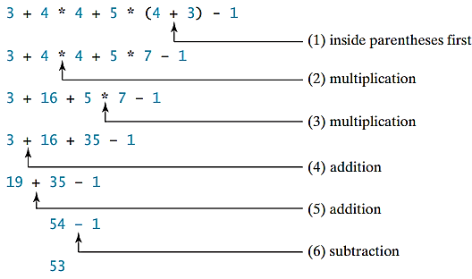
Arithmetic Expressions and How to Evaluate
is translated to (3+4*x)/5 – 10*(y-5)*(a+b+c)/x + 9*(4/x + (9+x)/y)
Ex:

Slide 25
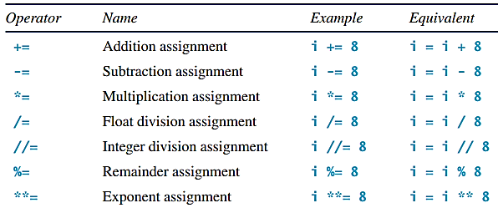
Augmented Assignment Operators
There are no spaces in the augmented assignment operators

Slide 26
Type Conversion and Rounding
datatype(value)
i.e., int(4.5) => 4 , float(4) => 4.0 , str(4) => “4”
round(4.6) => 5 , round(4.5) => 4
Int(“45”) convert str 45 to int 45 like as eval (“45”)
But there are a few different s between int and eval
eval(“4”) | Int(“4”) | Convert an integer string into an integer (“4”)
eval(“4.3”) | Int(“4.3”) error | Work for a non-integer string (“4.3”)
eval(“4 + 3”) | Int(“4 + 3”) error | To evaluate an expression (4 + 3)
eval(“004”) error | Int(“004”) | Numeric string that contains leading zeros

Slide 27
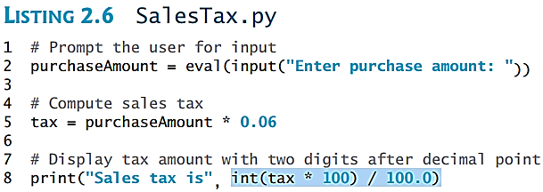
Problem: Keeping Two Digits After Decimal Points
Write a program that displays the sales tax with two digits after the decimal point. The sales tax ratio is 6%
For purchaseAmount is 197.55 Note that
tax * 100 is 1185.3
int(tax * 100) is 1185
int(tax * 100) / 100.0 is 11.85

Slide 28
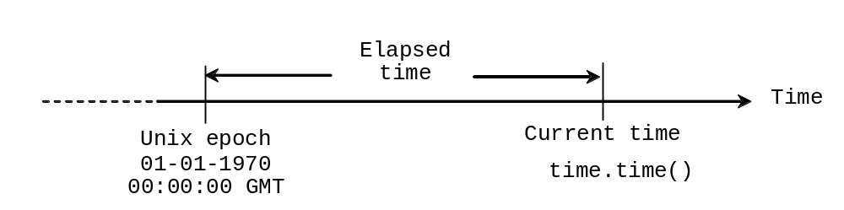
Problem: Displaying Current Time
Write a program that displays current time in GMT in the format hour:minute:second such as 1:45:19.
The time.time() function returns the current time in seconds with millisecond precision since the midnight, January 1, 1970 GMT. (1970 was the year when the Unix operating system was formally introduced.) You can use this function to obtain the current time, and then compute the current second, minute, and hour as follows.

Slide 29
Problem: Displaying Current Time
1 import time
3 currentTime = time.time() # Get current time
5 # Obtain the total seconds since midnight, Jan 1, 1970
6 totalSeconds = int(currentTime)
8 # Get the current second
9 currentSecond = totalSeconds % 60
11 # Obtain the total minutes
12 totalMinutes = totalSeconds // 60
14 # Compute the current minute in the hour
15 currentMinute = totalMinutes % 60
17 # Obtain the total hours
18 totalHours = totalMinutes // 60
20 # Compute the current hour
21 currentHour = totalHours % 24
23 # Display results
24 print("Current time is", currentHour, ":",
25 currentMinute, ":", currentSecond, "GMT")

Slide 30
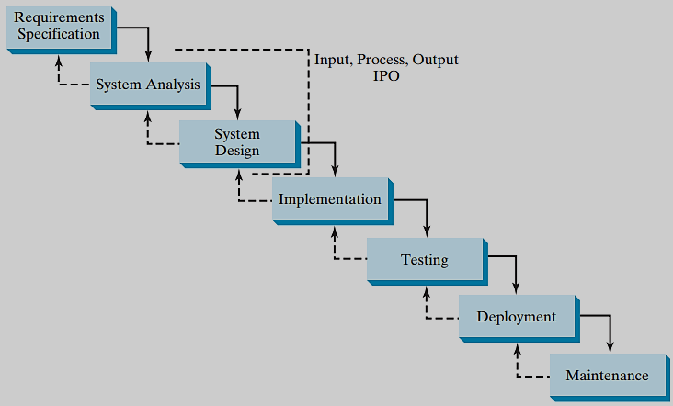
Software Development Process

Slide 31
Requirement Specification (Software Development Process)
Requirement Specification
A formal process that seeks to understand the problem and document in detail what the software system needs to do. This phase involves close interaction between users and designers.
Most of the examples in this book are simple, and their requirements are clearly stated. In the real world, however, problems are not well defined. You need to study a problem carefully to identify its requirements.

Slide 32
System Analysis (Software Development Process)
Seeks to analyze the business process in terms of data flow, and to identify the system’s input and output.
System Analysis
Part of the analysis entails modeling the system’s behavior. The model is intended to capture the essential elements of the system and to define services to the system.

Slide 33
System Design (Software Development Process)
The process of designing the system’s components.
System Design
This phase involves the use of many levels of abstraction to decompose the problem into manageable components, identify classes and interfaces, and establish relationships among the classes and interfaces.

Slide 34
IPO (Software Development Process)
System Analysis
System Design
The essence of system analysis and design is input, process, and output. This is called IPO.

Slide 35
Implementation (Software Development Process)
The process of translating the system design into programs. Separate programs are written for each component and put to work together.
Implementation
This phase requires the use of a programming language like Python. The implementation involves coding, testing, and debugging.

Slide 36
Testing (Software Development Process)
Ensures that the code meets the requirements specification and weeds out bugs.
Testing
An independent team of software engineers not involved in the design and implementation of the project usually conducts such testing.

Slide 37
Deployment (Software Development Process)
Deployment makes the project available for use.
Development

Slide 38
Maintenance (Software Development Process)
Maintenance is concerned with changing and improving the product.
A software product must continue to perform and improve in a changing environment. This requires periodic upgrades of the product to fix newly discovered bugs and incorporate changes.
Maintenance

Slide 39
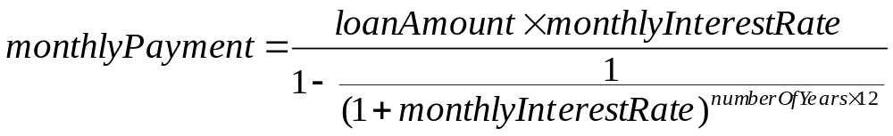
Problem: Computing Loan Payments
This program lets the user enter the interest rate, number of years, and loan amount, and computes monthly payment and total payment.
totalPayment = monthlyPayment * numberOfYears * 12

Slide 40
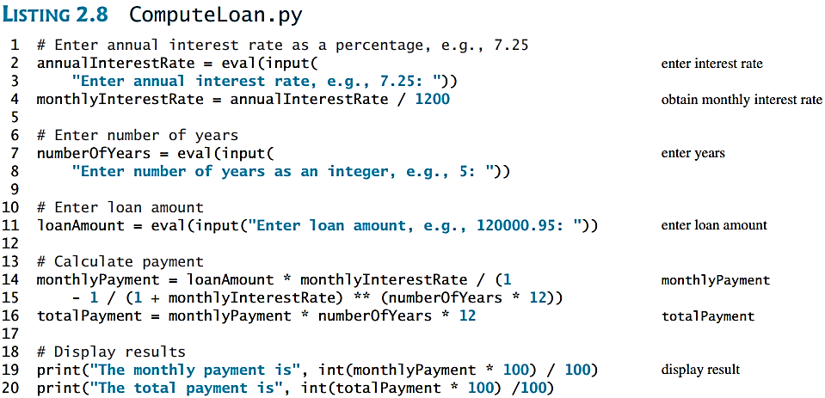
Problem: Computing Loan Payments

Slide 41
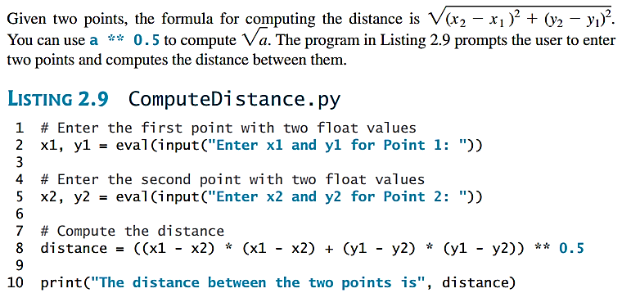
Case Study: Computing Distances
This program prompts the user to enter two points, computes their distance, and displays the points.

