Slide 1
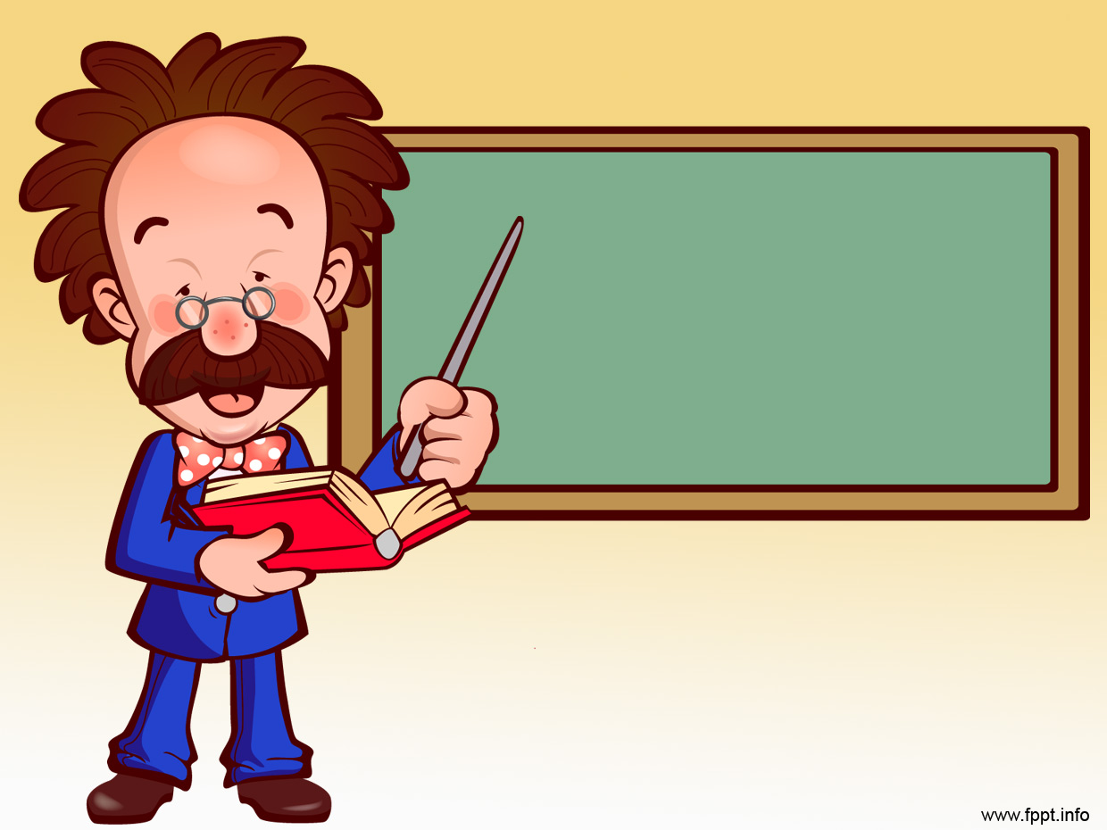
Unit 44: Electrical Supply
Prof. Fady El-Nahal
Technical English
Islamic University of Gaza
2020-2021

Slide 2
Outlines
Direct current and alternating current
AC generation and supply
DC generation and use

Slide 3
A. Direct Current and Alternating Current
The current from a cell is direct current (DC) -a constant flow of electricity which travels around a circuit in one direction. The electricity supplied to homes and other buildings - called mains electricity- is alternating current (AC). Unlike a DC supply, an AC supply flows backwards and forwards - its direction continually alternates. The rate at which the current alternates- called the frequency- is measured in hertz (Hz). For example, in the UK, AC supply is 50 Hz - it alternates 50 times per second. On a graph, the AC supply of mains electricity forms a sine wave.

Slide 4
A. Direct Current and Alternating Current
The current supplied to most homes is single-phase - it forms one sine wave. In factories and large buildings, which have powerful electrical equipment, the supply is often three-phase -effectively three currents, each with a different phase (timing). This provides a smoother supply as it reduces the gaps between the voltage peaks.
Note: The term mains electricity is not used in American English -terms like supply are used.

Slide 5
B. AC Generation and Supply
Mains electricity is generated (produced) at sites called power stations, which use large generators. A generator converts mechanical energy to electrical energy. A generator rotates a magnet within an iron surround. The iron- called an armature- has coils of wire around it, called field coils (or field windings). As the magnet rotates, it causes current to flow through the field coils, due to electromagnetic induction.

Slide 6
B. AC Generation and Supply
Current from the generators leaves the power station and enters the power grid (or grid)- the network of power lines (cables) which transmit it around the country. At the point where it enters the grid, the electricity flows through transformers -specifically step-up transformers, which increase voltage and decrease amperage. This reduces the energy lost from the power lines over long distances, as high-voltage (HV) supplies flow more efficiently than low-voltage (LV) supplies. Before the supply is used by homes and other buildings, it passes through several step-down

Slide 7
B. AC Generation and Supply
transformers, which reduce its voltage and increase its amperage. The supply may be stepped up to over 400,000 volts at the point where it enters the large transmission lines (long-distance power lines) leaving the power station. It is normally then stepped down in stages, first passing through a wider network of lower-voltage transmission lines, and finally through the small distribution lines which supply streets and houses –in many countries at around 230 volts.

Slide 8
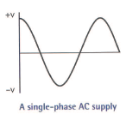
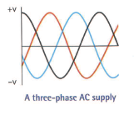
C. DC generation and use
The extract below is from a consumer magazine.
Photovoltaic cells (PVs) - or solar cells - are an effective way of generating your own electricity from sunlight. The current they produce can be used immediately, may be stored in rechargeable batteries (like the ones in cars), or can be fed into the power grid and sold to the electric company. But PVs produce direct current. This is fine for charging batteries, but is not suitable for powering household appliances, which require alternating current. For this, the DC supply from PVs and batteries needs to go through an inverter -a device which converts DC to AC.

Slide 9
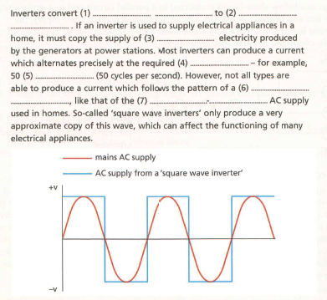

44.1 Complete Complete the text about inverters using words from A opposite.

Slide 10

44.2 Choose the correct words from the brackets to complete the descriptions of different stages of AC generation and supply (a-f). Then, put the stages in the correct order.
.
After the step-up transformer, the current enters a (distribution/ transmission) line.
Current is produced, by electromagnetic induction, in the (magnet/field coils) of a generator.
The current goes from the last step-down transformer to a (distribution/transmission) line.
The current leaves the power (grid/station) and enters the home.
Amperage is reduced and voltage is increased by a (step-up/step-down) transformer.
The current is stepped (up/down) from a higher voltage to a lower voltage, in stages.

Slide 11

44.3 Decide whether the sentences below are true or false, and correct the false sentences. Look at A, B and C opposite to help you.
Photovoltaic cells produce direct current.
The electricity supply from PVs can be used to charge rechargeable batteries.
Rechargeable batteries supply electricity as alternating current.
Inverters convert sunlight to alternating current.

Slide 12
End of
Unit 44

