Slide 1
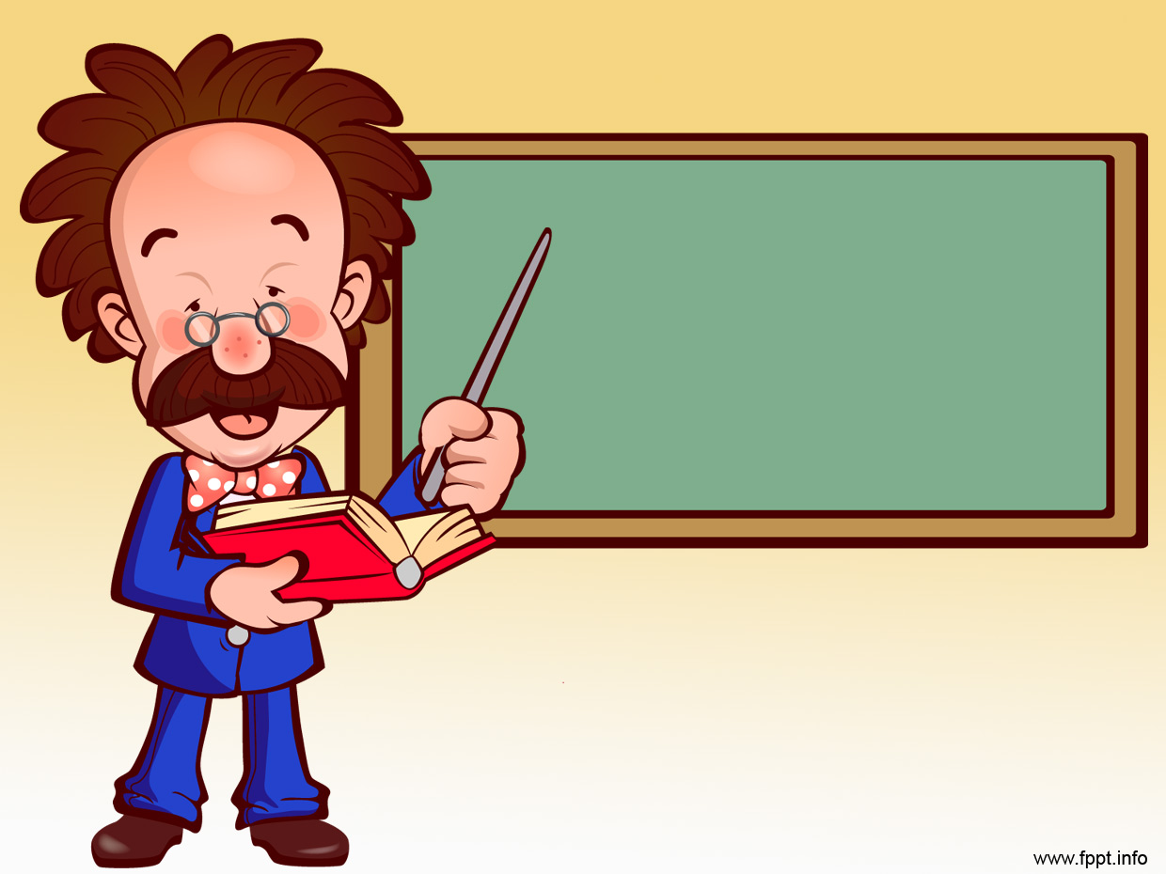
Unit 40: Engines and motors
Prof. Fady El-Nahal
Technical English
Islamic University of Gaza
2020-2021

Slide 2
Content
Types and functions of engines and motors
Internal combustion engines

Slide 3
Types and functions of engines and motors
The term engine usually refers to petrol engines, diesel engines and jet engines(or jets) . In engineering, motor usually means electric motor- but in general language,’ motor’ can also refer to petrol and diesel engine. Engines and motors power (or drive) machines by generating rotary motion – for example, to drive wheels. In jet engines, compressors and turbines rotate to generate thrust – pushing force, produced by forcing air from the back of the engine at high velocity.

Slide 4
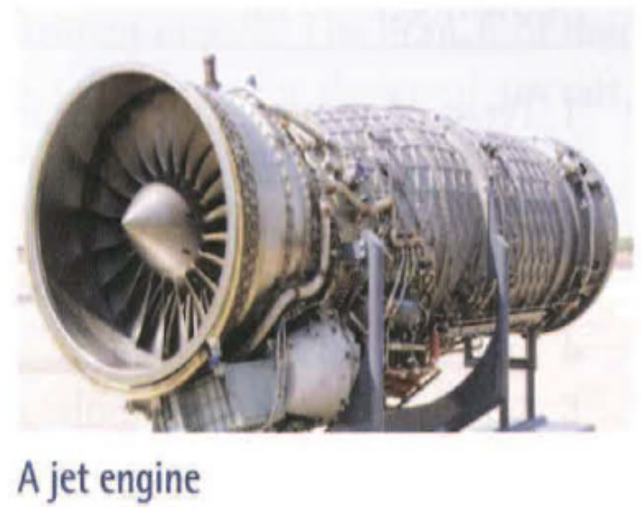
Types and functions of engines and motors
As an engine produces a couple – rotate force- the moving parts of the machine it is driving will produce resistance, due to friction and other forces. As a result, torque (twisting force) is exerted on the output shaft of the engine. Torque – calculated as a turning moment, in newton meters- is therefore a measure of how much rotational force an engine can exert.

Slide 5
Types and functions of engines and motors
The rate at which an engine can work to exert torque is the power of the engine, measured in watts. Although engineers normally calculate engine power in watts, the power of vehicle engines is often given in brake horsepower (bhp).
This is the power of an engine’s output shaft measured in horsepower(hp) – a historic measured of power (see Appendix III on page 100).
Note: See the following units for more information: Unit 33 (turning moments), Unit 34 (rotary motion), Unit 35 (power), and Unit 41 (shafts) .
BrE: petrol; AmE: gasoline
BrE: petrol engine; AmE: gasoline engine

Slide 6
B. Internal combustion engines
Petrol and diesel engines are internal combustion engines. This means they are driven by the combustion (burning) of fuel in enclosed, sealed spaces called combustion chambers. In petrol and diesel engines, the combustion chambers are cylinders surrounded by a cylinder block and closed at the top by a cylinder head. Each cylinder contains a piston. The number of piston cylinders in an engine varies – engine in small motorcycles have only one, while sports car engines may have twelve.

Slide 7
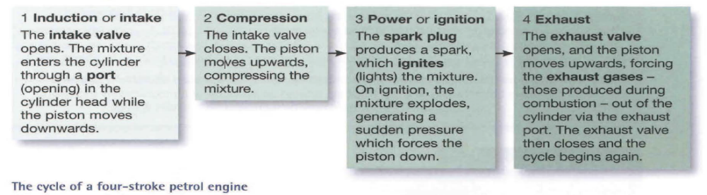
B. Internal combustion engines
Fuel is supplied to each cylinder from a tank. In most engines, the flow of fuel is generated by a pump, which forces it – at high pressure – through fuel injectors. These vaporize the fuel, allowing it to mix with air. Using this mixture (of fuel and air), most engines function as four-stroke engines. This means they work on a cycle of four stages – or four strokes. A stroke is an upward or downward movement of a piston.

Slide 8
B. Internal combustion engines
1 Induction or intake
The intake valve opens. The mixture enters the cylinder through a port (opening) in the cylinder head while the piston moves downwards.

Slide 9
B. Internal combustion engines
2 compression
The intake valve closes. The piston moves upwards, compressing the mixture.

Slide 10
B. Internal combustion engines
3 Power or ignition
The spark plug produces a spark, which ignites (lights) the mixture. On ignition, the mixture explodes, generating a sudden pressure which forces the piston down.

Slide 11
B. Internal combustion engines
4 Exhaust
The Exhaust valve opens, and the piston moves upwards, forcing the Exhaust gases – those produced during combustion – out of the cylinder via the exhaust port. The Exhaust valve then closes and the cycle begins again.
The cycle of a four – storke petrol engine
Notes: See exercise 40.2 opposite for an illustration of a cylinder.
See unit 42 for more on cam, camshaft,connecting rod and crankshaft.

Slide 12
40.1 Complete the text about diesel engines using words from A and B opposite.
Diesel engines differ from (1) ---------- engines in one key respect: they are not fitted with a (2) ------------ , in each cylinder, to ignite the fuel. This is because when a (3) -------- of diesel and air is compressed inside a hot (4) -------- , it will explode spontaneously, without the need for a spark to provide (5) ---------- .
A diesel engine must therefore work in a way which prevents the diesel from exploding before the piston is at the top of the cylinder. To achieve this, the engine takes in only air during the (6) -------- sttage of the cycle. Therefore, during the (7) ----------- stage, only air – and not an air – fuel mixture – is pressurized. It is only at that last intant, when full compression has occurred, that the (8) ------ above each cylinder forces vaporized diesel onto the combustion chamber, where it ignites.

Slide 13
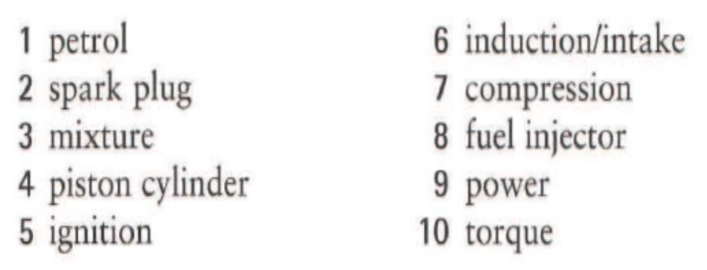
40.1 Complete the text about diesel engines using words from A and B opposite.
Diesel engines operate at lower speeds than petrol engines, making them less suitable for high – speed applications. However, they are more able to (9 ) --------------- heavy vehicles, as they can produce greater amounts of (10) ----------- than petrol engines.

Slide 14
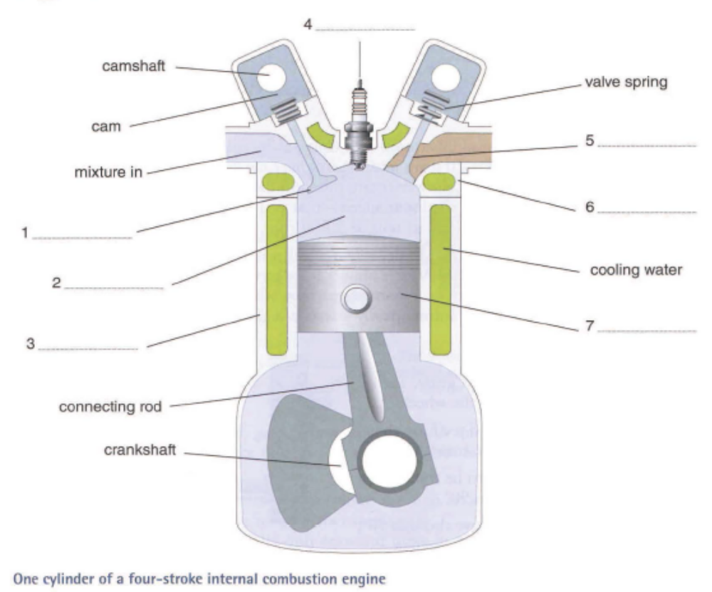
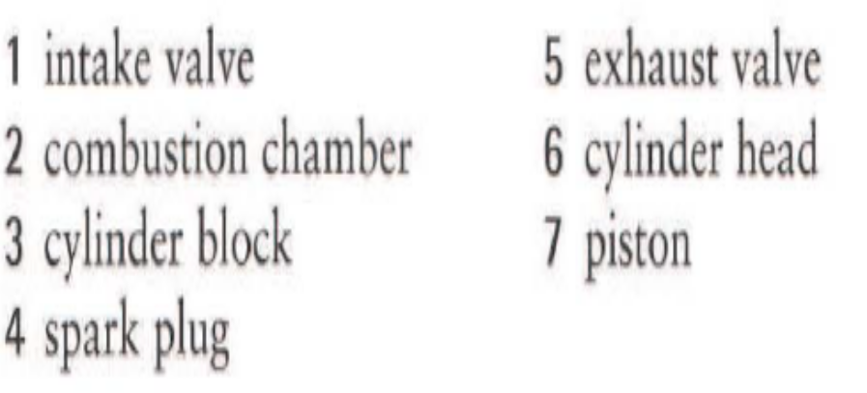
40.2 look at the cross – section of an engine, and label it using words and expressions from B opposite.

Slide 15
End of
Unit 40

