Slide 1

Unit 33: Motion and simple machines
Prof. Fady El-Nahal
Technical English
Islamic University of Gaza
2020-2021

Slide 2
Outline
Acceleration and motion
Inertia
Simple machines

Slide 3
A. Acceleration and motion
If an object is at rest (not moving) and is free to move (not fixed), an external force- a force from outside -will make the object accelerate. This means the velocity of the object (the speed of its movement in a given direction) will increase. Velocity is measured in metres per second (m/s). If acceleration is constant- that is, if the rate of acceleration remains the same- it is measured as the increase in velocity (in metres per second) that is achieved each second. The unit of acceleration is therefore metres per second per second - stated as metres per second squared (m/s2 ).
If an object is in motion (moving) and is subjected to an opposing force- that is, one acting on it in the opposite direction- the object will decelerate. As with acceleration, deceleration is measured in m/s2• If something moves in a straight line, we say its movement is linear- a car accelerating and driving along a straight road is an example of linear acceleration and linear motion.
On earth, acceleration due to gravity is roughly 10 m/s2• In other words, if an object is dropped and left to free fall, its velocity will increase by 10 m/s every second (not allowing for air resistance). Acceleration and deceleration, such as that generated by aircraft and cars, can be compared with acceleration due to gravity. This relative measure is called G-force (G stands for gravity). An acceleration of 10 m/s2 is measured as 1 G, 20 m/s2 as 2 G (or 2 Gs), and so on.

Slide 4
B. Inertia
The greater the mass of an object, the greater the external force required to cause it to accelerate or decelerate. Resistance to acceleration or deceleration, due to the mass of an object, is called inertia. When an object is in motion, its resistance to deceleration, due to inertia, is often called momentum.

Slide 5
C. Simple machines
The word machine generally refers to an assembly which has parts that move. However, a simple machine can be a very basic device. A simple machine is something which provides a mechanical advantage- that is, the load generated by the machine (the force it puts out, or output) is greater than the effort (the force put in, or input) required to generate the load.
An example of a simple machine is a lever, which is used with a fulcrum- a point which acts as a support, and allows the lever to pivot (turn around the support). If the lever is placed so that the distance between the effort and the fulcrum is greater than the distance between the load and the fulcrum, a mechanical advantage is created.
In general language, the turning force generated by a lever is called leverage. In engineering, a turning force is called a turning moment (or moment). Moments are calculated by multiplying the distance from the fulcrum, in metres, by the magnitude of the force, in newtons. They are measured in newton metres (Nm).

Slide 6
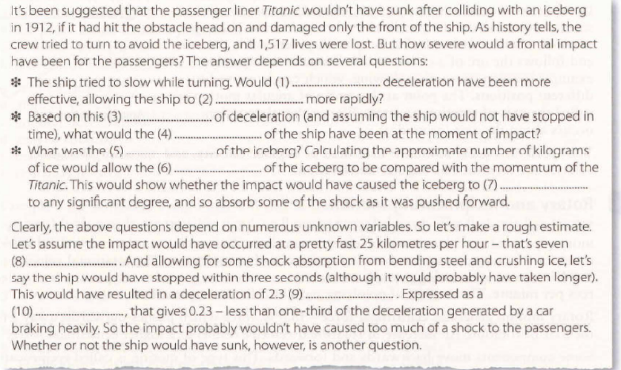
33.1 Complete the article about the Titanic, taken from a popular science magazine. Look at A and B opposite to help you.
1 linear
2 decelerate
3 rate
4 velocity
5 mass
6 inertia
7 accelerate
8 metres per second
9 metres per second squared
10 G-force

Slide 7
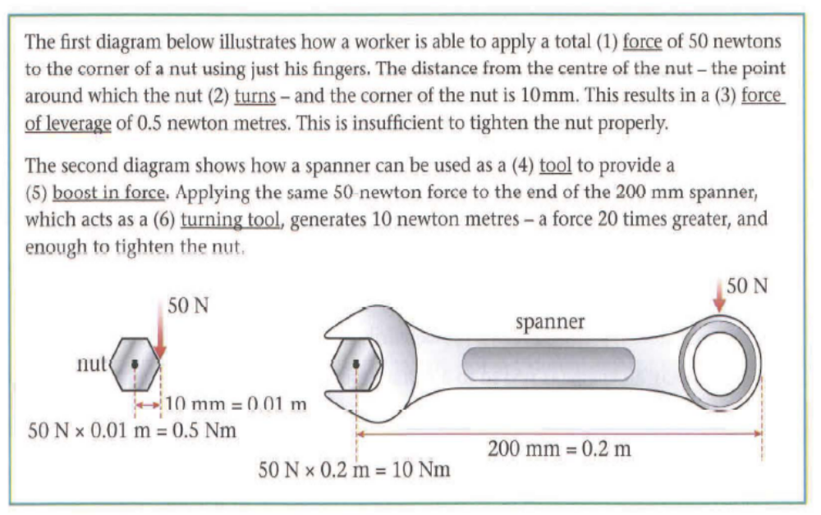
33.2 Replace the underlined words and expressions with alternative words and expressions from A and B opposite.
1 effort
2 pivots
3 turning moment/moment
4 simple machine
5 mechanical advantage
6 lever

