Slide 1

Unit 31: Force, deformation and failure
Prof. Fady El-Nahal
Technical English
Islamic University of Gaza
2020-2021

Slide 2
Outline
Types of force and deformation
Types of failure

Slide 3
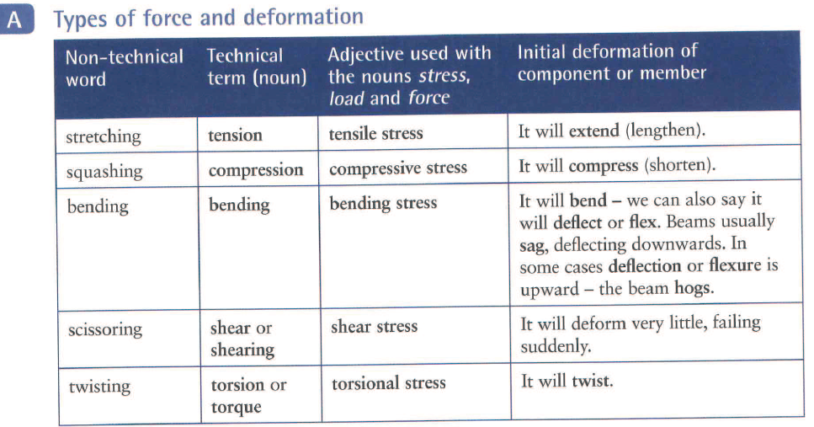
A. Types of force and deformation

Slide 4
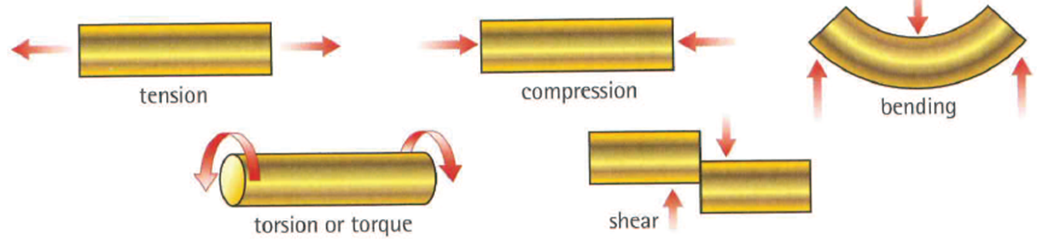
Types of force and deformation

Slide 5
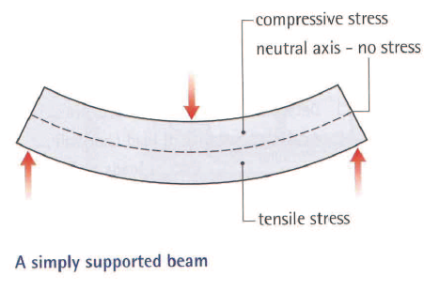
A. Types of force and deformation
Bending comprises two opposite stresses: tension and compression. This is shown in the diagram of a simply supported beam. As a result of the bending force, the lower half of the beam is in tension and the upper half is in compression. These opposite stresses reach their maximum at the upper and lower surfaces of the beam, and progressively decrease to zero at the neutral axis - an imaginary line along the centre of the beam which is free from stress.

Slide 6
B. Types of failure
The ultimate failure of a component or structural member depends on the type of force:
  in tension - it will fracture
  in compression- if it is thick, it will crush (squash). If it is slender (long and thin), it will buckle, bending out of shape
  in bending - it will fracture on the side of the component which is in tension, or crush on the side which is in compression- or fail due to a combination of both
  in shear- it will shear (break due to shear force)
  in torsion - it will fracture or shear.
When vertical members can no longer resist a load they either crush or buckle.

Slide 7
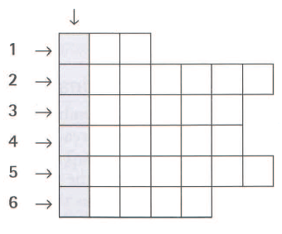
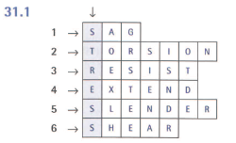
31.1 Complete the word puzzle and find the word going down the page.
bend downwards
a twisting force
take a force without breaking
increase in length, due to tension
long and thin, likely to buckle rather than crush
a scissoring force

Slide 8
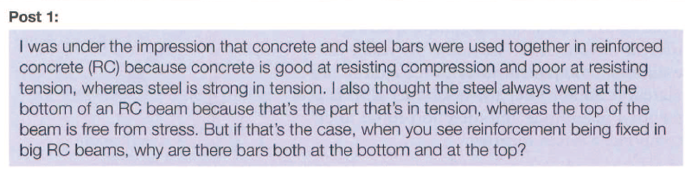

31.2 The question below, which was posted on a forum on a construction website, contains a mistake about a technical fact. Can you find the mistake? Look at A opposite to help you.

Slide 9
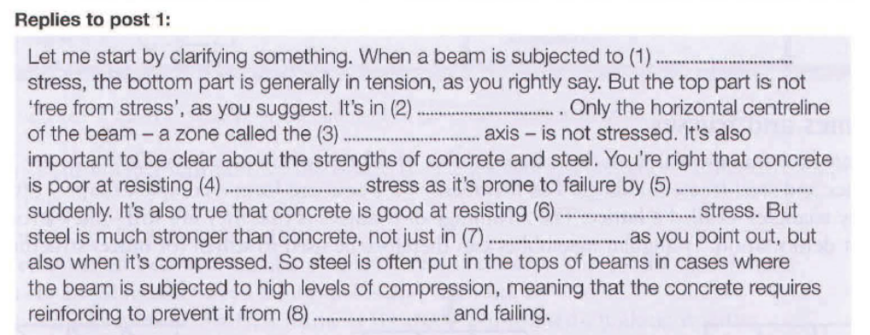
31.3 Now complete a structural engineer's answer to the question in 31.2 using the words in the box.

Slide 10
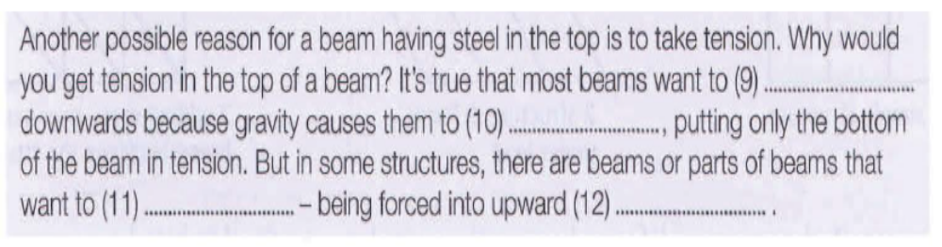
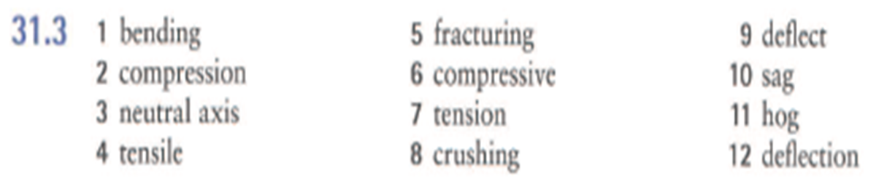
Exercise 31.3

Slide 11
End of
Unit 31

