Slide 1

Unit 30: Load, Stress and Strain
Prof. Fady El-Nahal
Technical English
Islamic University of Gaza
2020-2021

Slide 2
Vocabulary
exerted on تمارس على
Strain التواء
Bearing تحمل
proportional to يتناسب مع

Slide 3
Outline
Load
Stress and Strain

Slide 4
A. Load
When engineers design a machine or structure, they need to know what forces will be exerted on it (put pressure on it ). In engineering, forces are called loads. Usually, several different loads will act on - apply force to - the components in a machine, or the members (parts) of a structure. A component or member which is designed to carry (or bear) a load is called a load-bearing component or member.
To predict what will happen when components are loaded, engineers calculate the magnitude (size) of each load, and also work out the direction of the load -for example, vertically downwards. Load is therefore a vector quantity (or vector)- that is, a measurement with both a magnitude and a direction. This is different to a scalar quantity, which has a magnitude only.

Slide 5
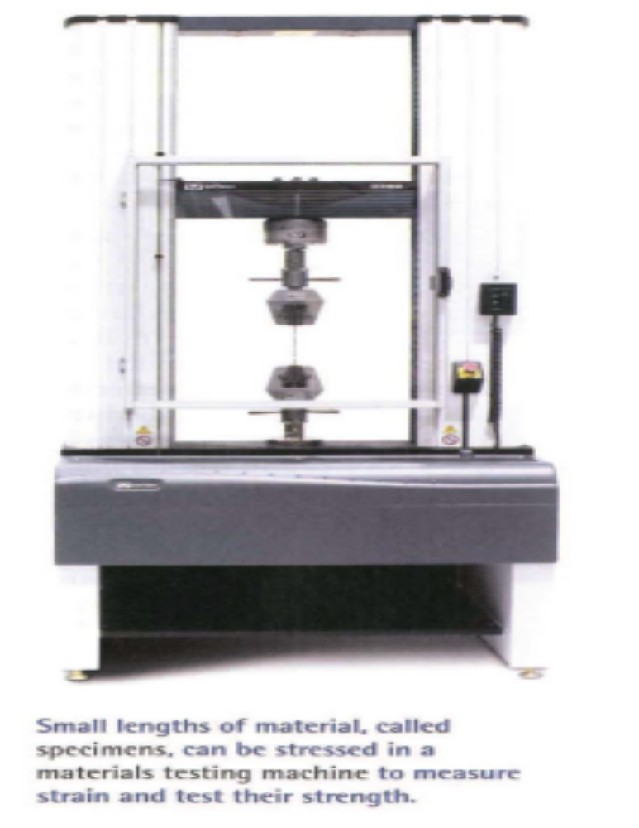

Slide 6
B. Stress and Strain
The extract below is from an engineering textbook.
In a test, a thick cable is used to pick up a heavy object. The cable stretches slightly, but lifts the weight. A second test is done using a thinner cable- one with only half the cross-sectional area of the thick cable. This time, the cable stretches, then breaks.
Why did the thinner cable fail? Not due to a higher load, as the weight was the same. The failure was due to stress. Stress is force per unit of area, and is measured in newton's per square metre, or Pascals (1 N/m2 = 1 Pa). The thinner cable was therefore stressed twice as much as the thick cable, as the same load was concentrated into a cross-sectional area that was 50% smaller.

Slide 7
B. Stress and Strain
Why did the thick cable stretch but not break? When objects are stressed, they deform -that is, they change size (if only slightly). In the tests, the cable extended- it increased in length. Extension can be measured as a change in an object's length compared with its original length before stress was applied. This measurement is called strain.
According to a law called Young's Modulus of Elasticity, stress is proportional to strain. In other words, a percentage increase in stress will cause the same percentage increase in strain. However, this is only true up to a point called the limit of proportionality. If a material is overstressed beyond this limit - it will start to become strained by a higher proportion. Stress and strain will therefore become disproportional.

Slide 8
Description | Type of load
a load that never changes, such as the self-weight of a structure (its own weight) | dead load
a load whose magnitude can be different at different times – usually imposed on (put on) a machine or structure by something that is not part of the machine or structure | live load
a load that remains still (does not move) | static load
a moving load, such as one which produces a sudden shock but lasts for only a brief moment (an impulse) | dynamic load
a load which is concentrated – that is, one which acts on a small area | point load
a load which is spread evenly over a reasonably large area | Uniformly distributed load (UDL)

Slide 9
30.1 Replace the underlined words and expressions with alternative words and expressions from A opposite and Appendix V on page 106.
If you look at the objects around you, it's difficult to find something that couldn't be smashed with a hammer. But if you laid a hammer down carefully on any of those objects, the (1) force which it (2) put on them wouldn't be sufficient to cause even the slightest damage. This comparison illustrates the difference between:
  a (3) moving force, which combines mass and movement to apply (4) a shock
  a (5) still force, which consists only of an object's (6) own mass.
Between the two situations, the (7) size of the load (8) placed on the surface is dramatically different.

Slide 10

Ex. 30.1
The above comparison illustrates another difference in the way surfaces are (9) pressured. When a hammer is laid horizontally on a surface, its weight is spread over a relatively large area. It therefore applies a (1 0) spread out force. By contrast, when a hammer hits something, only the edge of the hammer head comes into contact with the surface. The force is therefore (11) focused in a small area, applying a (12) localized pressure.

Slide 11
30.2 Complete the technical checklist (1-7) based on the questions (a-g), using words from A and B opposite and Appendix Von page 106.
Which components need to carry load?
What types of load will be carried by each part? Which loads will remain constant, and which will differ depending on use and circumstances?
What amount of load will be exerted, in newtons?
In what directions will the loads act?
For the materials used, how concentrated can maximum loads be without putting the component under too much pressure?
How much deformation can be expected?
If something breaks, will the assembly collapse dangerously, or in a controlled, relatively safe way?

Slide 12
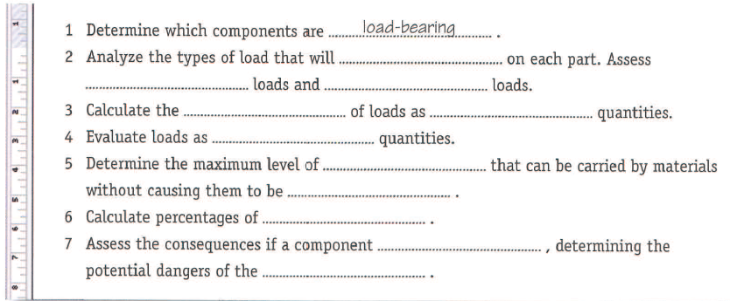


Slide 13
End of
Unit 30

