Slide 1

Unit 28: Non-mechanical joints 1
Prof. Fady El-Nahal
Technical English
Islamic University of Gaza
2020-2021

Slide 2
Outline
Welding
Common gas and arc welding techniques

Slide 3
A. Welding
Welding means permanently joining two pieces of material by heating the joint between them. The heat melts the edges of the components being welded together, and once the material has become molten (liquid), fusion occurs. When the joint fuses, material from each component is mixed together, joining to form a solid weld. Metal is often welded. It is also possible to weld plastic.

Slide 4
A. Welding
Welding is usually used to join components of the same base metal- that is, the metal the components are made of. It is possible - though more difficult - to weld certain dissimilar materials. For example, copper can be welded to steel. Often, a filler is added during welding.
This is new material, of the same type as the base metal, which is melted into the weld pool - the molten metal at the joint during welding.

Slide 5
A. Welding
One problem in welding is discontinuity, where joints are not completely solid. Another problem is residual stress. This is force- for example, tension- which is 'trapped' around the joint. This problem occurs after welding, as a result of contraction in the weld zone (or
fusion zone) -the area that was the weld pool. It can also occur in the heat-affected zone (HAZ) -the material close to the weld pool which was subjected to high temperature, and was modified by the heat.

Slide 6
B. Common gas and arc welding techniques
Shielded metal arc welding (SMAW), generally called arc welding or stick welding, involves striking an electric arc between the workpiece and an electrode – an electrical conductor. The heat from the arc melts the base metal. The electrode consists of a welding rod – a stick of metal of the same type as the workpiece – which provides filler. The welding rod is therefore consumable -it is used up. The rod is also coated with a material called flux. When heated, this produces a shielding gas, which protects the molten metal from oxygen. Without this gas, the hot metal would combine with the oxygen in the air, and this would weaken the weld.

Slide 7
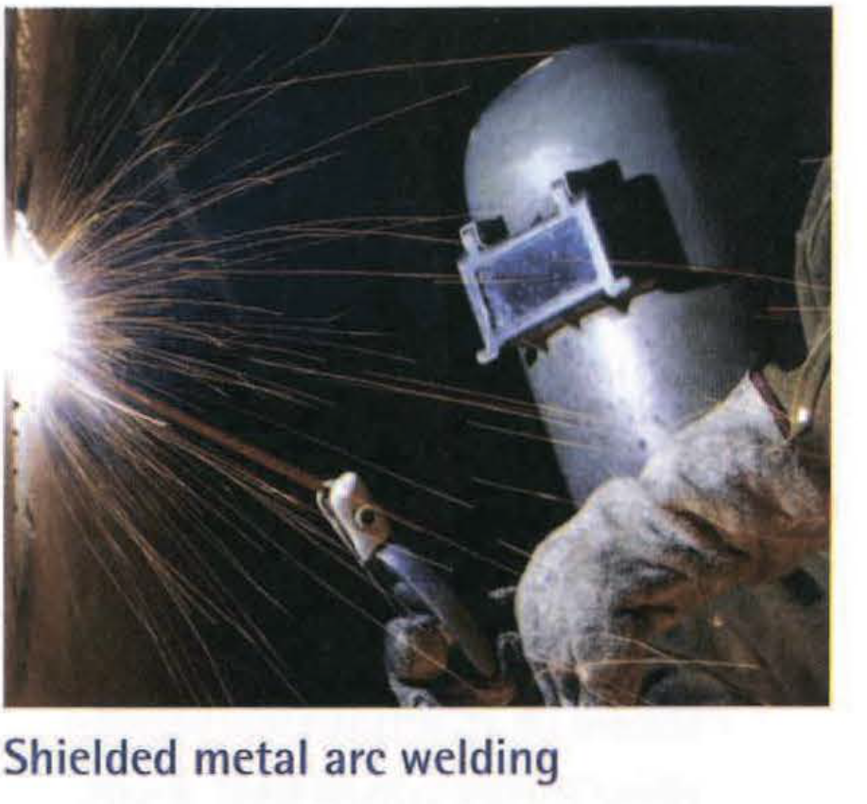
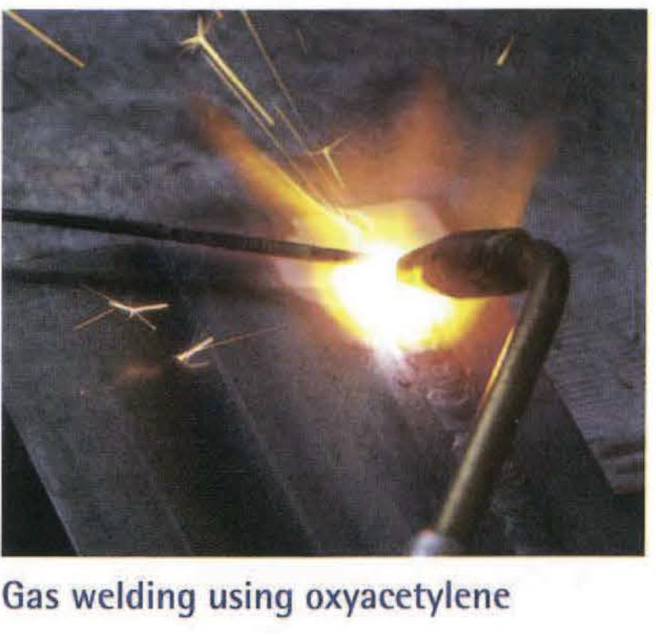
B. Common gas and arc welding techniques

Slide 8
B. Common gas and arc welding techniques
In gas welding, heat comes from a torch which burns oxyfuel - a mixture of oxygen (02) and a gas fuel. The gas fuel burns much hotter in oxygen than it would in the air. The most common fuel is acetylene (C2H2) called oxyacetylene when mixed with oxygen. Welding rods provide filler but flux is not required, as the burning oxyfuel produces carbon dioxide (C02) which acts as a shielding gas.

Slide 9
B. Common gas and arc welding techniques
In gas metal arc welding (GMAW)- often called MIG welding (Metal Inert Gas) - an arc is struck between the
workpiece and a wire which is made of the same metal
as the base metal. The wire acts as a consumable electrode, supplying filler. A shielding gas, often argon (Ar), is blown onto the weld pool.

Slide 10
B. Common gas and arc welding techniques
In gas tungsten arc welding (GTAW)- often called TIG welding (Tungsten Inert Gas) – an arc comes from an electrode made of tungsten (W). However, the tungsten is non-consumable-it does not melt, and is not consumed as filler during the welding process. A separate welding rod is used to supply filler, if required. As with MIG welding, a shielding gas such as argon is blown onto the weld.
Note: MIG and TIG are said as words: /rrug/ and /tlg/.

Slide 11
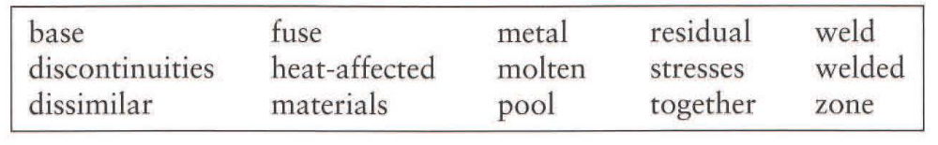
Exercises
28.1 Complete the extract from a technical document about welding using the words in the box. You will need to use some words twice. Look at A opposite to help you.
It is possible for components made of different metals to be (1) .............. . For instance, steel can be welded to copper and to brass. However, it is much more difficult to weld components made of two (2) .............. than it is to weld those made of the same (3) ............... While there is no difficulty in melting two different metals and mixing them together in a (4) ................ state, problems occur once the hot, liquid metal forming the (5)............. starts to cool.

Slide 12
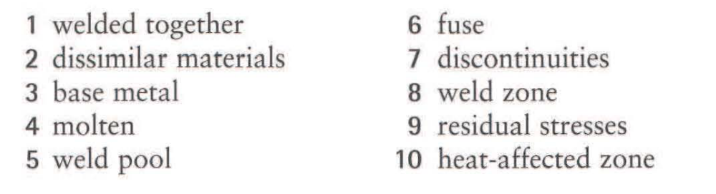
As this process takes place, the two metals will not necessarily
(6) ................................ properly. Once the joint has cooled, this can result in (7) ................................ , such as cracks, at the heart of the (8) .............................................. In addition, as the
metals contract at different rates (due to different coefficients of thermal expansion), powerful (9) ................................ can build up, not only in the joint, but also in the wider (10) ................................ near the joint

Slide 13
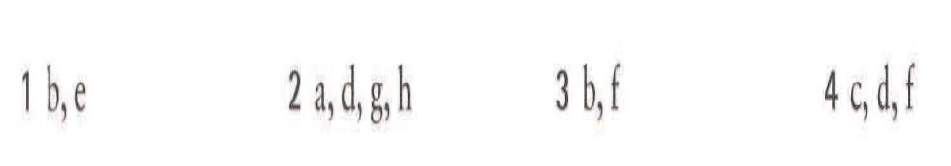
28.2 Match the two parts to make eleven correct sentences about welding techniques. You will need to use some parts more than once.
1 Shielded metal arc welding uses
2 Gas welding uses
3 Gas metal arc welding uses
4 Gas tungsten arc welding uses
a burning gas.
b a consumable electrode.
c a non-consumable electrode.
d a separate welding rod which is not an electrode.
e a special coating on the welding rod which produces a shielding gas.
f a separate gas supply, blown onto the weld as a shielding gas.
g a shielding gas generated by burned oxyfuel.
h a gas whose purpose is to increase the temperature of the welding process.

Slide 14
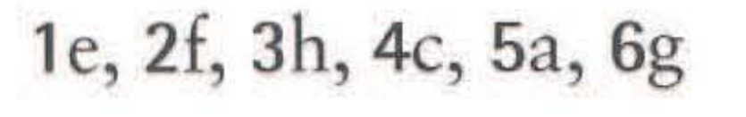
28.3 Match each of the substances (1-6) to the description (a-h) above that uses the substance. Look at B opposite to help you.
1 flux
2 argon
3 oxygen
4 tungsten
5 acetylene
6 carbon dioxide
a burning gas.
b a consumable electrode.
c a non-consumable electrode.
d a separate welding rod which is not an electrode.
e a special coating on the welding rod which produces a shielding gas.
f a separate gas supply, blown onto the weld as a shielding gas.
g a shielding gas generated by burned oxyfuel.
h a gas whose purpose is to increase the temperature of the welding process.

Slide 15
End of
Unit 28

