Slide 1

Unit 27: Mechanical fasteners 2
Prof. Fady El-Nahal
Technical English
Islamic University of Gaza
2020-2021

Slide 2
Outline
Screws
Screw Anchors
Rivets

Slide 3
A. Screws
Screws have threaded shafts with heads. They may be screwed into a predrilled hole- drilled for the screw to enter. Self-tapping screws do not require predrilled holes. They cut their own hole as they are screwed in. Unlike bolts, screws are not used with nuts and- generally- are
not screwed into threaded holes. Most screw heads are designed to be screwed in using a screwdriver. The most common types are slot head screws and crosshead screws.

Slide 4
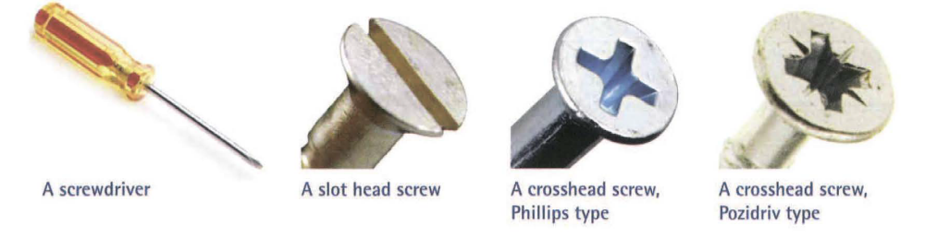
A. Screws

Slide 5
A. Screws
Small-diameter bolts, which can be used with nuts or screwed into threaded holes, are sometimes called machine screws. Bolts that hold components in place by pressing the end of the bolt against the component, in order to generate friction and prevent sliding, are called set screws or grub screws.

Slide 6
B. Screw anchors
Fasteners designed to fix objects to walls are called screw anchors. These fit into predrilled holes. A simple screw anchor is a plastic tube called a wall plug (or plug). It is inserted in a hole, and a screw or bolt is then screwed into it. As it enters the plug, the plug expands (its diameter increases). This increases friction, allowing the plug to resist pullout forces- the forces which would cause it to be pulled out of the hole if it were not firmly anchored. An expansion anchor is another type of anchor. It consists of a bolt fitted inside a metal sleeve. The sleeve expands as the bolt is tightened in the hole.

Slide 7
B. Screw anchors
In cases where pull out forces are very high, chemical anchors can be used. These are studs-threaded bars, onto which nuts can be screwed. The studs are set in - that is, held in the hole by an adhesive. Most chemical anchors are set into holes using a strong adhesive called epoxy resin (see Unit 29 for more on adhesives).

Slide 8
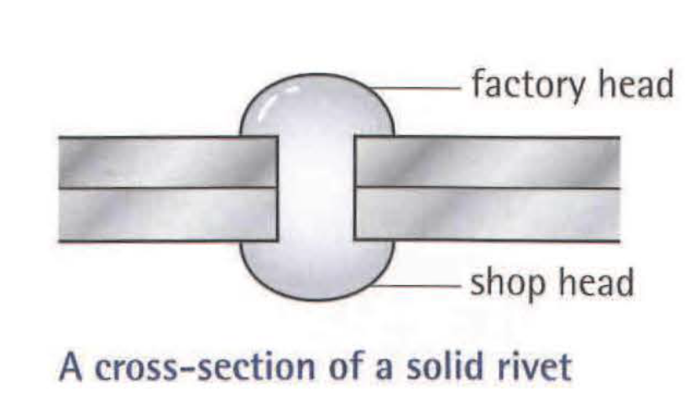
C. Rivets
Rivets are permanent fasteners - they cannot be unscrewed. A solid rivet consists of a short, solid shaft of metal with a head at one end, called the factory head. The rivet is inserted through a pre-drilled hole, then a special tool is used to deform (change the shape of) the other end of the rivet, flattening and widening it to form a second head, called the shop head. Solid rivets are widely used in aircraft.

Slide 9
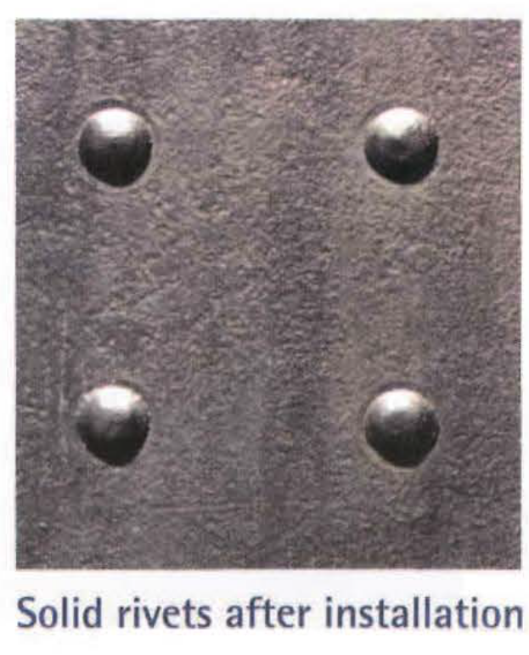
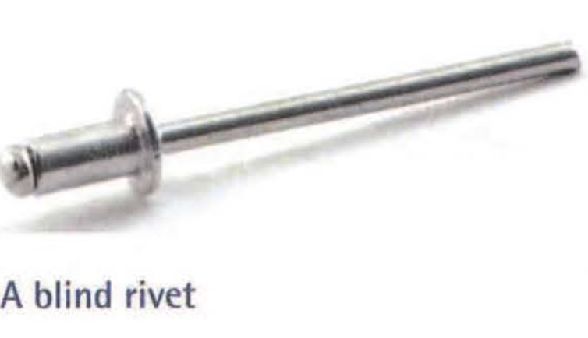
Blind rivets (or pop rivets) are made from hollow tubes, and are
fitted using a tool called a rivet gun. Blind rivets are not suitable
for high-strength joints.

Slide 10
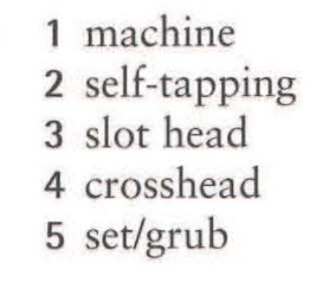
Exercises
27.1 Make word combinations with screw using words from A and B opposite. Then match the combinations with the descriptions (1-5) below. One description can be used twice.
1 A ................................ screw is a thin bolt.
2 A ................................ screw does not require a predrilled hole.
3 A ................................ screw has a straight groove cut into the top.
4 A ................................ screw fits screwdrivers with an X-shaped profile at the end.
5 A ................................ screw applies pressure at its end to hold a component in place.

Slide 11
27.2 Complete the article from a home improvements magazine using the words in the box. Look at A and B opposite to help you.
How NOT to use wall plugs
You check the diameter of hole required, then choose a drill bit one millimetre narrower. You've tried drilling the specified hole size many times in the past, only for it to be too big, leaving the (1) ............................... .spinning in the hole when you try to tighten the (2) ................................. You decide it's better to ensure a tight fit So you drill a smaller hole than suggested, then attempt to hammer in the plug. It bends sideways, useless. You try again. And again. Eventually, you manage to get a plug into the hole. You insert the end of the screw, pick up your (3) ................................ and get to work.

Slide 12
It certainly is a tight fit. And hard work. And as the screw goes in, and the plug starts to(4)........ ,the going gets harder. By the time the screw's halfway in, the screwdriver has slipped off the screw so many times that what used to be a (5).......... pattern on the screw (6).......... now looks more like a smooth, round hole. It's impossible to screw it in any further. Or unscrew it. So you take a pair of pliers, grip the end of the screw, and attempt to drag the whole thing out of the wall But the (7) ........... force is beyond the power of your now-aching arms. The screw might as well be (8) ........... with epoxy resin.

Slide 13
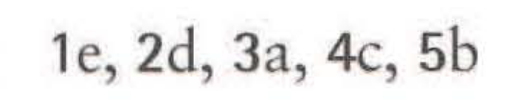
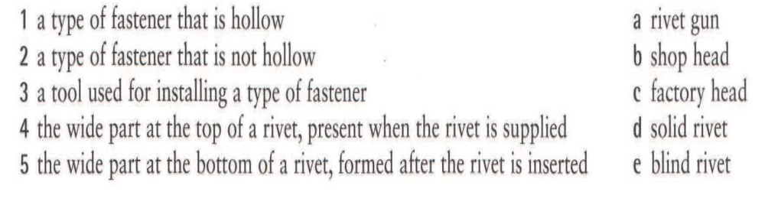
27.3 Match the descriptions (1-5) to the terms (a-e). Look at C opposite to help you.

Slide 14
End of
Unit 27

