Slide 1
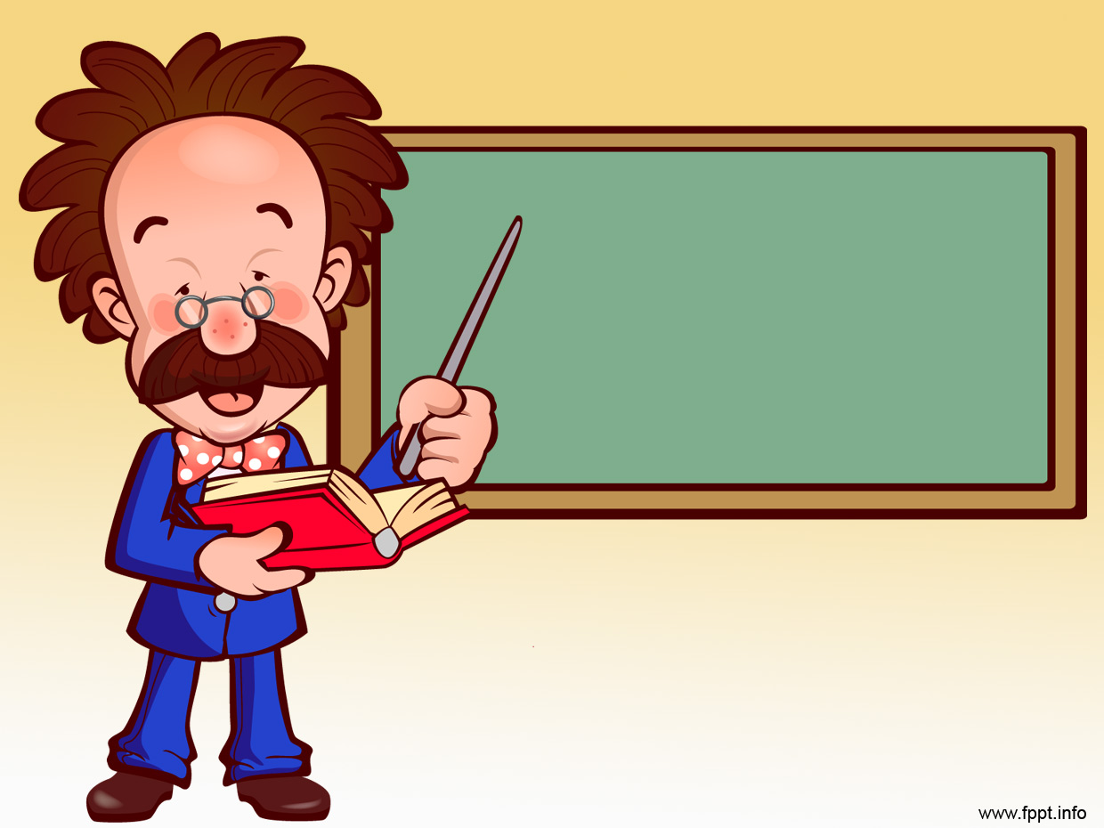
Unit 26: Mechanical fasteners 1
Prof. Fady El-Nahal
Technical English
Islamic University of Gaza
2020-2021

Slide 2
Vocabulary
Shaft محور, عمود المحرك
Threaded مترابطة
a helical وحلزونية
Hexagonal مسدس الأضلاع
Tension توتر, شد, ضغط
Wrench مفتاح الربط
Shear قص, جرد

Slide 3
Outline
Bolts
Preload in bolted joints
Washers

Slide 4
A. Bolts
The photo below shows a common fastener (or fixing): a bolt, with a nut. Bolts have threads grooves on the outside of the bolt's shaft (or shank), which run around the shaft in a helical pattern. The threaded shaft allows a nut, which has a thread inside it, to be screwed onto the bolt (by a turning motion). Nuts usually have a right-hand thread - they are screwed on by turning them clockwise (in the direction of clock hands) and unscrewed by turning them anticlockwise. However, in some situations, left-hand threads are used.

Slide 5
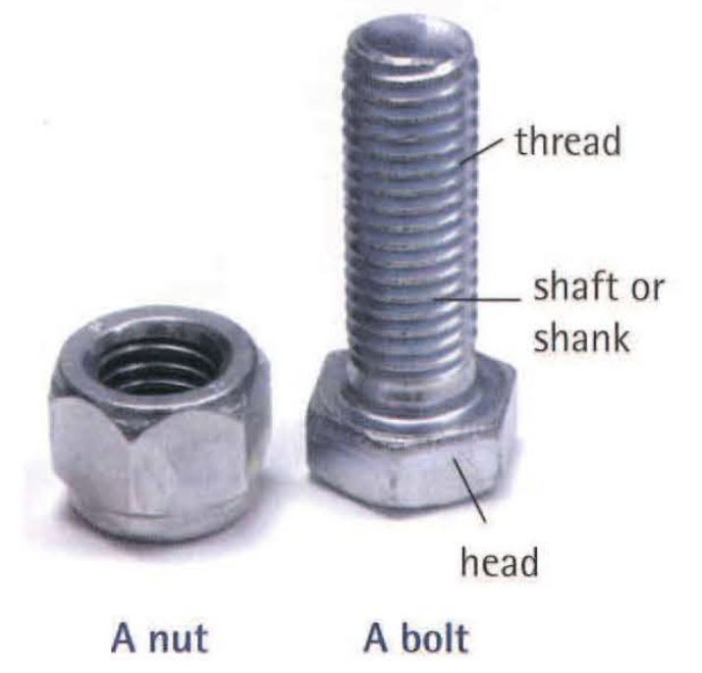
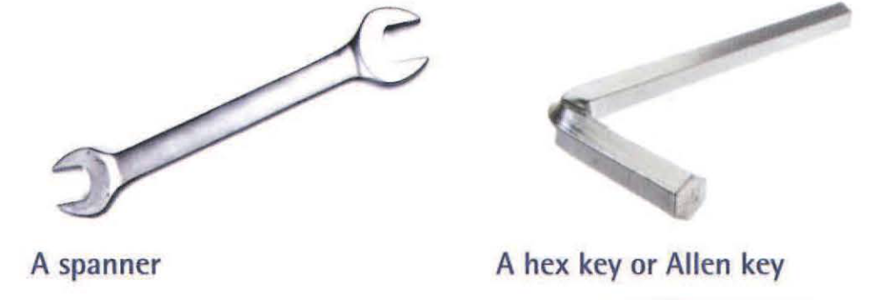
A. Bolts
BrE: anticlockwise; ArnE: counterclockwise
BrE: spanner; ArnE: wrench

Slide 6
A. Bolts
Most bolts have heads with hexagonal perimeters
(hexagonal heads or hex heads). These allow a spanner to turn them. Heads can also have a hexagonal hole in their top, called a socket head. This allows a hex key (or Allen key) to fit into them.
Note: A nut is screwed onto a bolt; a bolt can be screwed into a threaded hole.

Slide 7
B. Preload in bolted joints
Turning force, called torque, is applied to bolts to tighten them- that is, to make them grip tightly. As a bolt is tightened, the tension (stretching force) in its shaft increases, and the components being bolted together are pressed tightly together. This pressing force is called preload (or clamp load) . If enough preload is applied, friction between the components will prevent them sliding in different directions. This is an advantage, as sliding subjects the sides of bolts to shear force (scissoring force), which can cause them to break. In steel structures, bolts that apply high preloads to prevent sliding are called high strength friction grip (HSFG) bolts.

Slide 8
B. Preload in bolted joints
The amount of torque applied to bolts can be adjusted using a torque wrench, a tool which can tighten and loosen bolts, and which indicates how much torque is applied. This helps to ensure that bolts are tightened enough, but not over-tightened. Torque wrenches are also useful for checking that bolted joints do not work loose - that is, that they do not become loose over time.
Note: See Unit 31 for more on torque, tension, shear and other forces.

Slide 9
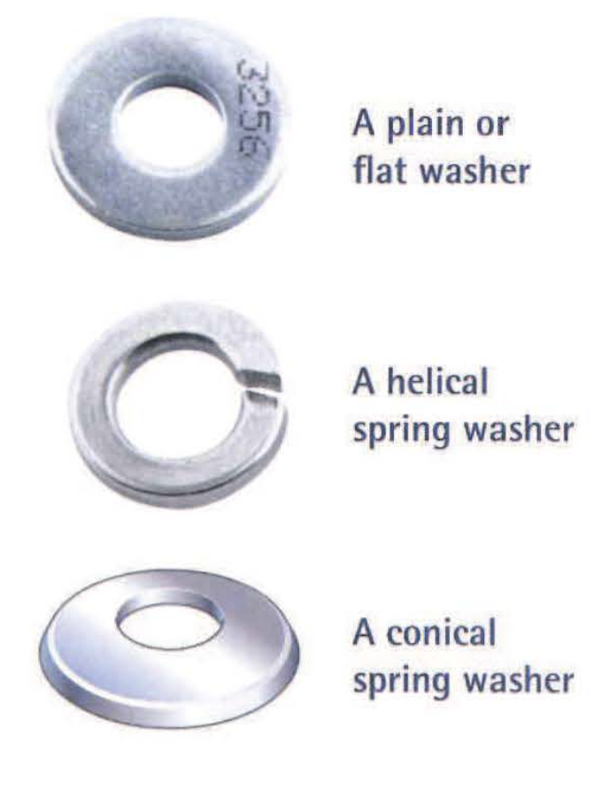
C. Washers
Washers are metal discs which fit between the head of a bolt or a nut and the components being bolted together. Ordinary washers- called flat washers or plain washers- have a larger outside diameter than the bolt head or nut. Their wider area is intended to spread the load (distribute pressure) over the surface of the component as the bolt is tightened.

Slide 10
C. Washers
Spring washers are designed to be compressed, to allow the amount of preload to be adjusted as the bolt is tightened. In some situations, spring washers are used to allow a bolt to move slightly, in order to absorb shocks. Common types of spring washer are helical spring washers and conical spring washers.

Slide 11
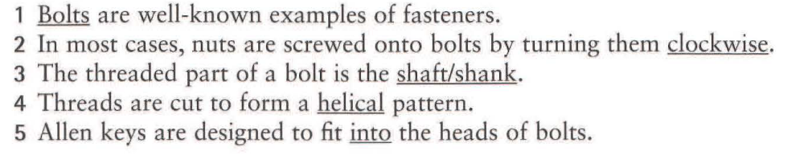
Exercises
26.1 Change one word in each of the sentences below to make them correct. Look at A opposite to help you..
1 Wrenches are well-known examples of fasteners.
2 In most cases, nuts are screwed onto bolts by turning them anticlockwise.
3 The threaded part of a bolt is the head.
4 Threads are cut to form a hexagonal pattern.
5 Allen keys are designed to fit around the heads of bolts.

Slide 12
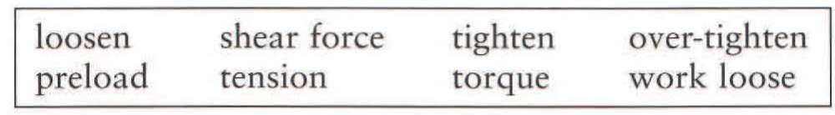
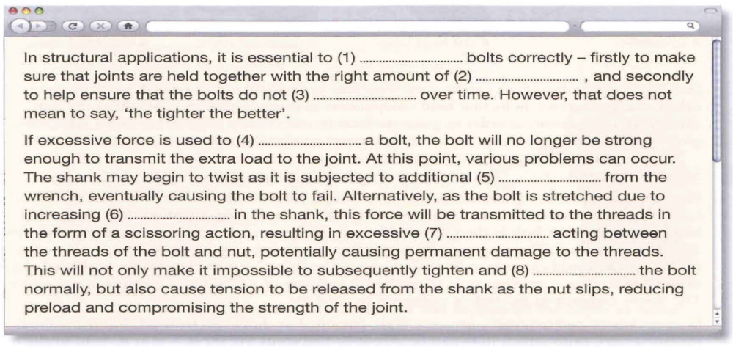
26.2 Use the words in the box to complete the text about bolted joints, taken from a bolt supplier's website. Look at B opposite to help you.

Slide 13
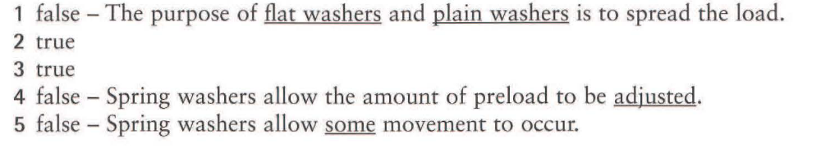
26.3 Decide whether the sentences below are true or false, and correct the false sentences. Look at C opposite to help you.
1 The purpose of all washers is to spread the load from the bolt across the surfaces of the components being bolted together.
2 Plain washers are flat.
3 Spring washers change shape as a bolt is tightened.
4 Spring washers ensure that, no matter how much a bolt is tightened, the amount of preload remains the same.
5 In situations where components are subjected to shocks, spring washers ensure that no movement occurs between the bolt and the component.

Slide 14
End of
Unit 26

