Slide 1

Unit 17: Wood
Prof. Fady El-Nahal
Technical English
Islamic University of Gaza
2020-2021

Slide 2
Vocabulary
Timber خشب البناء
Deciduous المتساقطة
Coniferous صنوبري الثمر
lumber خشب مقطوع, خشب منشور
a sawmill منشرة
sawn منشور
Glue صمغ
Laminated مصفح

Slide 3
Outline
Categories of wood
Solid structural timber
Engineered wood

Slide 4
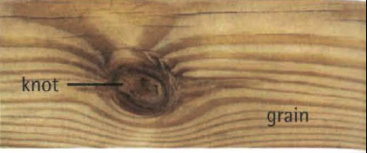
A. Categories of wood
The two main categories of wood are:
hardwood - usually from deciduous trees, which lose their leaves in autumn, although some hardwood (for example, tropical hardwood) comes from other types of tree
softwood - from coniferous trees, which remain green throughout the year

Slide 5
A. Categories of wood
In engineering, wood can be categorized as:
solid wood - softwood or hardwood that has been sawn into specific shapes and sizes, but whose natural structure, consisting of grain and knots, remains intact
engineered wood- made by bonding (sticking together) layers of solid softwood or hardwood, or by mixing quantities of wood particles and bonding them with resin.
Notes: In industry, wood is often referred to as timber (BrE) or lumber (AmE).
In American English, timber generally means wood that is still growing in trees.
Knot is pronounced /not/ (the k is silent).

Slide 6
B. Solid structural timber
The text below is from a technical handbook about structural timber- wood intended to support loads in a structure.
Generally, timber is cut to the required section- the width and depth that determine its cross section -at a sawmill, where a range of section sizes are produced. Timber from sawmills is generally supplied in rough-sawn sections. This refers to the surface texture produced by sawing timber with a circular saw. If the timber needs to have a smooth finish - for example, because it will be visible in the structure- it can subsequently be planed to smooth its surface.

Slide 7
B. Solid structural timber
Because the strength of wood varies, structural timber must be stress-graded. This means its strength is tested in order to give it a stress grade- a standard strength value which an engineer can use for design calculations. Timber can be mechanically stress-graded, where its strength is checked by machine. It can also be visually stress-graded, where the wood is examined by an inspector who looks for potential weaknesses- in particular, the position of knots.

Slide 8
C. Engineered wood
Engineered wood covers a range of softwood and hardwood materials. It includes:
cheap, low-strength boards, such as particle board (often called chipboard) and medium density fibre board (MDF)
stronger boards suitable for structural use - primarily orientated strand board (OSB), which is made from strands of wood bonded with resin, and plywood, which consists of several plies (layers) of solid wood, bonded so that the grain of each ply runs at 90 degrees to that of the adjacent plies, to provide increased strength
glue-laminated sections- sometimes called glulams - which can be used as major structural elements, such as beams, in large buildings.

Slide 9
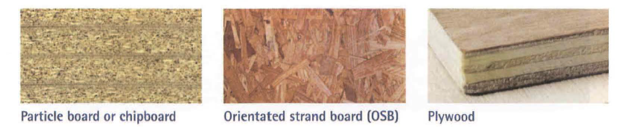
C. Engineered wood

Slide 10
a comes only from coniferous trees. b comes only from deciduous trees. c can come from either coniferous or deciduous trees. d specifically describes single pieces of timber, not multiple pieces that have been bonded together. e is always made from multiple pieces or particles of wood. f may have knots in it.
17.1 Match the two parts to make correct sentences about wood. In each case, there is more than
one possible answer. Look at A opposite to help you.
1 Engineered wood
2 Softwood
3 Solid wood

Slide 11
17.2 Complete the sentences below using words and expressions from B opposite.
1 Wood has a smooth finish after it has been ......... .
2 Wood cut with a circular saw is called ......... timber.
3 After timber is tested for strengths and weaknesses, it is given a ................................... .
4 When timber is inspected by a person who looks for ......................weaknesses, it is
5 When timber is inspected by a machine which tests its ......................strength, it is

Slide 12
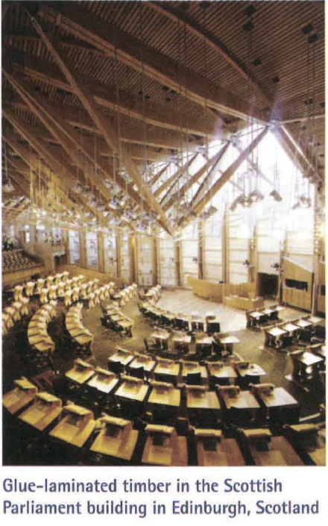
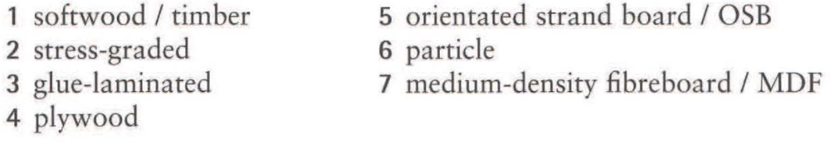
17.3 Complete the article about the environmental considerations of wood using words from B and C
From an environmental perspective, wood has many advantages. Firstly, it comes from a sustainable source. Coniferous trees grow relatively fast, providing a rapidly replaceable
source of (1) ............ . Secondly, almost all the timber in a tree can be utilized, leaving little or no waste. The best quality wood can be used for structural applications, where solid, (2) .......... sections are required by engineers; for high-strength elements such as
(3) ........... beams;

Slide 13

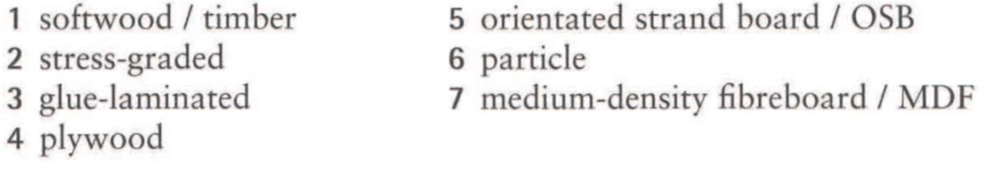
17.3 Complete the article about the environmental considerations of wood using words from B and C
and in the high-quality plies used to make (4)........... .Smaller strands can be made into engineering wood with structural properties, such as (5) ........ . And small particles and fibres, including those from waste timber, can go into cheaper materials, like (6) ........... board and (7) ......... .

Slide 14
End of
Unit Seventeen

