Slide 1

Unit 15: Minerals and Ceramics
Prof. Fady El-Nahal
Technical English
Islamic University of Gaza
2020-2021

Slide 2
Vocabulary
Mineral معدن
Ceramic سيراميك inorganic غير عضوي
Organic عضوي
Diamond الماس
Abrasive كاشط
Vitrified حول الى زجاج
Bricks الطوب
Clay طين
Sheets لوح
Float glass زجاج مصقول
Annealed مطوع, قوى
annealed glass زجاج صلب
toughened glass تشديد الزجاج
tempered glass زجاج ص
Shatters يحطم, تهشم
Windscreens الزجاج الأمامي
laminated glass الزجاج مغلفة

Slide 3
Outline
Mineral and ceramic engineering materials
Glass

Slide 4
A. Mineral and ceramic engineering materials
A mineral is a natural, inorganic material (one that is not living) which is found in the ground, often within rocks. Minerals are quite pure. Rocks, on the other hand, can be mixtures of several minerals, and may also contain previously organic material. Examples of minerals include different types of ore- from which metal can be extracted- such as iron ore. Non-metallic minerals include:

Slide 5
A. Mineral and ceramic engineering materials
diamond, an extremely hard form of carbon (C), which is used as an abrasive (very hard and rough) material in cutting tools- frequently referred to as industrial diamond when used in engineering
silicon (Si), found in sand as silica (silicon dioxide- Si02), which can be heated to high temperatures to make glass.

Slide 6
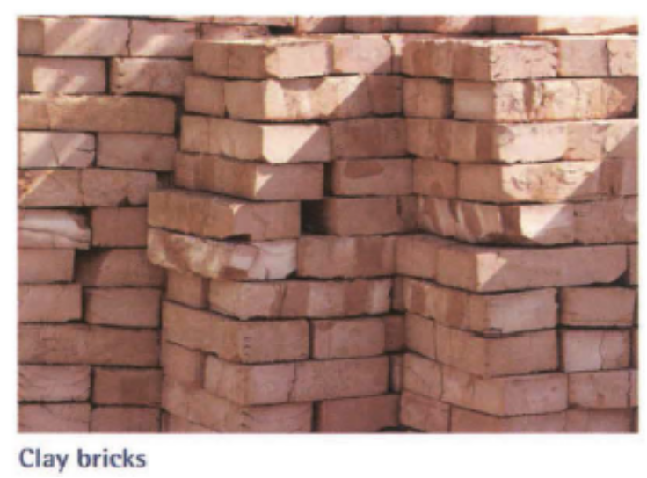
A. Mineral and ceramic engineering materials
Generally, inorganic, non-metallic materials that have been formed by heating are called ceramics. Glass is therefore a ceramic. When materials are heated to extremely high temperatures to form ceramics that are glasslike
- that is, with a structure like that of glass
- we say that they are vitrified.

Slide 7
A. Mineral and ceramic engineering materials
Ceramic materials are used to make construction materials such as bricks. These are made from clay, and are then fired in a kiln- that is, heated to a high temperature in an industrial oven. Clay can also be vitrified - for example, to make waterproof pipes.

Slide 8
B. Glass
A technical adviser for a glass manufacturer is giving a briefing to a group of engineers at a trade fair.
'Sheets of glass, which are obviously flat and thin, are called float glass. This refers to the manufacturing technique where molten glass is floated on molten tin, to produce flat sheets. Usually, after float glass has been formed, it's annealed - it's left to cool slowly. But if it's left in this state, and the glass later gets broken, it breaks into dangerous, sharp pieces. So for most engineering and architectural uses, annealed glass is unsuitable. We need to use what we call safety glass.'

Slide 9
B. Glass
One type of safety glass is toughened glass, also called tempered glass. As the term suggests, the glass is tempered - it's heated and kept hot for a certain time, to change its structure. Then if tempered glass is broken, it shatters - it breaks into tiny pieces. These are a lot safer than the long, sharp pieces produced when annealed glass breaks. The disadvantage of toughened glass is that it can't withstand impacts from small objects, such as flying stones. So, for instance, that makes it unsuitable for vehicle windscreens.

Slide 10
B. Glass
So in cases where impacts are a problem, another type of safety glass -laminated glass- is generally used. This is made by laminating glass with a polymer- in other words, making a glass and polymer 'sandwich', with a sheet of polymer in the middle and sheets of glass at either side. The advantage of having a laminated material is not just that it's very strong. The layers of glass are bonded to a layer of polymer- they're stuck to the polymer- so if the glass does break, the broken pieces are held together, and don't fly.'

Slide 11
15.1
Decide whether the sentences below are true or false. Then, change one word in each of the false sentences to correct them. Look at A opposite to help you.
1 Minerals are organic.
2 Minerals can be found in rocks.
3 Silica is a compound containing silicon.
4 Minerals can be metallic or non-metallic.
5 Industrial diamond is an abrasive, metallic mineral.
6 In order to become ceramics, materials must be vitrified.
7 Clay can be fired to produce material with a glass-like structure.

Slide 12
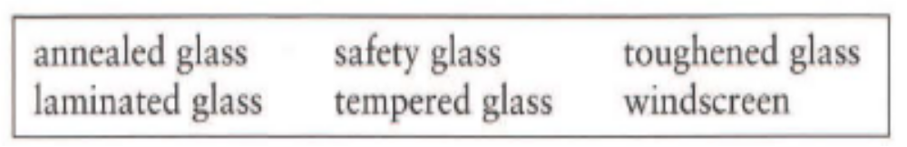
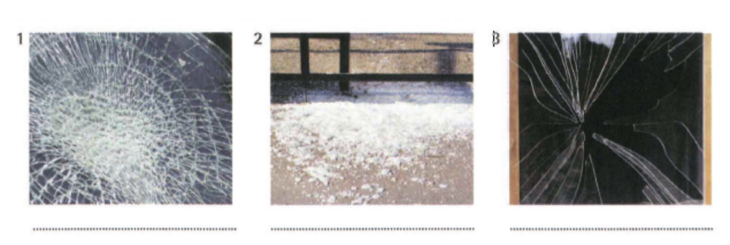
15.2
Use the words and expressions in the box to describe each photo. You will need to use some words more than once. Look at B opposite to help you.
1 laminated glass, safety glass, windscreen
2 safety glass, tempered glass, toughened glass
3 annealed glass

Slide 13
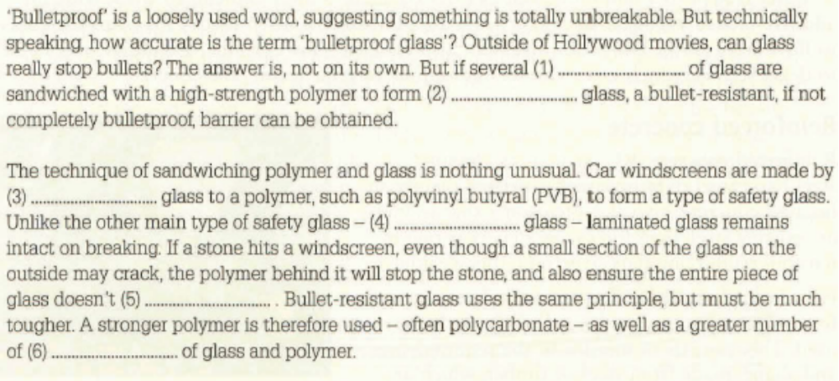
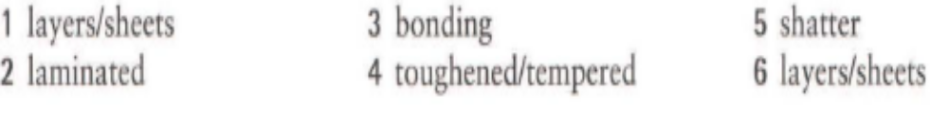
15.3
Complete the article about bulletproof glass from a science and technology magazine, using words from B opposite. Sometimes, more than one word is possible.

Slide 14
End of
Unit Fifteen

