Slide 1
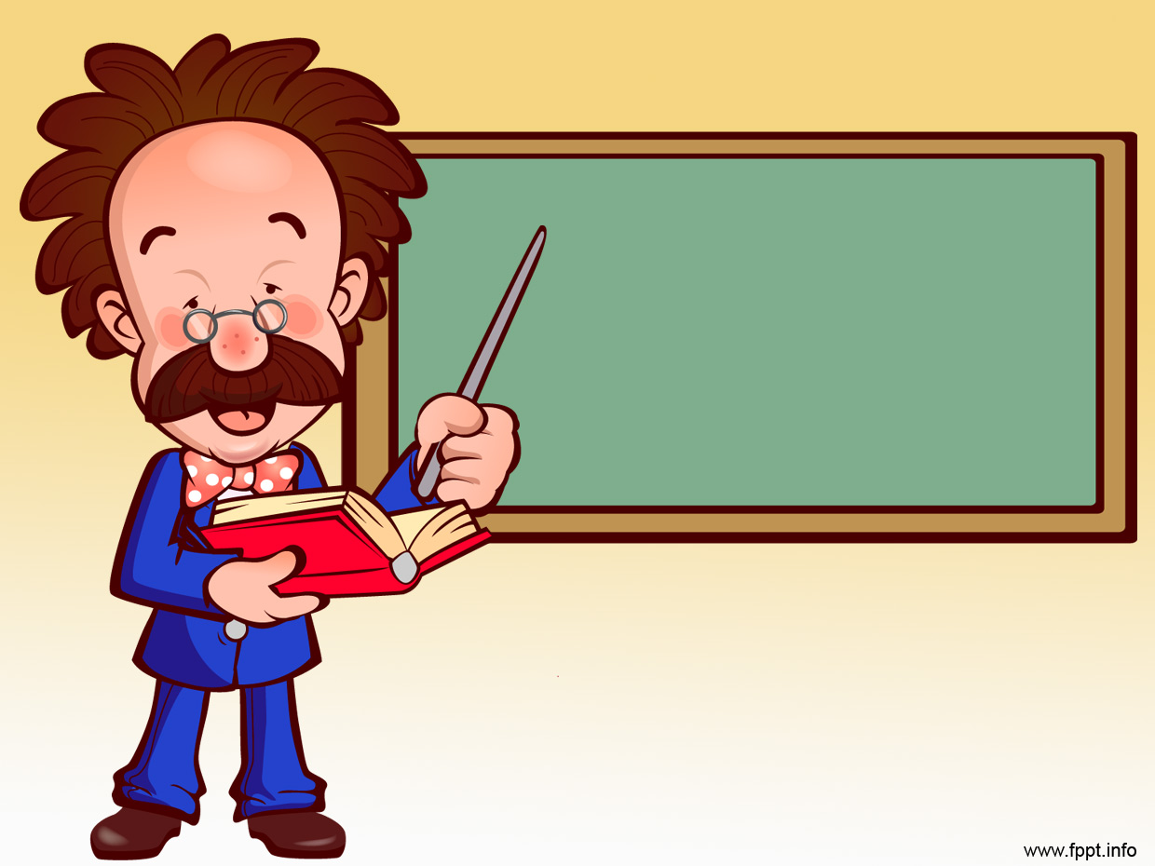
Unit 14: Polymers
Prof. Fady El-Nahal
Technical English
Islamic University of Gaza
2020-2021

Slide 2
Vocabulary
Synthetic تركيبي ,اصطناعي
Molecules جزيئات
Rubber مطاط
Cure شفاء
Elastomers المطاط الصناعي
Adhesives مواد لاصقة, مادة سريعة التماسك

Slide 3
Polymers
Natural and synthetic polymers
Thermoplastics and thermosetting plastics

Slide 4
A. Natural and synthetic polymers
The web page below, from a website for engineering students, provides an introduction to polymers.
With names such as polytetrafluoroethyline and polyethyleneteraphthalate, it's not surprising that polymers are usually called by their more common name, plastic. But what, exactly, is a polymer or a plastic?
Polymers are compounds made up of several elements that are chemically bound. Most compounds consist of large numbers of tiny molecules, which each contain just a few atoms. For example, a water molecule- H20- contains two hydrogen atoms and one oxygen atom. But the molecules of polymers contain huge numbers of atoms, joined together in long chains.

Slide 5
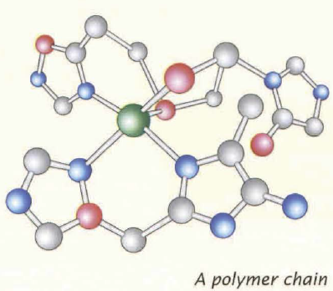
A. Natural and synthetic polymers
Rubber, thanks to its many uses from rubber bands to car tyres , is one of the best-known polymers. It comes from latex, a natural liquid which comes from rubber trees. Rubber is therefore a natural polymer. However, most of the polymers used in industry are not natural, but synthetic. The term 'plastic' is generally used to refer to synthetic polymers- in other words, those that are manmade.
Note: Rubber can be natural (natural rubber) or synthetic (synthetic rubber).

Slide 6
B. Thermoplastics and thermosetting plastics
The page goes on to look at types of polymer.
Synthetic polymers can be divided into two main categories:
Thermoplastics can be melted by heat, and formed in shaped containers called moulds. After the liquid plastic has cooled, it sets to form a solid material. A thermoplastic is a type of plastic that can be heated and moulded numerous times. Examples of thermoplastics that are common in engineering include:
  ABS (acrylonitrile butadiene styrene)- stiff and light, used in vehicle bodywork
  polycarbonate - used to make strong, transparent panels and vehicle lights
  PVC (polyvinylchloride) -a cheaper plastic used for window frames and pipes.

Slide 7
B. Thermoplastics and thermosetting plastics
Thermosetting plastics, also called thermosets, can be heated and moulded like thermoplastics. They may also be mixed from cold ingredients. However, during cooling or mixing, a chemical reaction occurs, causing thermosets to cure. This means they set permanently, and cannot be moulded again. If a thermoset is heated after curing, it will burn. Examples of thermosets used in engineering are:
  epoxy resins- used in very strong adhesives
  polyimides- strong and flexible, used as insulators in some electric cables.

Slide 8
B. Thermoplastics and thermosetting plastics
Two more categories of polymer are engineering plastics and elastomers. Engineering plastics are mostly thermoplastics that are especially strong, such as ABS and polycarbonate.
Elastomers are very elastic polymers which can be stretched by force to at least twice their original length, and can then return to their original length when the force is removed.

Slide 9
14.1 Circle the correct words to complete the text.
A lot of rubber is made from latex, a (1) natural/synthetic polymer which comes from rubber trees. However, not all rubber comes from trees. Synthetic rubber is a (2) manmade/natural polymer with similar properties to latex. Plastics are also polymers. Like rubber, they consist of long chains of (3) atoms/molecules which form extremely large (4) atoms/molecules.
1) natural, 2) manmade, 3) atoms, 4) molecules

Slide 10
14.2 Read the extract describing a plastic panel manufacturing process.
By this stage of the process, the plastic is solid, and has fully cooled. Selected panels can now undergo quality-control testing, to check they are strong enough to cope with the tough conditions they will be exposed to in use. Tests include tensile testing, where narrow lengths of panel are subjected to high tension loads to check they do not stretch or fracture. More tests are carried out to check the panels‘ resistance to impacts and scratching. Any products that fail the tests are returned to the beginning of the production process, melted down, and their material is reused.

Slide 11
14.2 …Then decide whether the sentences below are true or false, and correct the false sentences.
The plastic was heated earlier in the process.
The plastic has now set.
The plastic is now liquid.
To pass one of the tests, the plastic must be an elastomer.
The description suggests the plastic is a type of engineering plastic.
The material is a thermosetting plastic.
The material is a thermoplastic.

Slide 12
14.2 Answers
True
True
False - The plastic is solid.
False- The tests check that the plastic does not stretch - an elastomer would stretch significantly.
True
False- Material is melted down and reused, something not possible with thermosetting plastics.
True

Slide 13
14.3 Complete the word puzzle and find the word going across the page.
a shorter name for polyvinylchloride
used for forming melted plastic
a group of atoms
a long chain of atoms
to set permanently
a very elastic polymer
a plastic that sets permanently
a natural polymer
a very strong thermoset resin
not natural
particles that form molecules
another word for 'not natural'
material used to make rubber

Slide 14
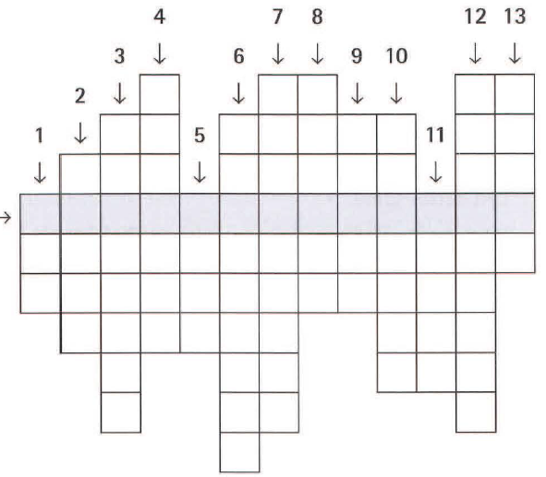

Slide 15
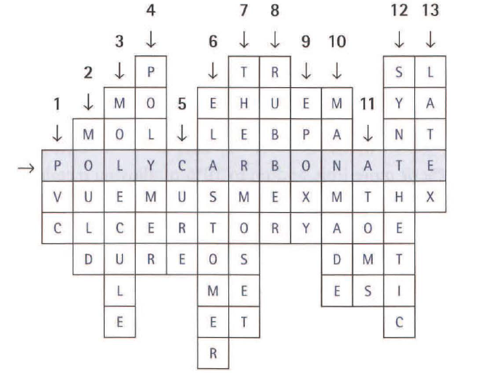

Slide 16
End of Unit Fourteen

