Slide 1

Unit 12: Steel
Prof. Fady El-Nahal
Technical English
Islamic University of Gaza
2020-2021

Slide 2
Vocabulary
Alloy خليط معدني
Corrosion تآكل
Steel صلب
Iron حديد
Rust صدأ
Cobalt كوبالت عنصر
Tungsten عنصر فلزي يستخدم لتقسية الفولاذ
Oxidizing المؤكسدة

Slide 3
Outline
Carbon steels
Alloy steels
Corrosion

Slide 4
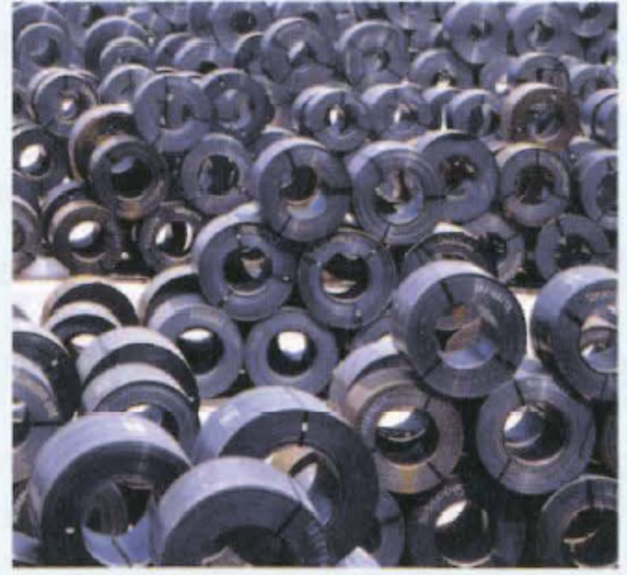
A. Carbon steels
This extract from an article in an engineering journal is about different types of steel.
Steel is the most widely used engineering material. Technically, though, this well-known alloy of iron and carbon is not as simple as one might think. Steel comes in a huge range of different grades, each with different characteristics. For the inexperienced, it can be difficult to know where to begin.

Slide 5
A. Carbon steels
A good place to start is with the two main types of steel. The first, carbon steels, consist of iron and carbon, and contain no significant quantities of other metals. Carbon steels can be divided into three main grades:
Mild steel - the most widely used grade - is a low carbon steel which contains up to approximately 0.3% carbon.
Medium carbon steel contains between approximately 0.3% and 0.6% carbon.
High carbon steel contains between approximately 0.6% and 1.4% carbon.
Note: The chemical symbol for iron = Fe, and carbon = C.

Slide 6
B. Alloy steels
The article goes on to look at alloy steels.
The second main category of steel is alloy steels, which consist of iron, carbon and one or more alloying metals. Specific grades of alloy steel include:
low alloy steels, which contain 90% or more iron, and up to approximately 10% of alloying metals such as chromium, nickel, manganese, molybdenum and vanadium
high strength low alloy steels (HSLA), which contain smaller quantities of the above metals (typically less than 2%)

Slide 7
B. Alloy steels
stainless steels, which contain chromium as well as other metals - such as nickel - and which do not rust.
tool steels, which are extremely hard, and are used in cutting tools. They contain tungsten and/or cobalt. A widely used grade of tool steel is high-speed steel, which is used in cutting tools that operate at high temperatures, such as drill bits.
Notes: The terms carbon steel and alloy steel can cause confusion, as carbon steels are also alloys, and alloy steels also contain carbon. The chemical symbol for chromium = Cr, cobalt= Co, nickel = Ni, manganese= Mn, molybdenum = Mo, tungsten = W, and vanadium = V.

Slide 8
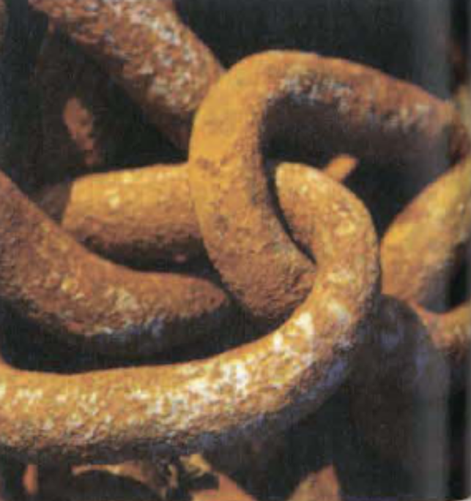
C. Corrosion
One weakness of mild steel is that it corrodes - its surface progressively deteriorates due to a chemical reaction. This reaction takes place between the iron in the steel and the oxygen (02) in the air, to form iron oxide. When iron corrodes, we say that it rusts. In some metals, such as aluminum (Al), the presence of corrosion is not a problem, as the layer of oxide around the metal remains hard, which prevents it from oxidizing any further. However, when mild steel goes rusty, the rust on the surface comes off continuously, and a new rusty layer forms, progressively 'eating into' the metal.

Slide 9
12.1 Decide whether the sentences below are true or false, and correct the false sentences. Look at A and B opposite to help you.
Steel is an alloy of iron and carbon.
Mild steel is a high carbon steel.
Alloy steels contain carbon.
Chromium and nickel are used as alloying metals in steel.
Low alloy steels contain more chromium than iron.
Stainless steel is an alloy steel.
Tungsten is added to steel to make it softer.
High-speed steel is suitable for making cutting tools that get very hot.

Slide 10
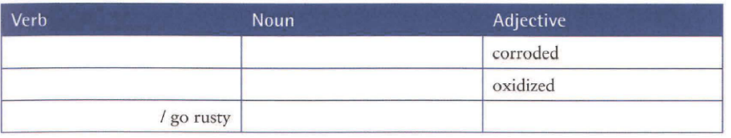
12.2 Complete the table with words related to corrode, oxide and rust. Then use the words to complete the sentences below. There is more than one possible answer.
1. When steel is exposed to air and water, it .............. .
2 .A brown/red material on the surface of steel is called ............... .
3 .The strength of steel is reduced if it is .................

Slide 11
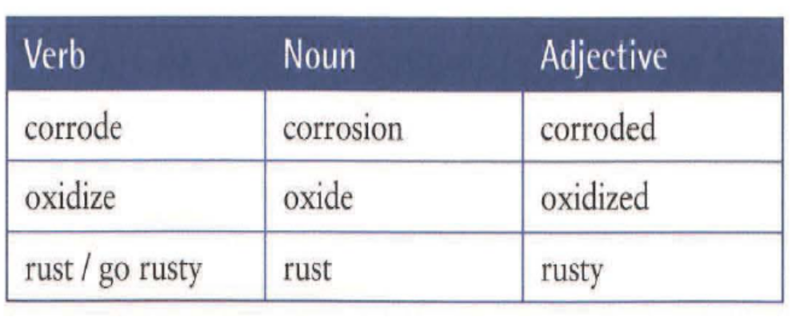
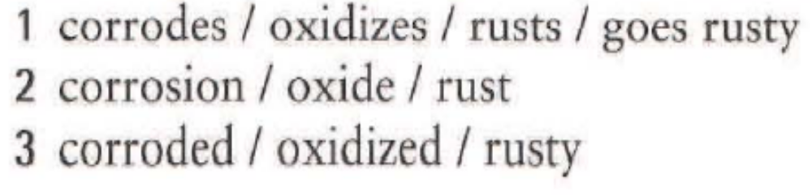
12.2

Slide 12
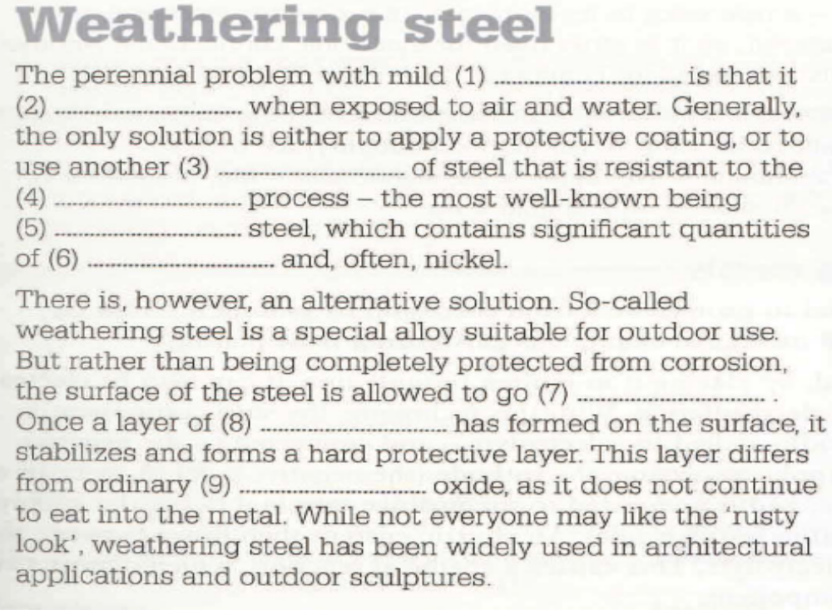
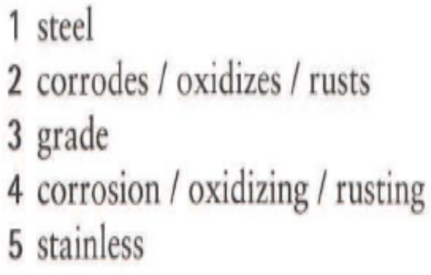

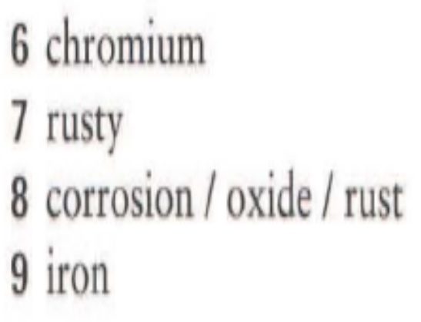
12.3 Complete the article about a special type of steel, using words from A, B and C opposite

Slide 13
End of
Unit Twelve

