Slide 1

Unit 10: Measurable parameters
Prof. Fady El-Nahal
Technical English
Islamic University of Gaza
2020-2021

Slide 2
Vocabulary
capacity سعة
Supply تزويد
Period فترة, مدة
Consumed مستهلك
Cumulative تراكمي
Consumption استهلاك
Rate معدل
Demand الطلب
Fluctuates يتقلب, تذبذب
Peak قمة, أعلى فترات الإستهلاك
Spare إضافي
Efficiency كفاءة
Surplus فائض
Gain ربح
Loss خسارة
Exceeds يتجاوز
Net صافي الدخل, شبكة

Slide 3
Outline
Supply, demand and capacity
Input, output and efficiency

Slide 4
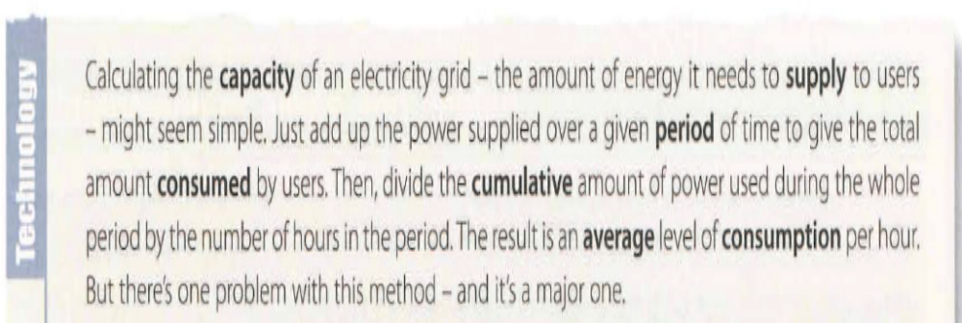
A. Supply, demand and capacity
The article below is from the technology section of a business magazine

Slide 5
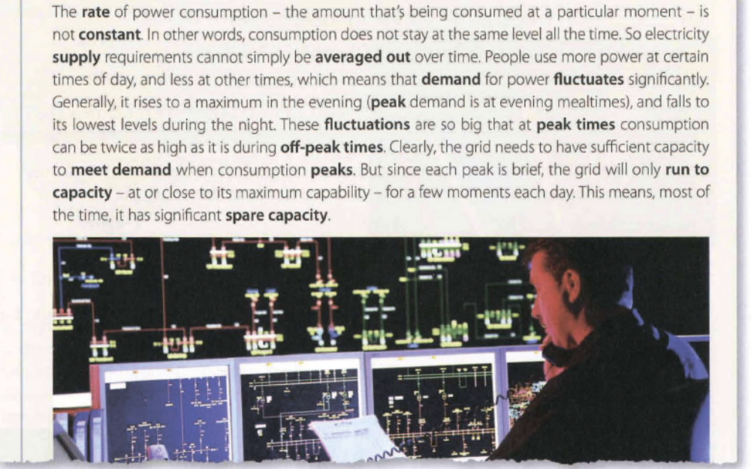
A. Supply, demand and capacity

Slide 6
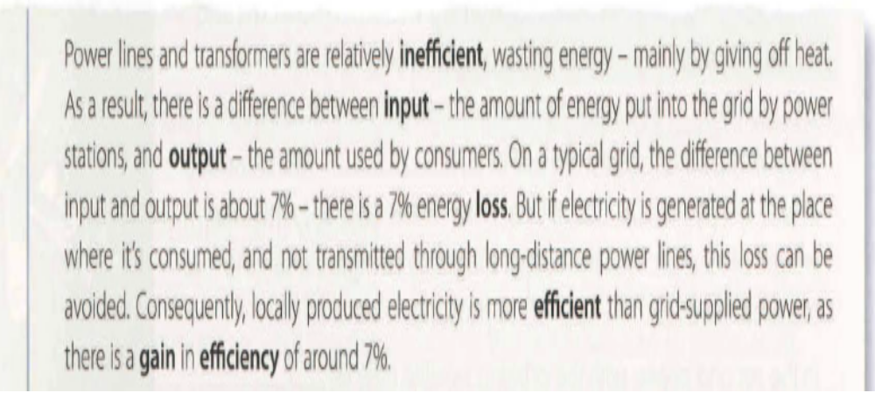
B. Input, output and efficiency

Slide 7
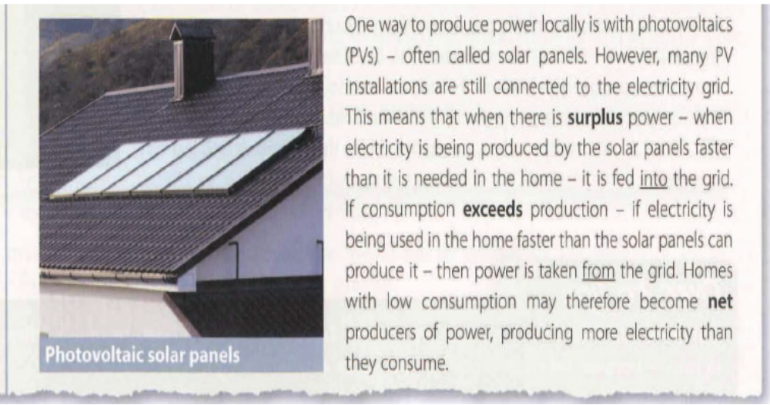
B. Input, output and efficiency

Slide 8
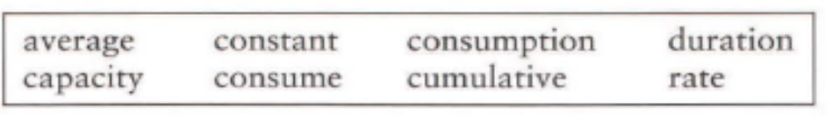
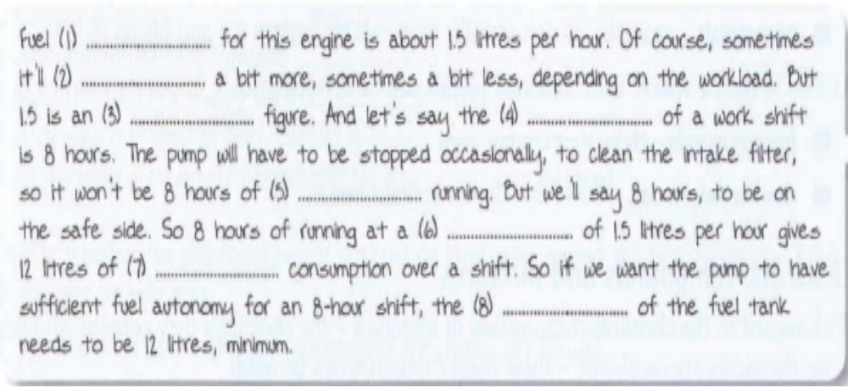
10.1 An engineer is talking to a colleague about the design of a fuel tank for a water pump. Complete the explanation using the words in the box. Look at A opposite to help you.
1. consumption 3 average 5 constant 7 cumulative
2 consume 4 duration 6 rate 8 capacity

Slide 9
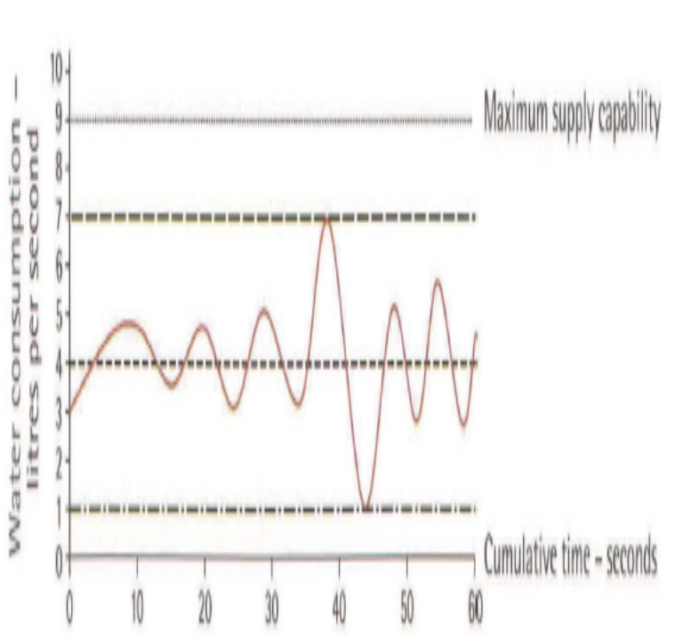
10.2 The graph below shows water consumption in a washing process at a manufacturing plant. Write figures to complete the comments. Look at A opposite to help you.
Water consumption fluctuated between ........ and ....... liters per second.
Averaged out over the period shown, consumption was roughly ............. liters per second.
Consumption peaked at a rate of ................ liters per second.
If the process ran to capacity, it could use water at a rate of ............. liters per second.
When consumption peaked, the process had spare capacity of .............. liters per second.
1. 1, 7 2. 4 3. 7 4. 9 5. 2

Slide 10
10.3 Choose the correct words from the brackets to complete the explanations from a guided tour of a manufacturing plant. Look at A and B opposite to help you.
A lot of heat is generated in this part of the process. And all of that (input/output) is recycled- it provides a (demand/supply) of heat for the next stage of the process. So it's quite an (efficient/inefficient) system.
Sometimes, there's (insufficient/surplus) heat, and it can't all be recycled. At other times there isn't quite enough recycled heat to keep up with (peak/off-peak) demand for heat energy further along the process.
Some material is lost in the washing process, but the mass of water absorbed is greater than the mass of material lost. So there's a net (loss/gain) in total mass.
1.output, supply, efficient 2. surplus, peak 3. gain

Slide 11
End of
Unit Ten

