Slide 1
Unit 9: Area, Size, and Mass
Engineering Technical English
Islamic University of Gaza
2023

Slide 2
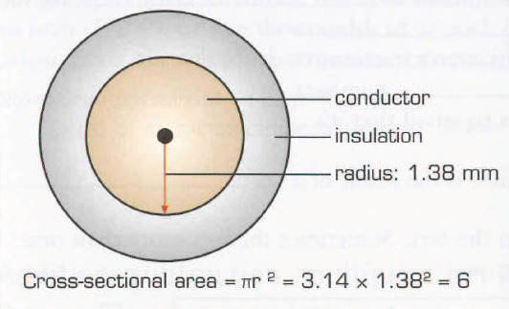
A. Area
The sizes of electrical wires are specified by a number which gives an area in square millimetres. For example, in a home, a 6 mm² wire may be specified to supply an electric oven in a kitchen. This number gives the cross-sectional area of the conductor. Increasing the cross-sectional area allows the conductor to carry more current safely, without overheating.

Slide 3
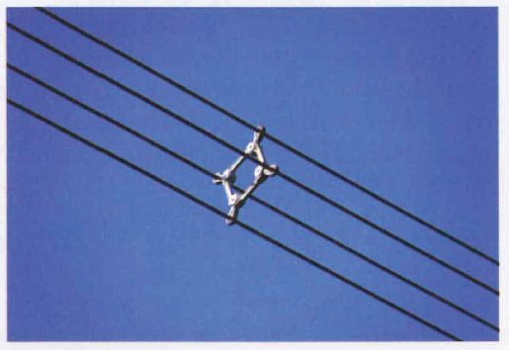
A. Area
In high-voltage power lines, it is not only the cross-sectional area of conductors that is important, but also their surface area - the amount of surface that is in contact with the air, to allow cooling. Therefore, instead of using single cables with large sections for each conductor, power lines often use groups of two, three or four small-section cables, to give more surface area than a single, large-section cable.

Slide 4
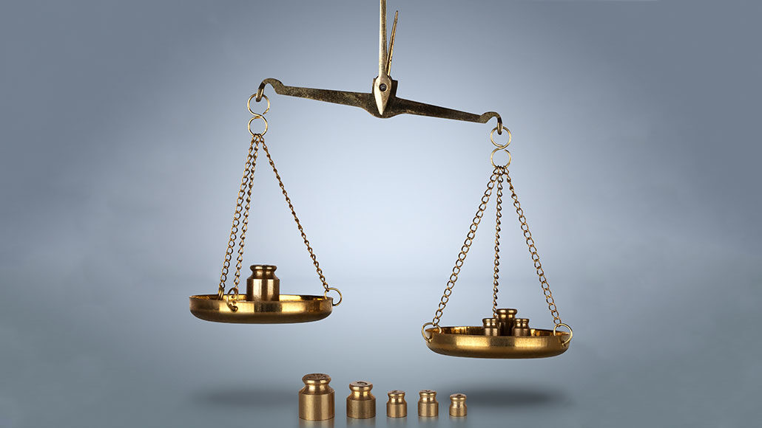
B. Weight, mass, volume, and density
In everyday language, the term weight means how heavy things are (how much they weigh), and grams and kilograms are used as units of weight. But in physics and in engineering, grams and kilograms are units of mass. Whether an object is on earth - where it is subjected to gravity (the pull of the earth) - or floating weightless in space, its mass is always the same.

Slide 5
B. Weight, mass, volume, and density
The mass of an object depends on:
the volume of the object, measured in cubic metres (m³) - as an object's volume increases, its mass increases
the density of the object, measured in kilograms per cubic metre (kg/m³) - as density increases, mass per unit of volume increases.

Slide 6
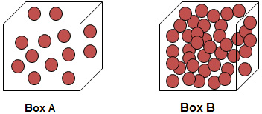
B. Weight, mass, volume, and density
The mass of an object depends on:
the volume of the object, measured in cubic metres (m³) - as an object's volume increases, its mass increases
the density of the object, measured in kilograms per cubic metre (kg/m³) - as density increases, mass per unit of volume increases.

Slide 7
B. Weight, mass, volume, and density
The mass of an object is the object's volume multiplied by its density. The weight of an object is the force exerted on the object's mass by gravity.
Some materials are very dense, and therefore very heavy. An example is lead (Pb), which has a density of 11,340 kg/m3. Other materials, such as expanded polystyrene (which can have a density as low as 10 kg/m3), are very lightweight.

Slide 8
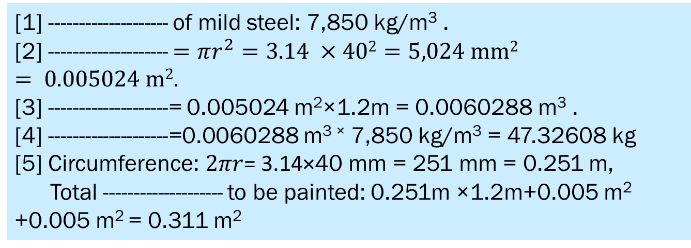
9.1 The component below is made of mild steel. It has a radius of 40 mm and it is 1,200 mm long. Complete the calculations using the words in the box. Look at A and B opposite to help you.
.
cross-sectional area, density ,mass, surface area, volume
[1] -------------------- of mild steel: 7,850 kg/m³ .
[2] -------------------- $=πr^{2}=3.14 ×402=5,024 mm2 = 0.005024 m2.$
[3] --------------------= 0.005024 m²×1.2m = 0.0060288 m³ .
[4] --------------------=0.0060288 m^{3 ×} 7,850 kg/m³ = 47.32608 kg
[5] Circumference: $2πr$= 3.14×40 mm = 251 mm = 0.251 m,
Total -------------------- to be painted: 0.251m ×1.2m+0.005 m² +0.005 m² = 0.311 m²

Slide 9
9.2 Now write the whole words for the unit abbreviations in the calculation in 9.1 above.
m
mm
mm²
m²
m³
kg
kg/m³
metres
millimetres
squared millimetres
squared metres
cubic metres
kilograms
kilograms per cubic metre

Slide 10
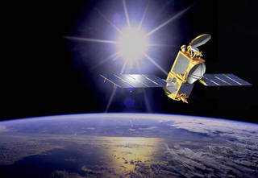
9.3 Complete the extract from an article about satellite design using the words in the box. Look
cubic , gravity , lightweight, mass, square, weigh, weightless ,
Satellites need to be designed to cope with two very different phases: deployment (the journey into space by rocket) and operation (working in space).
For the first phase, engineers are faced with the problem that every (1)...... ............of volume taken up within the rocket will add millions of dollars to its ticket into space.
(1) cubic

Slide 11
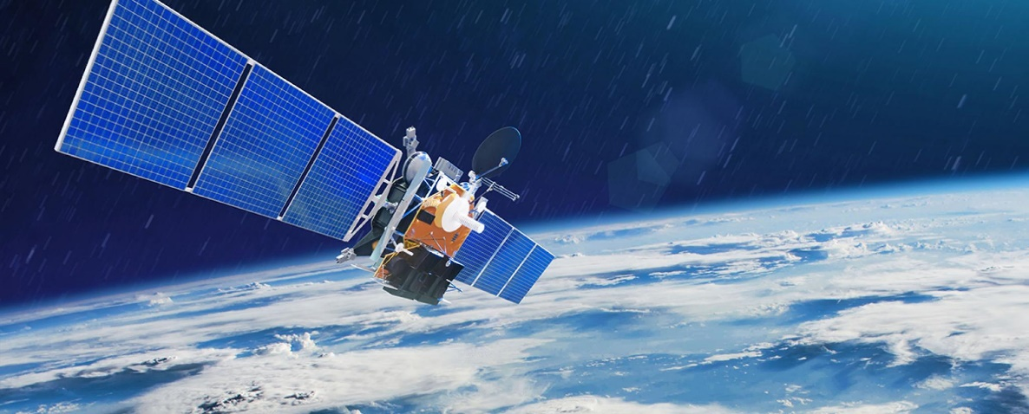
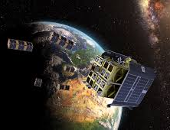
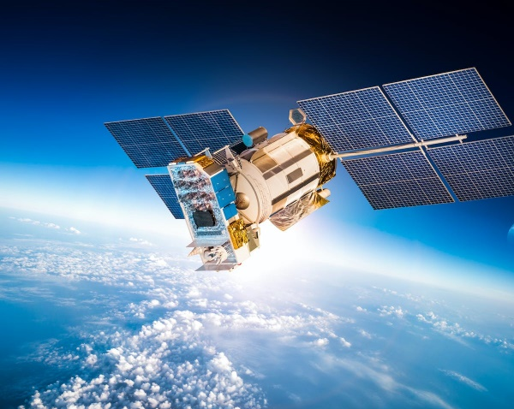
9.3 Complete the extract from an article about satellite design using the words in the box. Look
(1) mass
(2) gravity
(4) weigh
(5) lightweight
cubic , gravity , lightweight, mass, square, weigh, weightless ,
And each extra gram of (2)........ added to the craft will increase the fuel needed to propel it upwards against the pull of (3)..... ...................That extra fuel, in turn, will (4)................... a little more, further adding to the total weight of the craft. With the cost of kilograms so high, the satellite must therefore be as (5) -----------as possible.

Slide 12
9.3 Complete the extract from an article about satellite design using the words in the box. Look
(6) weightless
(7) square
cubic , gravity , lightweight, mass, square, weigh, weightless
In the second phase, with the orbiting satellite now (6)…….
its mass is practically irrelevant. As for the amount of space occupied, the situation is completely reversed. The satellite's solar panels, which transform sunlight into battery power, must unfold to cover as wide an area as possible - opening out to cover an area of several (7)......metres in order to maximize their exposure to the sun.

