Slide 1

Unit 7: Dimensional accuracy
Prof. Fady El-Nahal
Technical English
Islamic University of Gaza
2020-2021

Slide 2
Vocabulary
Precise شديد العناية بالتفاصيل, دقيق
Vary تفاوت, تنوع
Variation الاختلاف, تغيير
Accurate مضبوط, دقيق
Tolerances التسامح, تفاوت مسموح ميكانيكيا
Deviation الانحراف, إنحراف الضوء
Permissible جائز, مسموح
Insufficient غير كاف
Bind ربط
Expands توسع
Contracts انكماش, تقلص

Slide 3
A. Precision and tolerance
It is impossible to produce components with dimensions that are absolutely precise, with sizes exactly the same as those specified in a design. This is because all production processes are imprecise to a certain extent. Therefore, the sizes of several components produced from the same design will vary (differ). Although the variation may only be a few hundredths of a millimetre, sizes will not be 100% accurate (exact) compared with the design.

Slide 4
A. Precision and tolerance
Because engineers know that accuracy cannot be perfect, in designs they often specify tolerances -that is, acceptable variations in precision. Instead of giving one precise size, a tolerance specifies a range of acceptable sizes- an allowed amount of variation. This is often given as a deviation (difference) from a precise size.

Slide 5
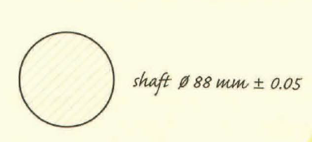
A. Precision and tolerance…
The drawing on the side shows a shaft with a specified diameter of 88 mm, plus or minus (±) 0.05 mm. This means the diameter may deviate 0.05 mm either side of this size. Therefore, diameters of 87.95 mm and 88.05 mm, which are slightly inaccurate, are still permissible (allowed), as they are within tolerance. However, diameters of 87.94mm or 88.06mm are not permissible- they are outside tolerance.

Slide 6
A. Precision and tolerance…
When the permissible deviation in size is very small, we say it is a tight tolerance (or a close tolerance). A large permissible deviation is a loose tolerance. For example:
  Machining a metal component to a tolerance of ±0.1 mm is relatively easy to do, so this tolerance is loose. But a tolerance of just ±0.01 mm is a tight tolerance in metalworking.
  In a concrete structure, ±10mm is a loose tolerance. But ±1mm is tight, because it is difficult to place wet concrete accurately.

Slide 7
B. Fit
When one component goes through another, such as a shaft or a bolt going through a hole, the two must fit together- their sizes and shapes must match. The key question is, how tightly (or loosely) should they fit together? There are two main types of fit:
A clearance fit allows a component to slide or turn freely, by leaving clearance (a gap) between itself and the sides of the hole. This distance must be quite precise. If there is insufficient clearance - if the gap is too small - the component will fit too tightly. As a result, the component will bind - it will not be able to slide or turn freely. In other words, there will not be enough play. However, if there is too much clearance, there will be too much play and the component will be able to move too much.

Slide 8
B. Fit…
An interference fit is a very tight fit which does not allow a component to move freely inside a hole. This type of fit can be achieved by forcing the component into the hole. Alternatively, the metal around the hole can be heated so that it expands (increases in size due to heat). After sufficient expansion, the component is placed in the hole. The metal then cools and contracts (decreases in size due to cooling). The contraction results in a tight fit. An example of an interference fit is a train wheel fitted on an axle.

Slide 9
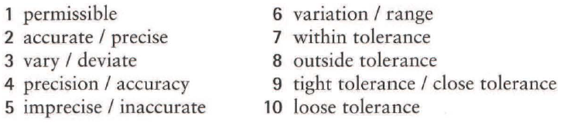
7.1 Find words and expressions with similar meanings to the words and expressions below. Sometimes there is more than one possible answer.
allowed permissible
Exact
Differ
Exactness
not exact
deviation between maximum and minimum
an acceptable deviation
an unacceptable deviation
little deviation allowed
large deviation allowed

Slide 10

7.2 Match the related sentences.
It'll bind.
It'll contract.
It'll expand.
There'll be too much play.
It needs a clearance fit.
It needs an interference fit.
The bolt will have to turn in the hole.
The bolt won't be able to turn freely enough in the hole.
The bolt won't fit tightly enough in the hole.
The wheel will have to fit very tightly on the axle.
The hole will widen with the high temperature.
The shaft will shorten and narrow slightly as it cools.

Slide 11
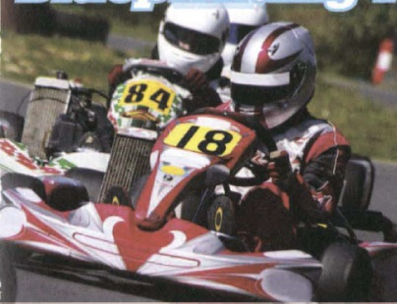
7.3 Complete the article about engine blueprinting using the words in the box.
Clearances, minus, plus, range, variation, fit, permissible precise, tolerances, within
Blue Printing for performance
The advantage of racing in a kart class with a standard engine spec seems obvious – everyone has the same power, so it's driving talent that makes the difference. But things aren't quite that simple.

Slide 12
7.3 Continue
No two standard engines are identical. There will always be a slight (1) ............... in the size of engine parts, since they are manufactured, not to perfectly (2) ............. dimensions, but to specified (3) ................ Although these differences may only be (4) ............ or (5) ............... . a few hundredths of a millimetre, they will nevertheless result in a slight performance gap between any two engines.

Slide 13
7.3 Continue
One way round this problem (if you have the cash) is to have your engine blueprinted. The process is perfectly legal, as the sizes of all parts remain (6) ....................... the tolerances that are (7) .................... for the standard engine specification. However, by carefully matching pairs or groups of parts that are all in either the lower or upper half of the tolerance (8) ...................... , a blueprinted engine is built to (9) ................... . together very precisely, thanks to almost perfect (10) ..................... between moving parts.

Slide 14
End of
Unit Seven

