Slide 1

Unit 4: Horizontal and vertical measurements
Prof. Fady El-Nahal
Technical English
Islamic University of Gaza
2020-2021

Slide 2
Vocabulary
Dimensions الأبعاد
Measured قياس
Strike (touch) (لمس) إضراب
Horizontal أفقي
Vertical عمودي
Extremities أطراف الجسم
Wingspan باع الجناح المسافة بينهما
Span امتداد
Fuselage جسم الطائرة
Thickness سماكة
Flat مسطحة
Plumb راسيا
Inclined from يميل من
Internal width عرض الداخلي
External width عرض خارجي

Slide 3
Outline
Linear dimensions
level and plumb

Slide 4
A. Linear dimensions
The web page shows the key dimensions of the Airbus A380 in meters, and the explanations below it describe how they are measured. In the explanations, the word plane means an imaginary surface (not an aeroplane).
On drawings, planes are shown as lines that indicate where dimensions are measured from and to, and are positioned to strike (touch) the faces (edges or surfaces) of components. Often, they are either horizontal planes or vertical planes.

Slide 5
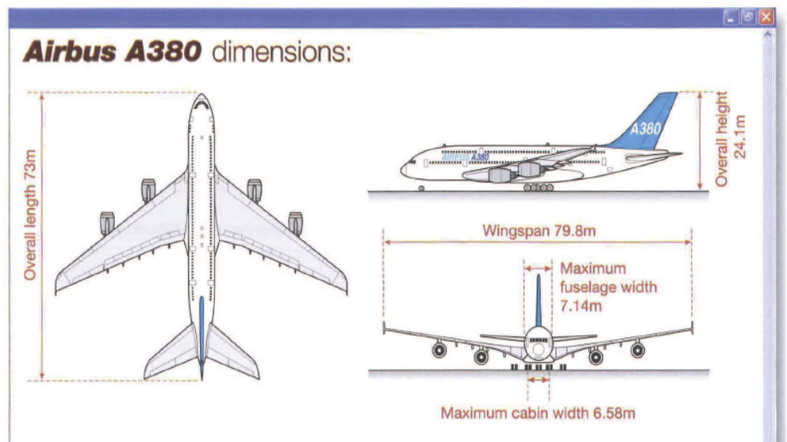
A. Linear dimensions

Slide 6
A. Linear dimensions
Overall length is a measurement of how long the aircraft is in total. The measurement is taken between the two points that are furthest apart (the front and rear extremities), along the length of the aircraft. The length is measured along a horizontal plane. It is the distance between a vertical plane striking the front of the nose, and a vertical plane striking the rear of the tail.
Wingspan is the total distance spanned by both wings. The span is measured as a straight line between the two wingtips

Slide 7
A. Linear dimensions
Overall height measures how tall the aircraft is. The dimension is measured vertically between the underside of the wheels and a horizontal plane striking the top of the tail.
Maximum fuselage width is the external width of the aircraft's body- how wide it is, measured horizontally between vertical planes striking the outside faces of the fuselage.
Maximum cabin width states the maximum internal width, measured between the inside faces of the fuselage. The measurement is equivalent to the external width, less the thickness of the fuselage at each side of the aircraft.

Slide 8
A. Linear dimensions
Notes: When written, the words dimension and dimensions are often abbreviated to dim and dims. Span is also used to describe the distance(s) crossed by a bridge, between its supports. If a bridge has a support at its center (as well as at each end), then it has two spans.

Slide 9
B. Level and plumb
If a surface is described as being level, this means it is both horizontal and flat (smooth). However, a surface which is flat is not necessarily horizontal. A flat surface may be vertical, or inclined (sloping at an angle to the horizontal or vertical plane).
Faces that are vertical, such as those of the walls of buildings, are described by engineers as being plumb. Structures that are slightly inclined from vertical are said to be out of plumb.

Slide 10
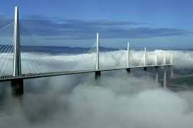
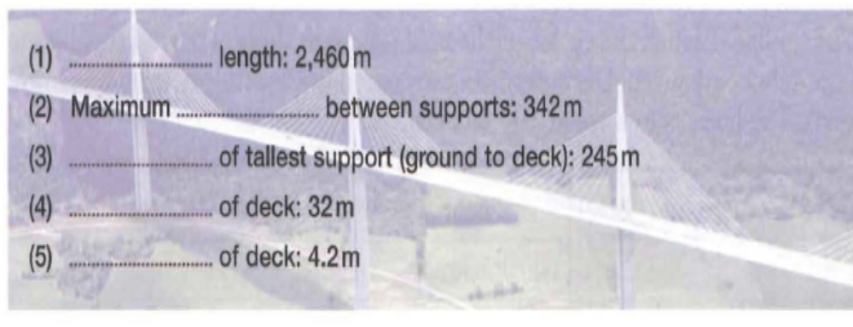
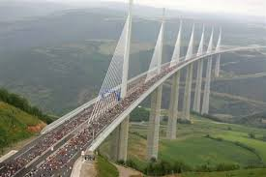
Exercises
4.1 Complete the key dimensions of the Millau Viaduct in France, using the words in the box. Look at A opposite to help you.
height overall thickness span width

Slide 11
Exercises
1. False 2. False 3. True 4. True 5. False 6. False
4.2 Decide whether the sentences about the viaduct are true or false, and correct the false sentences. Look at A and B opposite to help you.
The height of the towers is measured horizontally.
The overall span is measured along the width of the bridge.
The tops of the towers are at different levels, so a horizontal plane striking the top of one tower will not strike the tops of all the others.
The highest point of the structure is the top extremity of the highest tower.
The thickness of each tower decreases towards the top, so the faces of the towers are plumb.
The greatest thickness of each tower is its internal thickness at its base.

Slide 12
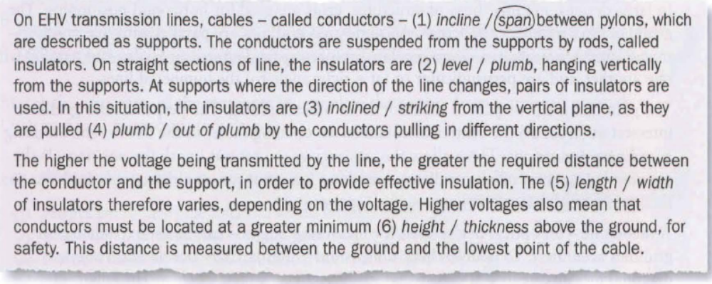
Exercises
4.3 Circle the correct words to complete the text about extra-high voltage (EHV) power lines. Look at A and B opposite to help you. The first one has been done for you.

Slide 13
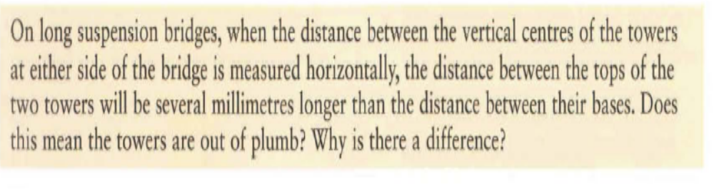
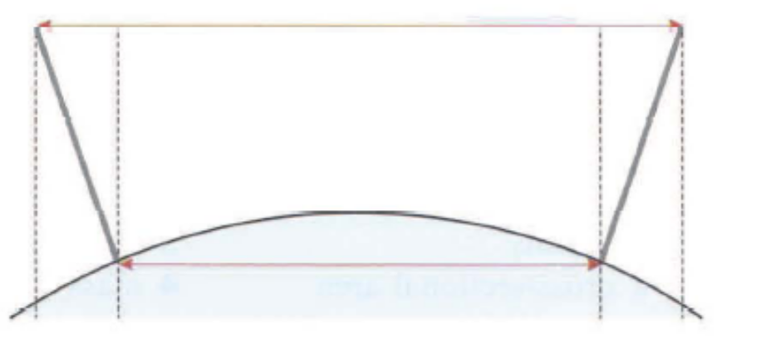
Exercises
4.4 Read the text below. Can you answer the questions?
The towers are plumb, but because they are a long distance a part, the curvature of the earth (the curve of the earth's surface) has a noticeable effect, which is increased by the height of the towers. The diagram below shows the effect in exaggerated form.

Slide 14
End of
Unit Four

