Slide 1

Unit 3: Design Solutions
Prof. Fady El-Nahal
Technical English
Islamic University of Gaza
2020-2021

Slide 2
Vocabulary
Proposed المقترح
drawn up مُحَرّر؛ مُدَوّن design solution تصميم الحل Constraints القيود
existing models النماذج الحالية
Budget ميزانية
cost-effective اقتصادية / ذات تكلفة معقولة / ذات سعر مناسب
belt and braces حزام والأقواس
worst-case scenario السيناريو الأسوأ
Overdesign افراط بالتصميم
Murphy's Law نظام داخلي, اللائحة التنفيذية للقانون

Slide 3
Outline
Design objectives
Design calculations

Slide 4
A. Design Objectives
The web page below is from a manufacturing company's intranet
Company design procedure- the design brief
A design brief for the proposed product should be drawn up by the project engineer. This should consist of a detailed list of technical objectives which the design team must work to, in order to produce a design solution.

Slide 5
A. Design Objectives
Key elements of the brief are:
function - the product's intended use (what it is designed to do), including performance targets (strength, power, durability, etc.)
constraints - limits on the design (for example, it must not exceed a maximum size or weight limit)
comparative targets- how well the product should perform, compared with existing models (competing products already on the market. Or the current model that the new product will replace)

Slide 6
A. Design Objectives
design features - specific things the new design must have (for example, rechargeable batteries, or a lid with a lock)
budget - the cost limits that must not be exceeded, in order to make the design cost-effective.

Slide 7
B. Design Calculations
Design information is shown on drawings, and written in specifications - documents which describe the materials, sizes and technical requirements of components. In order to specify this detailed information, an engineer must evaluate- that is, identify and calculate- the loads (forces) that key components will have to carry. To do this, the engineer needs to determine (identify) the different loads, then quantify them- that is, calculate them in number form. Usually, each load is quantified based on a worst-case scenario- in other words, the engineer will allow for the maximum load, such as an aircraft making a very hard landing, or a bridge being hit by extremely high winds.

Slide 8
B. Design Calculations
After maximum loads have been quantified, an engineer will apply a factor of safety. This is an extra margin to make the component strong enough to carry loads that are higher than the worst-case scenario. For example, a factor of 1.5 increases the load a component can carry by 50%. After this has been factored in, the engineer will then size the components that is, calculate their required size.

Slide 9
B. Design Calculations
Engineers are sometimes criticized because they overdesign things (add excessive factors of safety), which increases costs. However, according to Murphy's Law, 'Anything that can go wrong, will.' This suggests that belt and braces- an expression often used in engineering, based on the safest method of holding up trousers - is a sensible approach.

Slide 10
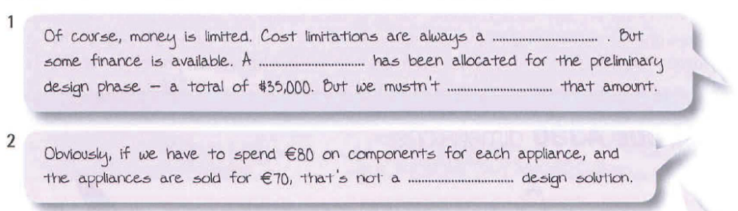
Exercises
3.1 Complete the sentences from technical conversations using the words in the box. Look at A opposite to help you.
Budget cost-effective exceed feature proposed
Constraint designed existing function

Slide 11

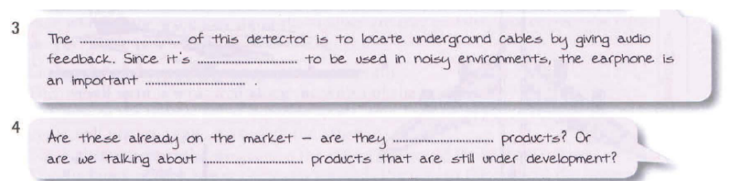
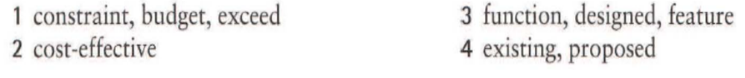
Exercises (continue 3.1)

Slide 12
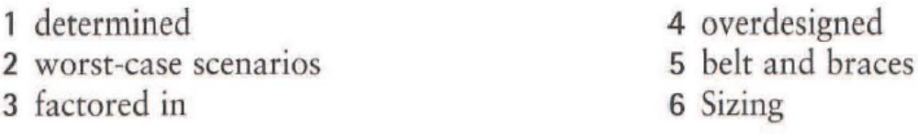
Exercises
3.2 Choose the correct words from the brackets to complete the sentences. Look at B opposite to help you.
The types of loads that will be encountered must be (designed / determined).
Maximum loads are based on predicted (specifications/worst-case scenarios).
On top of maximum loads, additional safety margins are (factored in/ sized).
For cost reasons, components shouldn't be (overdesigned / quantified) .
The practice of overdesigning components can be described as the (belt and braces / factor of safety) approach.
(Quantifying / Sizing) components means calculating their dimensions.

Slide 13
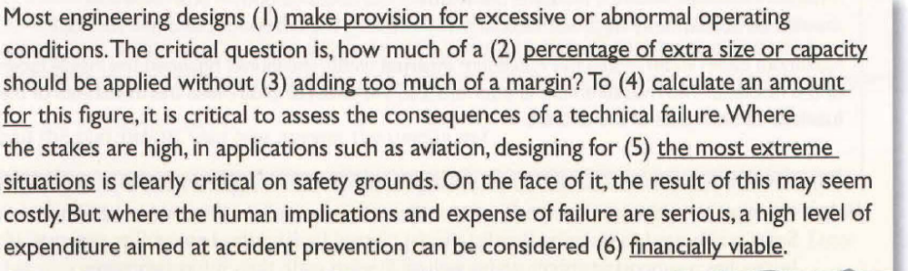
Exercises
3.3 Replace the underlined words and expressions with alternative words and expressions from A and B opposite.

Slide 14
End of
Unit Three

