Slide 1

Unit 2: Design Development
Prof. Dr. Fady El-Nahal
Technical English
Islamic University of Gaza
2020-2021

Slide 2
Vocabulary
amendment تعديل
current تيار
draft مسودة
Issue العدد
Note ملحوظة , مذكرة
Revision مراجعة
Supersede حل محل ,بدل
preliminary drawings الرسومات الأولية
Redesign إعادة تصميم
Refine صقل
Revise تراجع, صحح
sign off تسجيل خروج
Approve يوافق
Circulate نشر , وزع
design brief تصميم وجيزة
Sketches رسم تخطيطي, صمم

Slide 3
Outline
Initial design phase
Collaborative development

Slide 4
A. Initial design phase
A structural engineer from a firm of consulting engineers has sent an email to a more senior colleague, with an update on a project for a new airport terminal.

Slide 5
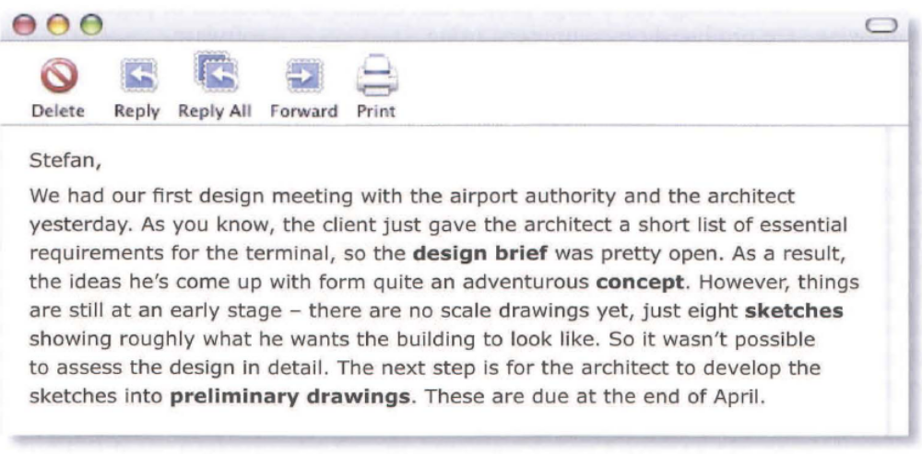
A. Initial design phase

Slide 6
B. Collaborative development
When a design team consists of engineers and consultants from different organizations, the design development process needs to be carefully co-ordinated.
Before the first draft (version) of a drawing is sent to members of the team, a decision is made about who needs a copy. Sometimes, a drawing will only be issued to certain specialists in the team. Sometimes, it will be circulated to all the team members.

Slide 7
B. Collaborative development
After team members have received a drawing, they can comment on it, and may ask for the design to be changed. Following these comments, the drawing will be revised- that is, drawn again with the requested changes made to it. Every drawing is numbered, and each time a drawing is amended (revised), the letter next to the drawing number is changed. Therefore drawing 11 OA, after a revision, becomes 11 OB. When revision B is issued, it becomes the current drawing, and A is superseded. With each new revision, written notes are added to the drawing. These describe the amendments that have been made.

Slide 8
B. Collaborative development
When engineers revise drawings during the early stages of the design process, they may have to go back to the drawing board (start again), and redesign concepts completely. For later revisions, the design should only need to be refined slightly.
After a preliminary drawing has been finally approved (accepted), a senior engineer can sign off (authorize) the drawing as a working drawing- that is, one that the production or construction team can work to. However, this does not always mean the drawing will be final. Often, working drawings go through more revisions to resolve problems during production.

Slide 9
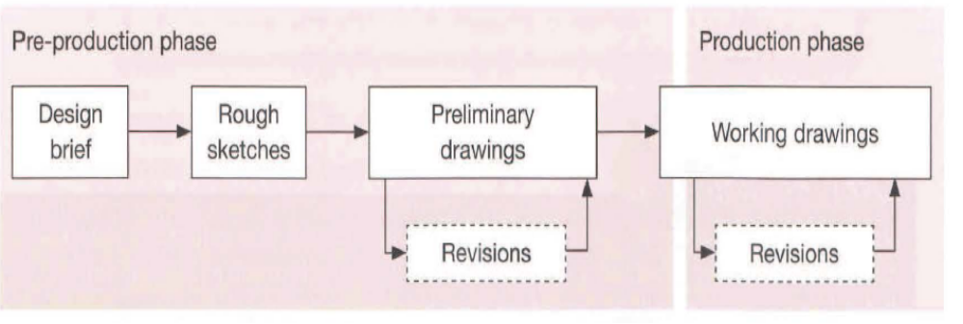
B. Collaborative development

Slide 10
Exercise
2.1 Find words in A opposite with the following meanings.
a description of design objectives
a rough, hand-drawn illustration
an initial diagram, requiring further development
an overall design idea
1.design brief
2 sketch
3 preliminary drawing
4 concept

Slide 11
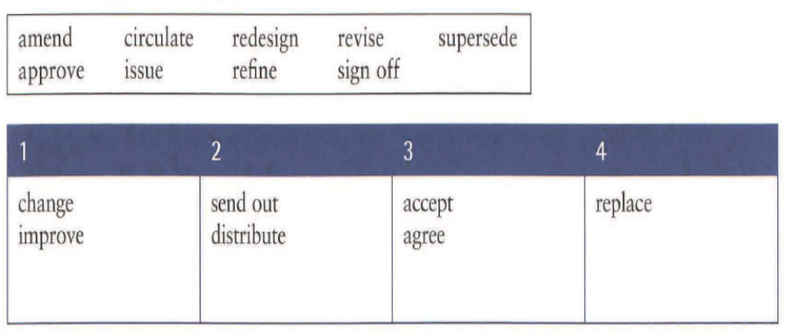
Exercise
2.2 Put the words in the box into the table to make groups of verbs with similar meanings. Look at B opposite to help you.
1. amend, redesign, refine, revise
2. circulate, issue
3. approve, sign off
4. supersede

Slide 12
Exercise
1. draft 2. current 3. work 4. comment 5 working
2.3 Choose the correct words from the brackets to complete the sentences about drawings. Look at B opposite to help you.
Has the drawing been revised, or is this the first (draft/refine)?
This has been superseded. It's not the (current/preliminary) drawing.
Has this drawing been signed off? Can they (circulate/work) to it in the factory?
I still need to (comment/note) on the latest set of drawings.
Construction can't start until the first (current/working) drawings have been issued.

Slide 13
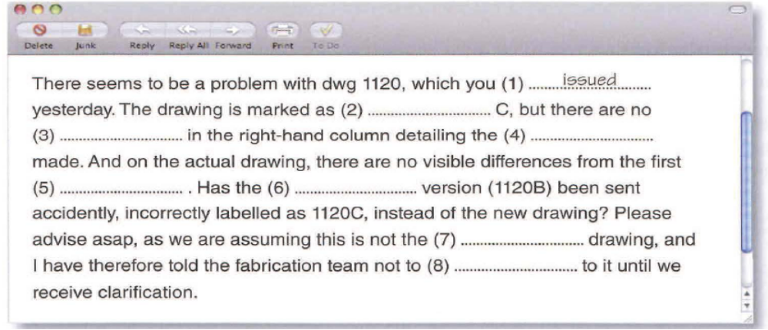
Exercise
2.4 Complete the email using the correct forms of the words in the box. Look at B opposite to help you. The first one has been done for you.
amendment current draft Issue note revision supersede work
1.Issued
2 revision
3 notes
4 amendments
5 draft
6 superseded
7 current
8 work

Slide 14
End of
Unit Two

