Slide 1

Unit 1: Drawings
Prof. Fady El-Nahal
Technical English
Islamic University of Gaza
2020-2021

Slide 2
Vocabulary
detail التفاصيل
Elevation ارتفاع
General arrangement (GA) الترتيب العام
Plan خطة
Scale مقياس
Schematic تخطيطي
Section الجزء
oblique projection إسقاط منحرف
Isometric projection القياس الإسقاط متساوي
Exploded View is technical drawing of an object, that shows the relationship or order of assembly of various parts.

Slide 3
Outline
Drawing types and scales
Types of views used on drawings

Slide 4
A. Drawing types and scales
In engineering, most design information is shown on drawings. Today, drawings are generally not drawn by hand. They are produced on computer, using CAD (computer-aided design) systems.

Slide 5
A. Drawing types and scales
A key factor on a drawing is the scale - that is, the size of items on the drawing in relation to their real size. When all the items on a drawing are shown relative to their real size, the drawing is drawn to scale, and can be called a scale drawing.
An example of a scale is 1:10 (one to ten). At 1:10, an object with a length of 100 mm in real life would measure 10 mm on the drawing.

Slide 6
A. Drawing types and scales
Most engineering designs consist of a set of drawings (a number of related drawings):
General arrangement (GA) drawings show whole devices or structures, using a small scale. This means objects on the drawing are small, relative to their real size (for example, a 1:100 drawing of an entire building).
Detail drawings show parts in detail, using a large scale, such as 1:5 or 1:2. Small parts are sometimes shown in a detail as actual size (1:1), or can be enlarged to bigger than actual size (for example, 2:1).

Slide 7
A. Drawing types and scales
For electrical circuits, and pipe and duct networks, it is helpful to show designs in a simplified form. In this case, schematic drawings (often referred to as schematics) are used. An everyday example is the map of a train network.
Notes: When written, drawing is often abbreviated to dwg.

Slide 8
B. Types of views used on drawings
Technicians are discussing different views shown on drawings (looking at components from above, from the side, etc.), as they search for the information they require.
We need a view from above showing -the general arrangement of all of -the roof panels - a plan of -the whole area.
According "to this list, -there are of all elevation four sides of -the machine on drawing 28. So one of Those should show the front of the machine.

Slide 9
B. Types of views used on drawings
There should be a section Through the pipe, showing the valve Inside, on drawing 36.
We need an exploded view of -the mechanism, showing -the components spaced out.
It's hard "to visualize This assembly, based on two-dimensional elevations and sections. It would be clearer if we had a three-dimensional view, as either an oblique projection or an Isometric projection.

Slide 10
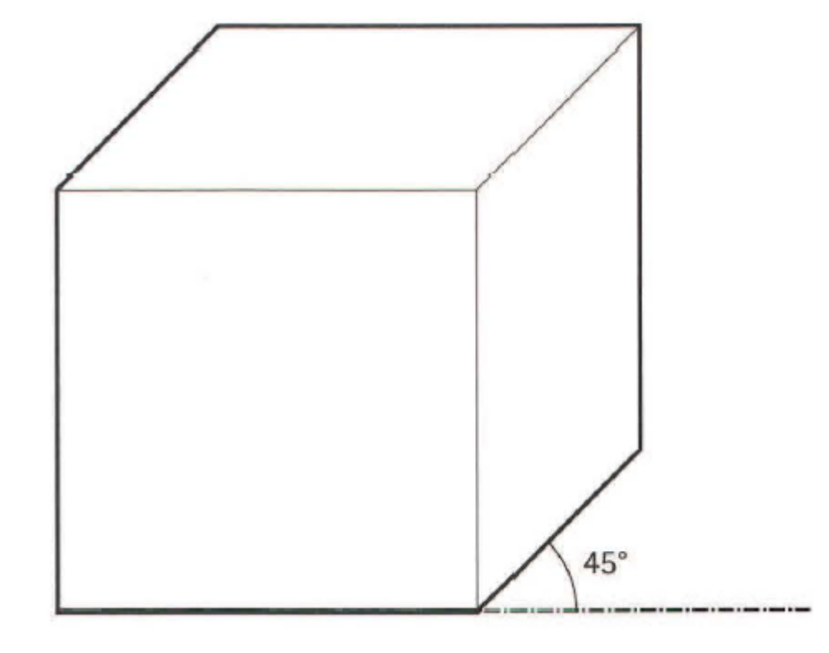
Appendix I Three-dimensional drawings
An oblique projection shows an object with one of its faces at the front. The 3D shape of the object is shown by lines at 45 degrees from the horizontal.

Slide 11
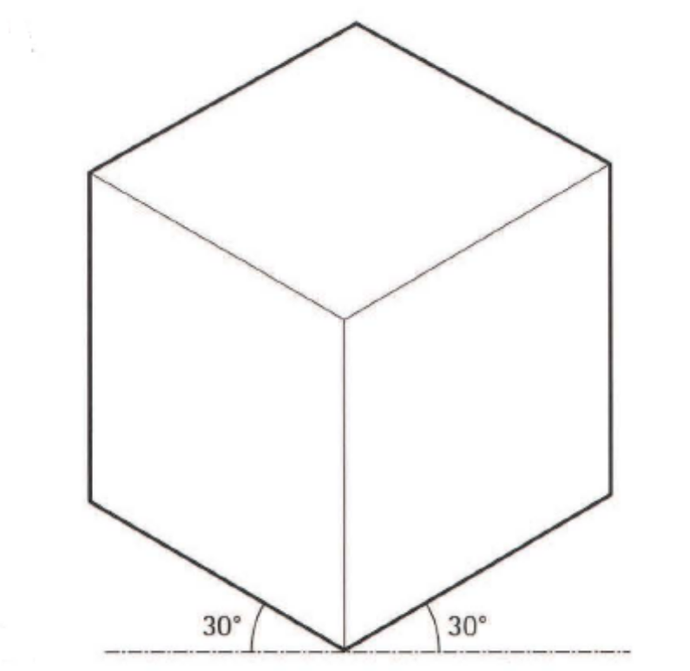
Appendix I Three-dimensional drawings
An isometric projection shows an object with one of its corners at the front. The 3D shape of the object is shown by lines at 30 degrees from the horizontal.

Slide 12
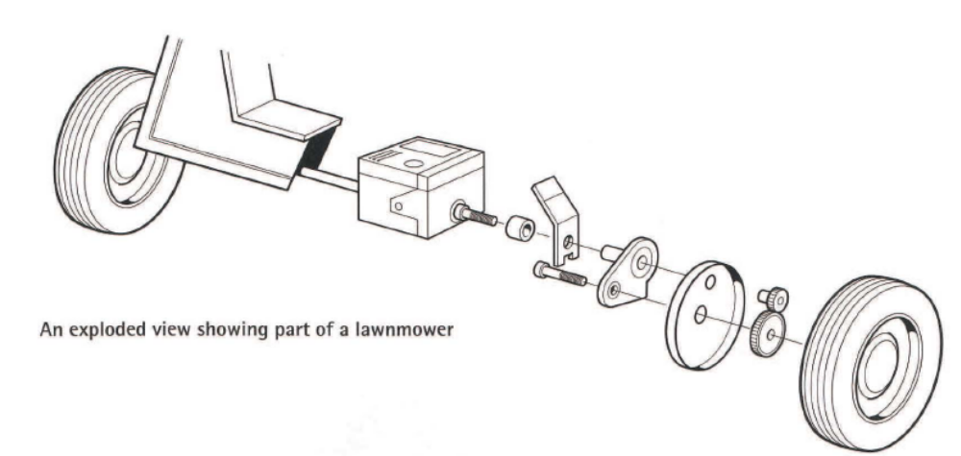
Appendix I Three-dimensional drawings
An exploded view shows an assembly with its components spaced out, to show how the components fit together.

Slide 13
Exercise
1.1 Complete the sentences. Look at A opposite to help you
1. Enlarged drawings show components larger than their ........... .
2 For engineering drawings, 1:5 is a commonly used ..........................
3 Whole machines or structures are shown on ............................ drawings.
4 Electrical drawings don't usually show sizes. They're shown as ............. .
5 A ......................... of drawings for a large project can consist of hundreds of pages.
6 Most drawings are produced on computers, using .................... software.

Slide 14
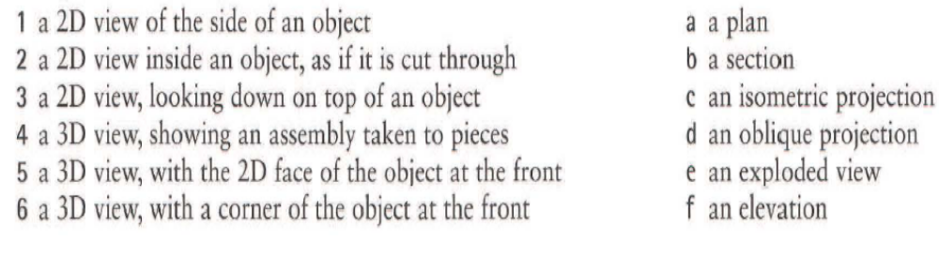
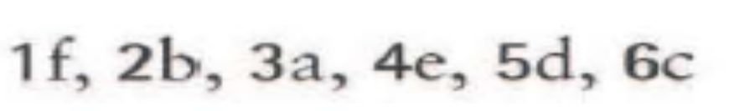
Exercise
1.2 Match the descriptions (1-6) with the names of views used on drawings (a-f). Look at B opposite and Appendix I on page 98 to help you.

Slide 15
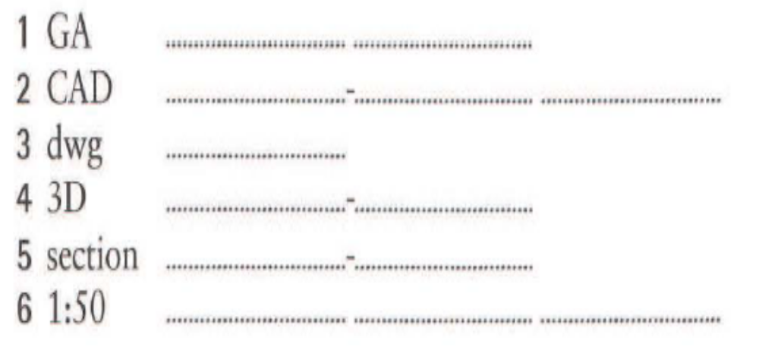
Exercise
1.3 Write the full forms, in words, of the abbreviations and shortened terms below. Look at A and B opposite and Appendix I on page 98 to help you.
1 general arrangement
2 computer-aided design
3 drawing
4 three-dimensional
5 cross-section
6 one to fifty

Slide 16
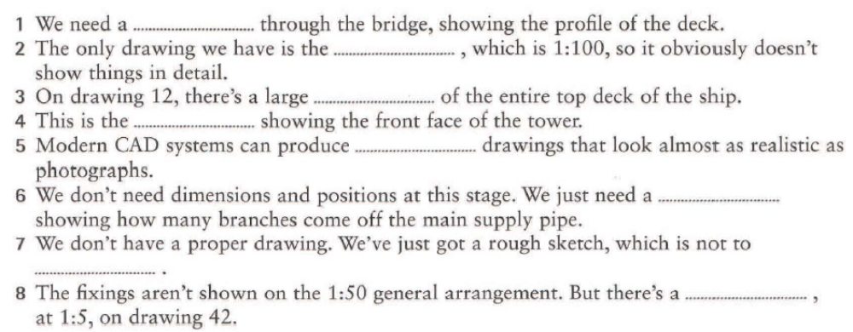
Exercise
1.4 Complete the sentences, taken from conversations about drawings, using the words and abbreviations in the box. Look at A and B opposite
1 section
2 GA
3 plan
4 elevation
5 3D
6 schematic
7 scale
8 detail

Slide 17
End of
Uint One

